Slide 1
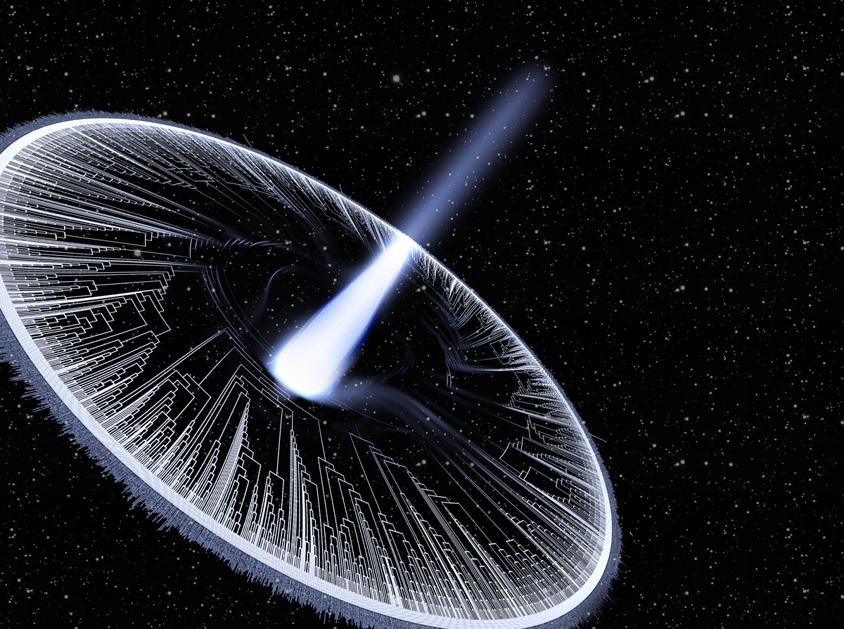
Macroevolution
Instructor: Josef Uyeda
juyeda@vt.edu
uyedalab.com

Slide 2
1. Learn the core of phylogenetic models
2. Learn how to use trees
3. Learn about the big questions in macroevolution
4. What are your goals?
Goals of the course:

Slide 3
Syllabus
See Canvas Site
(Syllabus subject to change, especially schedule)

Slide 4
Introductions
Your name, department, year, program
What topic you most want to learn about in this class
What's your best science "hot take"?

Slide 5
Why phylogeny?
What does a phylogeny represent?
  OneZoom
We will use poll everywhere:
  Permalink: www.pollev.com/josefuyeda941

Slide 6
How many ancestors do you have?
Consider your personal family tree (i.e. a pedigree). How many parents do you have? How many grandparents? Great grandparents? What's the formula?
Approximately how many ancestors do we have 25 generations ago? (25 generations for humans is ~ 400-900 years)
What are phylogenies? Are they a) hypotheses b) real facts that exist in nature or c) a metaphor?

Slide 7

Consider your personal family tree

Slide 8
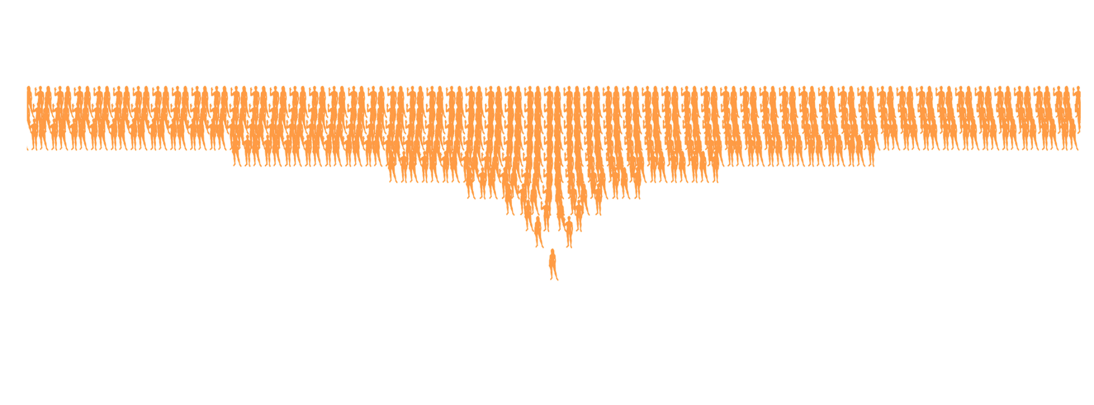

Counting ancestors
40 generations ago, you would have > 1 trillion ancestors
….2500 times the population 800 years ago

Slide 9
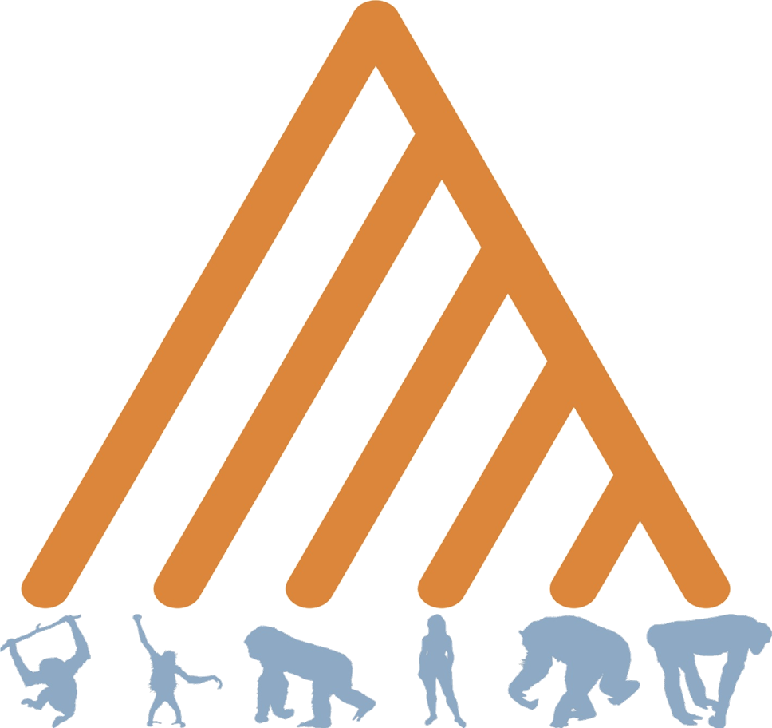
What does a phylogeny represent?

Slide 10
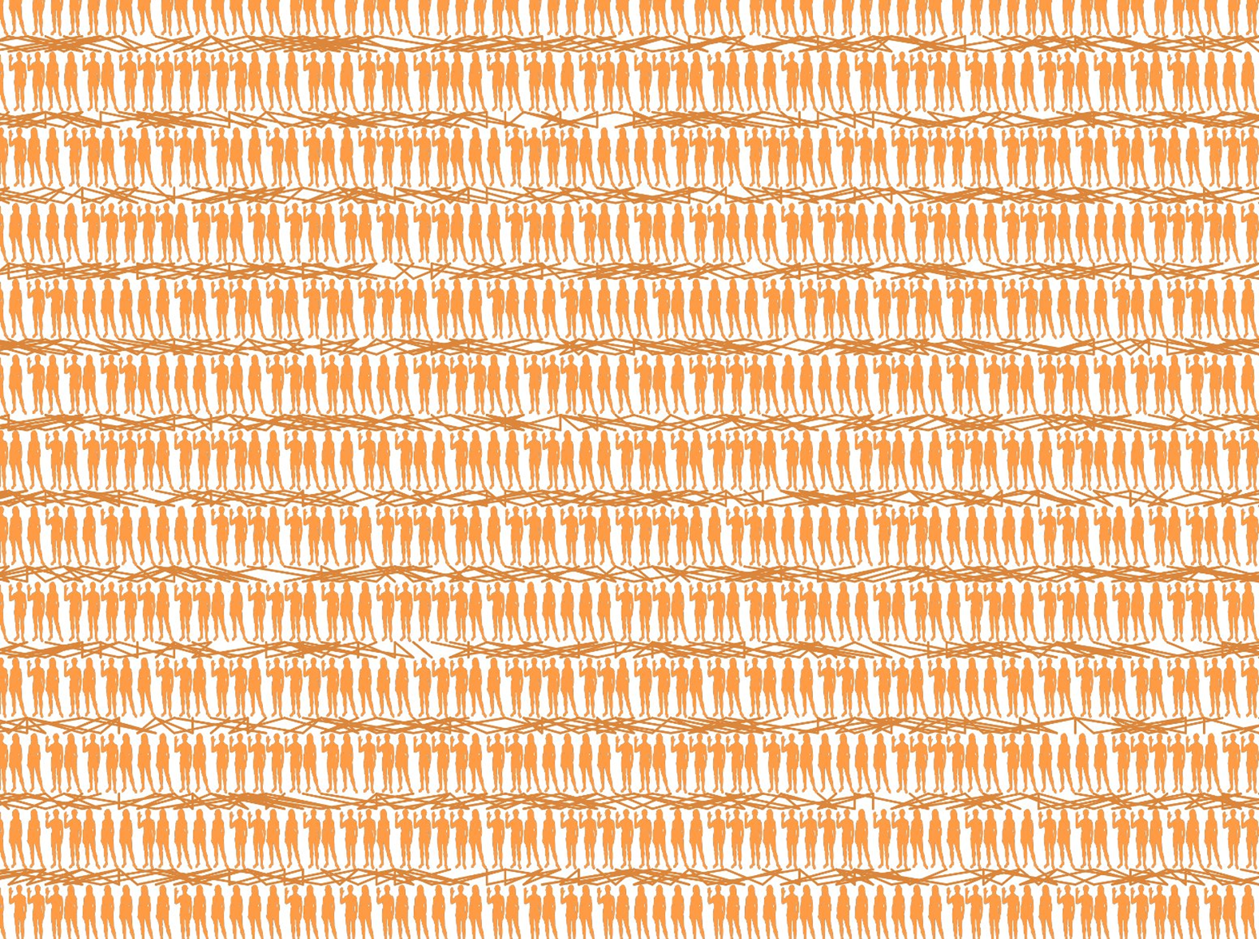
Branches represent population ancestry

Slide 11
What do nodes represent?
What happened here?

Slide 12
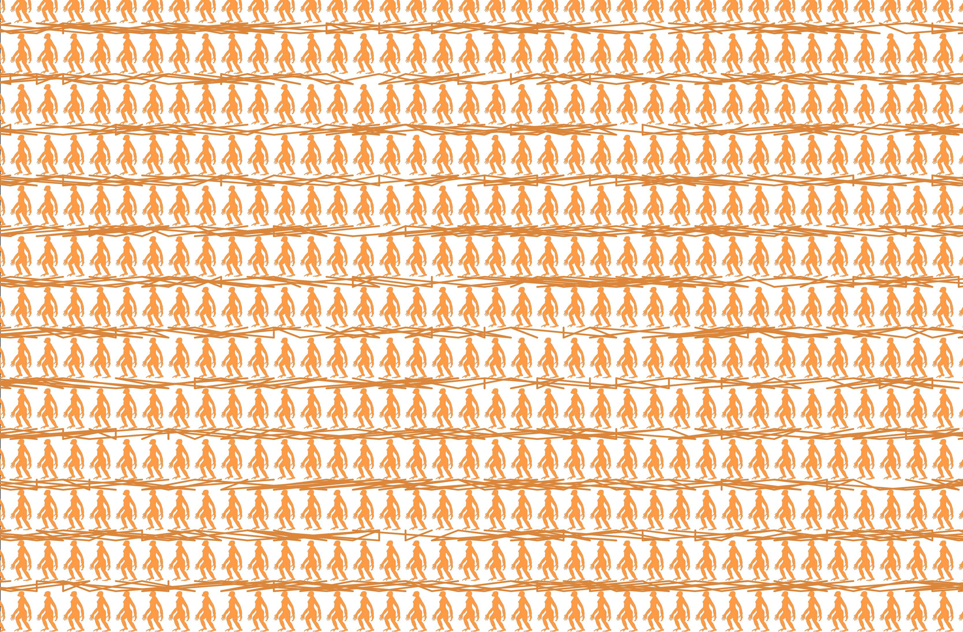
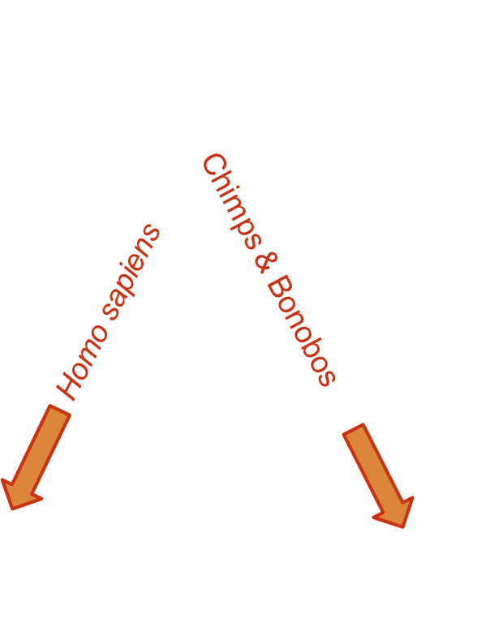
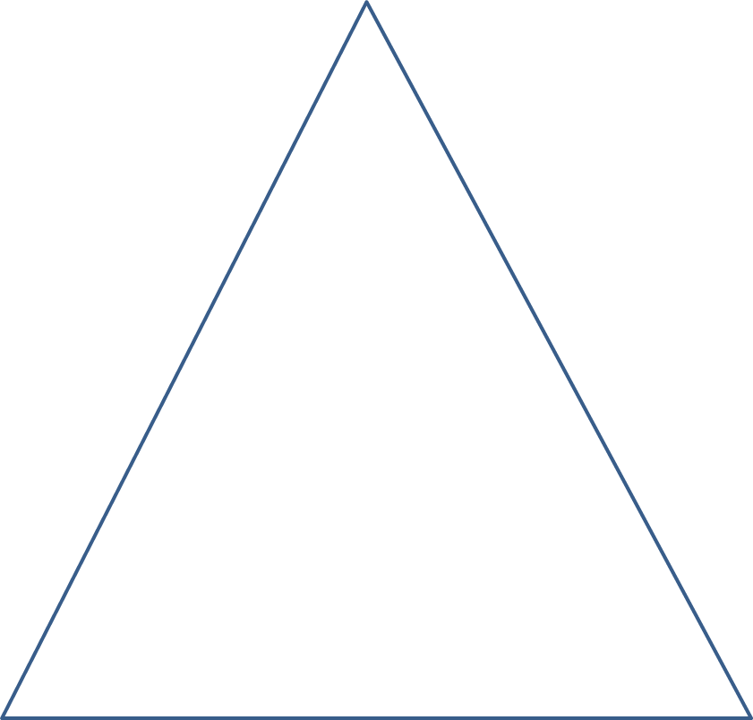
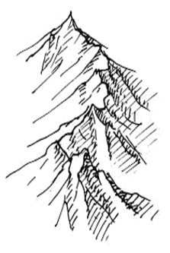
Nodes represent speciation events
What happened here?

Slide 13
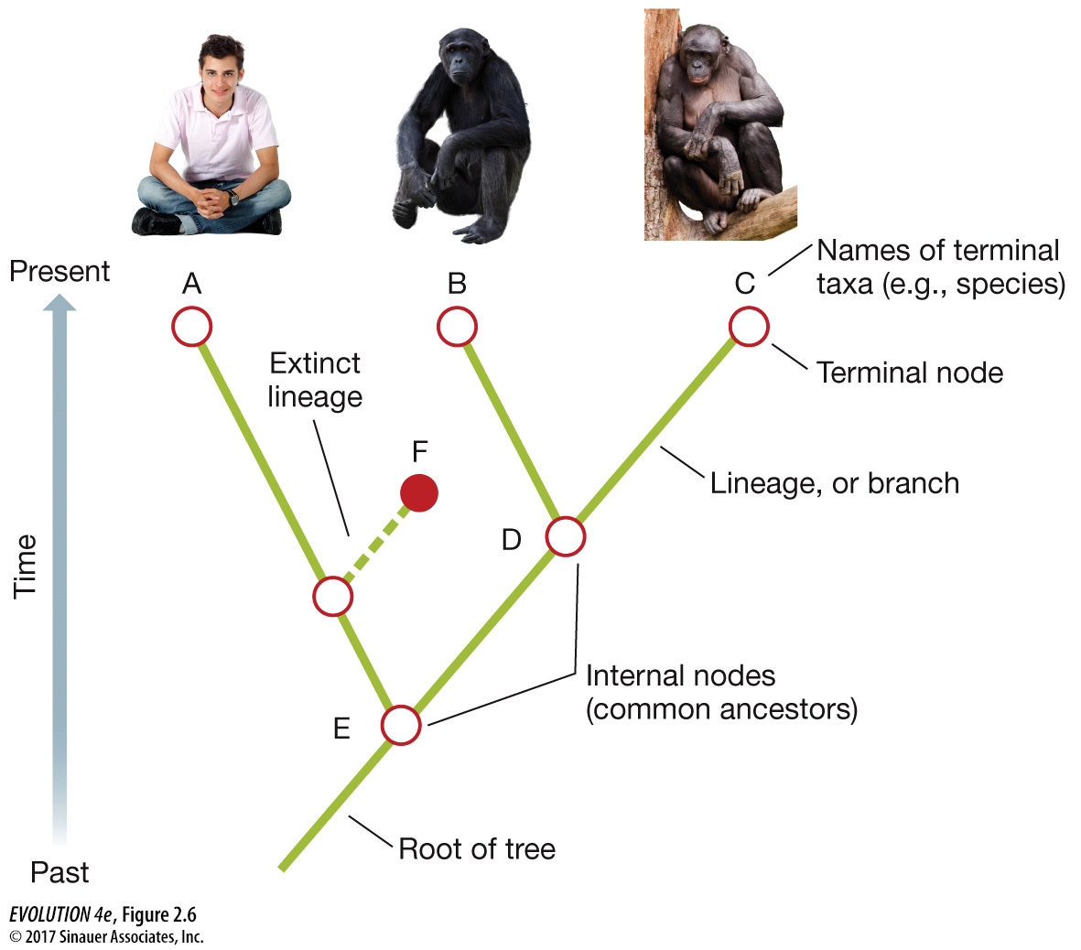
Terminology
Root
Branch
Node
Tip
Outgroup
Clade
Monophyletic
Paraphyletic
Polyphyletic

Slide 14
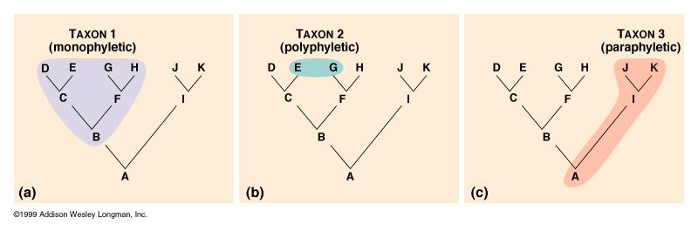
The goal of taxonomy and systematics is to represent monophyly

Slide 15
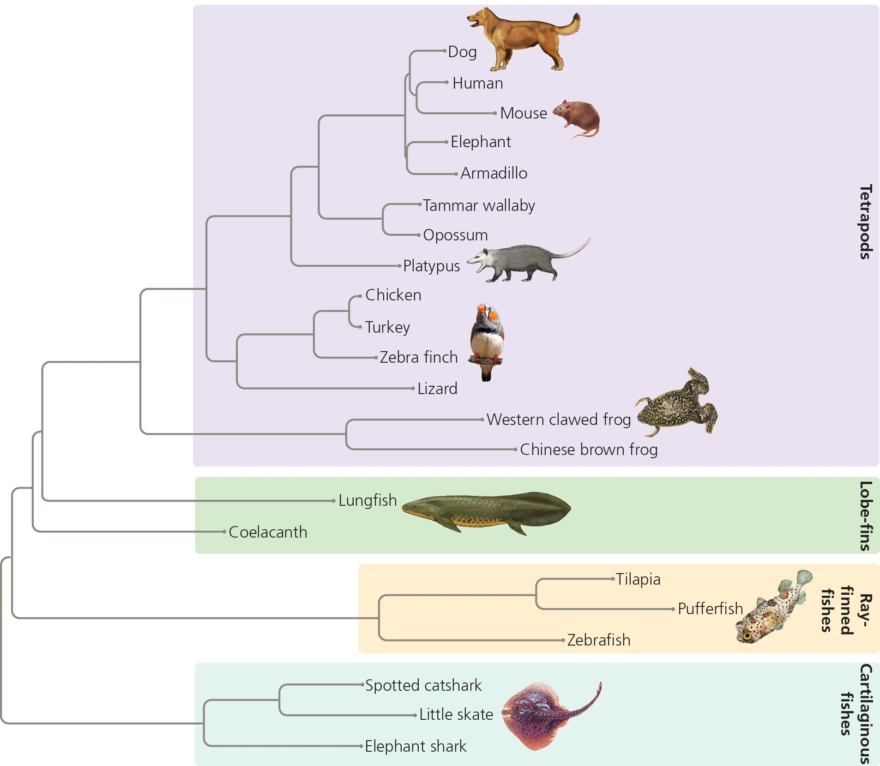
Practice question 1
The phylogeny depicted demonstrates that lungfish are basal to and more primitive than frogs.
True
False

Slide 16
Assignment I: Canvas self-assessment
Read Baum & Smith, and complete the questions in Assignment I. The purpose is a self-reflection of your understanding.
I'm going to assume you understand basic terminology and can read & interpret trees going forward. If you find it challenging (almost everyone does when first interpreting trees), reach out (e.g. come to office hour).

Slide 17
Macroevolution, systematics, phylogenetics, taxonomy, biodiversity science, phylogenetic comparative methods, oh my
What is macroevolution?
We seek to understand the processes that explain biodiversity.

Slide 18
My terminology for macroevolution
Inferring trees from data =
Phylogenetics
Using trees to study evolution =
Phylogenetic comparative methods sensu lato
Asking evolutionary questions over deep time = Macroevolution

Slide 19

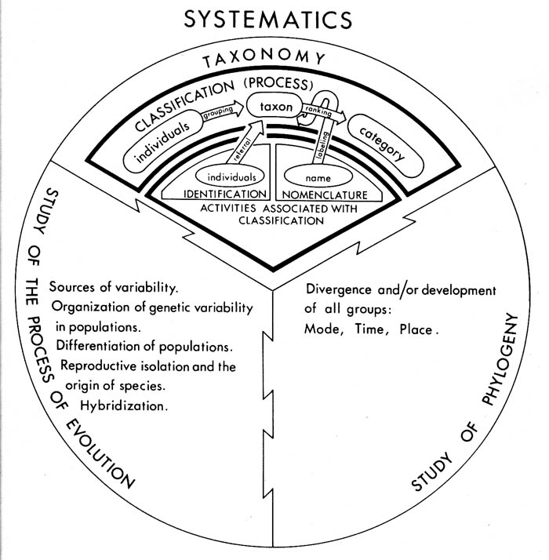
What is systematics?
Stuessy 1990 Plant Taxonomy

Slide 20
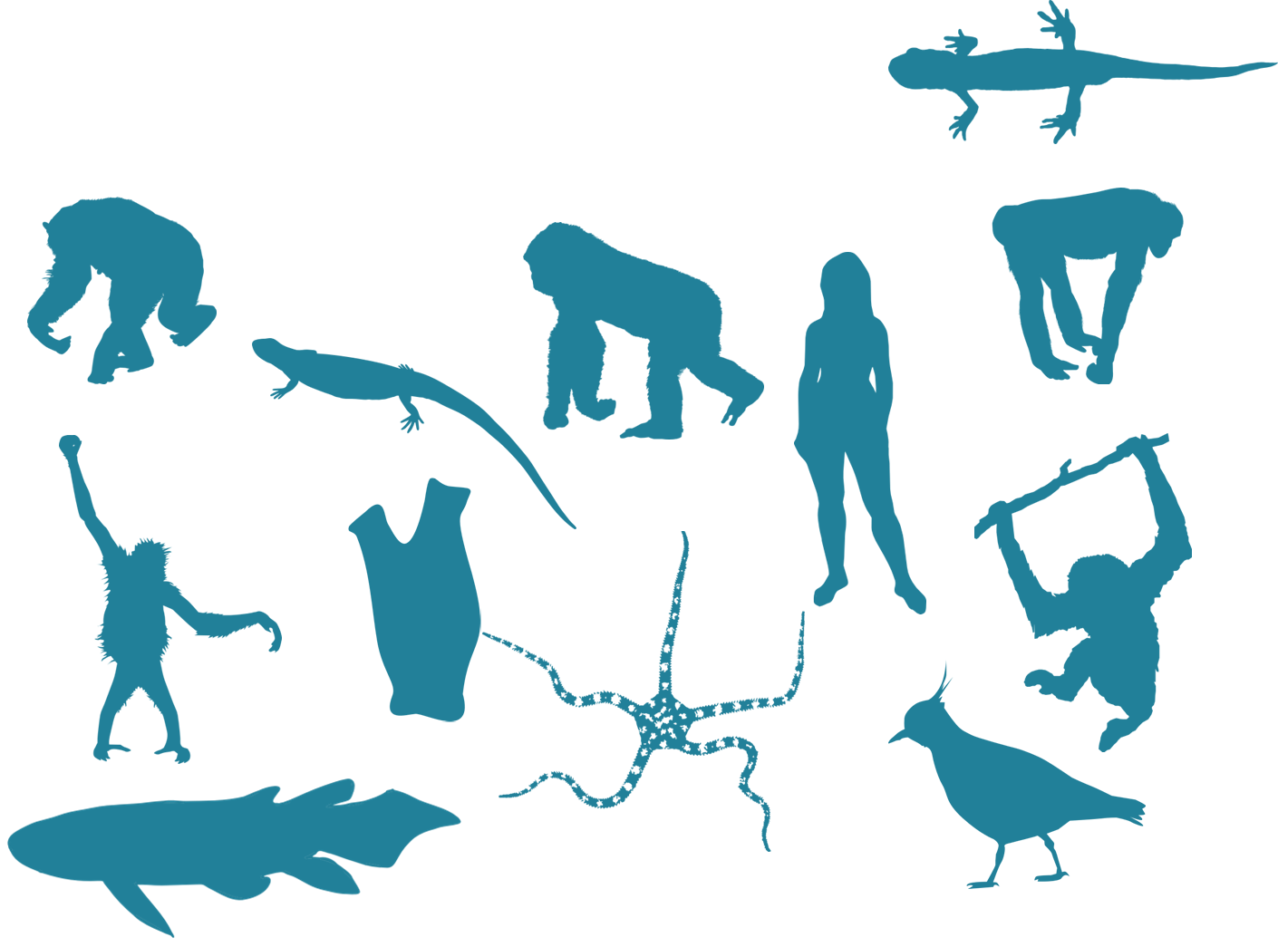
Going backwards- inferring phylogeny

Slide 21
How can we find the "true" tree?
(Is there a true tree?!?)

Slide 22
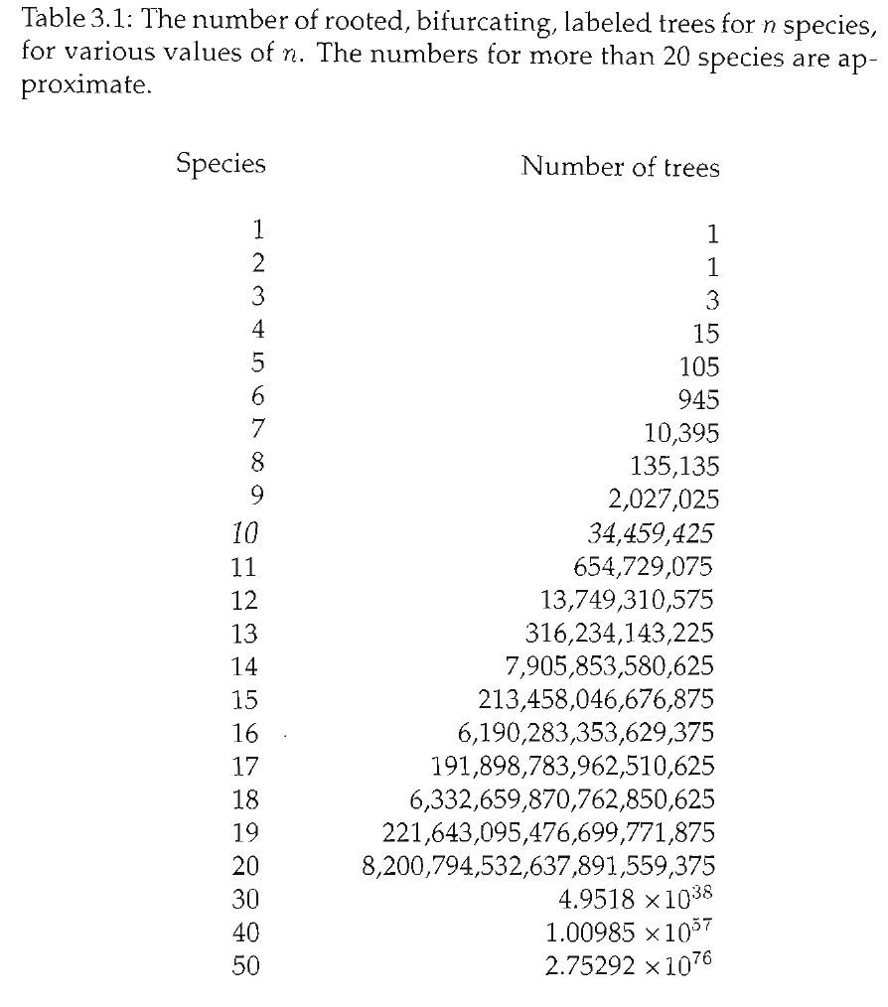
Tree space is HUGE.
Inferring phylogenies is incredibly challenging statistical and computational task.
For that reason, phylogenetics is/has been at the forefront of many advances in statistics & computer science.
This course will cover the story of phylogenetics and the basic models, as they are shared with phylogenetic comparative methods.
For in depth “how-to” on building trees from molecular data, take Anton Suvorov’s course next semester!

Slide 23
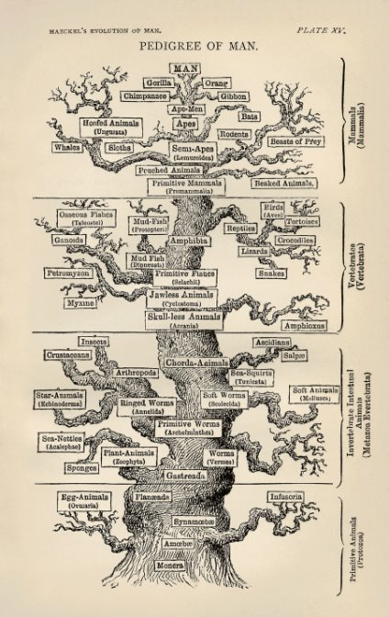
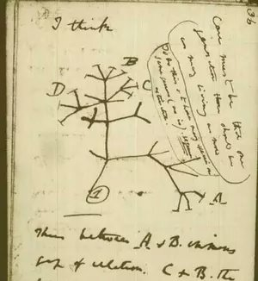
A brief history of phylogenetics

Slide 24

The four cannibalistic schools of phylogenetics history
Evolutionary Taxonomy
(Pre-1960s)
Phenetics
(1950s-70s)
Cladistics
(1960s-90s)
Statistical Phylogenetics
(1970s- present)

Slide 25
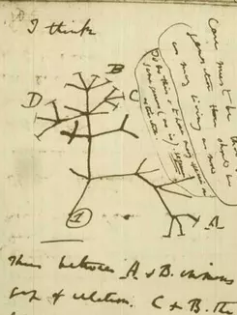
History of phylogenetics: Evolutionary taxonomy
No objective methodology
Relies on expert opinion and a lifetime of study
Strengths? Weaknesses?

Slide 26
History of phylogenetics:
Phenetics
Numerical Taxonomy & distance methods - measure overall similarity
How do you measure similarity?
What are the drawbacks of this approach?
Sokal, Sneath & Rohlf (1960's) argued phenetics provided much needed reproducibility

Slide 27
History of phylogenetics: Phenetics
Numerical taxonomy and distance methods
Measure overall similarity
Sokal, Sneath, and Rohlf (1960s) argued
phenetics provided much needed reproducibility
How do you measure similarity?
What are the drawbacks of this approach?

Slide 28
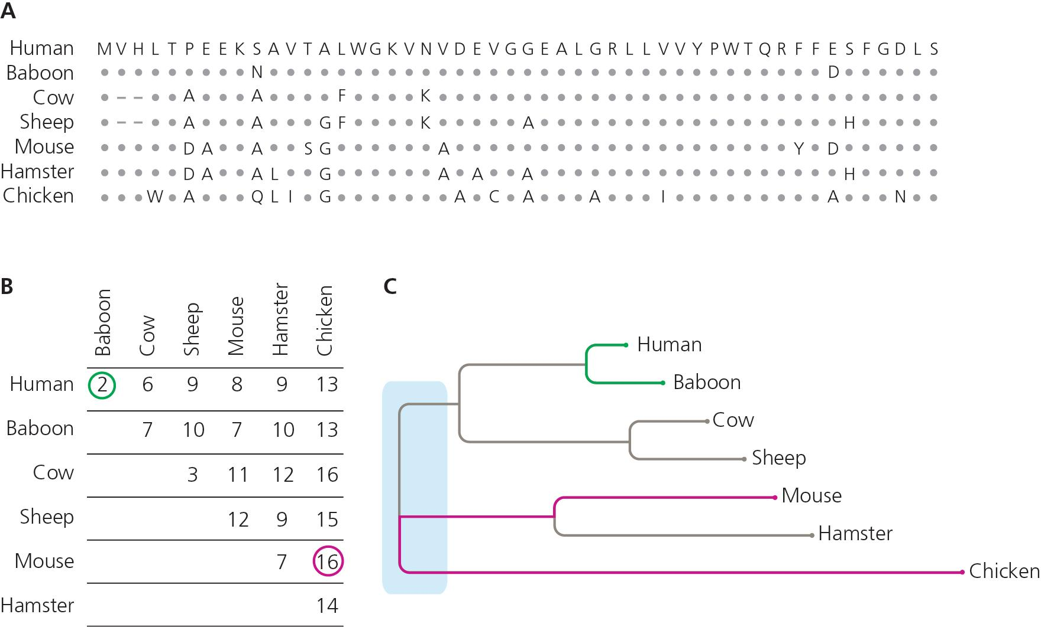
Distance methods
Still used for fast tree construction
Notes:
The figure here shows A) a protein alignment of 7 species of vertebrate (human, baboon, cow, sheep, mouse, hamster, chicken). B) A raw count of the number of amino acid substitutions for all pairwise comparisons between the same taxa arranged as a distance matrix. C) Distance-based phylogenetic inference attempts to build a phylogeny that best describes the distance matrix, with more closely related species being placed more closely together based on overall similarity.

Slide 29
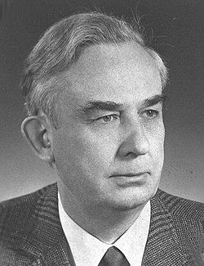
History of phylogenetics: Cladistics
Coined "phylogenetic systematics"
Grouping should not be based on overall trait similarity, but only on shared derived traits (synapomorphies)
Taxonomy based on monophyly
Parsimony & Occam's Razor- The simplest explanation is probably the correct one
Willi Hennig (1966)

Slide 30
Phenogram
Cladogram

Slide 31
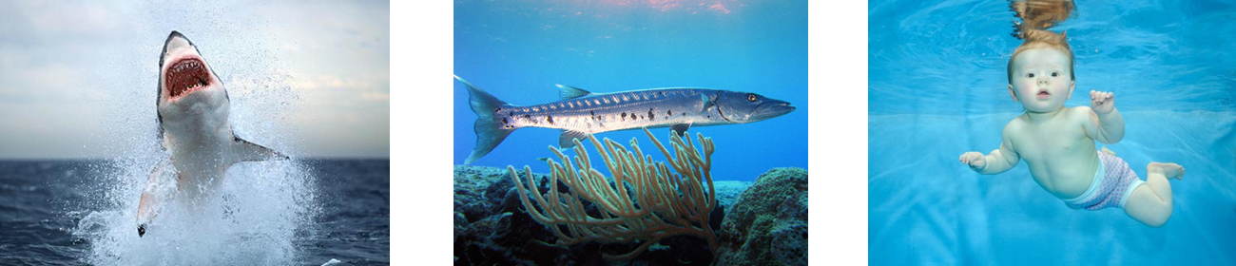
What’s the phylogenetic relationship?

Slide 32
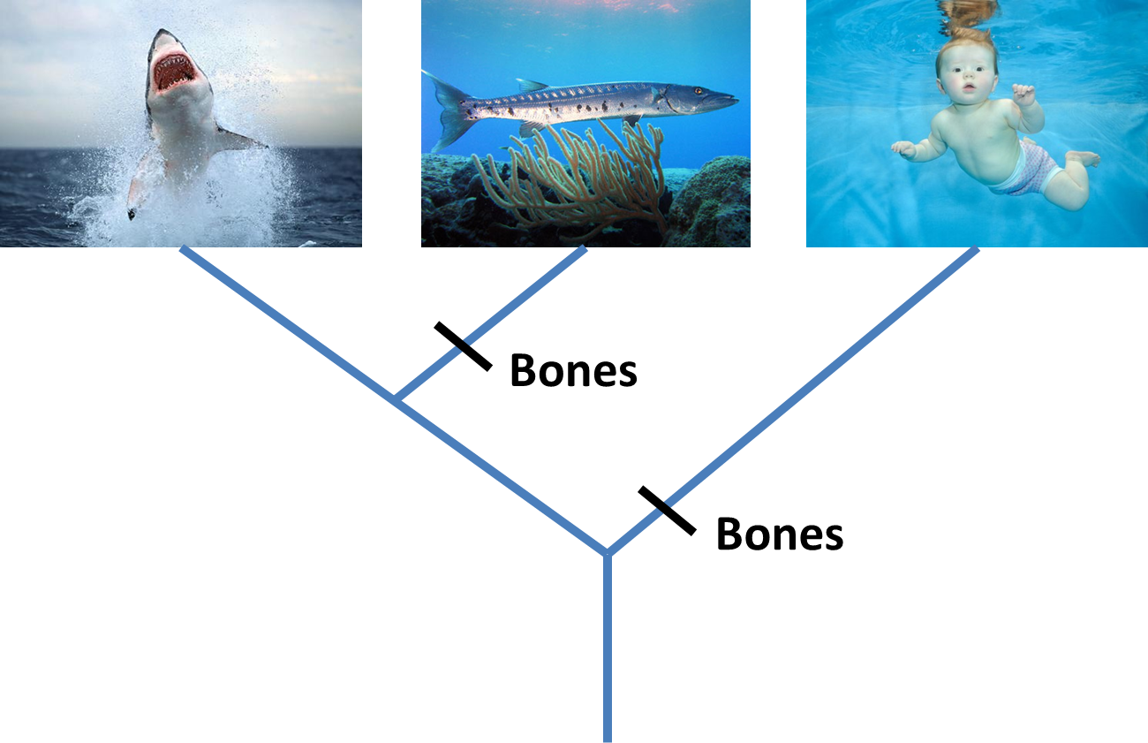

Slide 33
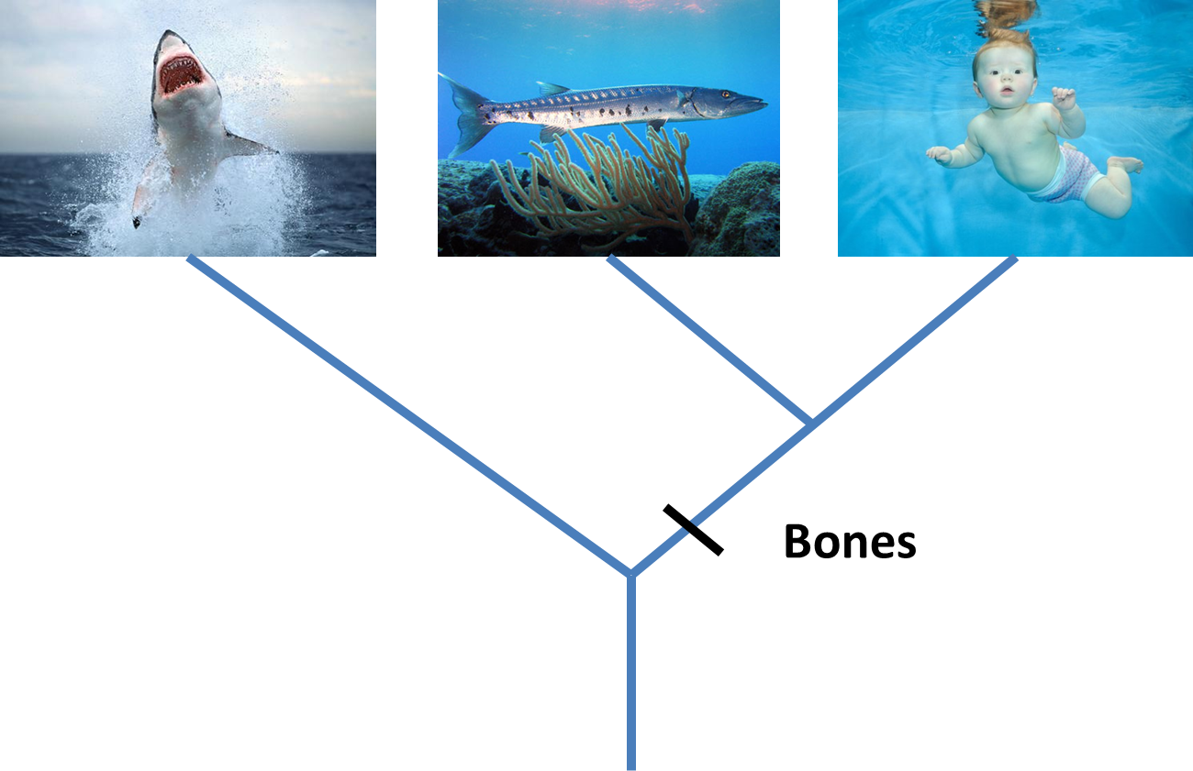
Parsimony

Slide 34
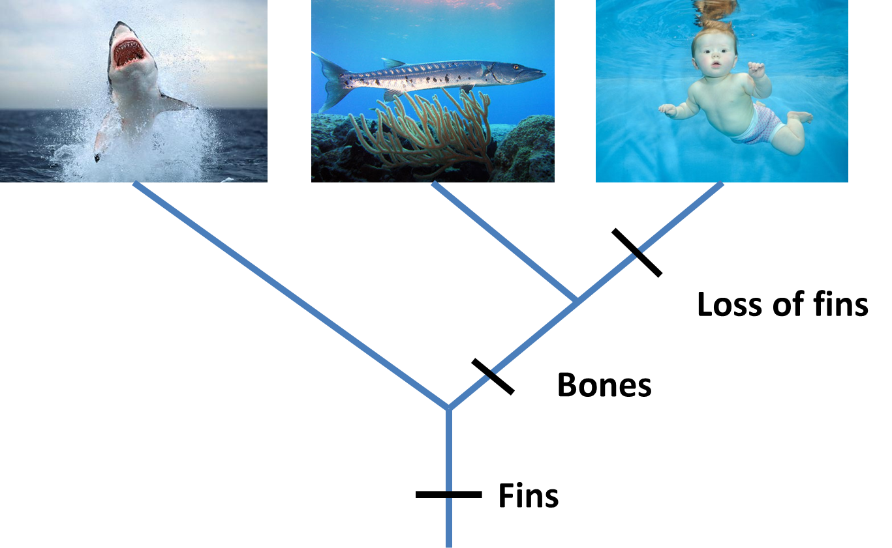

Slide 35
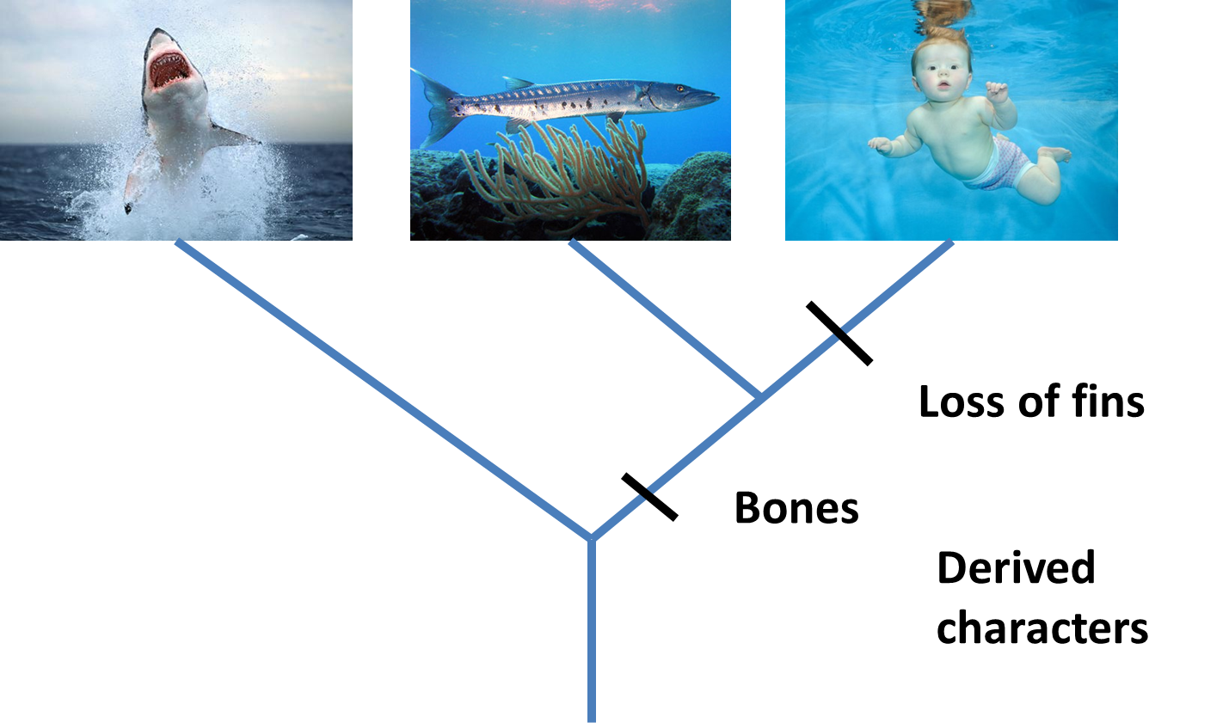
Derived Characters = Apomorphies

Slide 36
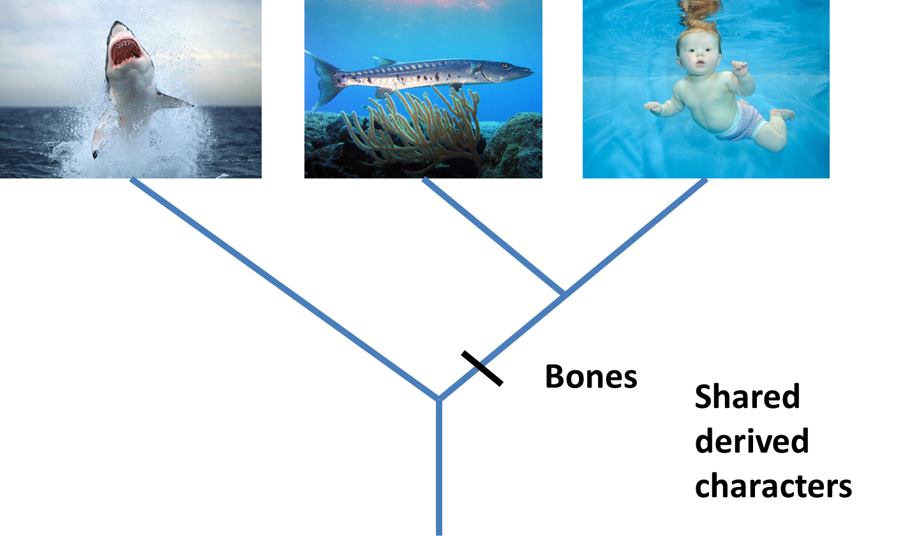
Shared derived characters = Synapomorphies

Slide 37

Shared ancestral characters = Symplesiomorphies

Slide 38
Overall similarity takes all characters equally
Cladistics only considers synapomorphies, and excludes autapomorphies & symplesiomorphies
Best supported hypothesis: Minimizing # of steps
Critical role of outgroup to distinguish derived vs. ancestral characters
Also note that characters are defined as derived/ancestral relative to the taxa being considered (the ingroup)

Slide 39
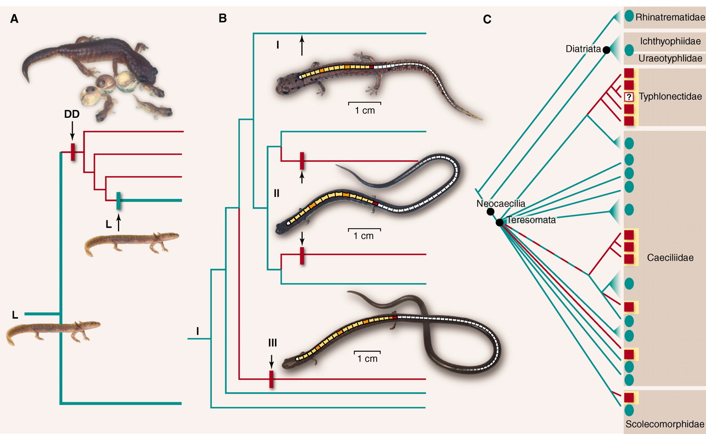
Conflict = Homoplasy
Evolutionary reversals and/or convergence

Slide 40
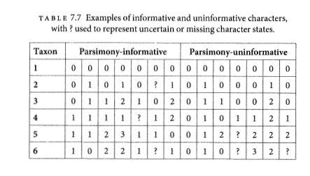
Parsimony informative vs. uninformative
Must have at least 2 taxa with shared traits in 2 different states.
Characters

Slide 41
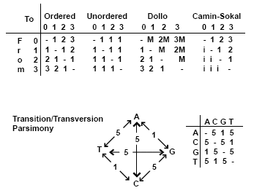
Generalized Parsimony
Step matrices
By Peter Forey
https://www.palass.org/publications/newsletter/cladistics-palaeontologists/cladistics-palaeontologists-part-4-optimisation

Slide 42
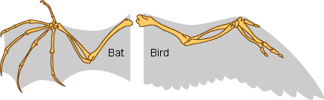
Homology
Primary homology - Initial hypothesis of homology due to similarity
Secondary homology - Implied homology single origin on phylogeny by parsimony analysis
Underlines importance of character construction - often surprisingly subjective
“Reciprocal illumination” Hennig 1966

Slide 43
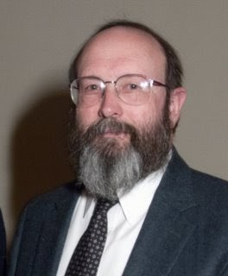
History of phylogenetic inference: Statistical phylogenetics
Luca Cavalli-Sforza, Anthony Edwards and later, Joseph Felsenstein
Probabilistic models of trait evolution
Showed statistical issues with parsimony, e.g. "the Felsenstein zone"
-> Highlighted the importance of simulation!
Maximum Likelihood & Bayesian inference
Joe Felsenstein

Slide 44
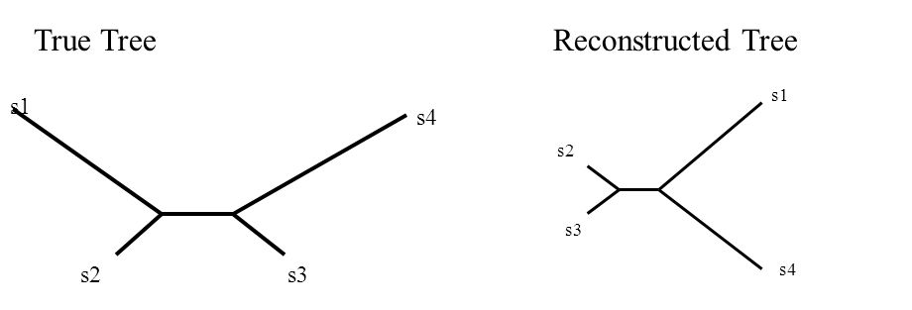
The Felsenstein Zone &
"Long-branch attraction"
More generally, parsimony fell out of favor for molecular data due to more flexibility in incorporating substition models in statistical phylogenetics

Slide 45
My oversimplification of the problem...
Under the cladistics philosophy (model), homoplasy is a “mistake” in character construction
Coding independently evolved traits the same, look closer and you'll see they're different!! (e.g. wings of birds & wings of bats)
But for DNA, complete convergence is real (a “T” is a “T” is a “T”, no matter how it became that)
As similarity by convergence becomes more common than similarity by shared ancestry, parsimony fails, and no “looking closer” at the character will save it.

Slide 46
Parsimony main assumption “Occam's Razor” has unclear implications for what this means for the assumed evolutionary process
Ultimately -> rare changes or "no common mechanism"
(Tuffley and Steele 1997)
Inconsistent estimator - An estimator that gets more and more certain of the wrong answer as more data is added

Slide 47
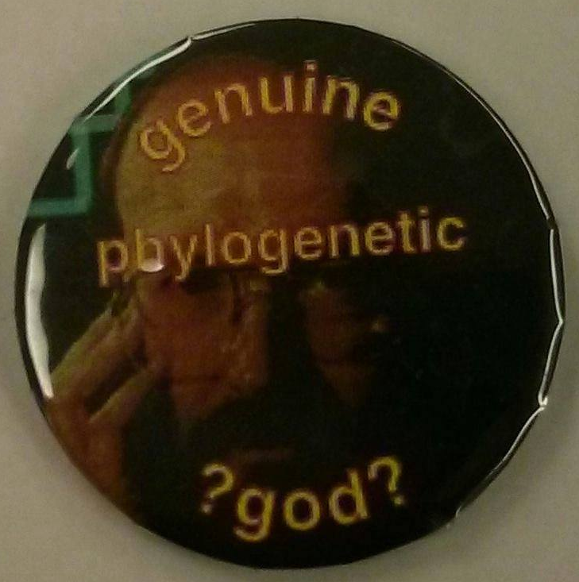
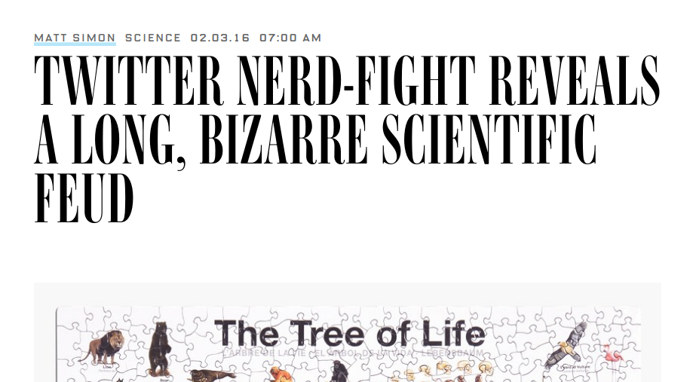
Conflict in science
#ParsimonyGate

Slide 48
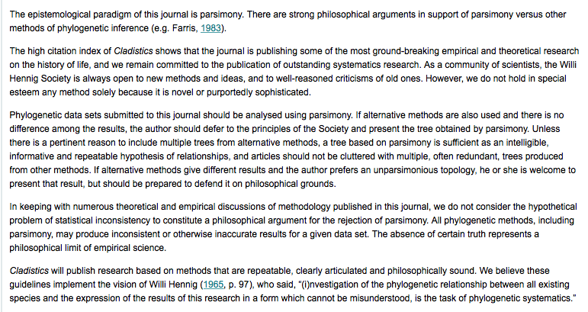

Slide 49
Parsimony still commonly used for:
Morphological analyses (though probabilistic models exist here too)
Starting trees
Understanding history of trait change (ancestral state reconstructions)

