Slide 1
Who gets flagged?
A CRISP-DM fairness audit of 30-day readmission prediction
UCI Diabetes 130-US Hospitals
Uygar Çatal
Machine Learning and Data Mining · University of Bologna · A.Y. 2026/27
Individual assignment · Option 2 (CRISP-DM)
Notes:
Good morning. A hospital can follow up only a few of its discharged diabetic patients and wants a model to choose who. I asked two questions: is any model usable at that fixed capacity, and are its errors shared equally across sex, age band and race? The answers up front: no model passes the usability gate. The clearest disparity is by age. The two post-processors that close it do so by lowering true-positive rates: levelling down, not a fix. And the race differences in recorded glucose results are largely, not wholly, a recording pattern of the data source.

Slide 2
The question: who gets the few follow-up slots?
1 Rank
2 Flag the top q %
3 Audit the errors
every discharged diabetic inpatient by predicted 30-day readmission risk
q = training-fold readmission rate (overall 0.114): a fixed follow-up capacity
equal TPR and FPR across sex, age band and race (equalized odds)
Usability gate (fixed in the approved proposal, before the approved protocol was run): usable only if the lower 95 % bound of accuracy − NIR (0.886) is > 0.
With m flagged, accuracy − NIR = (2·TP − m) / n, so the gate needs PPV > 0.5: most flags must be right.
Source: docs/APPROVED_PROPOSAL.md §2; approved_main.md header; approved_mitigation.md §3 note
2 / 11
Notes:
The hospital ranks every discharged patient by predicted risk and flags the top q percent, where q is the readmission rate of the training data, about 0.114. That fixes the number of follow-up slots without reading any test label. The fairness goal is equalized odds: every group should have the same true-positive rate among patients who really come back, and the same false-positive rate among those who do not. The approved proposal fixed a usability gate before the protocol was run: the model counts as usable only if the lower confidence bound of accuracy minus the no-information rate, 0.886, is above zero. With about 11 percent readmitted, that means a PPV above one half: most flags must be right.

Slide 3
Data and pipeline: CRISP-DM, validated patient by patient
Business understanding
flag the top q % at a fixed capacity; equal errors by sex, age band, race
Data understanding
98,470 encounters · 69,303 patients · 11,266 readmitted in 30 days (0.114)
Data preparation
23 inputs in 6 blocks; encoding and scaling fitted on training rows only
Modelling
tree, k-NN, logistic regression, random forest, gradient boosting; depth and k by the one-SE rule
Evaluation
patient-level stratified 5-fold CV × 5 repeats; 1,000 bootstrap draws
Deployment
a recommendation for the hospital, with its limits (slide 9)
Source: approved_main.md header; approved_fairness.md §1; approved_sources.md block table
3 / 11
Notes:
The data are the public Diabetes 130-US Hospitals file from the UCI repository. After removing deaths and hospice discharges, unknown sex, missing primary diagnosis and patients under 20, we keep 98,470 encounters from 69,303 patients; 11,266 of them were readmitted within 30 days. Many patients come back several times, so the folds are grouped by patient: the same person is never in training and test at once. We use 5 folds, repeated 5 times. Encoding and scaling are fitted on training rows only, tree depth and k are chosen by the one-standard-error rule on inner patient folds, and every interval comes from 1,000 bootstrap draws over patients.

Slide 4
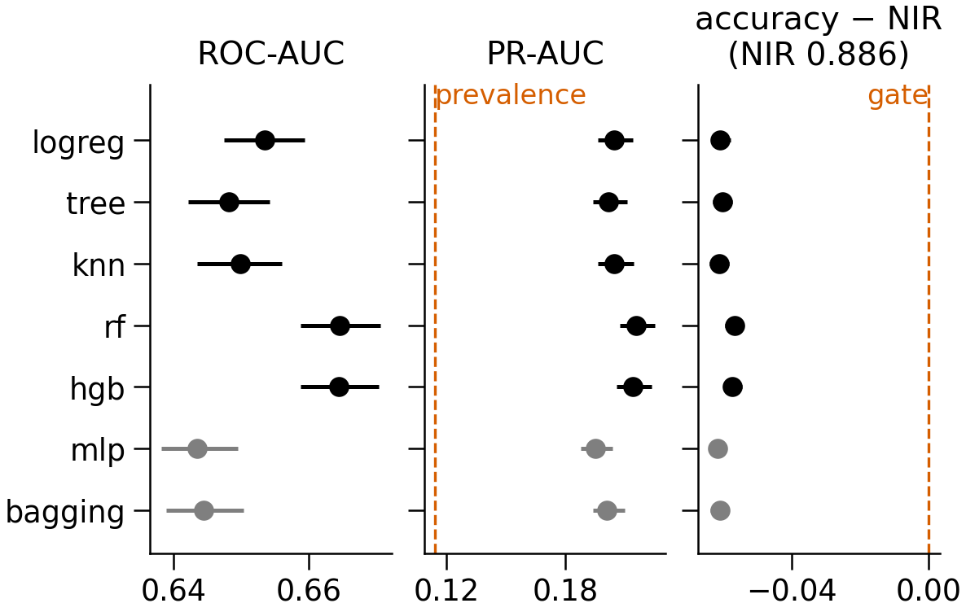
Models rank better than chance, but none passes the usability gate
Random forest: ROC-AUC 0.665 [0.659, 0.671]
PR-AUC 0.216, 1.9× the prevalence (0.114)
At capacity: TPR = PPV = 0.252
Accuracy − NIR −0.057 [−0.059, −0.054]
Closest rule (top 5 %): PPV 0.307, still below 0.5
Gate fails: 0 of 34 approved model × rule pairs pass (extensions fail too)
black = approved models, grey = course extensions†
Source: approved_main.md §1–§3 · outputs/approved/summary.json · † = addition beyond the approved proposal
4 / 11
Notes:
Five approved models in black, two course extensions in grey. The random forest has the highest ROC-AUC, 0.665, with gradient boosting at 0.664, inside its interval. That is clearly better than chance, and its PR-AUC is about 1.9 times the prevalence. But at the capacity rule the forest's true-positive rate and PPV are both 0.252: only about one flag in four is a real readmission. Accuracy minus the no-information rate is −0.0566, and the whole interval is below zero. So the gate fails for all 34 approved model and rule combinations, and the extensions fail too; the closest is the top five percent, with a PPV of 0.307. I still audit fairness, because a hospital that ranks patients still distributes errors.

Slide 5
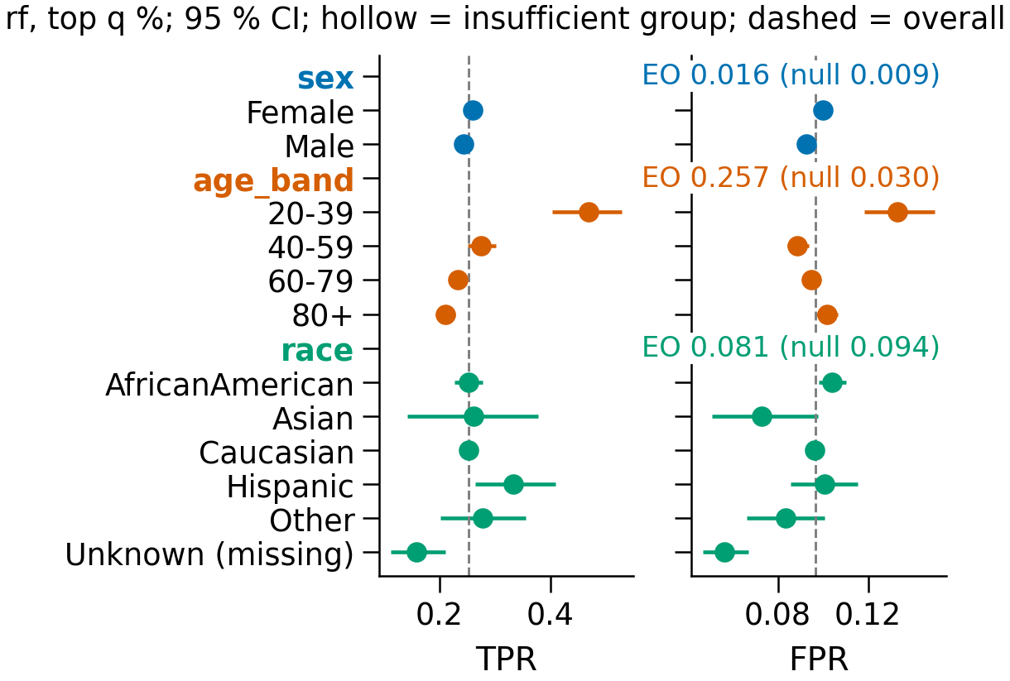
The errors differ by age, not clearly by sex or race
Age band: EO difference 0.257 [0.192, 0.320]; permutation null† 0.030 (p = 0.005, the minimum for 200 shuffles)
TPR 0.468 at 20–39 vs 0.211 at 80+; the young are flagged more (0.174 vs 0.107–0.115)
Sex 0.016 (null 0.009); race 0.081 (null 0.094; “Unknown” = missing code, left out; 0.175 with it): within chance
Not base rates (0.101–0.125), not calibration (observed − predicted within ±0.004)
Source: approved_fairness.md §2, §3.2, §4 · outputs/approved/fairness.json · † = addition beyond the approved proposal
5 / 11
Notes:
This is the audit of the random forest at the capacity rule: each dot is a group's true-positive rate, left, and false-positive rate, right. Age band stands out. Its equalized-odds difference is 0.257, against 0.030 expected by chance from a permutation null, and no shuffle reached it. Readmitted patients aged 20 to 39 are flagged 0.468 of the time, those over 80 only 0.211. Sex and race stay within their nulls; race Unknown is a missing code, left out. The Hispanic versus Caucasian difference alone has an interval above zero, but that extreme pair is chosen after seeing the data; the permutation null allows for that choice. The age gap is not base rates or calibration, and logistic regression and k-NN show about half of it.

Slide 6
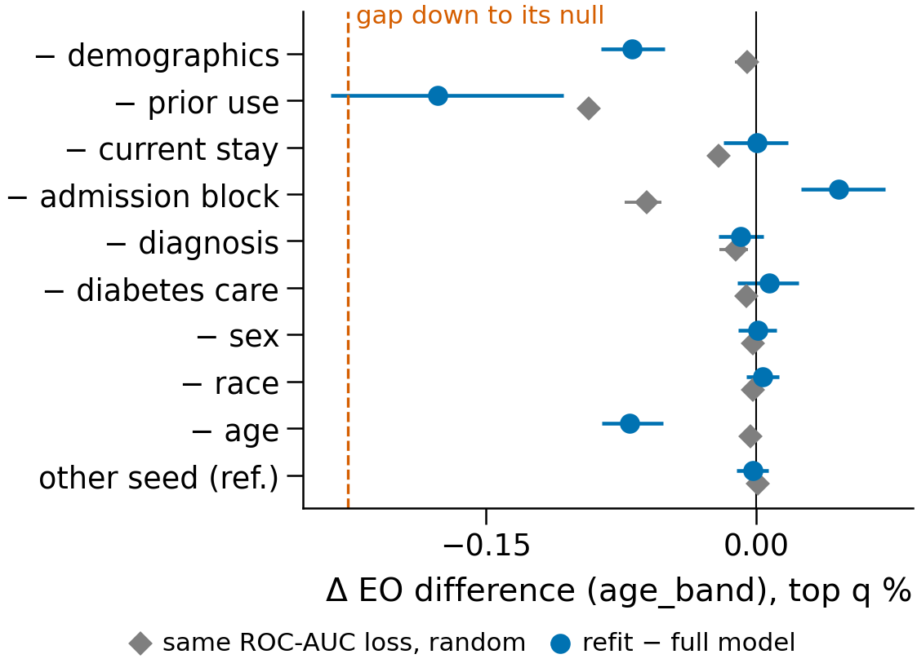
The age gap comes mainly from ranking young patients better
Ranked within their own group†, at the overall FPR: TPR 0.383 (20–39) vs 0.201 (80+), most of the 0.257 gap; the shared cut-off adds 0.085 to the young (ROC-AUC 0.755 vs 0.616)
Without prior-use counts: 0.257 → 0.080 (same AUC loss at random†: 0.164); it works by lowering 20–39 TPR (0.468 → 0.245): no remedy
Without age: 0.187; other inputs predict age band (ROC-AUC 0.773)
Source: approved_sources.md §1–§5 · outputs/approved/sources.json · † = addition beyond the approved proposal
6 / 11
Notes:
Where does the age gap come from? Mainly from ranking quality. Within their own group, the model separates readmitted young patients with ROC-AUC 0.755, but patients over 80 with only 0.616. At the overall false-positive rate their true-positive rates would be 0.383 and 0.201: most of the gap. The shared cut-off adds 0.085 to the young. I also refitted the forest without one block of inputs at a time, against the same ROC-AUC loss at random. Removing the prior-use counts moves the gap most, to 0.080, well beyond the random reference, but by lowering young patients' true-positive rate: no remedy. Removing age narrows it less, to 0.187, and the other inputs still predict age band with ROC-AUC 0.773, so unawareness does not remove the information.

Slide 7
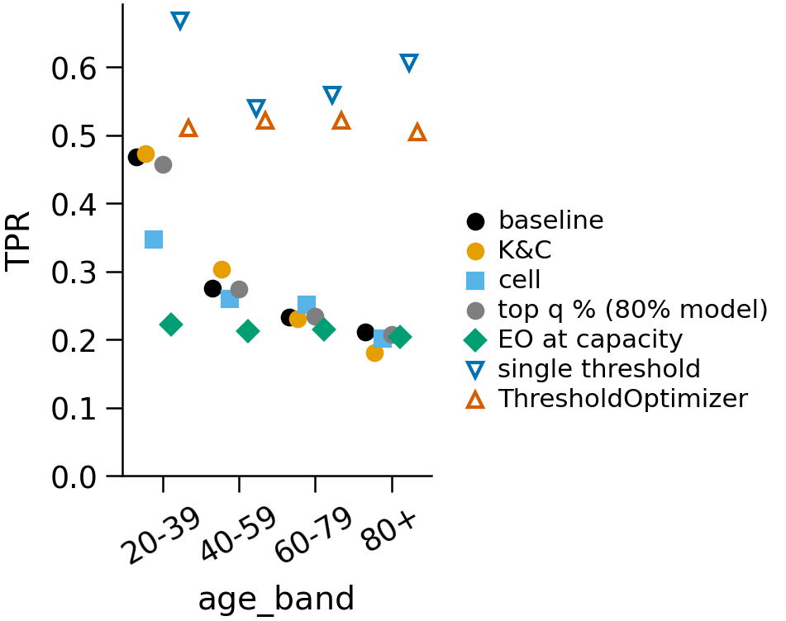
The mitigations that close the gap do so by levelling down
K&C reweighing widens it: 0.257 → 0.293
Cell balancing: 0.257 → 0.146 (−0.111); balancing race cells cuts it more (−0.124): mostly class balancing
EO at capacity† (vs same 80 % model, same number flagged): 0.250 → 0.018; TPR 20–39 0.457 → 0.222, 80+ 0.207 → 0.204
ThresholdOptimizer (vs one Youden threshold; both flag ≈ 36 %): 0.188 → 0.018; every age band falls (20–39 0.668 → 0.510)
Neither post-processor raises any age band's TPR: levelling down, not a fix
Filled markers flag ≈ q %, hollow ≈ 36 %: compare within each set
Source: approved_mitigation.md §1–§3, §5.1, §7 · outputs/approved/mitigation.json · † = addition beyond the approved proposal
7 / 11
Notes:
I tried four mitigations, each against its unconstrained counterpart under the same rule. Kamiran-Calders reweighing widens the gap, to 0.293. Cell balancing narrows it, but balancing race cells narrows the age gap even more, so it works mostly by balancing the classes. The two post-processors do close it. Equalized-odds post-processing at capacity, an addition, is compared with the same model flagging as many: the gap falls from 0.250 to 0.018, but in the right panel young patients' true-positive rate falls from 0.457 to 0.222, while the over-80s stay at about 0.204. ThresholdOptimizer is compared with one Youden threshold; both flag about 36 percent, the hollow markers, and every age band falls. Neither post-processor raises any age band's TPR against its twin: levelling down, not a fix.

Slide 8
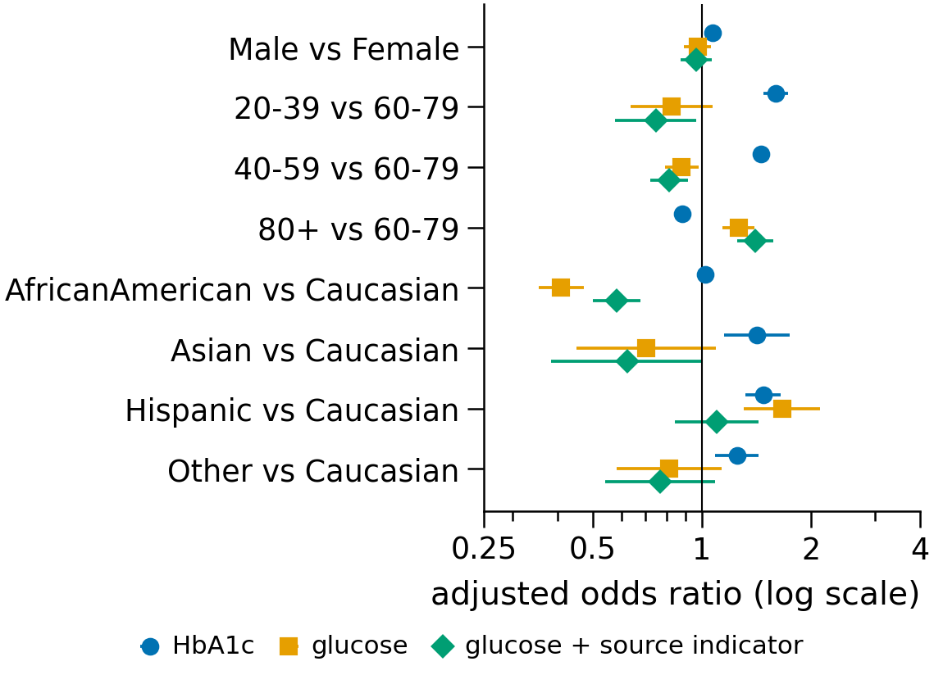
Glucose race gaps are largely, not wholly, a recording pattern
79.7 % of glucose results come from the 10.2 % of encounters with unknown admission type
With that indicator (post hoc sensitivity fit†, not tested):
Hispanic excess vanishes: 1.66 → 1.10 [0.84, 1.43]
African American deficit shrinks but remains: 0.41 → 0.58 [0.50, 0.68]
Odds ratios describe who has a recorded result; on their own they are not evidence of unequal care
Source: approved_ordering.md §2, §4 · outputs/approved/ordering.json · † = addition beyond the approved proposal
8 / 11
Notes:
Finally, measurement. The data record whether an HbA1c or glucose result exists, a proxy for an ordered test. A logistic model relates that to sex, age band and race, adjusting for the primary diagnosis. For glucose, African American patients have lower odds and Hispanic patients higher odds than Caucasian patients. But 79.7 percent of all glucose results come from the 10.2 percent of encounters whose admission type is unknown, a recording pattern of the source. With that indicator, a sensitivity fit added after seeing the results, the Hispanic excess falls to 1.10, indistinguishable from one, while the African American deficit shrinks to 0.58 but remains. So the gap is largely, not wholly, a recording pattern, and on their own the odds ratios are not evidence of unequal care.

Slide 9
What a hospital should do with this model
1. Do not use it alone
2. Report TPR by age band
PPV at capacity 0.252; the gate needs more than 0.5.
beside overall performance: 0.468 at 20–39 vs 0.211 at 80+.
3. Equal TPR is a policy choice
4. Improve the data
at capacity it lowers young patients' TPR and raises no one's: a cost, not a fix.
older patients' prior care; complete admission type and lab recording (not tested here).
Source: paper §Conclusions (deployment); approved_main.md §2; approved_mitigation.md §5.1, §7
9 / 11
Notes:
First, do not use this model as a stand-alone classifier: only about one flag in four is right, and the agreed gate needs more than one in two. Second, if it still allocates follow-ups by the ranking, it should report the true-positive rate by age band next to overall performance, because older patients are the ones the model misses. Third, imposing equal true-positive rates is a policy choice with a cost: here it means catching fewer young patients without catching more old ones. Finally, better information on older patients' prior care, and complete recording of admission type and lab results, may do more for equal errors than post-processing, although I did not test that.

Slide 10
Limitations, and what I would do next
Limitations
Next steps
Hospital and period are not in the public file: standard errors and bootstrap clustered by patient only
Intervals are conditional on the fitted models
“Result recorded” is a proxy for “test ordered”
Method changed mid-project (new proposal approved); admission-type fit post hoc
Validate on data with hospital and period identifiers
Improve the ranking for older patients (e.g. richer prior-care data) instead of post-processing
Agree q with the hospital and report the whole capacity curve (q = 5–30 % already computed)
Take-home: the model ranks better than chance but is not usable alone; its errors differ by age; equalising them by post-processing is levelling down.
Source: paper §Conclusions (limitations); docs/APPROVED_PROPOSAL.md §5
10 / 11
Notes:
The public file does not identify the hospital or the period, so standard errors and the bootstrap are clustered by patient only, although the recording analysis shows that the source matters. The intervals are conditional on the fitted models. A recorded result is only a proxy for an ordered test. And the method changed: a new proposal was approved during the project. Open choices were fixed in writing before the results they affect, with one exception, the admission-type sensitivity fit. Next, I would validate on data that identify hospital and period, try to improve the ranking for older patients instead of post-processing, and agree the capacity q with the hospital, reporting the whole capacity curve, already computed from 5 to 30 percent. Thank you.

Slide 11
Backup: how to reproduce every number
Five scripts in order: run_approved → run_fairness → run_mitigation → run_sources → run_ordering; each writes outputs/reports/approved_*.md and outputs/approved/*.json
Checkpoints per outer split carry a fingerprint of settings, prediction code and cohort; a mismatch is refused, never mixed
Colab notebook: fits one outer split live and redraws every table and figure from the saved JSONs
pytest collects 86 tests for the approved protocol (tests/test_readmission_*.py)
Paper figures (scripts/make_figures.py) and these slides (slides/build_slides.py) read the same JSONs: no number typed by hand
Source: README.md §Run; readmission/evaluate.py (fingerprint); slides/README.md
11 / 11
Notes:
This is a backup slide, in case you ask about reproducibility. The pipeline is five scripts run in order: the cohort and the models, then the fairness audit, the mitigations, the source analysis and the recording model. Each writes a report and a JSON summary. Every outer split is saved as a checkpoint together with a fingerprint of the settings, the prediction code and the cohort; a checkpoint that does not match is refused, never mixed with new results. A Colab notebook fits one outer split live and redraws every table and figure from the saved JSON files. For the approved protocol, pytest collects 86 tests. The paper's figures and these slides are built by scripts from the same JSON files, so no number on a slide was typed by hand.

