Slide 1
COMP9319: Web Data Compression and Search
Inverted index and its compression
Slides modified from Hinrich Schütze and Christina Lioma slides on IIR

Slide 2
About this lecture
Since COMP6714 is not a prerequisite of this course, this lecture will summarize the necessary elements regarding Web search index and compression, in particular:
  inverted index
  index compression
To learn more details of other related topics, you should consider taking COMP6714 - Information Retrieval and Web Search by Dr. Wei Wang

Slide 3
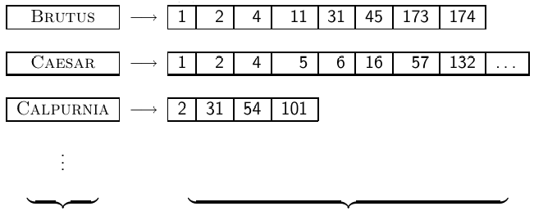
Inverted Index
  For each term t, we store a list of all documents that contain t.
dictionary postings

Slide 4



Inverted index construction
Collect the documents to be indexed:
Tokenize the text, turning each document into a list of tokens:
Do linguistic preprocessing, producing a list of normalized tokens, which are the indexing terms:
Index the documents that each term occurs in by creating an
inverted index, consisting of a dictionary and postings.

Slide 5
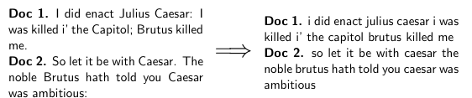
Tokenizing and preprocessing

Slide 6
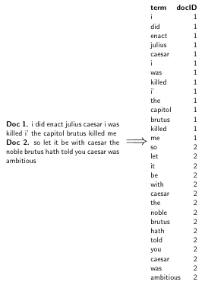
Generate posting

Slide 7
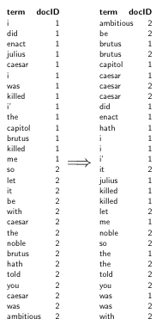
Sort postings

Slide 8
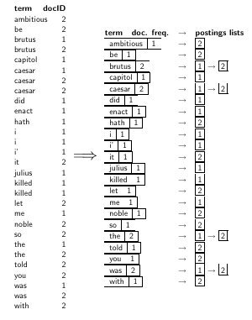
Create postings lists, determine document frequency

Slide 9
Split the result into dictionary and postings file
dictionary postings

Slide 10
Simple conjunctive query (two terms)
  Consider the query: BRUTUS AND CALPURNIA
  To find all matching documents using inverted index:
    Locate BRUTUS in the dictionary
    Retrieve its postings list from the postings file
    Locate CALPURNIA in the dictionary
    Retrieve its postings list from the postings file
    Intersect the two postings lists
    Return intersection to user

Slide 11
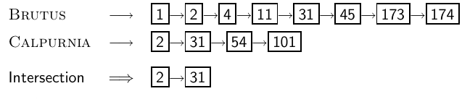
Intersecting two posting lists
  This is linear in the length of the postings lists.
  Note: This only works if postings lists are sorted.

Slide 12
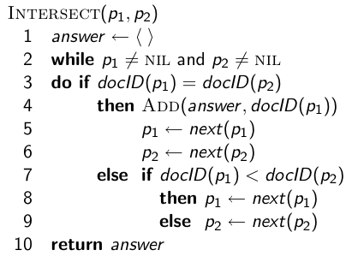
Intersecting two posting lists

Slide 13
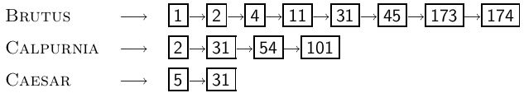
Typical query optimization
  Example query: BRUTUS AND CALPURNIA AND CAESAR
  Simple and effective optimization: Process in order of increasing frequency
  Start with the shortest postings list, then keep cutting further
  In this example, first CAESAR, then CALPURNIA, then BRUTUS

Slide 14
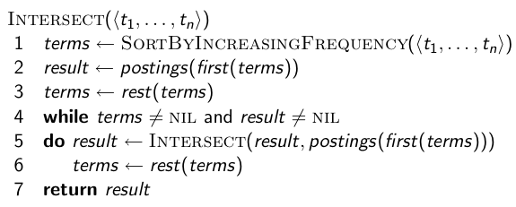
Optimized intersection algorithm for
conjunctive queries

Slide 15
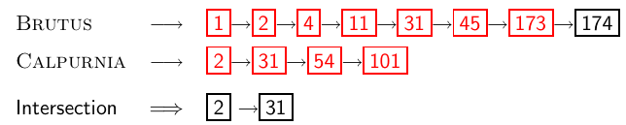
Recall basic intersection algorithm
  Linear in the length of the postings lists.
  Can we do better?

Slide 16
Skip pointers
  Skip pointers allow us to skip postings that will not figure in the search results.
  This makes intersecting postings lists more efficient.
  Some postings lists contain several million entries – so efficiency can be an issue even if basic intersection is linear.
  Where do we put skip pointers?
  How do we make sure intersection results are correct?

Slide 17
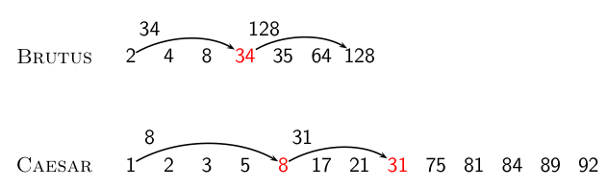
Basic idea

Slide 18
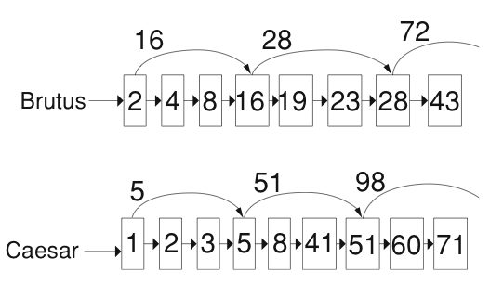
Skip lists: Larger example

Slide 19
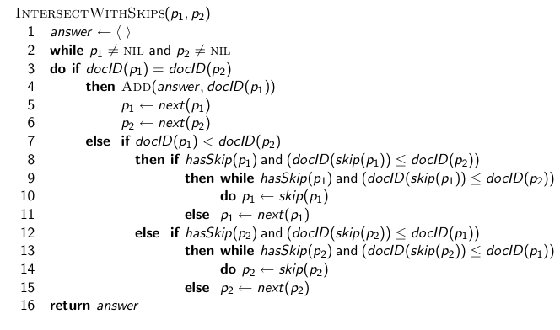
Intersection with skip pointers

Slide 20
Where do we place skips?
  Tradeoff: number of items skipped vs. frequency skip can be taken
  More skips: Each skip pointer skips only a few items, but we can frequently use it.
  Fewer skips: Each skip pointer skips many items, but we can not use it very often.

Slide 21
Phrase queries
  We want to answer a query such as [stanford university] – as a phrase.
  Thus The inventor Stanford Ovshinsky never went to university should not be a match.
  The concept of phrase query has proven easily understood by users.
  About 10% of web queries are phrase queries.
  Consequence for inverted index: it no longer suffices to store docIDs in postings lists.
  Two ways of extending the inverted index:
    biword index (cf. COMP6714)
    positional index

Slide 22
Positional indexes
  Postings lists in a nonpositional index: each posting is just a docID
  Postings lists in a positional index: each posting is a docID and a list of positions

Slide 23
Positional indexes: Example
  Query: “to₁ be₂ or₃ not₄ to₅ be₆”
  TO, 993427:
    ‹ 1: ‹7, 18, 33, 72, 86, 231›;
    2: ‹1, 17, 74, 222, 255›;
    4: ‹8, 16, 190, 429, 433›;
    5: ‹363, 367›;
    7: ‹13, 23, 191›; . . . ›
  BE, 178239:
    ‹ 1: ‹17, 25›;
    4: ‹17, 191, 291, 430, 434›;
    5: ‹14, 19, 101›; . . . › Document 4 is a match!

Slide 24
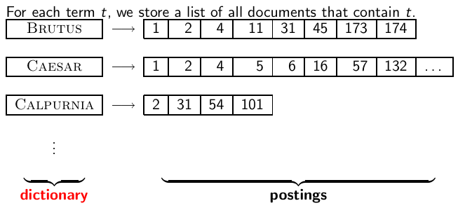
Inverted index

Slide 25
Dictionaries
  The dictionary is the data structure for storing the term vocabulary.
  Term vocabulary: the data
  Dictionary: the data structure for storing the term vocabulary

Slide 26
Dictionary as array of fixed-width entries
  For each term, we need to store a couple of items:
    document frequency
    pointer to postings list
    . . .
  Assume for the time being that we can store this information in a fixed-length entry.
  Assume that we store these entries in an array.

Slide 27
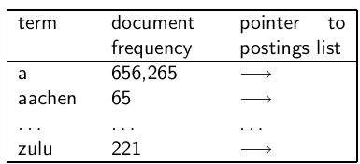
Dictionary as array of fixed-width entries
space needed: 20 bytes 4 bytes 4 bytes
How do we look up a query term q_{i} in this array at query time? That is: which data structure do we use to locate the entry (row) in the array where q_{i} is stored?

Slide 28
Data structures for looking up term
  Two main classes of data structures: hashes and trees
  Some IR systems use hashes, some use trees.
  Criteria for when to use hashes vs. trees:
    Is there a fixed number of terms or will it keep growing?
    What are the relative frequencies with which various keys will be accessed?
    How many terms are we likely to have?

Slide 29
Hashes
  Each vocabulary term is hashed into an integer.
  Try to avoid collisions
  At query time, do the following: hash query term, resolve collisions, locate entry in fixed-width array
  Pros: Lookup in a hash is faster than lookup in a tree.
    Lookup time is constant.
  Cons
    no way to find minor variants (resume vs. résumé)
    no prefix search (all terms starting with automat)
    need to rehash everything periodically if vocabulary keeps growing

Slide 30
Trees
  Trees solve the prefix problem (find all terms starting with automat).
  Simplest tree: binary tree
  Search is slightly slower than in hashes: O(logM), where M is the size of the vocabulary.
  O(logM) only holds for balanced trees.
  Rebalancing binary trees is expensive.
  B-trees mitigate the rebalancing problem.
  B-tree definition: every internal node has a number of children in the interval [a, b] where a, b are appropriate positive integers, e.g., [2, 4].

Slide 31
Sort-based index construction
  As we build index, we parse docs one at a time.
  The final postings for any term are incomplete until the end.
  Can we keep all postings in memory and then do the sort in-memory at the end?
  No, not for large collections
  At 10–12 bytes per postings entry, we need a lot of space for large collections.
  But in-memory index construction does not scale for large collections.
  Thus: We need to store intermediate results on disk.

Slide 32
Same algorithm for disk?
  Can we use the same index construction algorithm for larger collections, but by using disk instead of memory?
  No: Sorting for example 100,000,000 records on disk is too slow – too many disk seeks.
  We need an external sorting algorithm.

Slide 33
“External” sorting algorithm
(using few disk seeks)
  We must sort 100,000,000 non-positional postings.
    Each posting has size 12 bytes (4+4+4: termID, docID, document frequency).
  Define a block to consist of 10,000,000 such postings
    We can easily fit that many postings into memory.
    We will have 10 such blocks.
  Basic idea of algorithm:
    For each block: (i) accumulate postings, (ii) sort in memory, (iii) write to disk
    Then merge the blocks into one long sorted order.

Slide 34
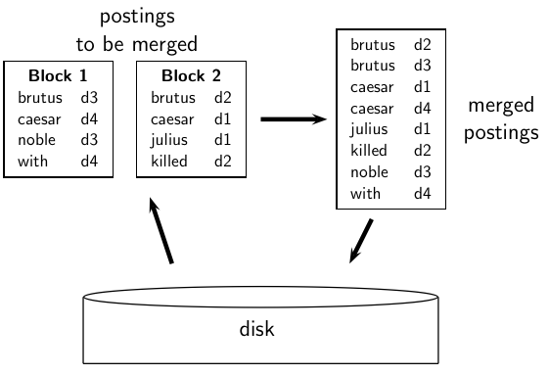
Merging two blocks

Slide 35
Why compression in information retrieval?
  First, we will consider space for dictionary
    Main motivation for dictionary compression: make it small enough to keep in main memory
  Then for the postings file
    Motivation: reduce disk space needed, decrease time needed to read from disk
    Note: Large search engines keep significant part of postings in memory
  We will devise various compression schemes for dictionary and postings.

Slide 36
Dictionary compression
  The dictionary is small compared to the postings file.
  But we want to keep it in memory.
  Also: competition with other applications, cell phones, onboard computers, fast startup time
  So compressing the dictionary is important.

Slide 37
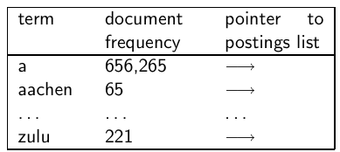
Recall: Dictionary as array of fixed-width entries
  Space needed: 20 bytes 4 bytes 4 bytes
  for Reuters: (20+4+4)*400,000 = 11.2 MB

Slide 38
Fixed-width entries are bad.
  Most of the bytes in the term column are wasted.
    We allot 20 bytes for terms of length 1.
  We can’t handle HYDROCHLOROFLUOROCARBONS and SUPERCALIFRAGILISTICEXPIALIDOCIOUS
  Average length of a term in English: 8 characters
  How can we use on average 8 characters per term?

Slide 39
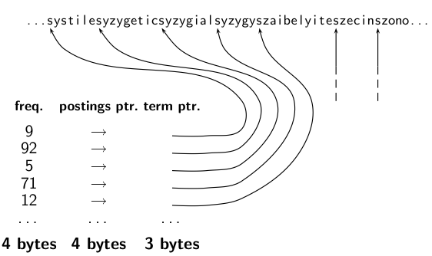
Dictionary as a string

Slide 40
Space for dictionary as a string
  4 bytes per term for frequency
  4 bytes per term for pointer to postings list
  8 bytes (on average) for term in string
  3 bytes per pointer into string (need log2 8 · 400000 < 24 bits to resolve 8 · 400,000 positions)
  Space: 400,000 × (4 +4 +3 + 8) = 7.6MB (compared to 11.2 MB for fixed-width array)

Slide 41
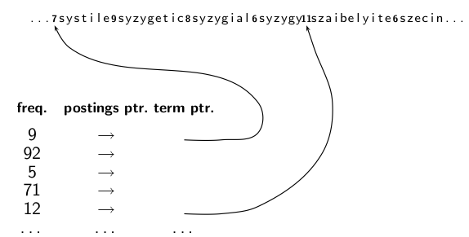
Dictionary as a string with blocking

Slide 42
Space for dictionary as a string with blocking
  Example block size k = 4
  Where we used 4 × 3 bytes for term pointers without blocking . . .
  . . .we now use 3 bytes for one pointer plus 4 bytes for indicating the length of each term.
  We save 12 − (3 + 4) = 5 bytes per block.
  Total savings: 400,000/4 ∗ 5 = 0.5 MB
  This reduces the size of the dictionary from 7.6 MB to 7.1 MB.

Slide 43
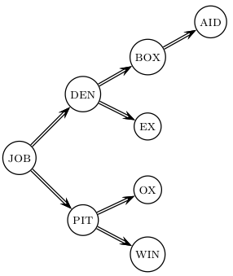
Lookup of a term without blocking

Slide 44
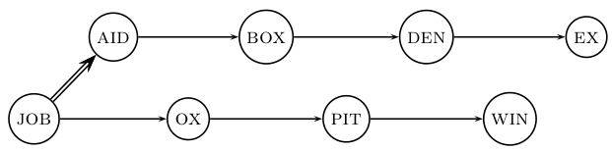
Lookup of a term with blocking: (slightly) slower

Slide 45
Front coding
One block in blocked compression (k = 4) . . .
8 a u t o m a t a 8 a u t o m a t e 9 a u t o m a t i c 10 a u t o m a t i o n
⇓
. . . further compressed with front coding.
8 a u t o m a t ∗ a 1 ⋄ e 2 ⋄ i c 3 ⋄ i o n

Slide 46
Dictionary compression for Reuters: Summary
data structure | size in MB
dictionary, fixed-width dictionary, term pointers into string ∼, with blocking, k = 4 ∼, with blocking & front coding | 11.2 7.6 7.1 5.9

Slide 47
Postings compression
  The postings file is much larger than the dictionary, factor of at least 10.
  Key desideratum: store each posting compactly
  A posting for our purposes is a docID.
  For Reuters (800,000 documents), we would use 32 bits per docID when using 4-byte integers.
  Alternatively, we can use log₂ 800,000 ≈ 19.6 < 20 bits per docID.
  Our goal: use a lot less than 20 bits per docID.

Slide 48
Key idea: Store gaps instead of docIDs
  Each postings list is ordered in increasing order of docID.
  Example postings list: COMPUTER: 283154, 283159, 283202, . . .
  It suffices to store gaps: 283159-283154=5, 283202-283154=43
  Example postings list using gaps : COMPUTER: 283154, 5, 43, . . .
  Gaps for frequent terms are small.
  Thus: We can encode small gaps with fewer than 20 bits.

Slide 49
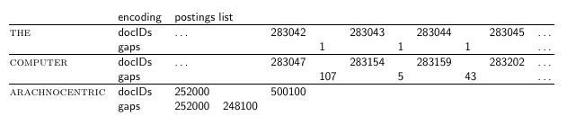
Gap encoding

Slide 50
Variable length encoding
  Aim:
    For ARACHNOCENTRIC and other rare terms, we will use about 20 bits per gap (= posting).
    For THE and other very frequent terms, we will use only a few bits per gap (= posting).
  In order to implement this, we need to devise some form of variable length encoding.
  Variable length encoding uses few bits for small gaps and many bits for large gaps.

Slide 51
Variable byte (VB) code
  Used by many commercial/research systems
  Good low-tech blend of variable-length coding and sensitivity to alignment matches (bit-level codes, see later).
  Dedicate 1 bit (high bit) to be a continuation bit c.
  If the gap G fits within 7 bits, binary-encode it in the 7 available bits and set c = 1.
  Else: encode lower-order 7 bits and then use one or more additional bytes to encode the higher order bits using the same algorithm.
  At the end set the continuation bit of the last byte to 1 (c = 1) and of the other bytes to 0 (c = 0).

Slide 52
VB code examples
docIDs gaps VB code | 824 00000110 10111000 | 829 5 10000101 | 215406 214577 00001101 00001100 10110001

Slide 53
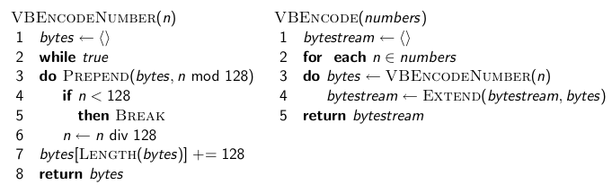
VB code encoding algorithm

Slide 54
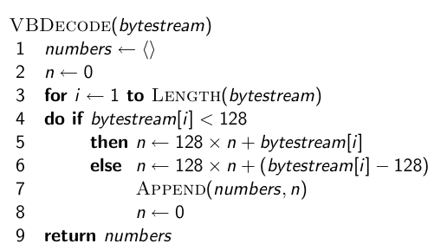
VB code decoding algorithm

Slide 55
Gamma codes for gap encoding
  You can get even more compression with another type of variable length encoding: bitlevel code.
  Gamma code is the best known of these.
  First, we need unary code to be able to introduce gamma code.
  Unary code
    Represent n as n 1s with a final 0.
    Unary code for 3 is 1110
    Unary code for 40 is 11111111111111111111111111111111111111110
    Unary code for 70 is:
  11111111111111111111111111111111111111111111111111111111111111111111110

Slide 56
Gamma code
  Represent a gap G as a pair of length and offset.
  Offset is the gap in binary, with the leading bit chopped off.
  For example 13 → 1101 → 101 = offset
  Length is the length of offset.
  For 13 (offset 101), the length is 3.
  Encode length in unary code: 1110.
  Gamma code of 13 is the concatenation of length and offset: 1110101.

Slide 57
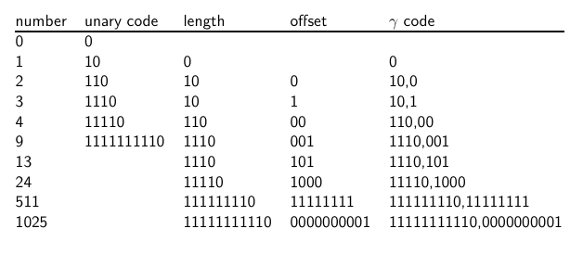
Gamma code examples

Slide 58
Properties of gamma code
  Gamma code is prefix-free
  The length of offset is ⌊log₂ G⌋ bits.
  The length of length is ⌊log₂ G⌋ + 1 bits,
  So the length of the entire code is 2 x ⌊log₂ G⌋ + 1 bits.
  ϒ codes are always of odd length.
  Gamma codes are within a factor of 2 of the optimal encoding length log₂ G.

Slide 59
Gamma codes: Alignment
  Machines have word boundaries – 8, 16, 32 bits
  Compressing and manipulating at granularity of bits can be slow.
  Variable byte encoding is aligned and thus potentially more efficient.
  Regardless of efficiency, variable byte is conceptually simpler at little additional space cost.

Slide 60
Compression of Reuters
data structure | size in MB
dictionary, fixed-width dictionary, term pointers into string ∼, with blocking, k = 4 ∼, with blocking & front coding collection (text, xml markup etc) collection (text) T/D incidence matrix postings, uncompressed (32-bit words) postings, uncompressed (20 bits) postings, variable byte encoded postings, gamma encoded | 11.2 7.6 7.1 5.9 3600.0 960.0 40,000.0 400.0 250.0 116.0 101.0

