Slide 1
BACKWARD SEARCH
FM-INDEX
(FULL-TEXT INDEX IN MINUTE SPACE)
Paper by
Ferragina & Manzini
Presentation by
Yuval Rikover

Slide 2
Combine Text compression with indexing
(discard original text).
Count and locate P by looking at only a small portion of the compressed text.
Do it efficiently:
  Time: O(p)
  Space: O(n H_{k}(T)) + o(n)

Slide 3
Exploit the relationship between the Burrows-Wheeler Transform and the Suffix Array data structure.
Compressed suffix array that encapsulates both the compressed text and the full-text indexing information.
Supports two basic operations:
  Count – return number of occurrences of P in T.
  Locate – find all positions of P in T.

Slide 4

Every column is a permutation of T.
Given row i, char L[i] precedes F[i] in original T.
Consecutive char’s in L are adjacent to similar strings in T.
Therefore – L usually contains long runs of identical char’s.
F
L
mississippi#
# mississipp i
ississippi#m
i #mississip p
ssissippi#mi
i ppi#missis s
sissippi#mis
i ssippi#mis s
issippi#miss
Sort the rows
i ssissippi# m
ssippi#missi
m ississippi #
sippi#missis
ippi#mississ
ppi#mississi
pi#mississip
i#mississipp
#mississippi
p i#mississi p
p pi#mississ i
s ippi#missi s
s issippi#mi s
s sippi#miss i
s sissippi#m i

Slide 5


Reminder: Recovering T from L
F
L
Find F by sorting L
First char of T? m
Find m in L
L[i] precedes F[i] in T. Therefore we get mi
How do we choose the correct i in L?
  The i’s are in the same order in L and F
  As are the rest of the char’s
i is followed by s: mis
And so on….

Slide 6

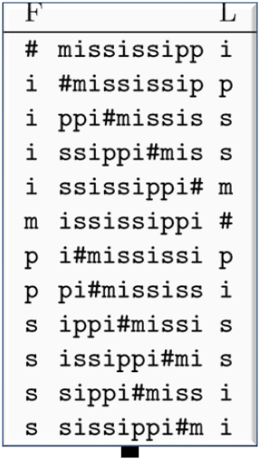

Backward-search algorithm
Uses only L (output of BWT)
Relies on 2 structures:
  C[1,…,|Σ|] : C[c] contains the total number of text chars in T which are alphabetically smaller then c (including repetitions of chars)
  Occ(c,q): number of occurrences of char c in prefix L[1,q]
Example
C[ ] for T = mississippi#
occ(s, 5) = 2
occ(s,12) = 4
    Occ Rank
1
2
3
4
5
6
7
8
9
10
11
12
1 | 5 | 6 | 8
i m p s

Slide 7
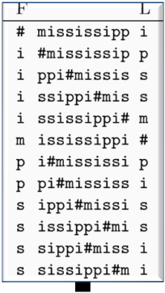
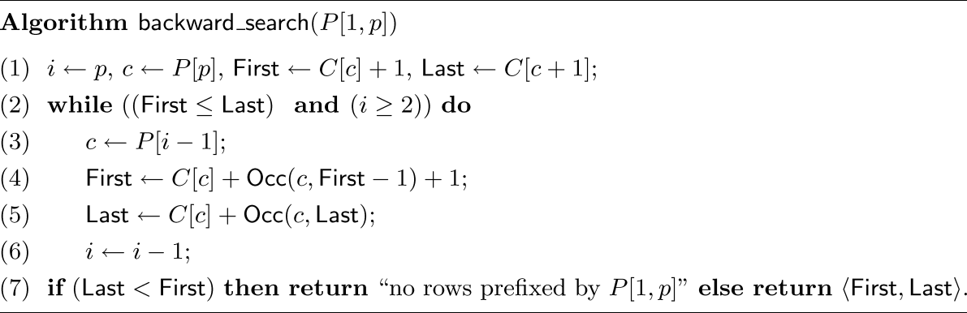
Works in p iterations, from p down to 1
Remember that the BWT matrix rows = sorted suffixes of T
  All suffixes prefixed by pattern P, occupy a continuous set of rows
  This set of rows has starting position First
  and ending position Last
  So, (Last – First +1) gives total pattern occurrences
At the end of the i-th phase, First points to the first row prefixed by P[i,p], and Last points to the last row prefiex by P[i,p].
i = 3
i = 2
i = 1
P = msi
msi
msi
msi
c = ‘i’
c = ‘s’
c = ‘m’

Slide 8
SUBSTRING SEARCH IN T (COUNT THE PATTERN OCCURRENCES)
P[ j ]
C
P = si
# 0
i 1
m 5
p 6
S 8
Available info
First step
L
unknown
#mississipp
i#mississip
ippi#missis
issippi#mis
ississippi#
mississippi
pi#mississi
ppi#mississ
sippi#missi
sissippi#mi
ssippi#miss
ssissippi#m
i
p
s
s
m
#
p
i
s
s
i
i
rows prefixed
by char “i”
fr
s
s
lr
Inductive step: Given fr,lr for P[j+1,p]
mississippi
Take c=P[j]
Find the first c in L[fr, lr]
Find the last c in L[fr, lr]
fr
L-to-F mapping of these chars
occ=2
[lr-fr+1]
lr
Occ() oracle is enough

Slide 9

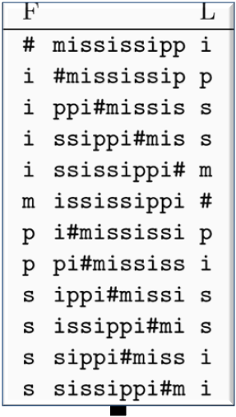
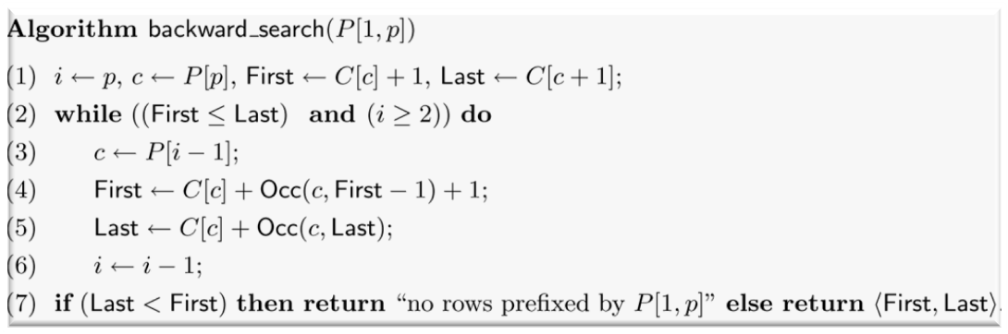
P = pssi
  i =
  c =
  First =
  Last =
  (Last – First + 1) =
1
2
3
4
5
6
7
8
9
10
11
12
First
4
3
Last
‘i’
‘s’
C[‘i’] + 1 = 2
C[‘s’] + Occ(‘s’,1) +1 = 8+0+1 = 9
C[‘i’ + 1] = C[‘m’] = 5
C[‘s’] + Occ(‘s’,5) = 8+2 = 10
4
2
C[ ] =
1 | 5 | 6 | 8
i m p s

Slide 10

P = pssi
  i =
  c =
  First =
  Last =
  (Last – First + 1) =
1
2
3
4
5
6
7
8
9
10
11
12
3
2
‘s’
C[‘s’] + Occ(‘s’,1) +1 = 8+0+1 = 9
C[‘s’] + Occ(‘s’,8) +1 = 8+2+1 = 11
First
C[‘s’] + Occ(‘s’,5) = 8+2 = 10
C[‘s’] + Occ(‘s’,10) = 8+4 = 12
Last
2
C[ ] =
1 | 5 | 6 | 8
i m p s

Slide 11
P = pssi
  i =
  c =
  First =
  Last =
  (Last – First + 1) =
1
2
3
4
5
6
7
8
9
10
11
12
2
1
‘s’
‘p’
C[‘s’] + Occ(‘s’,8) +1 = 8+2+1 = 11
C[‘p’] + Occ(‘p’,10) +1 = 6+2+1 = 9
C[‘s’] + Occ(‘s’,10) = 8+4 = 12
C[‘p’] + Occ(‘p’,12) = 6+2 = 8
First
2
0
Last
C[ ] =
1 | 5 | 6 | 8
i m p s

Slide 12
COMP9319 LECTURE 5
Compressed suffix array / BWT

Slide 13
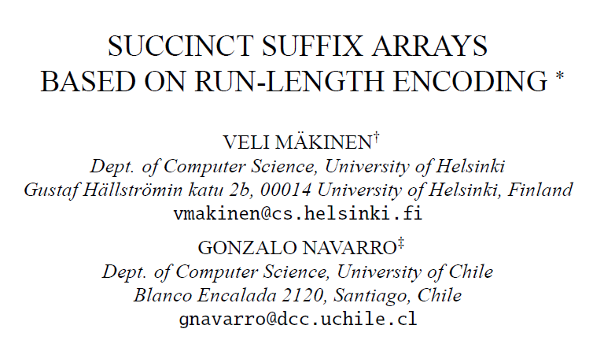
Slides modified from the original Makinen & Navarro’s

Slide 14
SIMPLE FM-INDEX
Construct the Burrows-Wheeler-transformed text bwt(T) [BW94].
From bwt(T) it is possible to construct the suffix array sa(T) of T in linear time.
Instead of constructing the whole sa(T), one can add small data structures besides bwt(T) to simulate a search from sa(T).

Slide 15
BURROWS-WHEELER TRANSFORMATION
Construct a matrix M that contains as rows all rotations of T.
Sort the rows in the lexicographic order.
Let L be the last column and F be the first column.
bwt(T)=L associated with the row number of T in the sorted M.

Slide 16
EXAMPLE
pos 123456789
T = kalevala#
sa
F
M
L
1:9 #kalevala
2:8 a#kaleval
3:6 ala#kalev
4:2 alevala#k
5:4 evala#kal
6:1 kalevala#
7:7 la#kaleva
8:3 levala#ka
9:5 vala#kale
L = alvkl#aae, row 6
==>
Exercise: Given L and the row
number, we know how to compute T.
What about sa(T)?

Slide 17
T⁻¹=
#
a
l
a
v
e
l
a
k
L
sort
F
L
M
sa(T)
1 a
2 l
3 v
4 k
5 l
6 #
7 a
8 a
9 e
#
a
a
a
e
k
l
l
v
k a l e v a l
a
l
v
k
l
#
a
a
e
1:
2:
3:
4:
5:
6:
7:
8:
9:
9
8
6
2
…
4
a l e v a l a
1
7
3
5
i 1 2 3 4 5 6 7 8 9
LF[i] 2 7 9 6 8 1 3 4 5

Slide 18
IMPLICIT LF[I]
Ferragina and Manzini (2000) noticed the following connection:
LF[i]=C_{T}[L[i]]+rank_{L[i]}(L,i)
Here
C_{T}[c] : amount of letters 0,1,...,c-1 in L=bwt(T)
rank_{c}(L,i) : amount of letters c in the prefix L[1,i]

Slide 19
RANK/SELECT
select₁(L,j)
3 6 9 10 12
L
001001001101
rank₁(L,i)
001112223445

Slide 20
T⁻¹=
#
a
l
a
v
e
l
a
k
L
sort
F
L
M
sa(T)
1 a
2 l
3 v
4 k
5 l
6 #
7 a
8 a
9 e
#
a
a
a
e
k
l
l
v
a
l
v
k
l
#
a
a
e
1:
2:
3:
4:
5:
6:
7:
8:
9:
9
8
6
2
…
4
1
7
3
5
i 1 2 3 4 5 6 7 8 9
LF[7]=C_{T}[a]+rank_{a}(L,7)
LF[i] 2 7 9 6 8 1 3 4 5
=1+2=3

Slide 21
RECALL: BACKWARD SEARCH ON BWT(T)
Observation: If [i,j] is the range of rows of M that start with string X, then the range [i’,j’] containing cX can be computed as
i’ := C_{T}[c]+rank_{c}(L,i-1)+1,
j’ := C_{T}[c]+rank_{c}(L,j).

Slide 22
BACKWARD SEARCH ON BWT(T)...
Array C_{T}[1,σ] takes O(σ log |T|) bits.
L=Bwt(T) takes O(|T| log σ) bits.
Assuming rank_{c}(L,i) can be computed in constant time for each (c,i), the algorithm takes O(|P|) time to count the occurrences of P in T.

Slide 23
RUN-LENGTH FM-INDEX
We make the following changes to the previous FM-index variant:
- L=Bwt(T) is replaced by a sequence S[1,n’] and two bit-vectors B[1,|T|] and B’[1,|T|],
- Cumulative array C_{T}[1,c] is replaced by
C_{S}[1,c],
- wavelet tree is build on S (to be discussed later), and
- some formulas are changed.

Slide 24
RUN-LENGTH FM-INDEX...
L
B
S
L
F
B’
c
c
c
a
a
g
g
a
t
t
1
0
0
1
0
1
0
1
1
0
c
a
g
a
t
c
c
c
a
a
g
g
a
t
t
a
a
a
c
c
c
g
g
t
t
1
0
1
1
0
0
1
0
1
0

Slide 25
CHANGES TO FORMULAS
Recall that we need to compute
C_{T}[c]+rank_{c}(L,i) in the backward search.
Theorem: C[c]+rank_{c}(L,i) is equivalent to select₁(B’,C_{S}[c]+1+rank_{c}(S,rank₁(B,i)))-1,
when L[i]≠ c, and otherwise to
select₁(B’,C_{S}[c]+rank_{c}(S,rank₁(B,i)))+
i-select₁(B,rank₁(B,i)).

Slide 26
EXAMPLE, L[I]=C
L
F
B
S
B’
LF[8]= select₁(B’,C_{S}[a]+rank_{a}(S,rank₁(B,8)))+
8-select₁(B,rank₁(B,8))
c
c
c
a
a
g
g
a
t
t
a
a
a
c
c
c
g
g
t
t
1
0
0
1
0
1
0
1
1
0
c
a
g
a
t
1
0
1
1
0
0
1
0
1
0
= select₁(B’,0+rank_{a}(S,4))+8-select₁(B,4)
= select₁(B’,0+2)+8-8
= 3

Slide 27
For more detail, read the original paper

Slide 28
EXERCISE
ipsm$pisi
111011111010

Slide 29
WHAT IS B’
i
1
2
3
4
5
6
7
8
9
10
11
12
B
1
1
1
0
1
1
1
1
1
0
1
0
S
i
p
s
m
$
p
i
s
i

Slide 30
USUALLY B’ IS GIVEN TO SAVE COMPUTATIONS
i
1
2
3
4
5
6
7
8
9
10
11
12
B
1
1
1
0
1
1
1
1
1
0
1
0
S
i
p
s
m
$
p
i
s
i
B’
1
1
1
1
0
1
1
1
1
0
1
0

Slide 31
REVERSE BWT FROM ROW 6
i
1
2
3
4
5
6
7
8
9
10
11
12
B
1
1
1
0
1
1
1
1
1
0
1
0
S
i
p
s
m
$
p
i
s
i
B’
1
1
1
1
0
1
1
1
1
0
1
0

Slide 32
REVERSE BWT
i
1
2
3
4
5
6
7
8
9
10
11
12
B
1
1
1
0
1
1
1
1
1
0
1
0
S
i
p
s
m
$
p
i
s
i
B’
1
1
1
1
0
1
1
1
1
0
1
0
S[rank₁(B, 6)]= $

Slide 33
REVERSE BWT
S[rank₁(B, 6)]= $
i
1
2
3
4
5
6
7
8
9
10
11
12
B
1
1
1
0
1
1
1
1
1
0
1
0
S
i
p
s
m
$
p
i
s
i
B’
1
1
1
1
0
1
1
1
1
0
1
0
LF[6]
= select₁(B’, C_{S}[$] + rank$(S, rank₁(B, 6))) + 6 – select₁(B, rank₁(B, 6)))
= select₁(B’, 0 + rank$(S, 5)) + 6 – select₁(B 5)
= 1 + 6 – 6 = 1

Slide 34
REVERSE BWT
S[rank₁(B, 1)]= i
i
1
2
3
4
5
6
7
8
9
10
11
12
B
1
1
1
0
1
1
1
1
1
0
1
0
S
i
p
s
m
$
p
i
s
i
B’
1
1
1
1
0
1
1
1
1
0
1
0
LF[1]
= select₁(B’, C_{S}[i] + rank_{i}(S, rank₁(B, 1))) + 1 – select₁(B, rank₁(B, 1)))
= select₁(B’, 1 + rank_{i}(S, 1)) + 1 – select₁(B, 1)
= 2 + 1 – 1 = 2

Slide 35
REVERSE BWT
S[rank₁(B, 1)]= i
i
1
2
3
4
5
6
7
8
9
10
11
12
B
1
1
1
0
1
1
1
1
1
0
1
0
S
i
p
s
m
$
p
i
s
i
B’
1
1
1
1
0
1
1
1
1
0
1
0
LF[1]
= select₁(B’, C_{S}[i] + rank_{i}(S, rank₁(B, 1))) + 1 – select₁(B, rank₁(B, 1)))
= select₁(B’, 1 + rank_{i}(S, 1)) + 1 – select₁(B 1)
= 2 + 1 – 1 = 2
You can also construct the SA in this way:
12, 11, ….
12,11,8,5,2,1,10,9,7,4,6,3

Slide 36
BACKWARD SEARCH
Suppose search for si:
c = i, First = 2, Last = 5
c = s
First = C[c] + Occ(c, First – 1) + 1
Last = C[c] + Occ(c, Last)
i
1
2
3
4
5
6
7
8
9
10
11
12
B
1
1
1
0
1
1
1
1
1
0
1
0
S
i
p
s
m
$
p
i
s
i
B’
1
1
1
1
0
1
1
1
1
0
1
0

Slide 37
BACKWARD SEARCH
c = i, First = 2, Last = 5
c = s
First = select₁(B’, C_{S}[s]+1+rank_{s}(S, rank₁(B,2-1))) -1 + 1
=select₁(B’,7+1+rank_{s}(S,1))
=select₁(B’, 8) = 9
Last = select₁(B’, C_{S}[s]+1+rank_{s}(S, rank₁(B,5))) -1
=select₁(B’,7+1+rank_{s}(S,4)) – 1
=select₁(B’, 9) -1 = 11 – 1 = 10
i
1
2
3
4
5
6
7
8
9
10
11
12
B
1
1
1
0
1
1
1
1
1
0
1
0
S
i
p
s
m
$
p
i
s
i
B’
1
1
1
1
0
1
1
1
1
0
1
0

