Slide 1
AN OVERVIEW
Both factor and numerical variables
Imbalanced data
‘1’ : 24%
‘0’: 76%
Missing values only in factor variables: ‘?’ values
No need to impute or remove missing values.
‘?’ will be taken as a factor level.

Slide 2
PREPROCESSING
Dataset was randomly reordered.
Some redundant columns were removed.
‘RECORD_ID’
‘EDUCATION_NUM’
Since there is also ‘EDUCATION’
‘PROXY’
‘TARGET’ variable was converted into factor.
Since we are interested in classification
Numerical and factor variables were split into separate datasets.
Also, a onehot encoded version was generated.

Slide 3
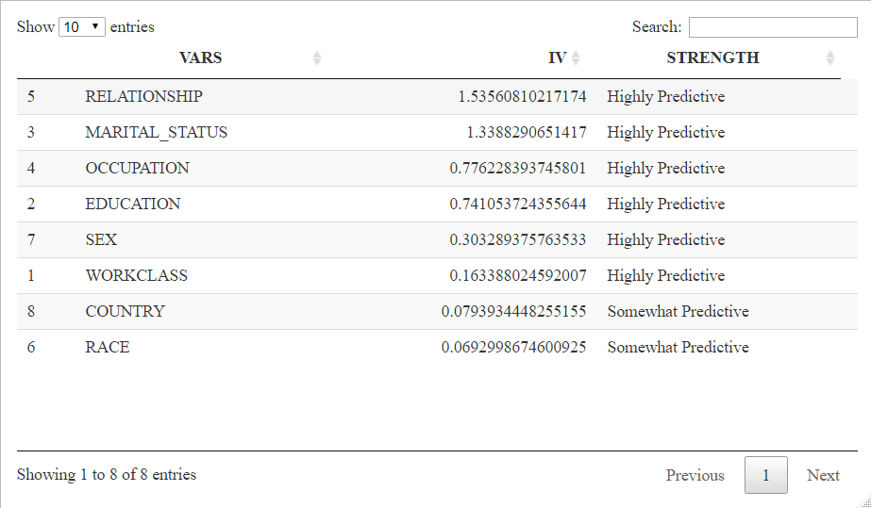
FEATURE SELECTION
Information Value (IV) of factor variables were computed.
According to their strengths, they all can be included in the model.
Moreover, by generating a Logistic Regresson model via GLM, p-value of each variable (onehot encoded) was calculated.
Numerical variables were all significant
At least one level from each factor was significant.
44 out of 107 variables (onehot-encoded) were significant.
The significant variable subset will be used as a dataset for some algorithms in the model.
The full dataset will also be used.

Slide 4
MODELLING
Since it would provide a quite effective dimensionality reduction, significant variable subset was used as a dataset for KNN and SVM. It will provide:
Reducing the running time of SVM
Enhancing the performance of the KNN
The Random Forest takes the predictions of the KNN, SVM and GLM as input, besides the original dataset.
For the Random Forest, all the variables in the original dataset was used
As a tree-based algorithm, its predictive performance is not adversely affected by high dimensions.
Its running time is not also much affected by high dimensions, compared to others.

Slide 5
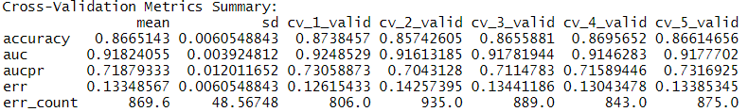
MODEL VALIDATION AND PERFORMANCE
5-fold cross validation was used for validation.
Stratification was applied since the data is imbalanced.
AUC was reported as 0.917 on the training data, and as 0.918 on the cross-validation sets
The model performs well in terms of distinguishing classes.
The mean Accuracy across cross-validation sets was 0.86.

