Slide 1
OUTLINE
Seasonality
Time series plot
Autocorrelation Function
Seasonality Test
Analysis of Means
Forecasting
Regression analysis
ARIMA
3. Monitoring the performance of the restaurants,
TASK 2
Data Migration Procedure

Slide 2
1- Is there any seasonality in the data?
Where to look for seasonality?
Sale/order figures are usually seasonal, which can be weekly, monthly, yearly etc.
How to look for seasonality in the number of sales/ orders:
We can start by creating a time series plot and looking for seasonal patterns
We can apply statistical methods such as seasonality test, analysis of means (ANOM), Autocorrelation function (ACF),
Let us analyze the countries one by one:

Slide 3
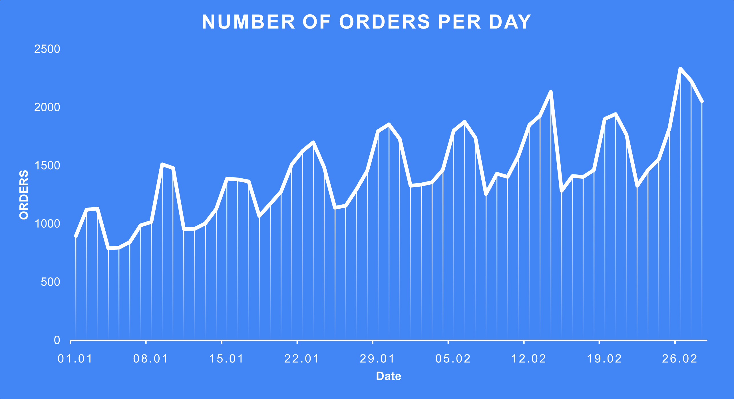
PORTUGAL - SEASONALITY - Time-series plot
We can see a weekly pattern in the graph.
The number of orders fluctuates in a period of 7 days.

Slide 4
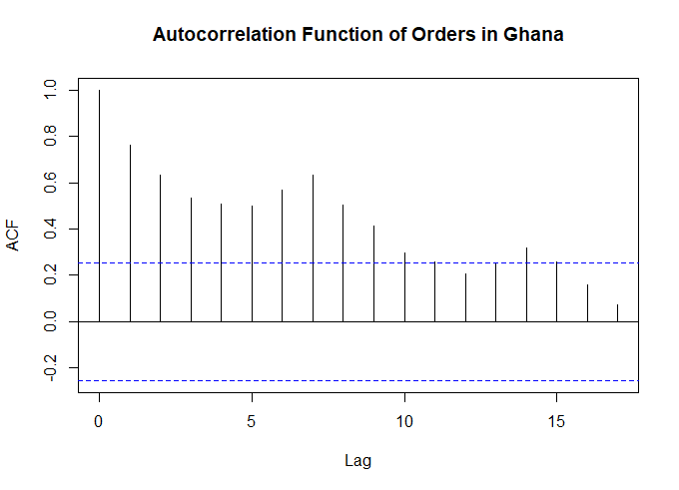
PORTUGAL - SEASONALITY - Autocorrelation Function (ACF)
Spikes peak at lags 7 and 14, meaning that there is a correlation between data points which are 7-time-periods apart.
In other words: seasonality.

Slide 5
PORTUGAL - SEASONALITY - WO-test
For another statistical proof, we can apply the WO-test presented by the isSeasonal function in the seastests package.
The function returns ‘TRUE’, indicating that the time series data includes seasonality.
seasonality_test <- seastests::isSeasonal(Order_p, test = "wo", freq = 7)
> print(seasonality_test)
[1] TRUE

Slide 6
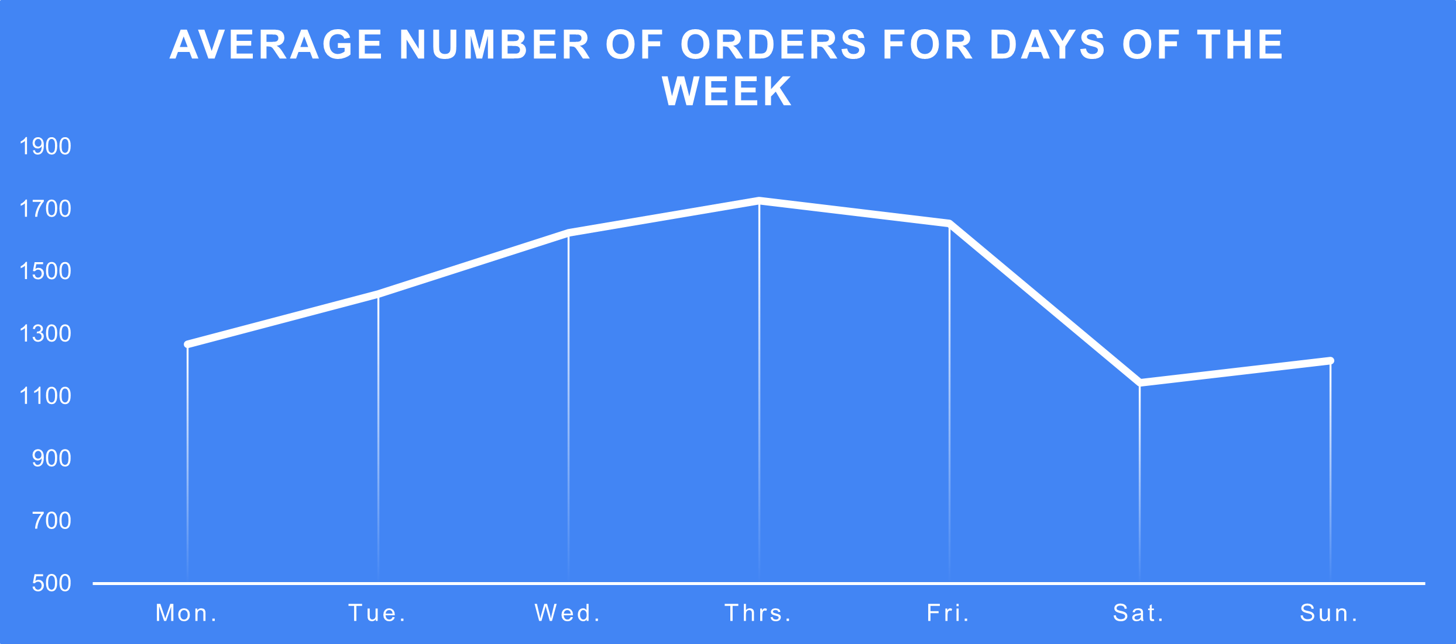
PORTUGAL - SEASONALITY - Time-series plot: average values
From another perspective:
Average number of orders for each day seems different from another.
We can look further into that via applying ANOM.

Slide 7
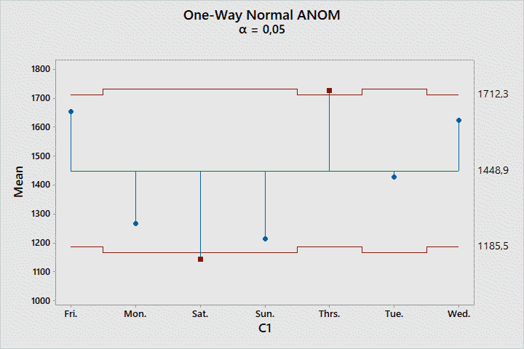
PORTUGAL - SEASONALITY - ANOM
ANOM shows whether a group has a different mean than the overall mean of the whole data.
We can see that Saturday and Thursday have significantly different mean values, which can be interpreted as seasonality.

Slide 8
PORTUGAL - SEASONALITY - Conclusion
Based on 3 different statistical analyses, we can say that the Portugal data has seasonality.

Slide 9
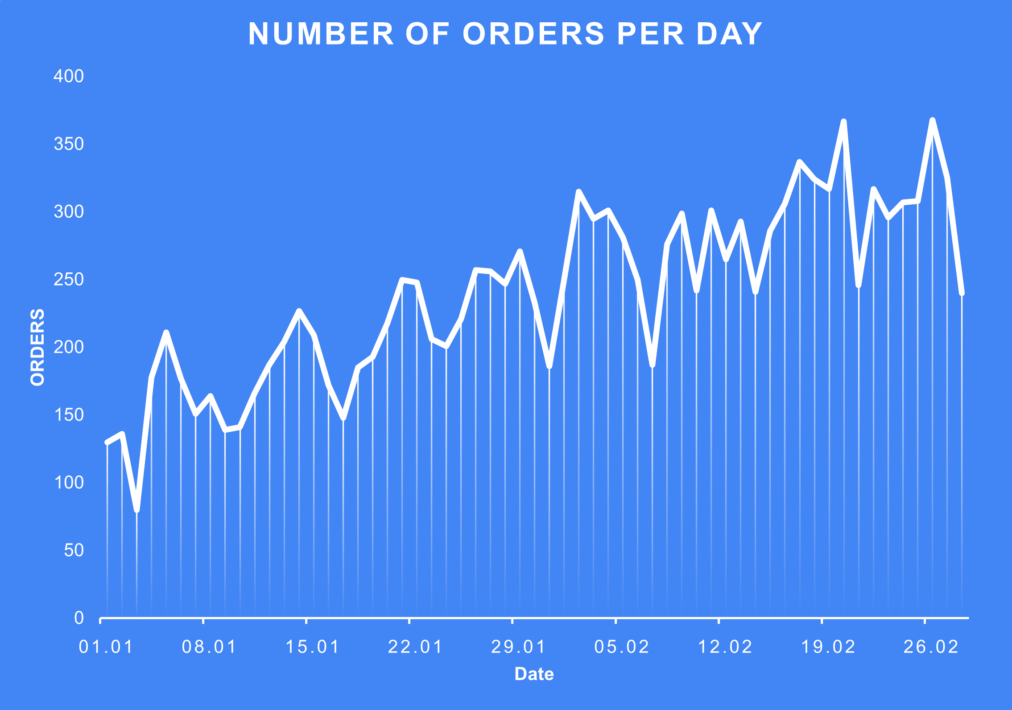
GHANA - SEASONALITY - Time-series plot
Again, we see a weekly pattern.

Slide 10
GHANA - SEASONALITY - ACF
Spikes peak at lags which are multiples of 7, showing that there exists seasonality with a period of 7.

Slide 11
GHANA - SEASONALITY - WO-test
The WO-Test returns ‘TRUE’ for the Ghana data as well.
seasonality_testt <- seastests::isSeasonal(Order_g, test = "wo", freq = 7)
print(seasonality_testt)
[1] TRUE

Slide 12
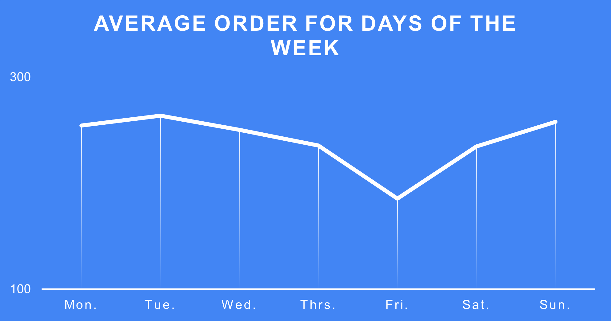
GHANA - SEASONALITY - Time-series plot: average values
We see different mean values for different days, which implies seasonality.

Slide 13
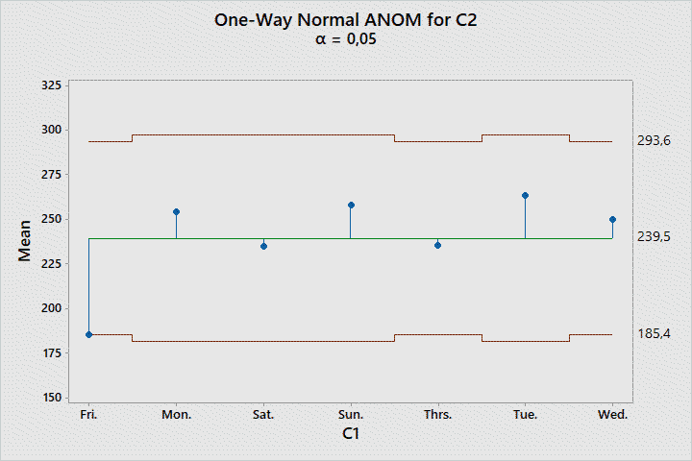
GHANA - SEASONALITY - ANOM
The mean of Friday is significantly different than that of the whole data.

Slide 14
GHANA - SEASONALITY - Conclusion
Similar to the Portugal case, we found that the Ghana data is seasonal according to our statistical analyses.

Slide 15
2- How can we forecast the number of orders in the next month?

Slide 16
PORTUGAL - FORECASTING - Regression Analysis
Another important factor besides seasonality: upward trend.
A regression model to explain ‘number of orders’ with ‘seasonality’ and ‘trend’:
Seasonality: Day of the week
Trend: No. of the day (1,2,…34,35,…)

Slide 17
PORTUGAL - FORECASTING - Regression Model
Regression Equation
Day
Fri. Order_P = 1177,7 + 15,36 Day number
Mon. Order_P = 799,5 + 15,36 Day number
Sat. Order_P = 706,2 + 15,36 Day number
Sun. Order_P = 761,9 + 15,36 Day number
Thrs. Order_P = 1266,4 + 15,36 Day number
Tue. Order_P = 943,7 + 15,36 Day number
Wed. Order_P = 1178,2 + 15,36 Day number
‘Day number’ and ‘Day of the week’ were chosen as predictors.
Coefficient of the ‘Day number’ corresponds to the upward trend, whereas the constant of each day of the week represents seasonality.

Slide 18
PORTUGAL - FORECASTING - Evaluating the Model and Predictors
P-values of the model and parameters are 0, meaning that our model and predictors are statistically significant to explain the response variable (number of orders).
R-sq values of the model are quite high, meaning that the model can explain a great part of the response variable.
So, our model is good for prediction.
Source DF Adj SS Adj MS F-Value P-Value
Regression 7 6822157 974594 55,99 0,000
Day number 1 4025231 4025231 231,24 0,000
Day 6 2690684 448447 25,76 0,000
Error 51 887781 17407
Total 58 7709939
Model Summary
S R-sq R-sq(adj) R-sq(pred)
131,937 88,49% 86,90% 84,44%

Slide 19
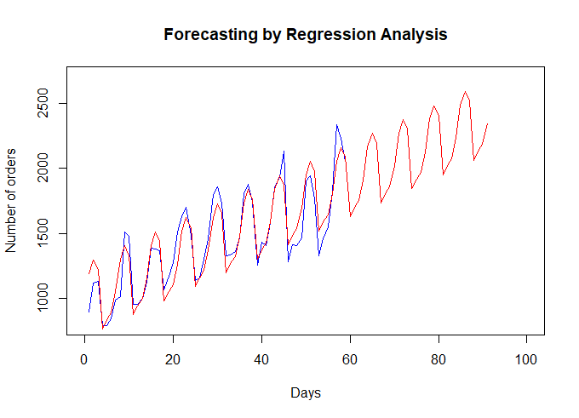
PORTUGAL - FORECASTING - Forecast Plot of the Regression Model
After generating the predictions of the model, its fits and forecasts were plotted

Slide 20
PORTUGAL - FORECASTING - ARIMA
A more complex method to analyze time series data is fitting an ARIMA model.
It consists of non-seasonal and seasonal parts, each having Autoregressive (p and P), Moving Average (q and Q) and Difference (d and D) terms.
ARIMA(p,d,q)[P,D,Q]7

Slide 21
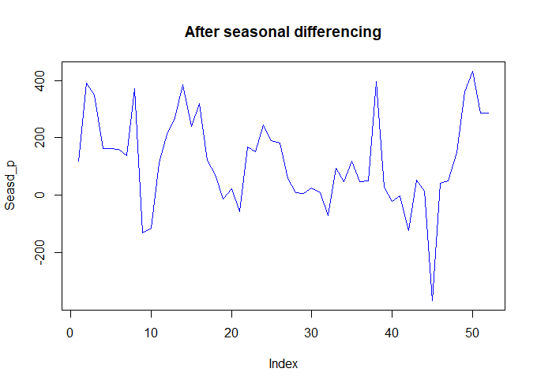
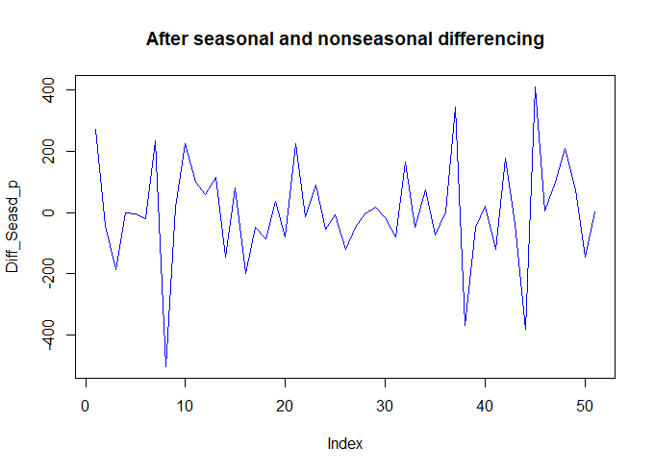
PORTUGAL - FORECASTING - Making the Data Statitionary
First, the data must be made stationary (i.e., having no trend or seasonality) by differencing.
Quantity of differencing to make it stationary determines the difference terms (d and D) in the model.

Slide 22
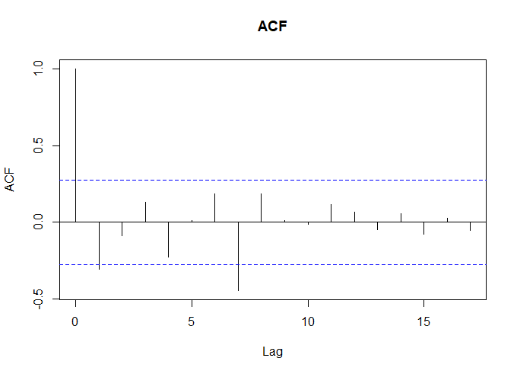
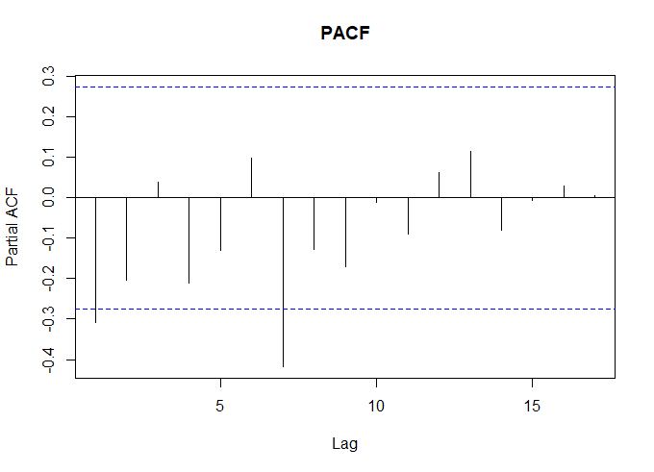
PORTUGAL - FORECASTING - ACF and PACF Plots
In both graphs, spike in the lag 1 shows MA(1).
In both graphs, spike in the lag 7 shows SMA(1)

Slide 23
PORTUGAL - FORECASTING - ARIMA Model
Final Estimates of Parameters
Type Coef SE Coef T P
MA 1 0,4833 0,1265 3,82 0,000
SMA 7 0,7246 0,1365 5,31 0,000
Differencing: 1 regular, 1 seasonal of order 7
Number of observations: Original series 59, after differencing 51
Residuals: SS = 797856 (backforecasts excluded)
MS = 16283 DF = 49
P-values of the parameters show strong statistical significance.
When other parameters were searched, the P-values did not improve.
So, our model:
ARIMA(0,1,1)[0,1,1]7

Slide 24
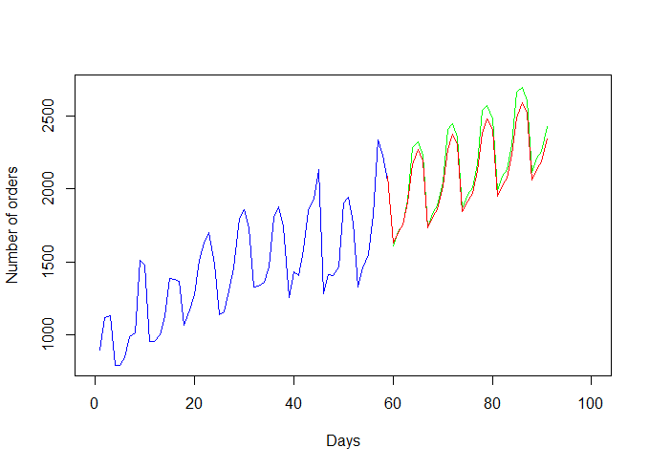
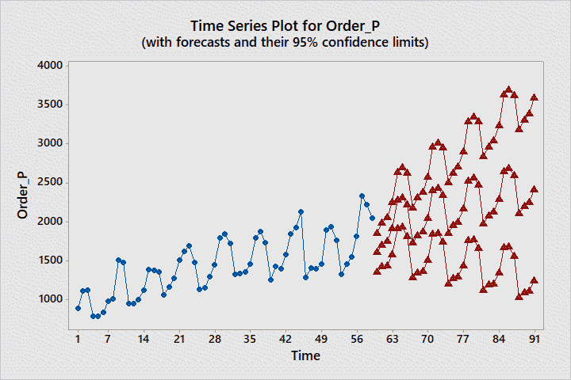
PORTUGAL - FORECASTING - ARIMA Forecasts
On the left, the forecast and its confidence limits can be seen.
On the right, green curve shows the ARIMA forecast, whereas red curve shows the regression forecast.

Slide 25
GHANA - FORECASTING - Regression Model and Significance
Regression Equation
Day
Fri. Order_G = 85,43 + 3,230 Day number
Mon. Order_G = 156,0 + 3,230 Day number
Sat. Order_G = 142,82 + 3,230 Day number
Sun. Order_G = 162,7 + 3,230 Day number
Thrs. Order_G = 138,77 + 3,230 Day number
Tue. Order_G = 161,9 + 3,230 Day number
Wed. Order_G = 156,67 + 3,230 Day number
Source DF Adj SS Adj MS F-Value P-Value
Regression 7 214633 30662 53,41 0,000
Day number 1 177889 177889 309,87 0,000
Day 6 38965 6494 11,31 0,000
Error 51 29278 574
Total 58 243911
Model Summary
S R-sq R-sq(adj) R-sq(pred)
23,9599 88,00% 86,35% 83,79%
We see significant p-values and high R-sq values, meaning that we have a good fit.

Slide 26
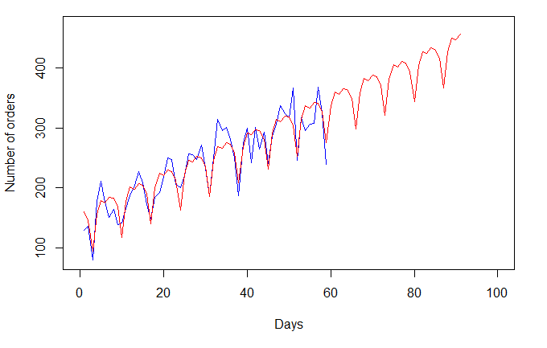
GHANA - FORECASTING - Regression Forecast

Slide 27
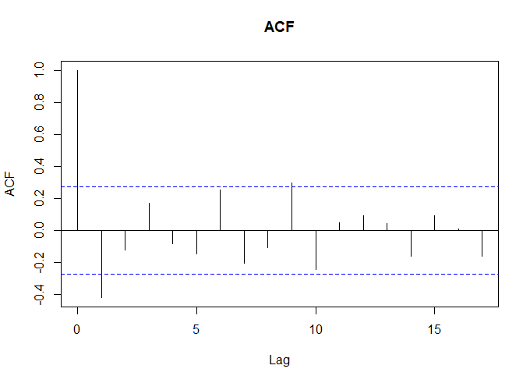
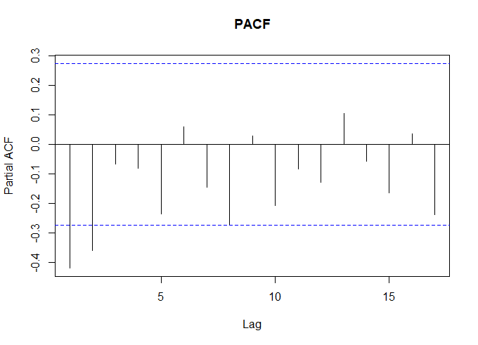
GHANA - FORECASTING - ACF and PACF After Differencing
ACF shows MA(1), PACF shows MA(2). Yet, MA(2) did not yield a significant p-value when tried. So, MA(1) was accepted.

Slide 28
GHANA - FORECASTING - ARIMA Model
ARIMA (0,1,1)[0,1,0] is statistically significant.
Final Estimates of Parameters
Type Coef SE Coef T P
MA 1 0,9494 0,0699 13,58 0,000
Differencing: 1 regular, 1 seasonal of order 7
Number of observations: Original series 59, after differencing 51
Residuals: SS = 50819,0 (backforecasts excluded)
MS = 1016,4 DF = 50

Slide 29
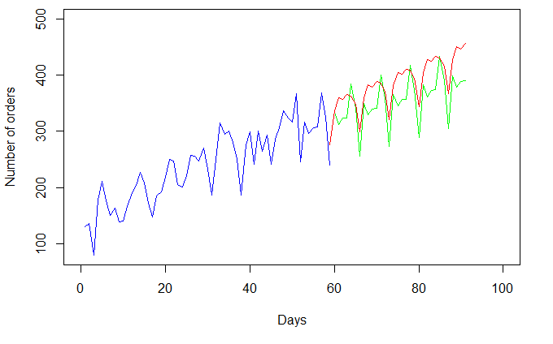
GHANA - FORECASTING - ARIMA Forecast
Green: ARIMA
Red: Regression

