Slide 1




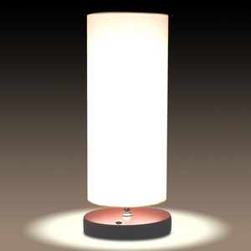


HTTP REQUEST
Maker Channel
Server
User
HTTP REQUEST
Voice
STT
Control
Google API
Smart Voice Lamp
Application

Slide 2
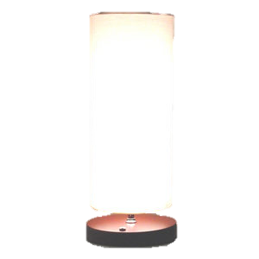

새로운 메일이 도착했습니다.

