Slide 1
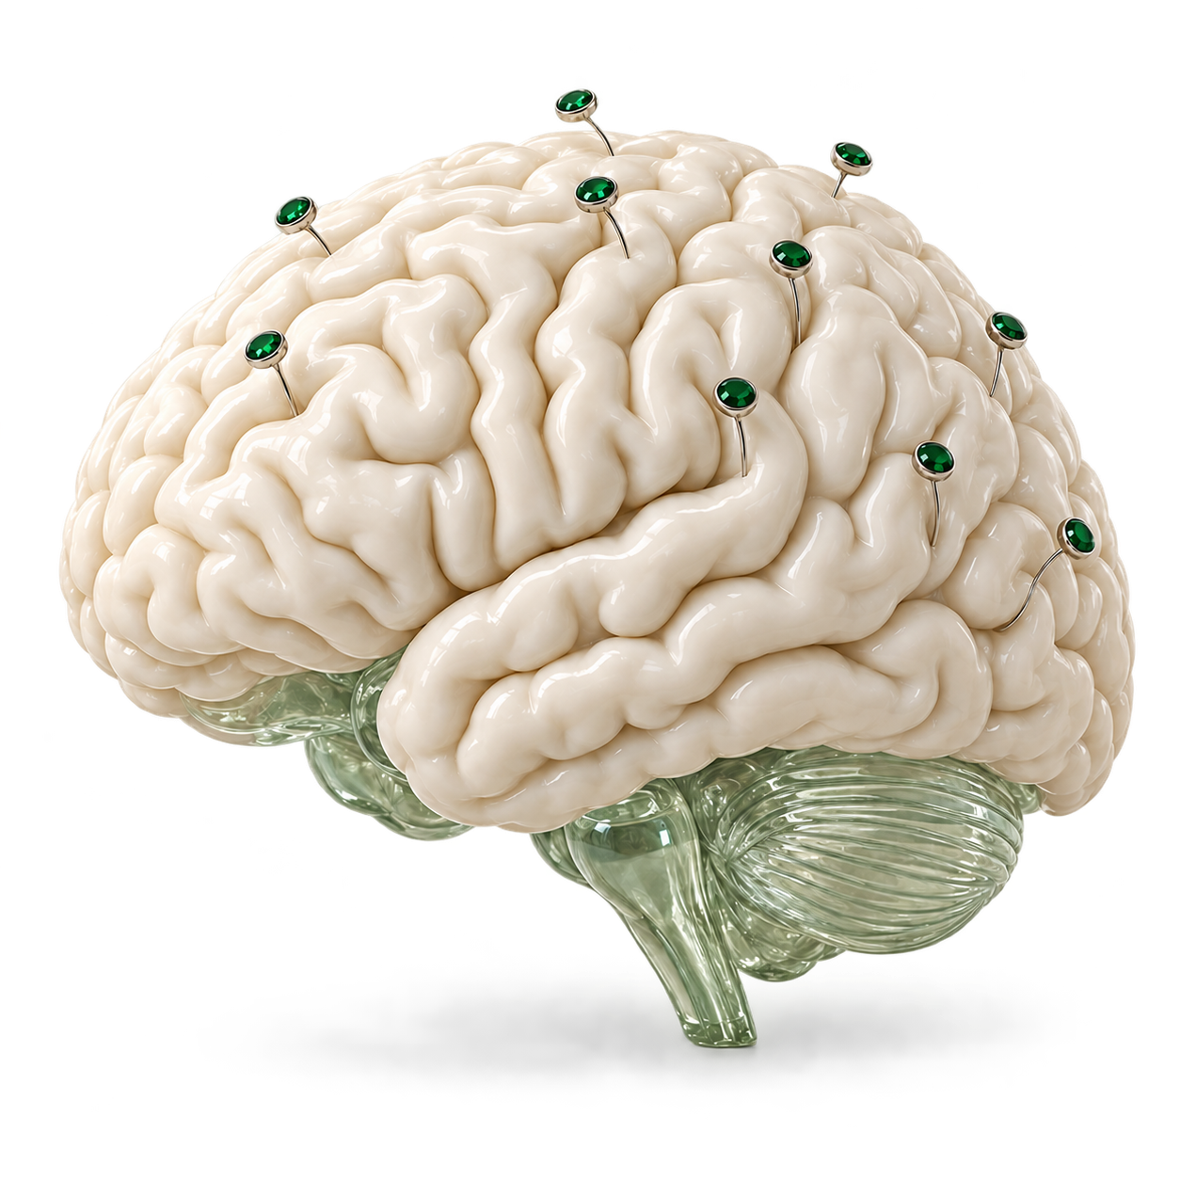
Second Shift
MongoDB × Cerebral Valley
AUTONOMOUS NEUROSCIENCE RESEARCH
Second
Shift
An autonomous research assistant
for brain signals.
Andrew Shatsky and David Shatsky
NEURO AI
01 / 06
Notes:
0–15 seconds
We built Second Shift, an autonomous research assistant for brain signals. It runs EEG experiments and keeps the research moving, even when its agent crashes, loses context, or receives a new constraint.
Sources and context
- README.md: What it does
- Conceptual artwork generated with built-in image_gen. Electrode placement is illustrative, not a measured montage.

Slide 2
Second Shift
The research question
Finding patterns in
brain signals
Imagined fists or imagined feet?
Electrical activity recorded from the scalp
225
possible experiment configurations
Electrodes, frequency bands,
time windows, classifiers
Real EEG excerpt · C3 · amplitude in µV
NEURO AI
02 / 06
Notes:
15–35 seconds
EEG records electrical activity from the scalp. Our task is concrete: distinguish imagined fists from imagined feet. Second Shift searches 225 configurations of electrodes, frequency bands, time windows, and classifiers. Every experiment produces a measured result that the next decision can use.
Sources and context
- harness/contracts.py: 225 effective configurations
- harness/eeg.py: within-subject run 6 training, run 10 validation, run 14 sealed test
- PhysioNet EEG Motor Movement/Imagery v1.0.0: https://physionet.org/content/eegmmidb/1.0.0/
- Plot: S001R06.edf, channel C3, first T1 cue at 12.5 seconds, unfiltered 160 Hz samples. See source/eeg.json.

Slide 3
Second Shift
The research loop
How Second Shift
researches
A fresh decision. A persistent research record.
01
02
03
AI chooses
Code measures
Atlas remembers
The next EEG experiment
A reproducible numerical result
Evidence for the next decision
Worker resets → context rebuilt
Completed research persists across worker restarts
NEURO AI
03 / 06
Notes:
35–60 seconds
The planner chooses the next configuration using recorded evidence. Numerical code trains and evaluates it. MongoDB Atlas stores the goal, experiments, and results. Each decision starts with a fresh evidence packet. Exact database reads supply measured results. Vector search retrieves research notes. A replacement worker can continue the same campaign.
Sources and context
- harness/worker.py
- harness/context.py: exact reads of best, leaders, laggards, recent results; semantic retrieval over notes
- harness/store.py: deduplication, protocol identity, lease-fenced commits
- harness/eeg.py: numerical evaluation

Slide 4
Second Shift
60-second dashboard demo
The working
system
A research campaign survives
a restart and a new electrode limit.
Play the accompanying demo MP4
NEURO AI
04 / 06
Notes:
60–120 seconds
Play the new, narrated 60-second dashboard demo. Do not speak over the recorded voiceover. At the end, advance to the measured-results slide. This slot intentionally contains no previous recording. The final demo must show the actual newly recorded actions.
Sources and context
- New recording required. Previous recordings and raw frames are excluded at the user’s request.
- Use the voiceover embedded in the user’s new finished demo. The separately generated Eric narration is an optional alternate and must not be layered over that soundtrack.
Play the accompanying new 60-second MP4 from the media folder. Do not use previous demo recordings.

Slide 5
Second Shift
Evidence from completed runs
Measured on real EEG
REFERENCE CAMPAIGN · 21 ELECTRODES
SEPARATE RELIABILITY CHECKS
73.2%
8 / 8
Recovery checks passed
held-out balanced accuracy
5 / 5
5 participants · 75 test trials · test scored once
Goal-change checks passed
Offline demonstration, not a clinical or real-time decoder
NEURO AI
05 / 06
Notes:
120–150 seconds
Our reference campaign reached seventy-three point two percent balanced accuracy on a held-out test scored once. That used twenty-one electrodes across five participants and seventy-five test trials. Separately, all eight recovery checks and all five constraint-change checks passed. These are small, offline experiments. They demonstrate the research loop, not clinical performance or a real-time decoder.
Sources and context
- README.md: camp_0f8981ee, 0.774 validation, 0.732 sealed test, 21 electrodes, 75 test trials, subjects 1–5
- eval/checks.json: camp_51b0f538 recovery 8/8; camp_66e4900c constraint 5/5
- Reference campaign and reliability checks are separate from the new demo campaign.

Slide 6
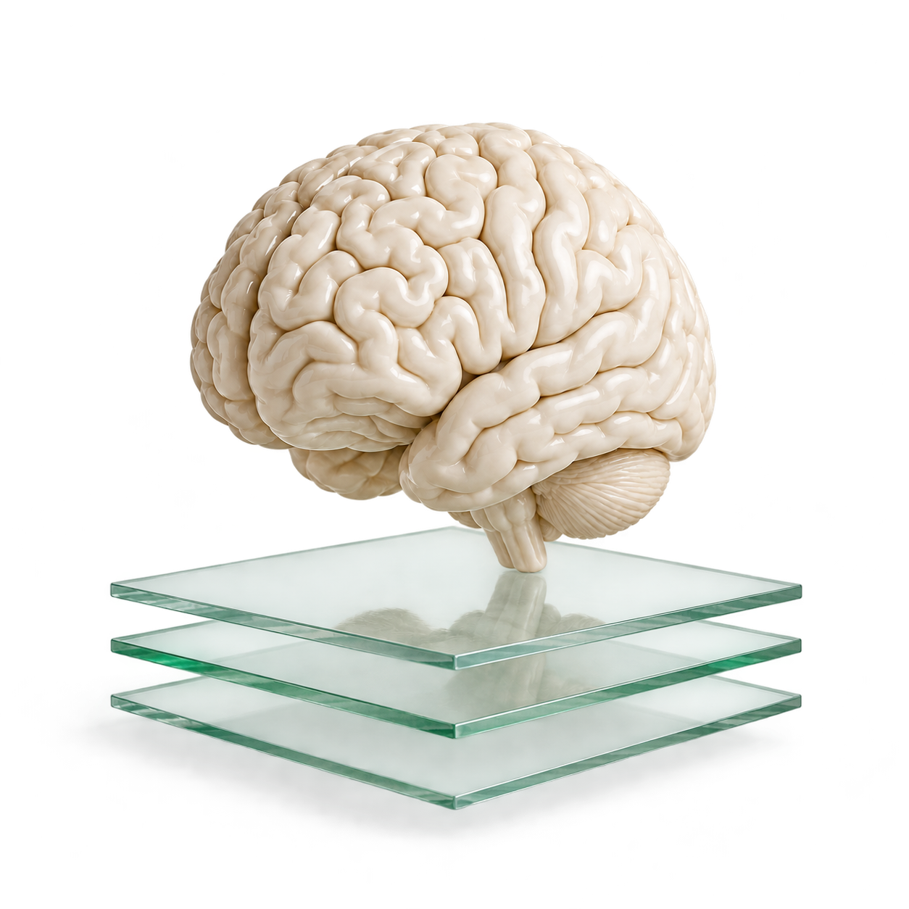
Second Shift
Second Shift
Research that
keeps its
progress
Autonomous EEG experiments.
Evidence that survives the restart.
Andrew Shatsky and David Shatsky
github.com/uyqv/MongoDB-Hackathon
NEURO AI
06 / 06
Notes:
150–175 seconds
The Neuro AI value is a research assistant that can test ideas on real brain signals and preserve what it learns. Researchers can inspect the evidence, change an electrode budget, and continue from completed work. We built Second Shift to give the next experiment a reliable starting point. Thank you.
Sources and context
- README.md: project scope and team
- Repository: https://github.com/uyqv/MongoDB-Hackathon
- Conceptual brain and evidence-layer artwork generated with built-in image_gen.

