Slide 1
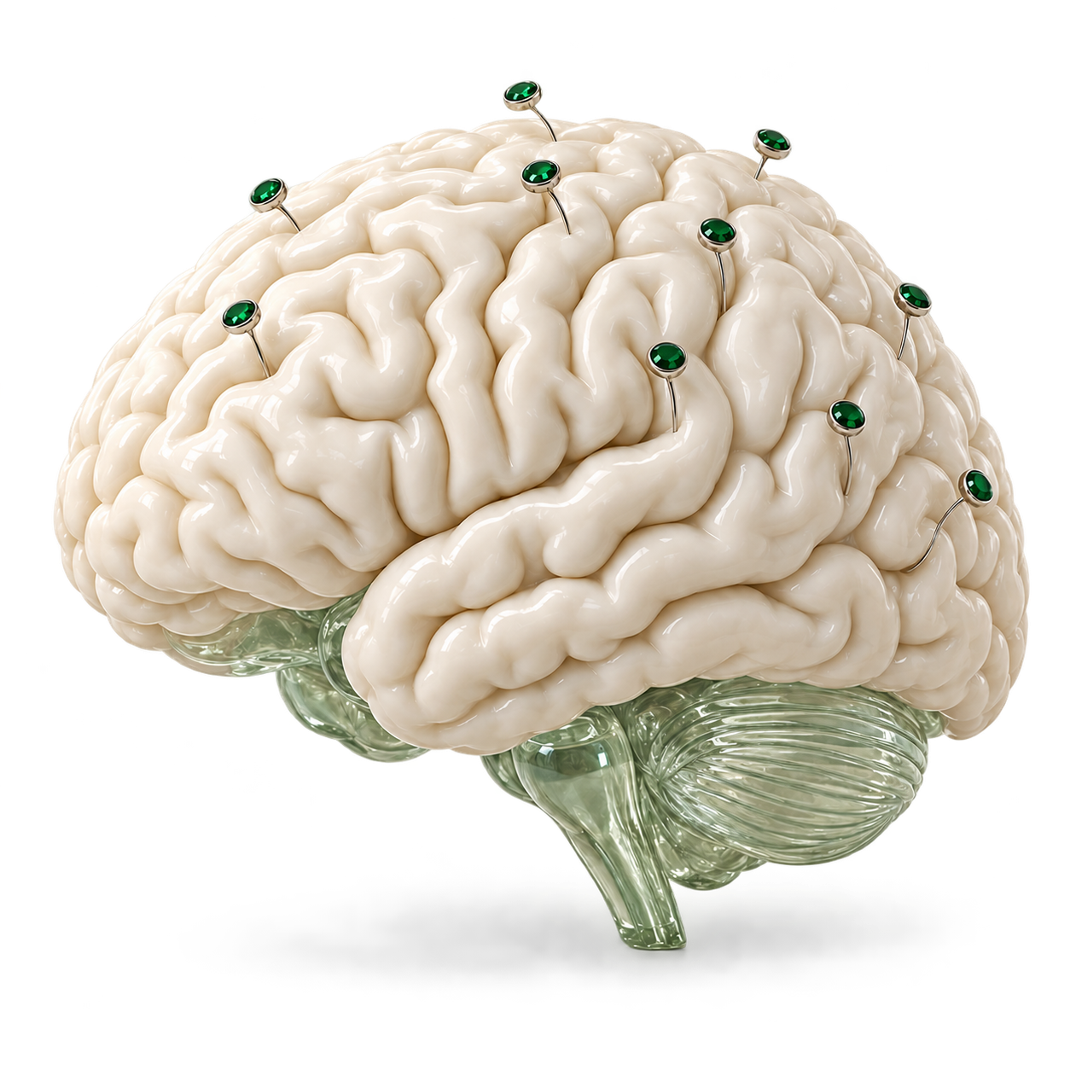
Second Shift
MongoDB × Cerebral Valley
AUTONOMOUS NEUROSCIENCE RESEARCH
Second
Shift
A neuroscience harness
for recorded brain signals.
Andrew Shatsky and David Shatsky
NEURO AI
01 / 06
Notes:
0–12 seconds
We built Second Shift, a neuroscience harness that keeps EEG research moving when an agent crashes or loses its working context.
Sources and context
- README.md: What it does
- Conceptual artwork generated with built-in image_gen. Electrode placement is illustrative, not a measured montage.

Slide 2
Second Shift
The research question
Finding patterns in
brain signals
Imagined fists or imagined feet?
Electrical activity recorded from the scalp
225
possible experiment configurations
Electrodes, frequency bands,
time windows, classifiers
Real EEG excerpt · C3 · amplitude in µV
NEURO AI
02 / 06
Notes:
12–27 seconds
EEG records electrical activity from the scalp. Our task is to distinguish imagined fists from imagined feet. The agent searches 225 configurations, and each measured result helps guide its next experiment.
Sources and context
- harness/contracts.py: 225 effective configurations
- harness/eeg.py: within-subject run 6 training, run 10 validation, run 14 sealed test
- PhysioNet EEG Motor Movement/Imagery v1.0.0: https://physionet.org/content/eegmmidb/1.0.0/
- Plot: S001R06.edf, channel C3, first T1 cue at 12.5 seconds, unfiltered 160 Hz samples. See source/eeg.json.

Slide 3
Second Shift
The research loop
How Second Shift
researches
Fresh context for every experiment
01
02
03
Remember
Decide
Experiment
Exact results and relevant notes
Claude plans via OpenRouter
Code measures EEG accuracy
Each decision rebuilds context within a 4,000 token budget
Atlas stores results. Jev routes notes. Voyage embeds them.
NEURO AI
03 / 06
Notes:
27–45 seconds
Each decision starts with evidence from Atlas. Exact reads retrieve measured results. Vector search retrieves notes. Claude chooses the next experiment, and numerical code evaluates it. The result returns to Atlas for the next decision.
Sources and context
- harness/worker.py
- harness/context.py: exact reads of best, leaders, laggards, recent results; semantic retrieval over notes
- harness/store.py: deduplication, protocol identity, lease-fenced commits
- harness/eeg.py: numerical evaluation

Slide 4
Second Shift
90-second narrated demo
The working
system
Saved results survive a restart.
The electrode limit drops from 64 to 9.
Play the accompanying demo MP4
NEURO AI
04 / 06
Notes:
45–140 seconds
Watch the saved results survive a restart and a tighter electrode limit.
At 0:50, press Enter. Let the 90-second narration play without speaking over it. Advance when the video ends at 2:20.
Sources and context
- presentation/second-shift-neuroai-90s.mp4: 90 seconds, campaign camp_639cfbea, original narration preserved
- run/video-v6/export/edit-decisions.json and transcript-review.json
- run/video-v6/take-1/recovery-proof.json: interrupted experiment resumes as attempt 2
Play media/second-shift-neuroai-90s.mp4 with its existing narration. This static backup does not embed the movie.

Slide 5
Second Shift
Demo and separate evaluations
Results and reliability
DEMO CAMPAIGN: 9 ELECTRODES
SEPARATE REFERENCE CAMPAIGN
75.9%
73.2%
sealed test balanced accuracy
21 electrodes, 5 participants
75 test trials, scored once
validation balanced accuracy
SEPARATE RELIABILITY CHECKS
After restart and the new electrode limit
8/8 recovery checks passed
5/5 constraint checks passed
Offline research prototype. Clinical use and live decoding remain outside scope.
NEURO AI
05 / 06
Notes:
140–162 seconds
The demo reaches seventy five point nine percent validation balanced accuracy using nine electrodes. Separately, our reference campaign scored seventy three point two percent on its sealed test using twenty one electrodes. These are small offline experiments, supported by separate reliability checks.
Sources and context
- presentation/second-shift-neuroai-90s.mp4 at 1:26–1:29: 0.759 best eligible validation score with 9 electrodes
- run/video-v6/take-1/experiments.json: camp_639cfbea, central9, val_balanced_accuracy 0.7592, n_val 75
- README.md: camp_0f8981ee, 0.774 validation, 0.732 sealed test, 21 electrodes, 75 test trials, subjects 1–5
- eval/checks.json: camp_51b0f538 recovery 8/8; camp_66e4900c constraint 5/5
- Validation guides model selection. The 73.2% sealed test result and reliability checks come from separate campaigns, not the demo.

Slide 6
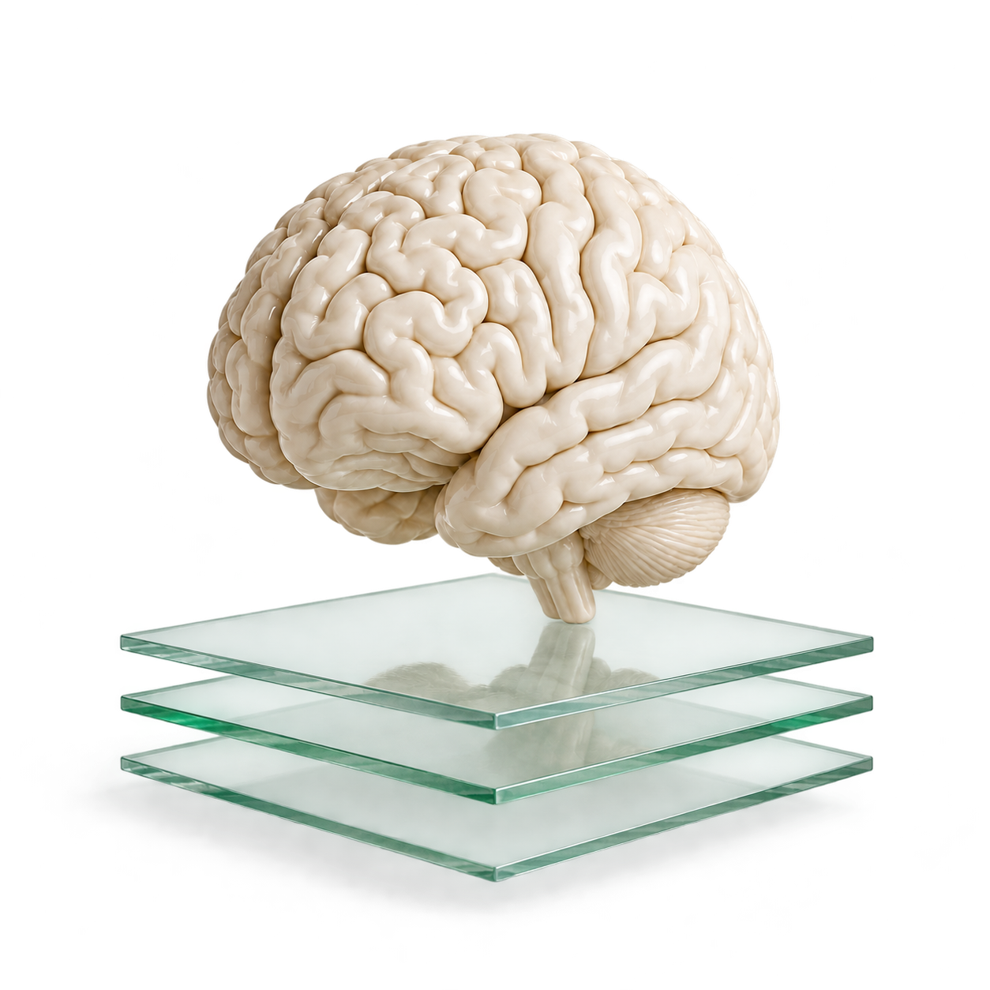
Second Shift
Second Shift
Research that
keeps its
progress
Tested with 10,000 distractor notes.
Billions of tokens is the long term target.
Andrew Shatsky and David Shatsky
github.com/uyqv/MongoDB-Hackathon
NEURO AI
06 / 06
Notes:
162–175 seconds
We tested memory with ten thousand distractor notes. Billions of tokens remains the goal. Second Shift keeps research moving, even when the agent starts over. Thank you.
Sources and context
- eval/stress.json: 10,000 synthetic distractor notes in a copied real campaign
- eval/stress_current_packet.json: 10,009 total memories, estimated 1,204 tokens within a 4,000 token budget
- README.md: billions of tokens is a target, not an achieved scale
- README.md: project scope and team
- Repository: https://github.com/uyqv/MongoDB-Hackathon
- Conceptual brain and evidence-layer artwork generated with built-in image_gen.

