Slide 1

MINISTRY OF EDUCATION AND SCIENCE OF RUSSIA
Federal State Budgetary Educational Institution of Higher Education.
SARATOV NATIONAL RESEARCH UNIVERSITY
STATE UNIVERSITY NAMED AFTER N. G. CHERNYSHEVSKY.
STUDY OF THE FRIENDSHIP INDEX OF NODES IN GROWING
NETWORKS BASED ON MODELS WITH PREFERENTIAL ATTACHMENT
student 4 ’th year 411 group
specialization 02.03.02—Fundamental computer science and information technologies
department CSIT
Kozyrev Yuri Dmitrievich
Academic advisor
head of department,PhD, associate professor
S. V. Mironov

Slide 2
RANDOM
GRAPH
$G=\left(V,E\right)$
$V=\{v_{1},...v_{n}\}$
$E⊆V×V$

Slide 3
BARABASI-ALBERT MODEL
Initially a complete graph
of m+1 vertices is created
New vertex is added
Repeat m times
One vertex is randomly selected with
a probability proportional to its degree
The new vertex connects
to the selected one

Slide 4
TRIAD CLOSURE MODEL
The vertex is selected among
all the vertices of the graph
The selected vertex connects to the new one
Repeat m - 1 times
The vertex
is selected
among the
neighbors
of the first
selected
vertex
The vertex
is selected
among all
the vertices
of the graph
random() > p
The selected vertex is
connected to the new one

Slide 5
$\deg_{v_{i}}=v∈V:\left(v,v_{i}\right)∈E$
$s_{i}=\sum_{j:\left(v_{i},v_{j}\right)∈E\left(t\right)}{\deg_{v_{j}}}\left(t\right)$
$α_{i}\left(t\right)=\frac{s_{i}\left(t\right)}{\deg_{v_{i}}\left(t\right)}$
$β_{i}\left(t\right)=\frac{α_{i}\left(t\right)}{\deg_{v_{i}}\left(t\right)}$

Slide 6
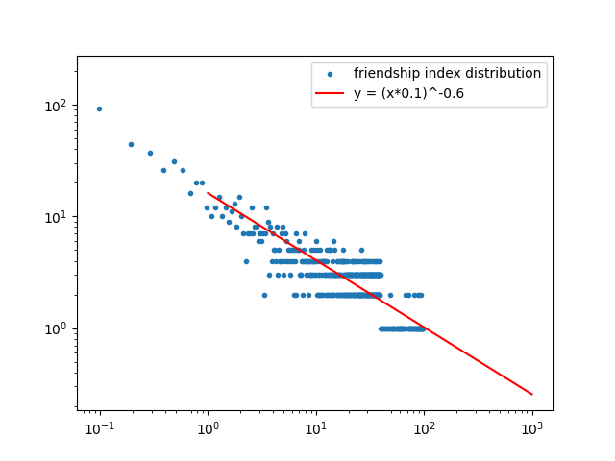
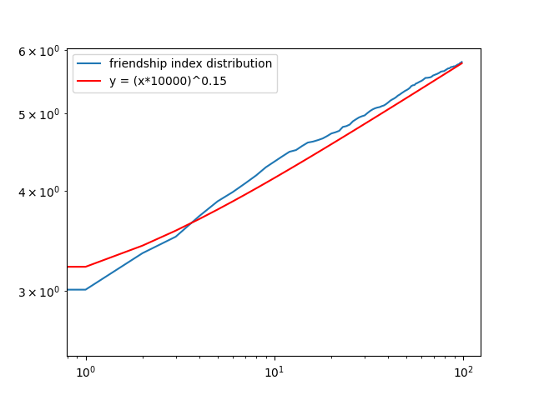
Analysis

Slide 7
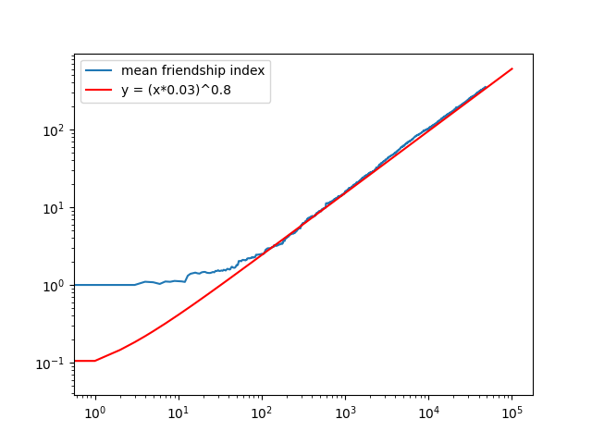
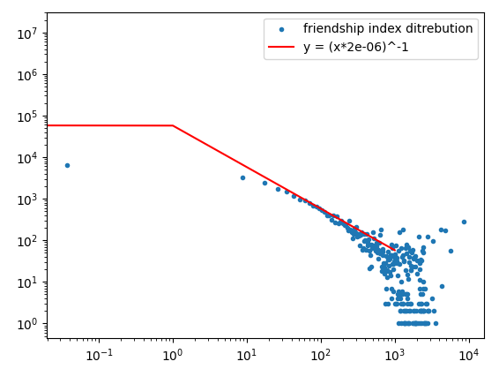
Analysis
Reddit

Slide 8
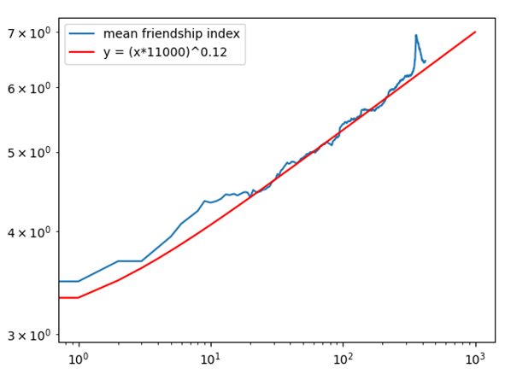
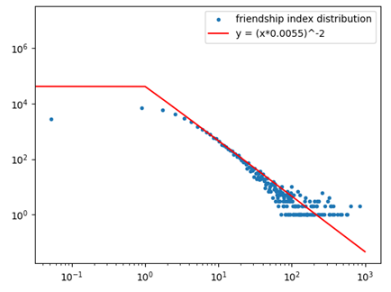
Analysis
Сеть цитирования статей в сфере феноменологии физики высоких энергий

Slide 9
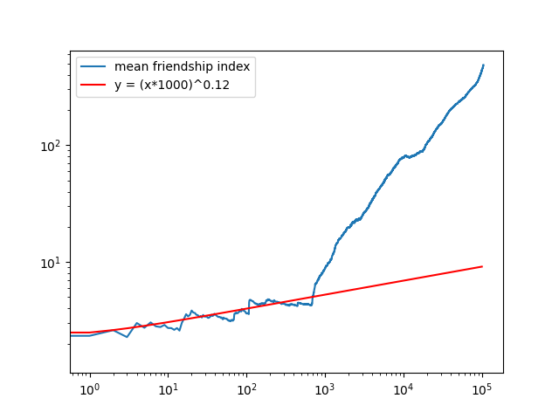
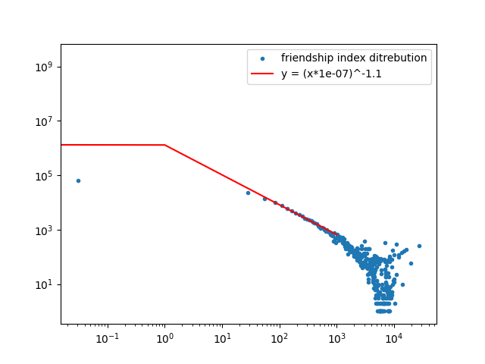
Analysis
SuperUser

Slide 10
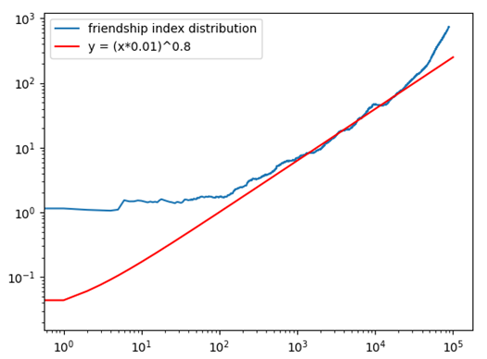
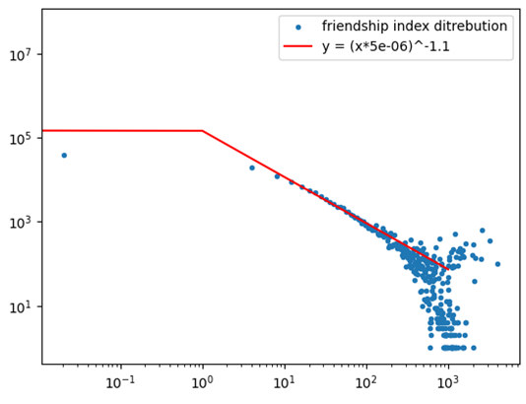
Analysis
SuperUser

Slide 11
Conclusion
The thesis shows that while Barabasi-Albert and triad closure models can be used to simulate some systems from different fields, there are some cases when those models do not apply. It is unclear how these two types of networks differ. To determine this an additional research may be needed.

Slide 12
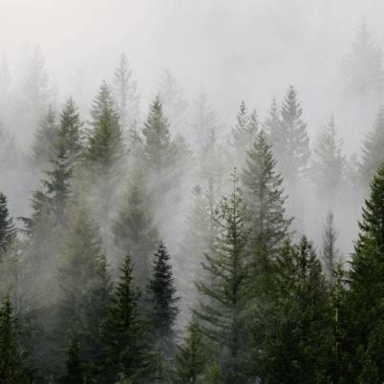
THANK YOU FOR YOUR ATTENTION!

