Slide 1
Self Balancing Robot with Gesture Control
Group No. - 21
B. Vishnu Vamsi - S20180020202
A. Manohar Sai - S20180020220
S. Vikhyath - S20180020243
U. Yugander – S20180020256
Course Name : Control Systems
Period : Monsoon 2019

Slide 2

OUTLINE
Motivation
Background
Implementation
Challenges
Future scope

Slide 3
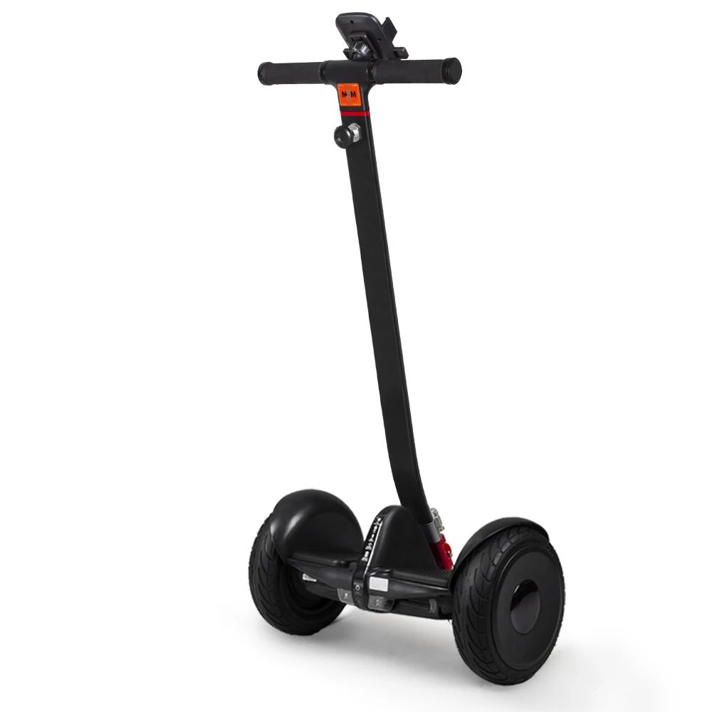
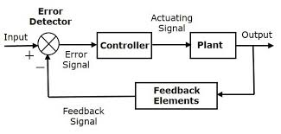
MOTIVATION
General understanding of feedback systems and PID controllers.
Basic principle behind Segway.
Build a digital control system to provide needed stability.

Slide 4
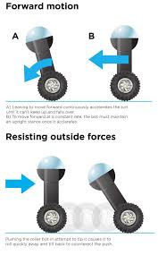
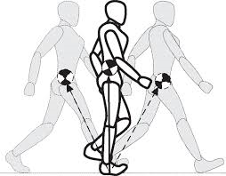
BACKGROUND
A basic feature in humanoid robots and is widely used in segways.
The controller used in robot replicates how we humans think while we balance ourselves.
Robot works on the principle of inverted pendulum.

Slide 5
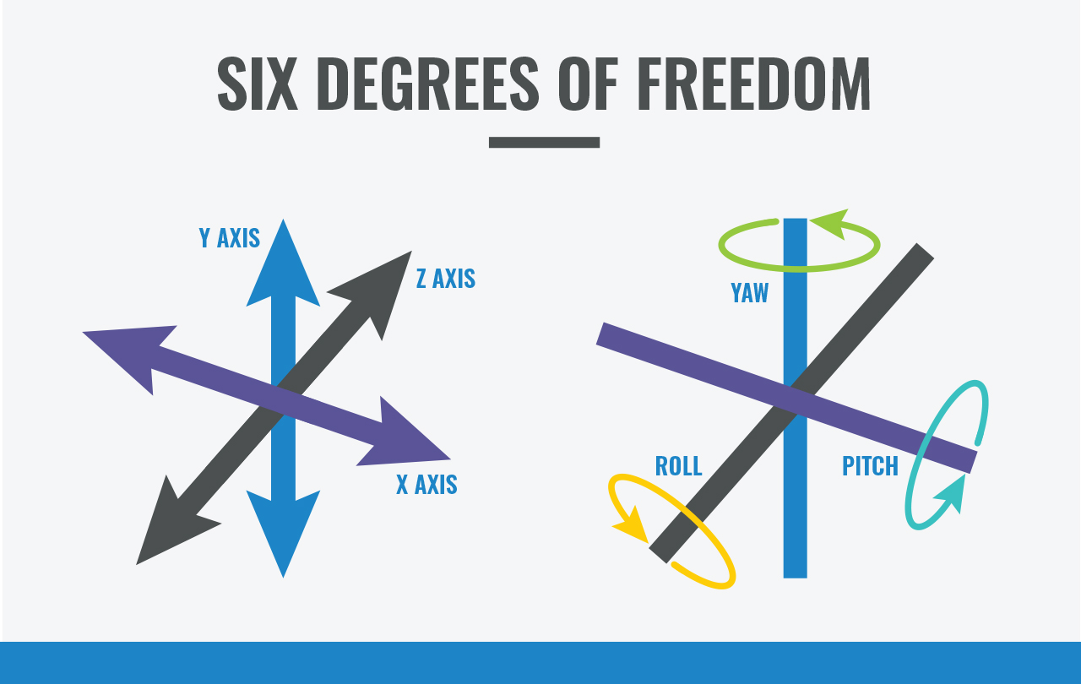
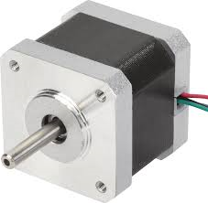
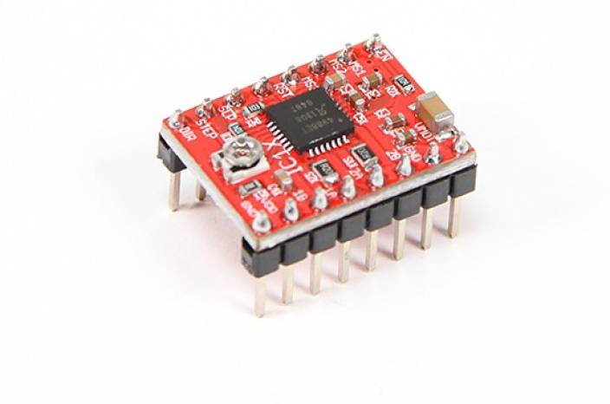
IMPLEMENTATION
Inertial Measurement Unit :
The IMU comprises of gyroscope and accelerometer.
The angle of inclination is calculated from values
of gyroscope and accelerometer.
Actuators :
Stepper motors are used to drive the robot
in the direction in which it is falling.
They provide high torque and keeps the robot
steady .

Slide 6
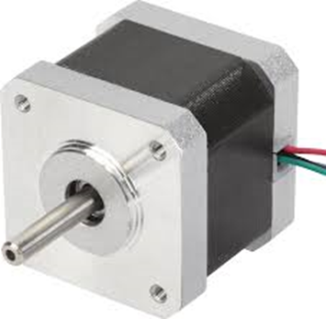
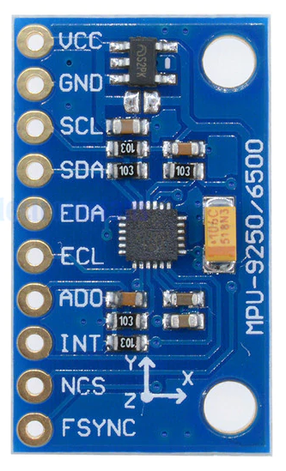
BLOCK DIAGRAM
Proportional
(kp)
+
Derivative
(kd)
-
Integral
(ki)

Slide 7
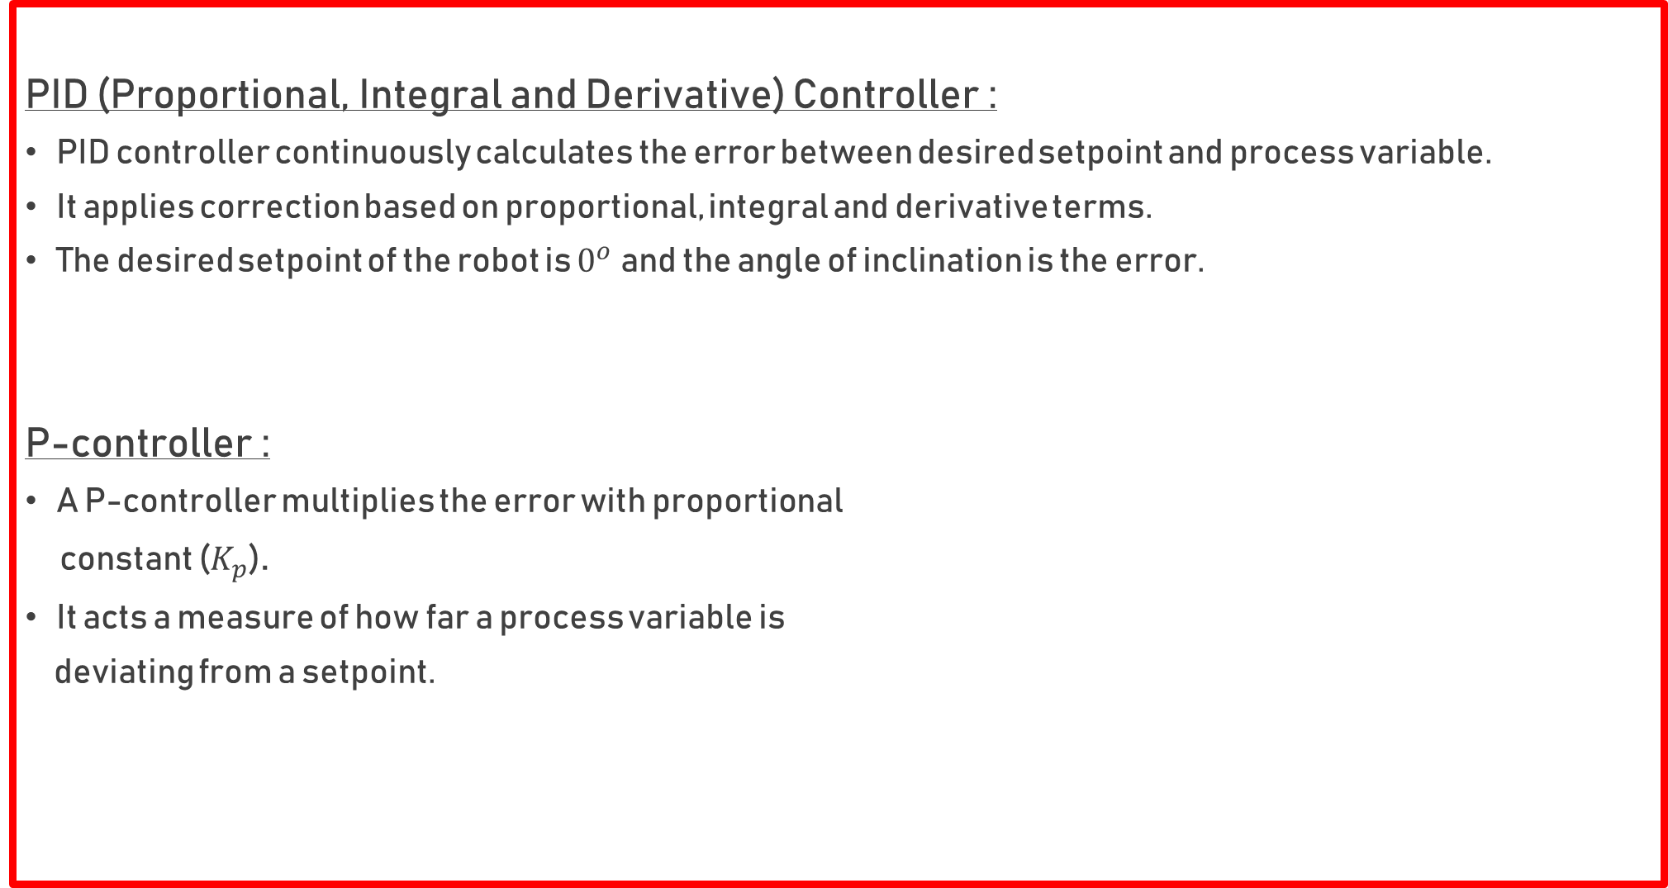
PID (Proportional, Integral and Derivative) Controller :
PID controller continuously calculates the error between desired setpoint and process variable.
It applies correction based on proportional, integral and derivative terms.
The desired setpoint of the robot is $0^{o}$and the angle of inclination is the error.
P-controller :
A P-controller multiplies the error with proportional
constant ($K_{p}$).
It acts a measure of how far a process variable is
deviating from a setpoint.

Slide 8
I-controller :
The I-controller helps in reducing the steady state error.
It integrates the error term over a period of time until the error
becomes zero
D-controller :
It senses the rate of change of process variable.
It helps in reducing any overshoots in the system.

Slide 9
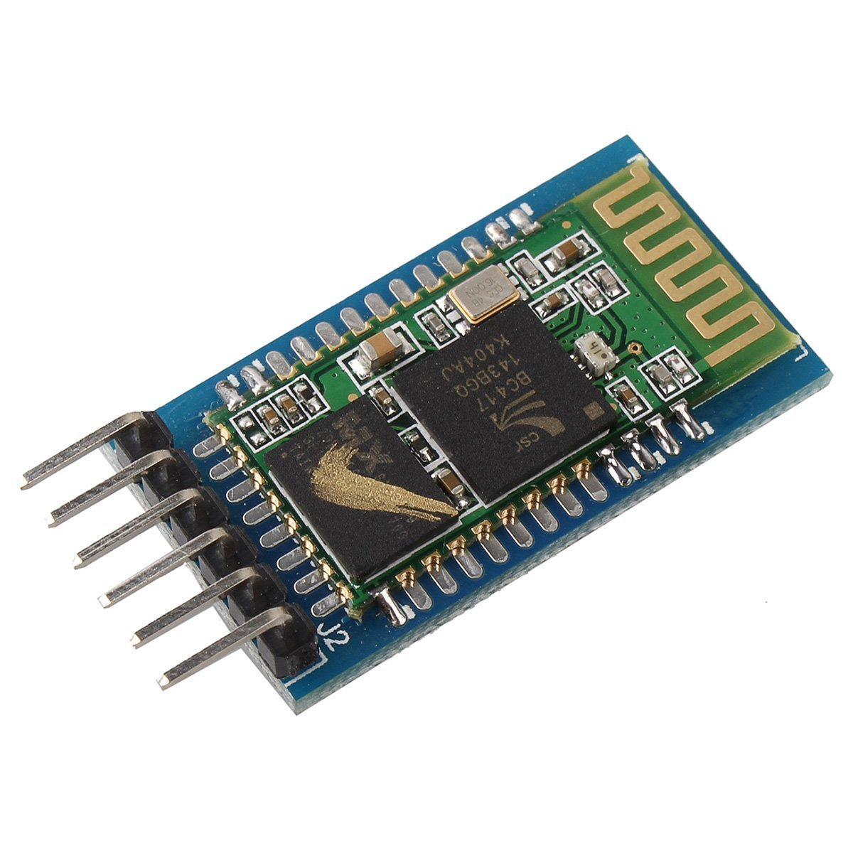
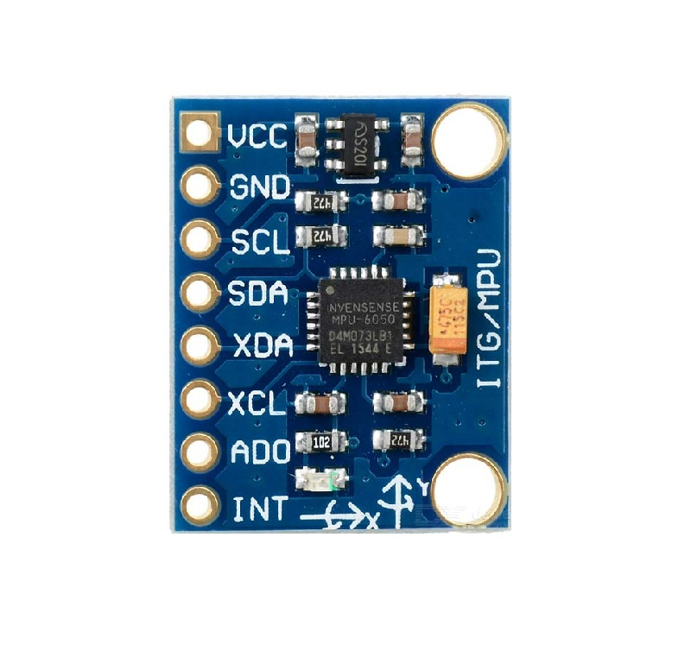
GESTURE CONTROL
Nowadays robots are used in various fields such as automobiles, defense etc.
Controlling the robot with a remote is quite complicated.
Robot moves according to the movement of hand as we place the accelerometer on your hand.
Bluetooth is used as an interface between the remote and the robot.

Slide 10
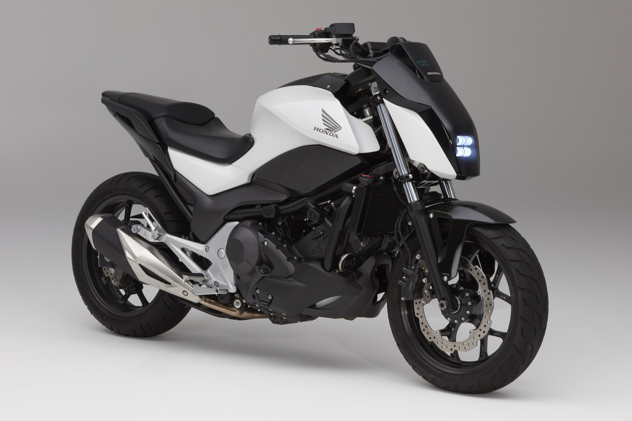
CHALLENGES
Minimizing the wobbling of the robot.
Higher the Centre of Mass of payload, more the difficulty to balance the robot
Debugging is very difficult if a component fails to work.
Robot cannot balance itself on slope.
Maintaining proper sensitivity of the gesture controller.
FUTURE SCOPE
Automatic tilt calibration to balance the robot even if the center of mass is shifted.
Can be used in home assistant bots.
Can be used in self balancing electric vehicles.

Slide 11
THANK YOU
Any Questions?

