Slide 1


RFM Segmentation and K-Means Clustering: Optimizing Customer Insights Using Elbow Method
Marketing & Customer Analytics
pacmann.io
© 2022 – Pacmann AI

Slide 2
Outline
Introduction
Problem
Solution
Modelling Process
Analysis & Conclusion
References

Slide 3
Introduction
Notes:
Transisi antar outline

Slide 4
Introduction
RetailCo Overview
Medium-sized retail company specializing in consumer goods with multiple sales channels, including in-store, online, and direct marketing.
Product offerings include groceries, electronics, fashion, and household goods.
Strategic objectives:
Increase customer retention and maximize customer lifetime value.
Optimize marketing strategies by targeting high-value customers.
Improve inventory management by understanding product demand patterns.

Slide 5
Problem
Notes:
Transisi antar outline

Slide 6
Problem
In a competitive market, RetailCo cannot cater to all potential buyers, necessitating a focus on specific, high-value customer segments.
Lack of detailed understanding of customer behavior and purchasing patterns leads to suboptimal marketing and inventory strategies.
Difficulty in identifying and prioritizing valuable customers who are more likely to make repeat purchases.
RetailCo requires robust analytical methods to segment and profile customers effectively.
Existing strategies do not fully leverage customer data to inform marketing and inventory decisions.

Slide 7
Solution
Notes:
Transisi antar outline

Slide 8
Solution
Strategic Approach Using RFM Analysis and Clustering
RFM Analysis
A proven model that identifies valuable customers based on Recency, Frequency, and Monetary value of their purchases.
Helps differentiate important customers from large data sets, providing insights into purchasing behavior.
K-Means Clustering
A widely used algorithm for grouping customers with similar RFM attributes.
Enables the creation of targeted marketing strategies for each segment, enhancing resource efficiency and customer engagement.

Slide 9
Solution
Expected Outcomes
Improved customer retention and increased customer lifetime value through personalized marketing.
Optimized inventory management by aligning stock levels with customer demand patterns.
Enhanced competitive position by strategically focusing on the most profitable customer segments, using detailed customer profiles and targeted marketing strategies.

Slide 10
Modelling Process
Notes:
Transisi antar outline

Slide 11
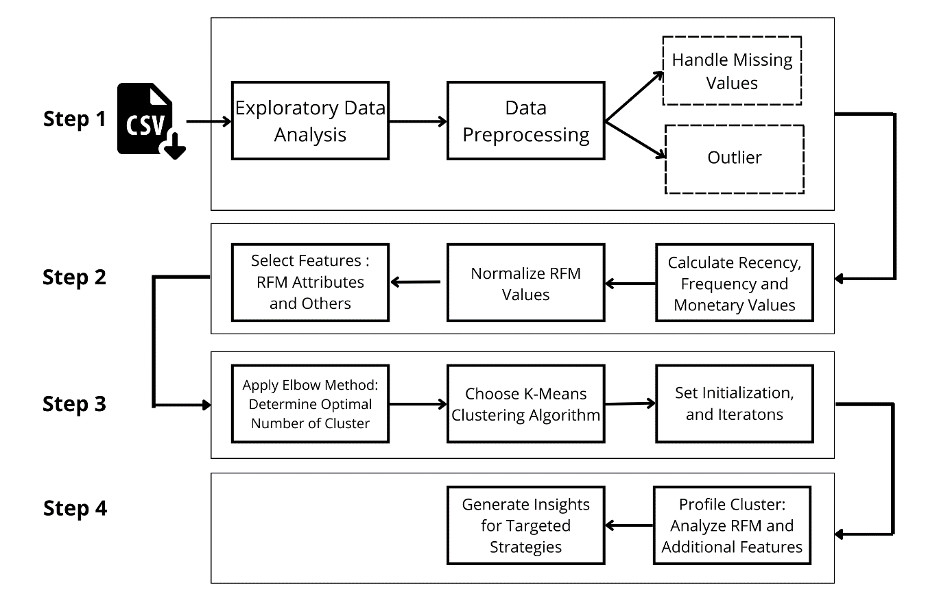
Modelling Process

Slide 12
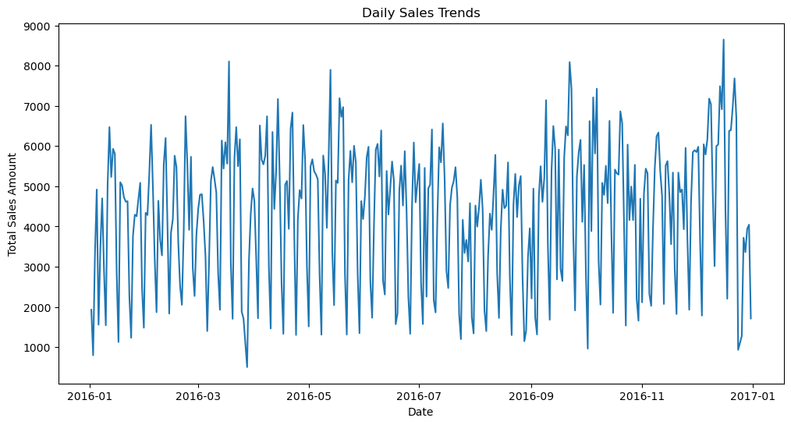
Modelling Process
Step 1 : Data Collection and Preprocessing
Collect data from relevant sources.
Exploratory Data Analysis (EDA). EDA helps understand the overall distribution of the data, including the scatter, central tendency, and skewness of key features such as Recency, Frequency, and Monetary values.

Slide 13
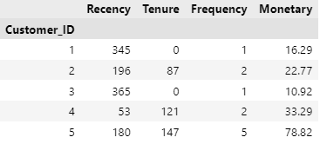
Modelling Process
Step 1 : Data Collection and Preprocessing
Prepare the data for modeling by handling missing values, removing duplicates, and addressing inconsistencies. Outliers are identified and either removed or transformed to reduce their impact on the model. This step ensures the data's integrity and quality, which is crucial for accurate analysis.
Step 2 : RFM Analysis
Recency, Frequency and Monetary values are calculated.

Slide 14
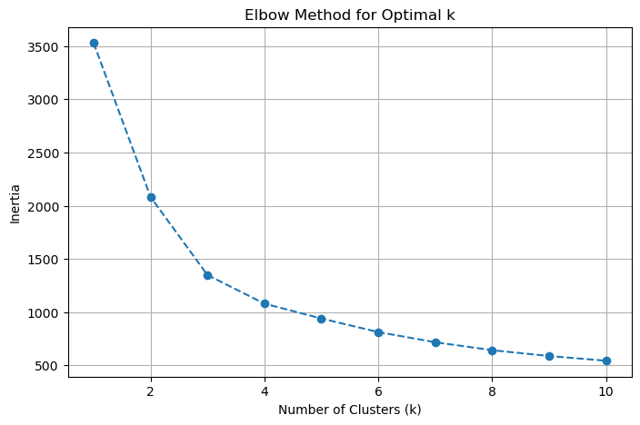
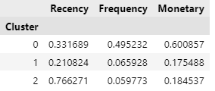
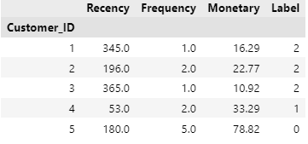
Modelling Process
Step 3 : Determine Optimal Cluster and K-Means Clustering
Use the Elbow Method to plot the sum of squared errors (SSE) against the number of clusters.
The K-means clustering algorithm is chosen with the optimal number of clusters set to 3, then configure the algorithm settings (e.g., distance metric, initialization).

Slide 15
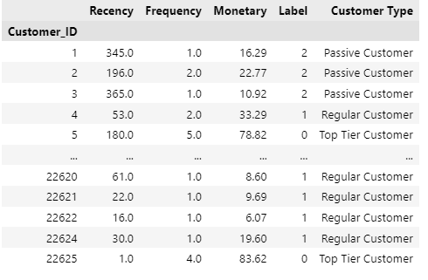
Modelling Process
Step 4 : Cluster Profiling and Insights
Cluster profiling is done to understand the characteristics of each segment.
- Cluster 0 = Top Tier Customers (low recency, high frequency and high monetary)
- Cluster 1 = Regular Customers (low recency, medium frequency and low monetary)
- Cluster 2 = Passive Customers (high recency, low frequency and low monetary

Slide 16
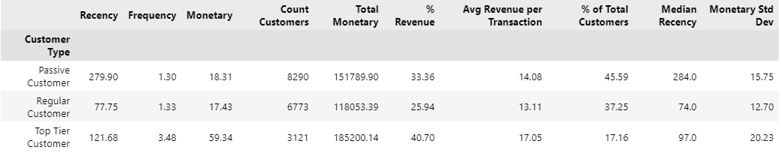
Modelling Process
Step 4 : Cluster Profiling and Insights
Aggregation and statistical analysis based on the cluster profiling results was conducted to gain further insight into the performance of each segment.

Slide 17
Analysis & Conclusion
Notes:
Transisi antar outline

Slide 18
Analysis & Conclusion
Analysis
Top Tier Customers : Highest value, frequent buyers; critical for revenue. Immediate actions include VIP rewards, personalized offers, and premium services. Long-term focus on loyalty programs and subscriptions.
Regular Customers : Moderate frequency and value; significant revenue potential. Strategies involve targeted campaigns and seasonal promotions to drive higher engagement.
Passive Customers : Largest group, lower engagement and spend. Focus on reactivation through time-sensitive offers and product bundles to boost engagement.

Slide 19
Analysis & Conclusion
Conclusions
RFM segmentation effectively aligns RetailCo's marketing strategies with customer behaviors, allowing precise targeting and improved resource allocation.
By prioritizing high-value customers and re-engaging passive segments, RetailCo can enhance customer loyalty and maximize profitability.
Implement predictive modeling and machine learning (e.g., decision trees, neural networks) for deeper insights and proactive engagement.
Use A/B and multivariate testing to refine and adjust strategies in line with evolving customer needs.

Slide 20
Reference
Abirami, M. & Pattabiraman, V. 2016. Data mining Approach for Intelligent Customer Behavior Analysis for A Retail Store. In: proceedings of the 3rd international symposium on big data and cloud computing challenges (ISBCC–16). 283-291.
Ching-Hsue Cheng, You-Shyang Chen C.-H. Cheng, Y.-S. Chen. 2008. Classifying the Segmentation of Customer Value Via RFM Model and RS Theory. Expert Systems with Applications 36 (2009) 4176–4184
Christy, A.J., Umamakeswari, A., Priyatharsini, L., Neyaa, A. 2018. RFM Ranking – An Effective Approach to Customer Segmentation, Journal of King Saud University - Computer and Information Sciences
Dursun, A. & Caber, M. (2016). Using Data Mining Techniques for Profiling Profitable Hotel Customers: An Application of RFM Analysis. Tourism Management Perspectives, 18, 153-160
Hadi Roshan, Masoumeh Afsharinezhad. 2017. The new Approach in Market Segmentation by Using RFM Model. Journal of Applied Research on Industrial Engineering
Ina Maryani, Dwiza Riana, Rachmawati Darma Astuti, Ahmad Ishaq, Sutrisno, Eva Argarini Pratama. 2018. Customer Segmentation based on RFM model and Clustering Techniques With K-Means Algorithm. Third International Conference on Informatics and Computing (ICIC)
John A. McCarty a, Manoj Hastak. 2006. Segmentation Approaches in Data-Mining: A Comparison of RFM, CHAID, and Logistic Regression Journal of Business Research 60 (2007) 656–662.
Onur Dogan, Ejder Aycin, Zeki Atil Bulut. 2018. Conducted A Study About Customer Segmentation By Using RFM Model And Clustering Methods: A Case Study In Retail Industry. International Journal of Contemporary Economics and Administrative Sciences ISSN: 1925– 4423 Volume :8, Issue: 1, Year:2018, pp. 1-19
Rahul Shirole, Laxmiputra Salokhe, Saraswati Jadhav. 2021. Customer Segmentation using RFM Model and K-Means Clustering. Department of Computer Engineering, Vishwakarma Institute of Technology Pune, Maharashtra, India
Rena Nainggolan, Resianta Perangin-angin, Emma Simarmata and Astuti Feriani Tarigan. 2019. Improved the Performance of the K-Means Cluster Using the Sum of Squared Error (SSE) optimized by using the Elbow Method. Journal of Physics: Conference Series
Sabuncu, İ., Türkan, E., & Polat, H. 2020. Customer Segmentation And Profiling With RFM Analysis, TUJOM, 5(1): 22-36

Slide 21
Thank You
Notes:
Transisi antar outline

