Slide 1


Fastag Fraud Detection
Fraud Analytics
pacmann.io
© 2022 – Pacmann AI

Slide 2
Outline
Background
Related Work
Dataset & Features
Methods
Experiment/Result/Discussion
Conclusion/Future Works
References

Slide 3
Background
Notes:
Transisi antar outline

Slide 4
Background
Introduction:
Increase in vehicle numbers leads to significant traffic at toll gates.
NHAI introduces Fastag as a solution for cashless toll payments.
Fastag is a passive RFID tag affixed to vehicles for direct toll payments.
Despite convenience, Fastag is vulnerable to abuse, including theft and data manipulation.
Fraudulent activities disrupt toll operators and tariff fairness.

Slide 5
Background
Objective:
Develop a classification model to detect and prevent Fastag abuse.
Aim to accurately classify transactions as genuine or fraudulent.
Metrics focus on maximizing detection accuracy while minimizing false positives.
Approach:
Use classification algorithms like logistic regression, decision tree, KNN, SVM, and random forest.
Evaluate model performance based on business objectives and detection accuracy.

Slide 6
Related Work
Notes:
Transisi antar outline

Slide 7
Related Work
1. Anis et al. (2015) conducted a study on credit card fraud detection using decision tree algorithms, focusing on finding the best classifiers and insights through Random Under Sampling (RUS) and feature selection. The project shares similarities with this study in fraud detection using classification techniques but differs in the dataset, which focuses on toll payment transactions using Fastag.
2. Sundarkumar et al. (2015) proposed a methodology using One-Class Support Vector Machine (OCSVM) based undersampling for fraud detection, applied to car insurance and credit card customer disconnect datasets. While both the study and the project focus on fraud detection using classification techniques, they differ in the datasets used, with the project focusing on Fastag toll payment transactions.
3. Sahin et al. (2011) developed and compared decision tree-based and support vector machine (SVM) models for credit card fraud detection, aiming to evaluate their performance using real datasets. Similar to the project, the study focuses on fraud detection using classification techniques but differs in the dataset used.

Slide 8
Dataset & Features
Notes:
Transisi antar outline

Slide 9
Dataset & Features
Dataset used comes from Fastag Fraud Detection (kaggle.com). The dataset is 5000 data and there are attributes that capture the main details about toll transactions, including: Vehicle Information (Type, Dimension, Plate Number), Payment Details (FastagID, Transaction Amount, Amount Paid), Toll Location and Time (TollBoothID, Timestamp), Lane Usage (Lane Type), Vehicle Speed and Fraud Indicator. Details of these attributes can be seen in the following table.

Slide 10
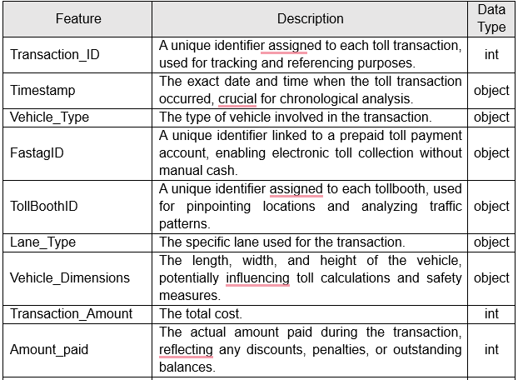
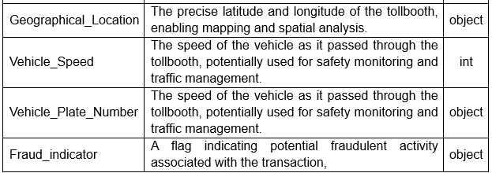
Dataset & Features

Slide 11
Methods
Notes:
Transisi antar outline

Slide 12
Methods
1. Logistic Regression
Logistic regression models are used to predict dependent variables that are binary in nature, such as the fraud indicator in this project. It is a generalized linear model that uses a logit function to constrain linear combinations of input variables between 0 and 1. This model is useful for estimating the probability of fraud risk in transactions.
2. Decision Tree
A decision tree is a tree structure that attempts to divide a given record into mutually exclusive subgroups. Each node in this tree is divided into child nodes based on attribute values that best separate the records. Decision tree methods use splitting algorithms and specific splitting metrics to build models.

Slide 13
Methods
3. KNN (K-Nearest Neighbors)
The KNN algorithm predicts the class of a sample based on the majority of votes from its K nearest neighbors in the feature space. KNN uses euclidean distance or other norms to measure the distance between points in the feature space. The user must specify the value of K, and KNN tends to monitor the database only once.
4. SVM (Support Vector Machine)
SVM tries to find a hyperplane to separate two classes while minimizing the classification error. SVM finds the hyperplane that maximizes the margin between the classes. It can use various kernels such as polynomial, sigmoid, or radial basis to map the data to a higher feature space.

Slide 14
Methods
5. Random Forest
Random Forest is a collection of multiple decision trees that adds additional diversity to the model by selecting the best features from a random subset of features. This reduces the tendency of overfitting and improves model generalization. RandomForest combines the speed and effectiveness of decision trees with the improvements of multiple models.

Slide 15
Experiments/Results/Discussion
Notes:
Transisi antar outline

Slide 16
Experiments/Results/Discussion
Baseline: AUC = 0.5 (both training and test), indicating poor performance.
Logistic Regression: Achieved AUC of 0.93 on training and 0.92 on test without hyperparameters.
SVM: Achieved AUC of 0.86 on training and 0.88 on test with hyperparameters C=0.5 and linear kernel.
Decision Tree: Achieved AUC of 0.92 on training and 0.94 on test with max_depth=10.
Random Forest: Achieved AUC of 0.95 on training and 0.94 on test with n_estimators=300.
KNN: Achieved AUC of 0.88 on training and 0.91 on test with n_neighbors=10.

Slide 17
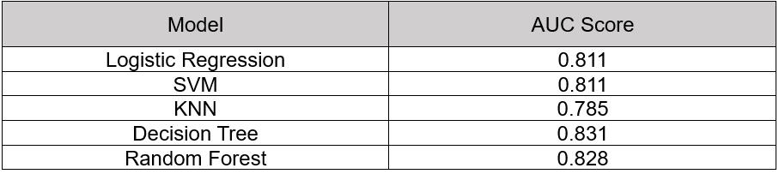
Experiments/Results/Discussion
Validation Data AUC Scores:
Decision Tree model performed the best with AUC of 0.831 on validation data.
Tested Decision Tree model on test data with AUC of 0.821.

Slide 18
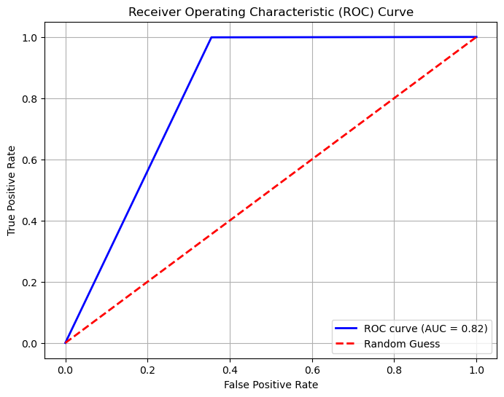
Experiments/Results/Discussion
ROC Curve illustrates model's ability to distinguish between fraud and non-fraud transactions.

Slide 19
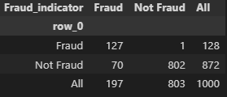
Experiments/Results/Discussion
Based on the crosstabulation results, there are 197 transactions predicted as fraud by the model. Of these, 127 transactions are actually fraud, while 70 transactions are predicted as fraud but are not. On the other hand, there are 803 transactions predicted as non-fraud by the model. Of these, 802 transactions are actually non-fraud, while only 1 transaction is actually fraud but predicted as non-fraud.
From the entire test data (1000 transactions), the model successfully identified 128 fraud transactions and 872 non-fraud transactions correctly. However, there were 71 misclassified transactions, of which 70 were false positives (non-fraud transactions incorrectly predicted as fraud) and 1 false negative (fraud transactions incorrectly predicted as non-fraud).

Slide 20
Conclusion
Notes:
Transisi antar outline

Slide 21
Conclusion
Based on the evaluation of model performance on training data, validation data, and test data, it can be concluded that the decision tree model shows the best performance in distinguishing between fraudulent and non-fraudulent transactions. By achieving an AUC of 0.831 on validation data and 0.821 on test data, the decision tree model has a strong ability to separate positive and negative classes with good accuracy. Furthermore, to improve the performance of Fastag fraud detection, it is recommended to consider using algorithms such as gradient boosting or XGBoost. These algorithms are known for their ability to overcome class imbalance and model complex relationships between transaction features. By utilizing the power of these algorithms, we can improve the model's ability to detect more complicated and unexpected fraud patterns.

Slide 22
Reference
Alec Zhixiao Lin, PayPal Credit, Timonium, MD. 2014. Expanding the Use of Weight of Evidence and Information Value to Continuous Dependent Variables for Variable Reduction and Scorecard Development. Dept. of Mathematics & Statistics, Univ of Maryland, Baltimore, MD.
G. Ganesh Sundarkumar. Vadlamani Ravi. V. Siddeshwar. 2015. One-Class Support Vector Machine based undersampling: Application to Churn prediction and Insurance Fraud detection. IEEE International Conference on Computational Intelligence and Computing Research.
G. Niveditha, K. Abarna, G. V. Akshaya. 2019. Credit Card Fraud Detection Using Random Forest Algorithm. International Journal of Scientific Research in Computer Science, Engineering and Information Technology (IJSRCSEIT).
Maria Anis, Mohsin Ali, Amit Yadav. 2015. A Comparative Study Of Decision Tree Algorithms For Class Imbalanced Learning In Credit Card Fraud Detection. International Journal of Economics, Commerce & Management Vol. III, Issue 12, December 2015 Licensed.
Masoud Khodabakhshi. Mehdi Fartash. 2016. Fraud Detection in Banking Using KNN (K-Nearest Neighbor) Algorithm. 5th international conference on research in science and technology London-united kingdom.
Sara Makki, Zainab Assaghir, Yehia Taher, Rafiqul Haque, Mohand-Saïd Hacid, Hassan Zeineddine. 2016. An Experimental Study with Imbalanced Classification Approaches for Credit Card Fraud Detection. IEEE Access.
Vipul Bhavar, Vishakha Borkar, Tanvi Hirave, Harsh Vishwanathan, Ranjita Asati. 2023. Fastag Fraud Detection : A Literature Survey. International Journal for Research in Applied Science & Engineering Technology (IJRASET) ISSN: 2321-9653; IC Value: 45.98; SJ Impact Factor: 7.538 Volume 11 Issue IV Apr 2023.
Y. Sahin and E. Duman. 2011. Detecting Credit Card Fraud by Decision Trees and Support Vector Machines. Proceedings of the International MultiConference of Engineers and Computer Scientists 2011 Vol I, IMECS 2011, March 16 - 18, 2011, Hong Kong.

Slide 23
Thank You
Notes:
Transisi antar outline

