Slide 1


Movie Recommendation System
Recommender System
pacmann.io
© 2022 – Pacmann AI

Slide 2
Outline
Introduction/Background
Recommendation System
Algorithm Implementation & Hyperparameter Experimentation
Conclusion
References

Slide 3
Introduction/Background
Notes:
Transisi antar outline

Slide 4
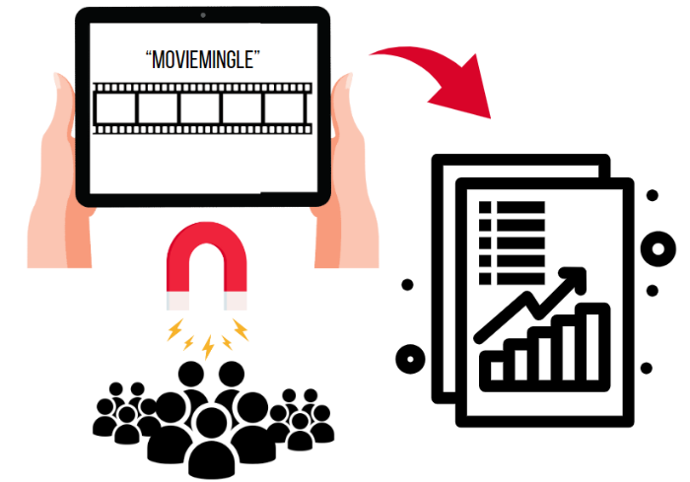
Introduction
MovieMingle is a movie streaming platform that has gained rapid popularity among movie lovers.
MovieMingle found that users are often confused in navigating through the various movie options available.

Slide 5
Introduction
Dataset : https://grouplens.org/datasets/movielens/25m/. The dataset files used are rating.csv and movies.csv.
The data has 62,423 movies and 25,000,000 ratings.
Before conducting further analysis, the data undergoes a preprocessing stage first.

Slide 6
Recommendation System
Notes:
Transisi antar outline

Slide 7
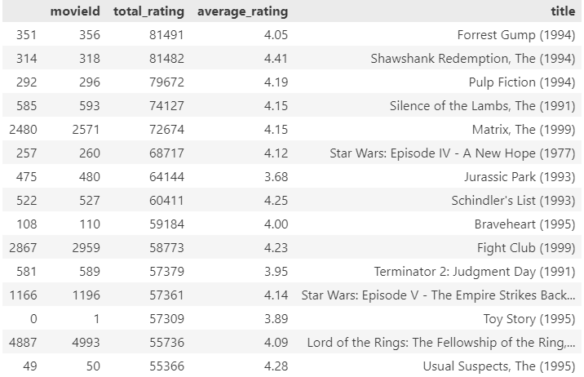
Recommendation System
Non Personalized Recommender System
- Top Popular

Slide 8
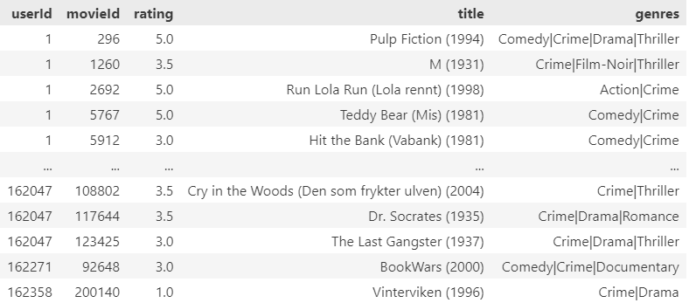
Recommendation System
Non Personalized Recommender System
Filter by Genre

Slide 9
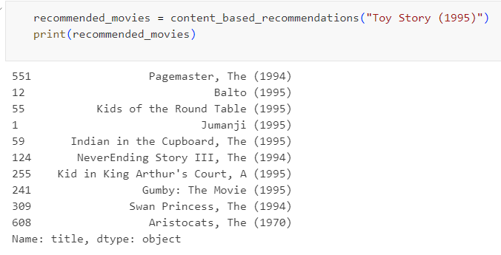
Recommendation System
Personalized Recommender System
- Content-Based System
Content-based systems focus on properties of items.

Slide 10
Recommendation System
Personalized Recommender System
- Collaborative Filtering
- User-to-user collaborative filtering, this method focuses on the similarity between users.
- Item-to-Item collaborative filtering, this method focuses on the similarity between items.

Slide 11
Algorithm Implementation & Hyperparameter Experimentation
Notes:
Transisi antar outline

Slide 12
Algorithm Implementation & Hyperparameter Experimentation
The first step is to set the baseline model using the `BaselineOnly()` method from the Surprise library. `BaselineOnly` is a model that is used as a starting point or baseline in building a recommendation system.
Furthermore, KNN Baseline, SVD, and NMF will be applied to find the best performance.

Slide 13
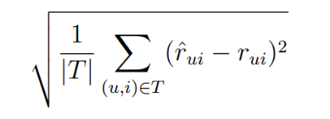
Algorithm Implementation & Hyperparameter Experimentation
Randomized Search CV is a technique that allows automatic exploration of parameters within a specified range of values. This process is performed randomly, selecting hyperparameter combinations from a predefined range. For each combination, the model is evaluated using cross-validation techniques to objectively measure its performance.
The most popular error metric is the Root Mean Square Error (RMSE) which predicts the accuracy of the predicted ratings for items recommended to users .

Slide 14
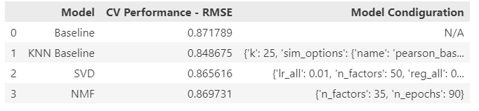

Algorithm Implementation & Hyperparameter Experimentation
A lower RMSE value indicates that the model has a smaller error rate in predicting user ratings of items.
KNN Baseline has the smallest RMSE value with hyperparameter k = 25 (refers to the number of nearest neighbors considered by the model, this number affects the model in understanding user preferences), pearson_baseline (calculation of similarity between items and users) and min_k = 2 (minimum value of nearest neighbors required to make predictions).

Slide 15
Conclusion
Notes:
Transisi antar outline

Slide 16
Conclusion
In developing a recommendation system, there are several approaches that can be used. First, there is non-personalized recommendation, which includes searching for top popular movies and filtering by genre.
Next, there is a personalized recommendation approach, which uses content-based recommendations. However, since there are some limitations with this approach, a user-to-user collaborative filtering approach is used. The test results show that the KNN Baseline algorithm with hyperparameter k=25, using Pearson Baseline, and min_k=2, is the best model. This model has an RMSE result on the test of 0.840, which indicates a good level of accuracy in providing recommendations to users.

Slide 17
Reference
Ashish Goel. 2009. MS&E 235: Lecture 7Long Tail. Notes by Rio Goodman. Lecture Notes in Cornell University.
Bell, R., Y. Koren, and C. Volinsky (2009). “Matrix Factorization Techniques for Recommender Systems”. In: Computer 42.8, pp. 30–37. issn: 0018- 9162.
Jahrer M., Toscher A. 2012. Collaborative Filtering Ensemble. Journal of Machine Learning Research 18:61–74, 2012.
Leskovec J. Rajaraman A. Ullman D. J. 2014. Mining of Massive Datasets.
Luo, X., M. Zhou, Y. Xia, and Q. Zhu (2014). “An Efficient Non-Negative Matrix-Factorization-Based Approach to Collaborative Filtering for Recommender Systems”. In: IEEE Transactions on Industrial Informatics 10.2, pp. 1273–1284. issn: 1551-3203. doi: 10.1109/TII.2014.2308433.
Ricci, Francesco, Lior Rokach, and Bracha Shapira (2011). “Introduction to Recommender Systems Handbook”. In: Recommender Systems Handbook. Ed. by Francesco Ricci, Lior Rokach, Bracha Shapira, and Paul B. Kantor. Boston, MA: Springer US, pp. 1–35. isbn: 978-0-387-85819-7 978-0-387- 85820-3. doi: 10.1007/978-0-387-85820-3_1.
Schafer J. B., Frankowski D., Herlocker J., Sen S. 2007. Collaborative Filtering Recommender Systems.
Soucy P., Mineau G.W. 2005. Beyond TFIDF Weighting for Text Categorization in the Vector Space Model. Proceedings of the Nineteenth International Joint Conference on Artificial Intelligence, Edinburgh, Scotland, UK, July 30-August 5, 2005.
Torstensson. 2019. Comparing neighborhood and matrix factorization models in recommendation systems.

Slide 18
Thank You
Notes:
Transisi antar outline

