Slide 1
Working from the Command Line
IOS110

Slide 2
Agenda
Introduction to the SHELL (cmd.exe)
Internal v External Commands
Command History
Making & Modifying Directories
Making & Modifying Files
PowerShell

Slide 3
SHELL
Application Program Layer
OPEN FILE
Operating System Layer
User Interface (shell) cmd.exe
Task Management
File Management
Device Management
Hardware Layer
Notes:
A shell is a piece of software that provides an interface for users of an operating system which provides access to the services of a kernel. However, the term is also applied very loosely to applications and may include any software that is "built around" a particular component, such as web browsers and email clients that are "shells" for HTML rendering engines. The name shell originates from shells being an outer layer of interface between the user and the internals of the operating system (the kernel).
The user wishes to open a file. It doesn’t matter whether the user issued a command from the CLI, or clicked a button in the GUI. The result is the same. The request is passed to the SHELL by the application layer and the OS responds by calling the open routine in the file management layer. The shell passes the open file request down to the file management layer which determines exactly where the requested file is located. If the file in on the local computer, the file management layer passes the request down to the device management layer, which communicates with the hardware layer.
Today we are going to focus on the CLI. For example:
Type cmd at the run command
The CLI window is the application layer user interface which allows use to communicate with kernel services and between services. Commands are separated by 1 or more spaces and to execute the command you press the enter key.
Type the command start notepad
The command start caused the application Notepad to open an untitled file.
When we issue a command whether from the CLI or the GUI the command line, it is not understood by the processor. The “English” like command called “source code” has to be converted into “object code”. Object code is machine code which the processor can execute. The interpretation process is the responsibility of the “command interpreter” which is built into the SHELL, called cmd.exe. The program checks that the command was typed correctly, called “syntax” and can be executed. If it can, it converts the command into object code which is executed by the processor; the result is passed back to the shell which sends it to file management to open notepad and the result is passed back to the application layer – and notepad is visible on the desktop

Slide 4
(Command Line Interface) CLI Syntax
Command tells CLI “what” user wants to do
Parameter tells CLI “where” user wants the command to happen. (A:)
Switch (or Option) tells CLI “how” the user wants the command to be executed
C:\>
COPY /A /V
myfile.txt e:\backup\
Prompt Drive and path
Command
Switch /A ASCII file /V Verify after copying
Parameter 1 Source
Parameter 2 Target

Slide 5
Internal Commands
Internal commands are built into the command interpreter cmd.exe
Installed with OS
No disk access
Faster performance
Examples:
CD, CHDIR
COPY
DEL
DIR
ECHO
GOTO
REN, RENAME
RD, RMDIR
SET
START
TITLE
PAUSE

Slide 6
External Commands
external commands that are not built into the command interpreter cmd.exe
Installed in separate folder
Disk Access required
Slower performance
Examples:
TREE
MORE
HELP
IPCONFIG
PING
ATTRIB
XCOPY
SORT
NET

Slide 7
Command History
F7 – to list commands to date
F9 – to select command number and place on the command line
F3 – to repeat previous command
UP Arrow – to scroll previous command
F2 – edits previous command line up to the identified character
Notes:
A useful feature is a command history of all commands that allows the creation of macros – which are automated keystrokes
Basic commands you should know are
F7 – history of all commands – to use a command use your arrow keys to select the one you want are press enter. This immediately executes it. Press ESC to close the windows, OR
use F9 to select the command reference number this is helpful if you want to modify it.
F3 can be used to execute the previous command you executed
OR you can cycle through the commands by using the up arrow key
F# is helpful if you wan to edit a previous command, press F2 allows you to specific the point you want to edit the previous command by specifying the character at which you want to modify from that point onward. – this is a good feature when editing long path statements.

Slide 8
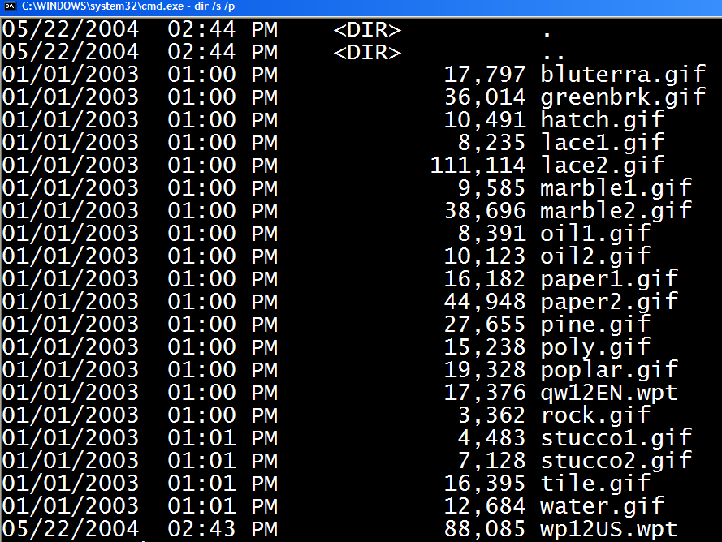
Directories and File-- CLI
Notes:
Files and stored inside containers called directories, -- when using the GUI they are called “folders” – same purpose.
And folders are organized in a hierarchical manner on the root of the drive.
The screen shot shows part of the directory table of the CLI looking at one folder, notice the date created and the time is displayed along with the name of the file.
Also notice that at the top of the directory containing the files is two other directories
A . And a ..
-. Represents the current or working directory
.. Represents the parent directory
These directories are built intot the CLI hiearchy to allow the user to use “relative path shortcuts” to speed typing and avoid errors at the prompt? – fewer keystrokes used the less likely errors will be made.

Slide 9
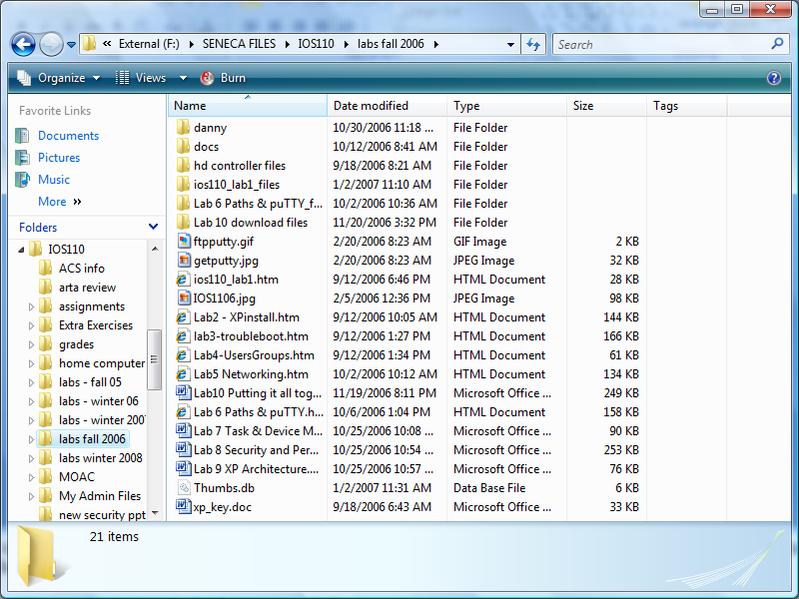
Directories and Files - GUI
Same Explorer information, but different views
Notes:
Here’s a look at the same directory from the GUI. Same information just different views. In both cases the SHELL is reading the directory table or master file table and presenting the same information in a different format.
Notice that the two directories . And .. Are missing why?
-- because the GUI doesn’t use relative path shortcuts, because the icons for folders are not presented in hierarchical view and you navigate by clicking on an icon. To see the hierarchical view click on the FOLDERS button on the STANDARD TOOLBAR. Notice the tree link structure on the left. To see subfolders click on the “+” sign.
Which format uses more system resources? – clearly the GUI holding all the color for the icons in pixels on the desktop will use more resources an the CLI. In the past, programmers and network support personnel have preferred the CLI because it provided faster performance. But today with the speed on modern processors, the use of the GUI is no longer an issue.
The last to slides don’t show the hierarchical nature of the directories, so lets type tree at the prompt.
TREE provides a “graphical view” of the hierarchy.
Note to the same command but use the /f switch. What happened?
/f is a swich which modifies the execution of the command tree – in this case it displays all the files in the directories, which scrolled by too fast to see.
Execute tree /f again only this time stop the process by pressing CTRL + C to stop execution. This is a handy tool specially if you wrote a script which created an “infinite loop”.

Slide 10
Directories and Files
C:\
Root
Child\Parent
IOS110
Child
Lectures
Lecture1.txt
Lecture1.pps
Child
Lab
Lab1.htm
Lab2.draft.htm
Notes:
Uusing the CLI, navigation is based on using absolute and relative paths, rather than icons and + signs, as one moves from root to parent folder to child folder or vise visa
Any directory under the directory you are currently in is referred to as a subdirectory or a child directory. Any directory directly above the current directory is referred to as the parent directory.
The parent directory is represented by .. which moves you up one level
Current or working directory is a .

Slide 11
File Names
You can use most characters in a file name although there are some illegal ones:
/ \ : * ? " < > |
File names can be up to 255 characters and can use upper and lower case, spaces and multiple extensions
Win16 programs must use 8.3 rule
XP automatically creates a “short file name” or “alias”
Long file name (LFN) e.g.
The little brown fox.foxx.jan.doc
Alias Thelit~1.doc

Slide 12
Absolute and Relative Paths
C:\
Absolute path defines a file or directory from the root
IOS110
\IOS110\lab\lab1.htm
Lectures
Relative path defines a file or directory from the working directory (its position in the directory tree)
Lecture1.txt
Lecture1.pps
Lab
Lab1.htm
Lab2.draft.htm
..\..\lab1.htm

Slide 13
Relative Pathnames
Instead of working from the root, we work from our current or working directory.
For example, if you were in the c:\apps directory and wanted to create a directory called word within the apps directory, you would simple type:
MD word

Slide 14
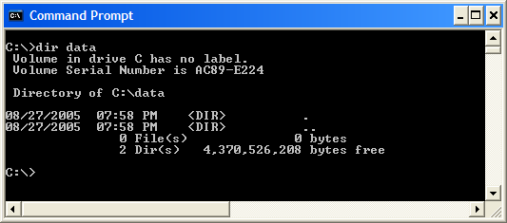
Make a directory (MD, MKDIR)
To create or make a directory type md or mkir at the prompt, with the name of the directory
For example, to create a file called data, use the command: MD data
Notes:
Notice that even though the directory data is empty, when we do a directory listing we find that it contains 2 directories. Who remembers what these are for?
-- “.” which represents the relative path shortcut to the current directory and
--- “..” which represents the relative path shortcut to the parent directory
Because these are built into the command interpreter we are able to use them to navigate directories which saves keystrokes and is less error prone.

Slide 15
Change Directory (CD,CHDIR)
To switch between directories, we use the CD command (chdir will also work).
Note: if you use the CD command and misspell the directory or enter a directory that does not exist, you will receive an error message.
”the system cannot find the path specified”
To go to the root from anywhere type cd\
To go up one directory (parent) type cd ..
To go up 2 levels type cd ..\..
Notes:
Notice the command interpreter is flexible when typing CD\, technically a space is required between the cd and the \ -- same when using .. , -- the interpreter knows what you are typing and stripes the extra spaces if you type them. UNIX and the Recovery Console interpreter are not as flexible.

Slide 16
Remove Directory (RD)
To remove an empty directory, the RD command works well.
If your directory is not empty though, you need to add the /s switch to delete a “directory tree”

Slide 17
DIR command
If you want to see a listing of all of the files and folders in a given directory or even your entire system, then this is the command to use.
DIR always lists the contents of your working directory unless you specify a directory such as:
DIR c:\2010\January
This command will list the contents of the January directory.
If you were in the January directory then simply typing the command DIR would also display the contents of the January directory.

Slide 18
Viewing Text Files
If all you want to do is view the contents of a file, then use the TYPE command.
TYPE [path to file] will display the contents of the file to the screen
However, if file is large it will scroll past very fast. For large files use Type file1.txt | more
The “|” pipe symbol is used to filter the output one page at a time
More file1.txt file2.txt file3.txt
More is a better command but is “external”. It automatically filters input and provides a “submenu” for greater control

Slide 19
Create a Text File
Copy nul [path to filename] - creates an empty file
Copy con - creates a file from the "console" - text must be entered
Edit - Runs a DOS-based editor, file needs content to be saved
Notepad - runs graphical text editing tool
Notes:
Create a text file using Notepad
Create a file using edit (Win16 program) notice the mouse doesn’t work and you must use the keyboard for navigation
Short one line files can be created at the prompt using copy con (copy from console)
Type copy con myfile.txt
Notice the cursor goes to the far left for you to start typing. Copy con is not an “editor” if you make a mistake you must delete all characters after the mistake to fix it
When finished type CTRL + Z to indicate EOF

Slide 20
DEL (Delete) command
To delete a file, use the DEL command.
You can delete multiple files at once by using wildcards.
Remember, use the RD command to remove empty directories
Notes:
Delete a file you created
Try to use delete command to delete a folder.– what is the message?
Notice it appears that del has deleted the directory, but it has not –only files
To delete directories use the rd command if the directories are not empty add the /s switch.

Slide 21
Wildcards
Most commands allow you to use wildcard characters to handle more than one file at a time.
Asterisk (*) – substitutes multiple characters
Question Mark (?) – substitutes only 1 character

Slide 22
Wildcards Example
BUDGET.JAN BUDGET.FEB BUDGET.MAR
BANK.DOC REPORT12.DOC REPORT2.DOC
C:\>dir *.*
C:\>dir budget.*
C:\>dir b*
C:\>dir *.doc
C:\>dir budget.?a?
C:\>dir report?.doc

Slide 23
Redirecting Output
You can modify where the output of a command goes
By default the output of a commands is generally displayed on the screen
You can redirect the output to a file (>, >>)
You can redirect the output to be used as input for another command (|)

Slide 24
Redirecting Output to a File
> - when you redirect output to an existing file, the redirected output replaces the original file
>> - you can add, or append to the end of an existing file
If the file doesn’t exist, it will be created in either case

Slide 25
Examples
File1.txt
This is file 1.
File2.txt
This is file 2.
C:\>type file1.txt >> file2.txt
C:\>type file1.txt > file2.txt
C:\>type file1.txt > file3.txt

Slide 26
Connecting Commands with a Pipe
You can redirect the output of one command to be the input of another. The two commands become connected using a pipe (|). You pipe the output of one command and use it as the input for a filter command.
C:\>dir \DOS | more
C:\>dir | sort

Slide 27
PowerShell
Notes:
Windows PowerShell is a task-based command-line shell and scripting language designed especially for system administration. Built on the .NET Framework, Windows PowerShell helps IT professionals and power users control and automate the administration of the Windows operating system and applications that run on Windows. Built-in Windows PowerShell commands, called cmdlets, let you manage the computers in your enterprise from the command line.

Slide 28
What is PowerShell?
Windows PowerShell Version 4.0 runs on Windows 8.1 and Windows Server 2012 R2
task-based command-line shell and scripting language designed especially for system administration
Built on the .NET Framework (object oriented)
Scripts allow you to automate the administration of the Windows operating system and applications that run on Windows
Notes:
Windows PowerShell is a new Windows command-line shell designed especially for system administrators. Windows PowerShell includes an interactive prompt and a scripting environment that can be used independently or in combination.
Unlike most shells, which accept and return text, Windows PowerShell is built on top of the .NET Framework common language runtime (CLR) and the .NET Framework, and accepts and returns .NET Framework objects. This fundamental change in the environment brings entirely new tools and methods to the management and configuration of Windows.
Windows PowerShell introduces the concept of a cmdlet (pronounced "command-let"), a simple, single-function command-line tool built into the shell. You can use each cmdlet separately, but their power is realized when you use these simple tools in combination to perform complex tasks. Windows PowerShell includes more than one hundred basic core cmdlets, and you can write your own cmdlets and share them with other users.

Slide 29
PowerShell Tasks
Any task you can perform with the GUI, you can also perform using PowerShell
Some tasks can only be performed through PowerShell
PowerShell is the preferred Server management tool. Once proficient in its use, it is much faster than the GUI, especially in large domain environments

Slide 30
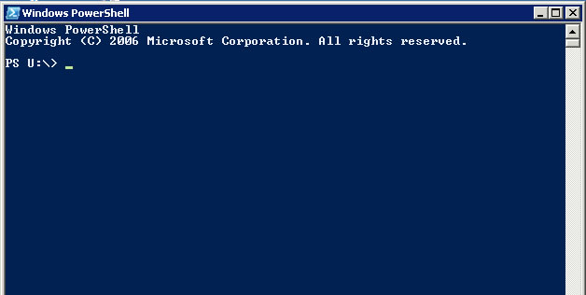
The PowerShell Console

Slide 31
PowerShell CmdLets
Cmdlets (pronounced command-lets) are the commands and structures used to run operations, view data and manage the system
The number of available cmdlets is constantly growing (over 500 in PowerShell 4.0)
Notes:
A cmdlet (pronounced "command-let") is a single-feature command that manipulates objects in Windows PowerShell. You can recognize cmdlets by their name format -- a verb and noun separated by a dash (-), such as Get-Help, Get-Process, and Start-Service.
In traditional shells, the commands are executable programs that range from the very simple (such as attrib.exe) to the very complex (such as netsh.exe).
In Windows PowerShell, most cmdlets are very simple, and they are designed to be used in combination with other cmdlets. For example, the "get" cmdlets only retrieve data, the "set" cmdlets only establish or change data, the "format" cmdlets only format data, and the "out" cmdlets only direct the output to a specified destination.
Each cmdlet has a help file that you can access by typing:
get-help <cmdlet-name> -detailed
The detailed view of the cmdlet help file includes a description of the cmdlet, the command syntax, descriptions of the parameters, and an example that demonstrate use of the cmdlet.

Slide 32
Basic Command Structure
PowerShell cmdlets are always a verb and noun pair structure:
verb-noun
Some examples:
Get-Childitem
Set-Service
Copy-Item
Stop-Process

Slide 33
CmdLet Structure
CmdLet usage generally follows the following structure:
CmdLet -parameter [value] -parameter [value]
Parameters are optional switches that affect the overall behaviour of the CmdLet
Samples:
Get-ChildItem -path c:\windows -exclude *.txt
Get-Process -Id 4

Slide 34
Some Popular CmdLets
Get-ChildItem – lists all files in the current directory
Set-Location – changes the current directory
Get-Process – returns a list of all processes
Get-Help – built-in help system

Slide 35
PowerShell Aliases
Allows users to use familiar commands in PowerShell to get started quickly
For example:
dir or ls = Get-ChildItem
Use Get-Alias command to view aliases
Built-in Aliases
User-defined Aliases
Notes:
Aliasing in PowerShell allows for the use of commands we become accustomed to. Windows users can utilize commands like dir, move, type, cls, etc… PowerShell also provides a set of aliases for Linux; ls, pwd, mv, man, cat, etc… PowerShell Aliases are provided for the purpose of allowing new users the ability to quickly interact with the shell. An alias is an alternative name assigned to a cmdlet. For example, “dir” is an alias for “Get-ChildItem.” This tutorial presents two types of aliases:
Built-in Aliases – Predefined alternative names for Windows, Unix, and PowerShell cmdlets.
User-defined Aliases – Custom alternative names created by the user.

