Slide 1

SWPP-TEAM1
Developed by 김기웅, 김대은, 옥선교, 제해성

Slide 2


What problem we are solving
MOTIVATION
What
do we use?
We want to meet someone
But not necessarily about
relationship matter

Slide 3


What we purpose to solve the problem
Simple & Easy
axios.get()
.then()
.finally()

Slide 4
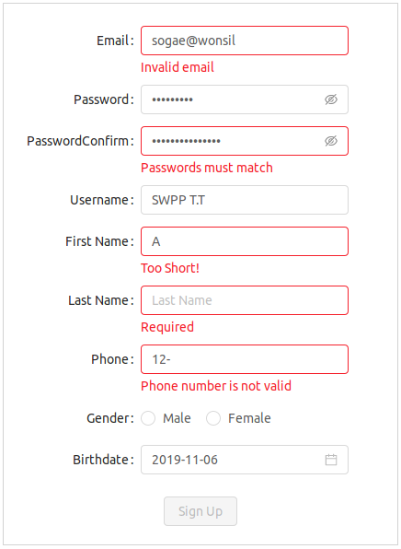
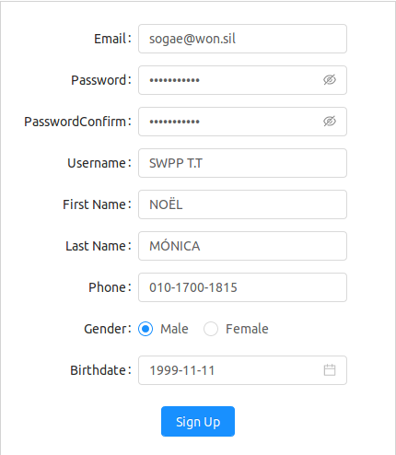
What we purpose to solve the problem
Fancy & Robust

Slide 5


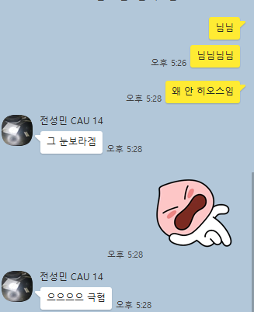

Main user stories we would cover
User Story

Slide 6
Main user stories we would cover
User Story
Match
E.T.C
Create / Edit Match
Join Match
Hot / New Match
Header
Profile

Slide 7
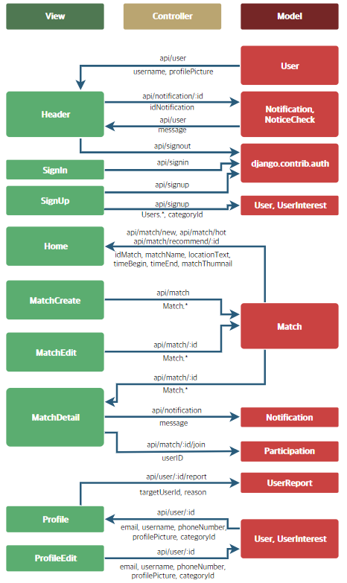
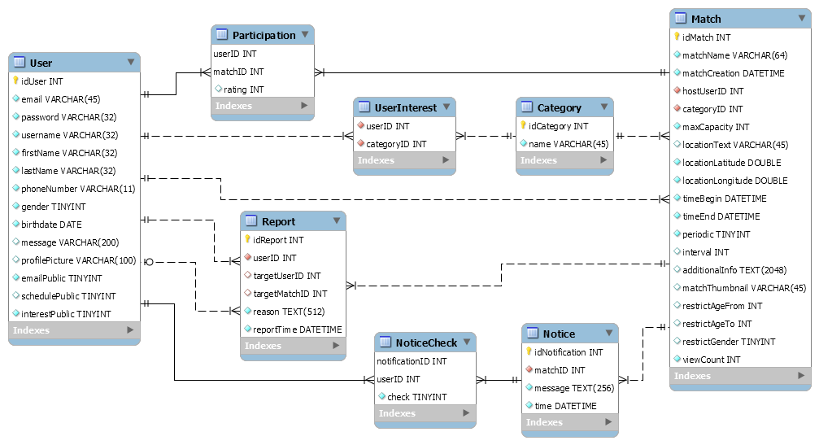
What is unique about our design?
System Design

Slide 8
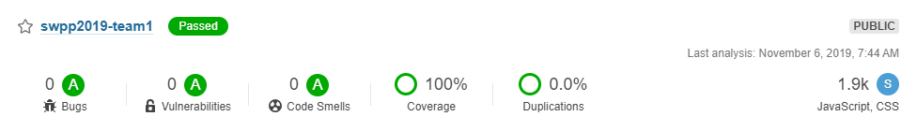
What challenges we solved / will solve
Challenges
We solved
We will solve
RESTful API server
Integrating front & back
Project management
git, Travis CI, ...
Chatting
Real-Time Notification
NLP

Slide 9
What we have learned these days
Lessons Learned
It’s important to design before starting coding with nothing.
resolves possible conflict on variable names
front - back communication
building directory structure
Maserati Problem
Make sure that it is being developed in the correct direction

Slide 10
Matchmaker
Live Demo
Let’s see how it works

Slide 11
Thank you

