Slide 1

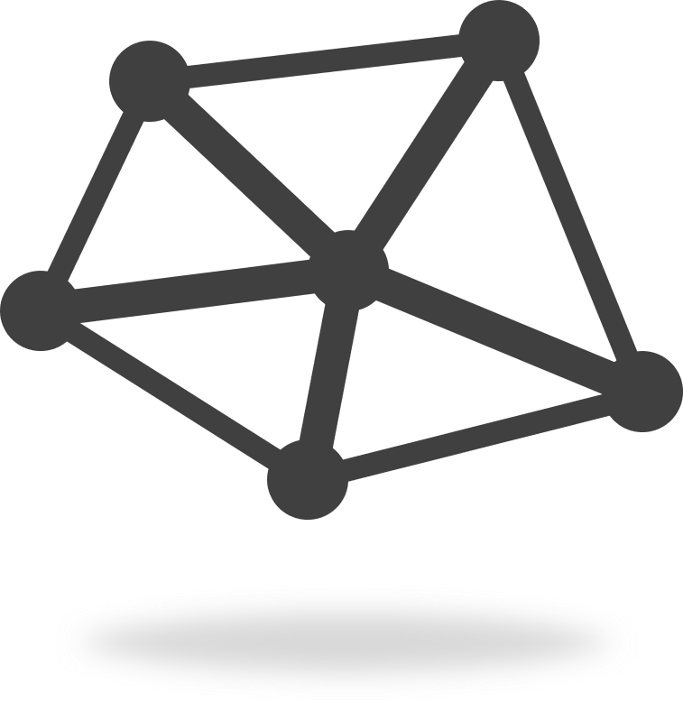
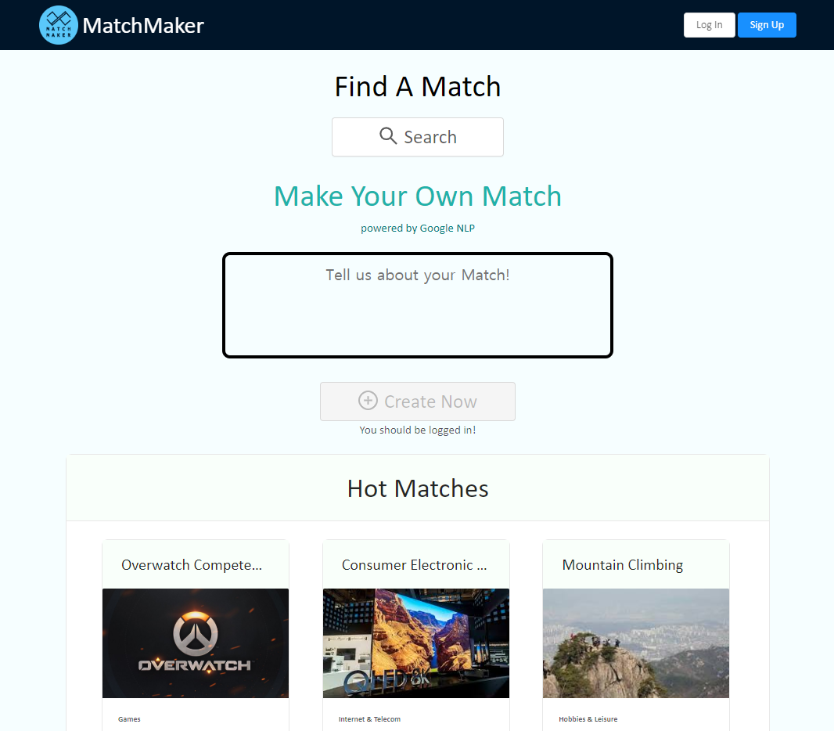
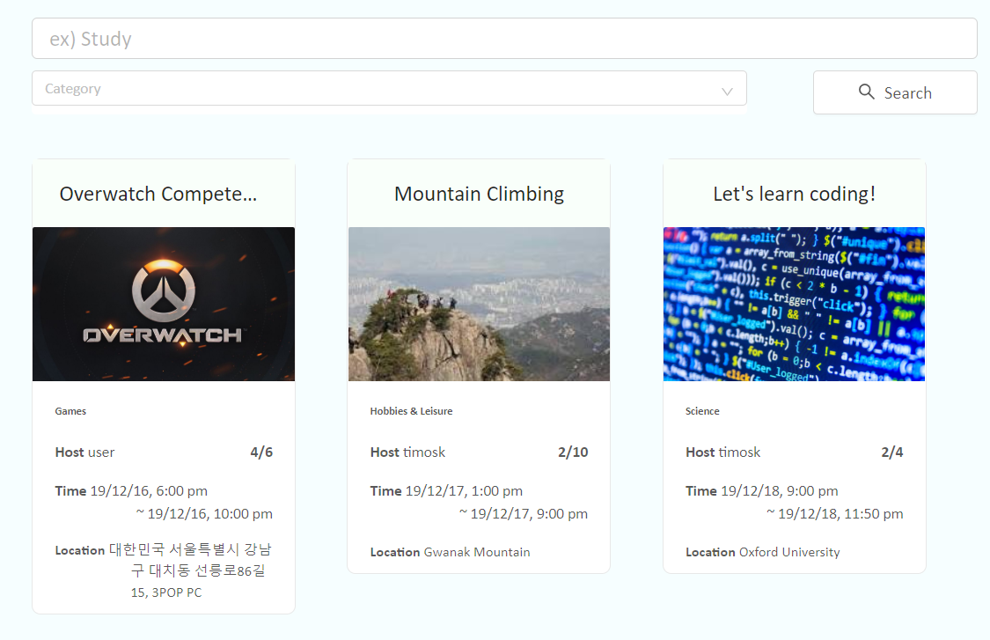
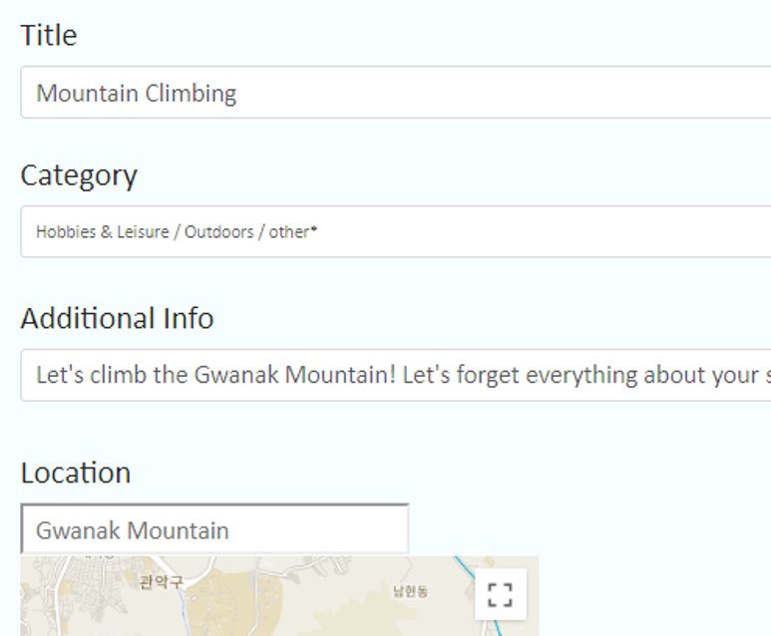
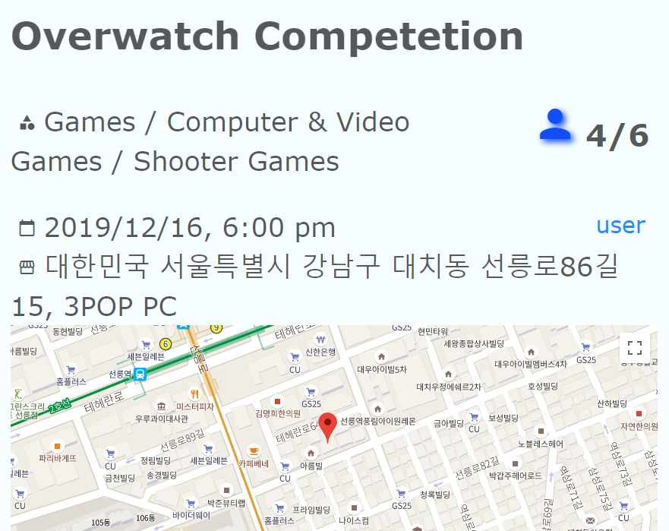
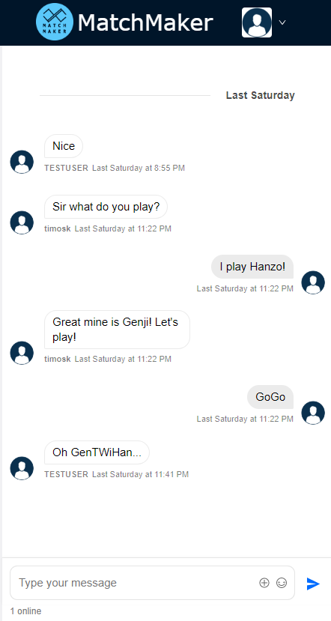
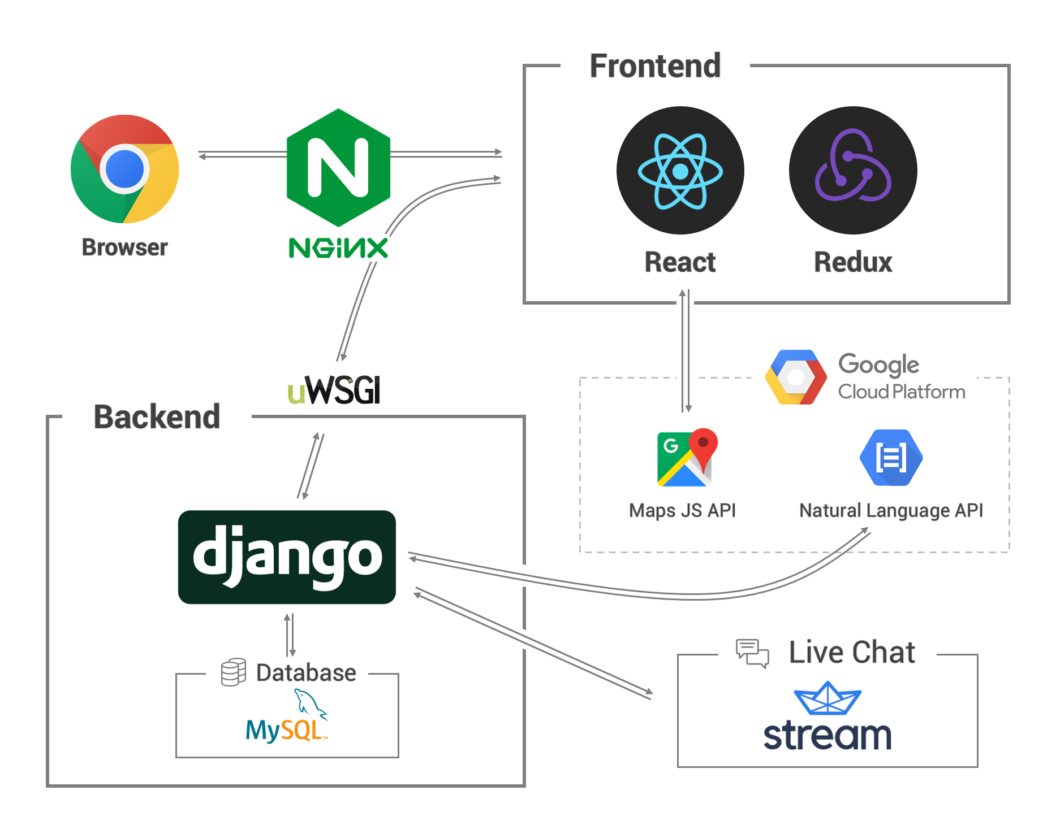
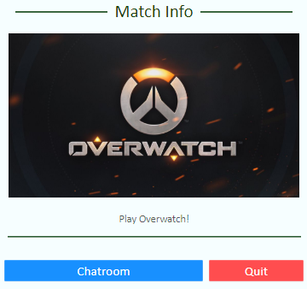

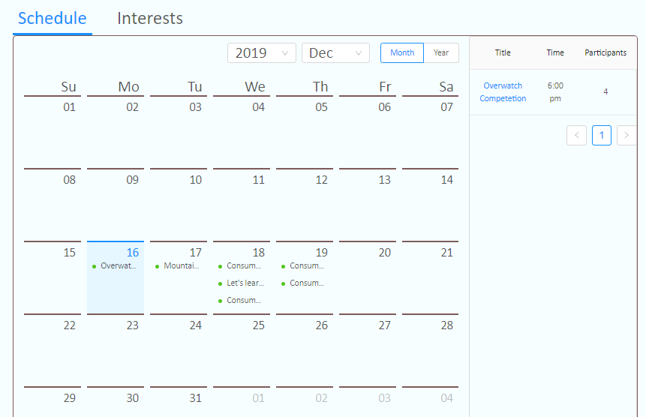
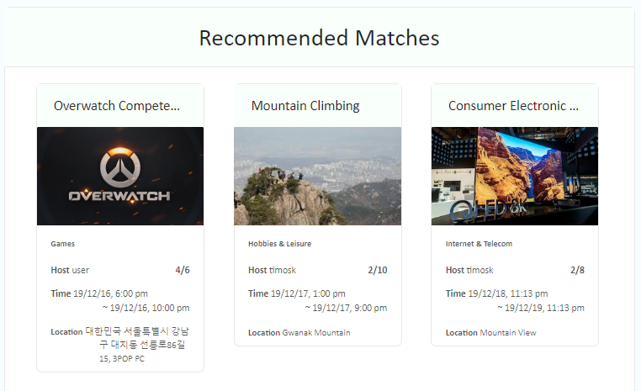
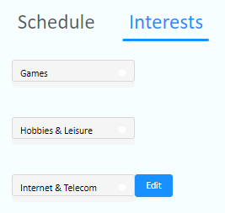
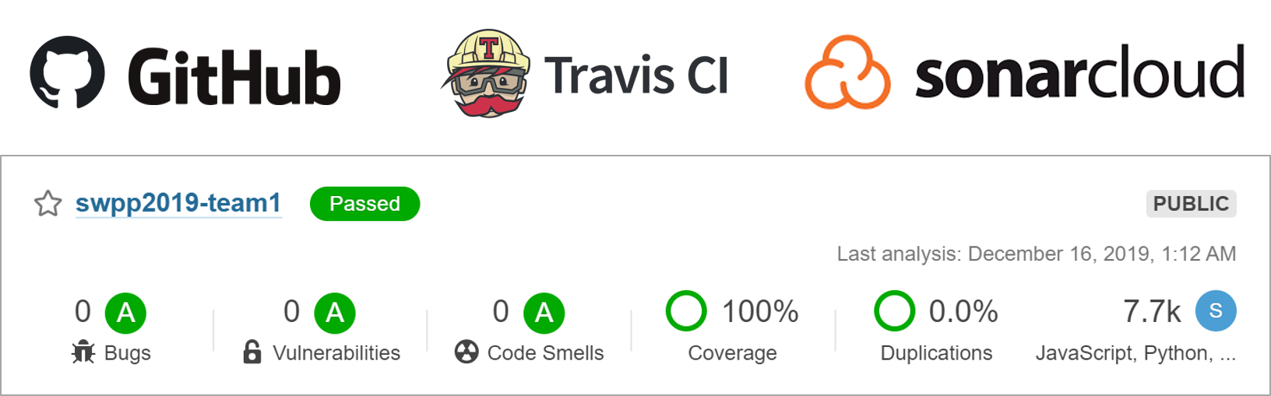
MatchMaker
Team 1
Haeseong Je
Daeeun Kim
Seonkyo Ok
Kiwoong Kim
“
Connected
”
Matchmaker connects people.
Would you like to find an online friend to play game with, or be excited about a chance encounter?
Create your own match with just one click, and you can also participate in other.
Wait for the meeting while chatting with other participants.
Matchmaker is waiting for you.
Key Features
User Interface
Create Match with NLP (Natural Language Processing)
Join / Quit Match
Participate Live Chatting
Manage my matches
Interest based Recommendation
Home Page
Search Page
Create Page
System Architecture
Match Detail
& Chatting
My Page
Once you set your interests,
You can get recommendation at homepage
Project Management
Future Works
User friendly features
  Match rating, Malicious user reporting
  Sync with Google Calendar
  Live Notification
Continuous Deployment
Developed in Principles and Practices of Softare Development class, Dept. Computer Science and Engineering, Seoul National University

