Slide 1
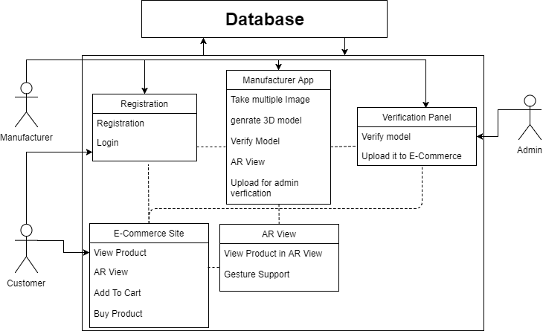
4TH National Level Project Exhibition 2018
Universal College of Engineering (IETE-ISF)
AUTO GENERATION OF 3D MODEL USING MULTIPLE 2D GRAPHICS TO MANIFEST THROUGH AUGMENTED REALITY
Abstract
Proposed Work
AR in E-Commerce
Images are more ambiance than words similarly the 3D models are more descriptive than 2D pictures. 3D model of any product will give the enhanced information about it. The main objective of generating the 3D model is to reduce the amount of time by automating the process of generating the 3D model. Augmented Reality (AR) technologies have been recognized as offering great benefit to almost every field and organizations, although they are not easy to implement. AR provides enhanced information of the product by overlaying the 3D model into the real world. 3D models can express the shape and dimensions of the products with greater precision and they are being extensively used these days.
In this paper, we are proposing a 3D Model ling application which will take only a few 2D images as input from any image capturing device taken from different angles and it will automatically convert it into a 3D model. The first step towards generating the 3D model from the images is to establish point correspondence which includes feature extraction and feature matching. Then refining correspondence is done followed by de-calibration of 3D structure and camera pose. The final step is texture mapping and rendering.
We are using an E-commerce portal as an example to display the 3D models generated by our 3D Modeling application. Most often customers shopping on e-commerce websites do not get complete information about the product by only viewing the 2D images. They can get a better understanding of the product by using AR View. The adaptation of Augmented Reality (AR) will take E-commerce to the next level.
We propose an approach to reduce the time, taken for the generation of the 3D model fromseveral 2D images. This automated 3D model will be overlayed into real world using Augmented Reality (AR). 2D images do not give a clear perception to the human mind about the idea of the product. In this case 3D model can give a very precise view and idea of the model. It is not possible to display AR view over the website, so we are designing a hybrid E-commerce portal and adapting it as an example to demonstrate the generation of 3D model of the products which will give an enhanced view/idea of the product. There will be 3 main modules in the architecture. First module is where the main 3D modeling application will be working i.e. Manufacture module which will be responsible for generating the 3D model from corresponding 2D images. Second module is Customer module where the produced 3D model will be overlayed into the real world. Third module is Admin module where the 3D models will be stored to be displayed to the customers’ module.
We are adapting E-commerce field to demonstrate our 3D model generating application. By using AR in E-commerce customer will get more precise understanding of the product. Customer can get the idea about perfect view and dimensions of the product.
Customer can upload few images of the product from different angles and the proposed application will generate the 3D model or the same. Then the 3D model of the product will be overlaid into the real world by Augmented Reality. Implementation of automated 3D model in E-commerce will abruptly take it to a more high level.
Market Potential of Project
3D technology is delivering three dimensional views of the captured images or data. There is an increasing demand for 3D technology based products in various application sectors such as entertainment, health-care, aerospace, government and defense, entertainment and automobile and industrial segments. 3D technology creates highly accurate and precise images of an object. Use of 3D technology in various application segments would help in saving production time and cost. Designers get a ready-made tool to have an intuitive understanding of the feasibility of any product right at the initial stages. Within the 3D technology market, 3D display accounted for maximum revenue in the year 2013, mainly due to the popularity of stereoscopic displays in televisions and mobile phones and it will have a direct impact on the overall 3D display technology market, as it is the maximum revenue-generating segment. In addition, 3D printing is projected to grow at a CAGR of 39.1
Introduction
A vast use of 3D technology is increasing day by day, as new 3D enable gadgets are being introduced in the current market. One of the reasons behind the growth in 3D technology is entertainment which includes and supports basic contents necessary for sports, movies, games, mobile phones, etc. In computers, 3D (3 dimensions or 3-dimensional) describes an image that provides the perception of depth. 3D models are made interactive so that users feel involved with the scene, the experience is known as Virtual Reality. During the development of 3D models, designers and developers have to handle a lot of input dimensions of the object, a lot of interaction techniques, and a lot of ways to present content. 3D models can express the shape and dimensions of the products with greater accuracy and they are being extensively used these days. By overlaying the 3D model into the real world we get Augmented Reality which provides enhanced information of the product.
Augmented Reality (AR) is a direct or indirect view of a physical, real-world environment where elements are "augmented" automatically or manually. It is related to a more general concept i.e. computer-mediated reality, which modifies a view of the reality by a computer. Virtual reality replaces the real world with a simulated one, whereas Augmented Reality is the one which enhances the current perception of reality. AR systems overlay the “Virtual” objects onto the real world to increase users’ visual experience, expand their visual system, and help them achieve their tasks in more natural way. So it has many applications in human-computer interaction, industry maintenance, multimedia computing, medical and military training.
The paper we are proposing is an application, in which, it will take few 2D images and then the 2D images will automatically get converted into the 3D model. The 2D images can be taken from any image capturing devices from every angle. After the generation of the 3D model, that 3D model can be displayed through augmented reality. The main use of this application is that we can get an enhanced view of the object, and it can be examined perfectly. The generated 3D model has application in many fields such as in medical, gaming, e-commerce, etc. We are using E-commerce as an example to display the 3D models generated by our 3D Modeling application. Most often customers shopping online do not get complete information about the product by only viewing the 2D images so to help them get a precise view of the product we are using AR. The adaptation of Augmented Reality (AR) will take E-commerce to the next high level.
Motivation
Motivation
Conclusion and Future Work
Click to aWe are proposing a 3D Modeling application which will take just a couple 2D pictures as a contribution from a picture catching gadget taken from various edges and it will consequently change it into a 3D model. The initial move towards creating the 3D demonstrate from the pictures is to set up point correspondence which incorporates highlight extraction and highlight coordinating. At that point, refining correspondence is done trailed by de-alignment of 3D structure and camera pose.The last advance is surface mapping and rendering.We are utilizing an E-trade entrance for instance to show the 3D models produced by our3D Modeling application. Frequently clients shopping on E-commerce sites don’t get finish data about the item by just review the 2D pictures. They can improve comprehension of the item by utilizing AR View. The adjustment of Augmented Reality (AR) will take E-business to a very high level.
We are proposing 3 modules in our project which are Manufacturer module, Customer module and Admin module.
Manufacturer module: After registration manufacturer can upload multiple 2D images. 3D model will be generated within the manufacturer application. Manufacturer will then verify the generated 3D model. If he is satisfied then he/she will finally upload the 3D model for further Verification.
Admin module: Admin will check weather the manufacturer is authorized or not, then it will check weather the details and the 3D model hence provided is correct or not.
Customer module: The customer mainly has to register/login then he/she can see the list of product. Then he/she can view the 3D model of any product in Augmented Reality.
One of the reasons behind the growth in 3D technology is entertainment which includes and supports basic contents necessary for sports, movies, games, mobile phones, etc. The conversion of 2D images to 3D model makes the object look more realistic. During the development of 3D models, designers and developers have to handle a lot of input dimensions of the object, a lot of interaction techniques, and a lot of ways to present content. So our module helps to reduce these problems. This automated 3D model will be overlaid into real world using Augmented Reality (AR).as shown in the paper The algorithmic process for generation of the 3D models are Feature Extraction and Feature matching, Uncalibrated 3D Structure and Camera Pose, Bundle Adjustment etc. can come into consideration. A clear future direction of this model is to automate the process of converting 2D images to 3D models and to reduce the manual process of the same. We are adapting e-commerce field so as to demonstrate the 3D model generation module which will help customer get more precise and clear understanding of the product they are supposed to buy
Notes:
1

