Slide 1
AUTO GENERATION OF 3D MODEL USING MULTIPLE 2D GRAPHICS TO MANIFEST THROUGH AUGMENTED REALITY

Slide 2
Presented by-
Khedwala Maria (14CO03)
Momin Furkan (15DCO55)
Pachhapure Uzair(15DCO59)
Shaikh Samir (15DCO73)

Slide 3
CONTENTS
1
2
3
4
5
Introduction
Proposed work
Main Modules
Literature Survey & Progress
Conclusion

Slide 4
Introduction
During the development of 3D models, designers and developers have to handle a lot of input dimensions of the object, a lot of interaction techniques, and a lot of ways to present the content. 3D models can express the shape and dimensions of the products with greater accuracy and they are being extensively used these days. By overlaying the 3D model into the real world we get Augmented Reality which provides enhanced information of the product.
4

Slide 5
Proposed Work
As per the given problem in the problem statement, it is quite time consuming to generate 3D model, to overcome this problem we will be implementing the app to generate 3D model.
So through this app, time consuming process of 2 to 3 days will be done in a few minutes.
Also while shopping online we can only see the images these days, but the future is augmented reality a level up for every online shopping sites.
We are going to produce the 3D model of the products to give user the better understanding about dimensions and look of the product.
5

Slide 6
Quick Development of
3D model
No Expert Needed
Automatic generation
Of 3D Models
Least Expensive
Features

Slide 7
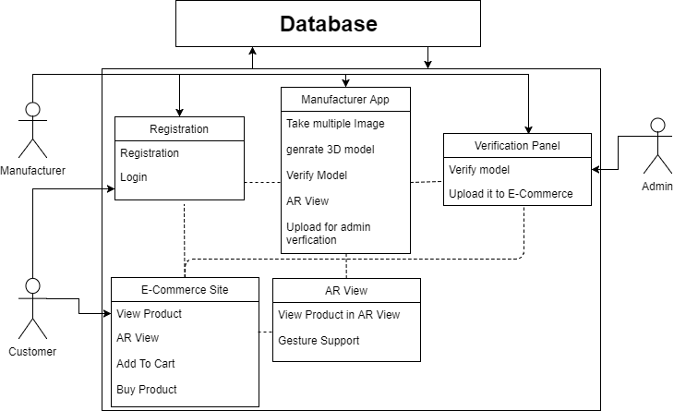

Slide 8
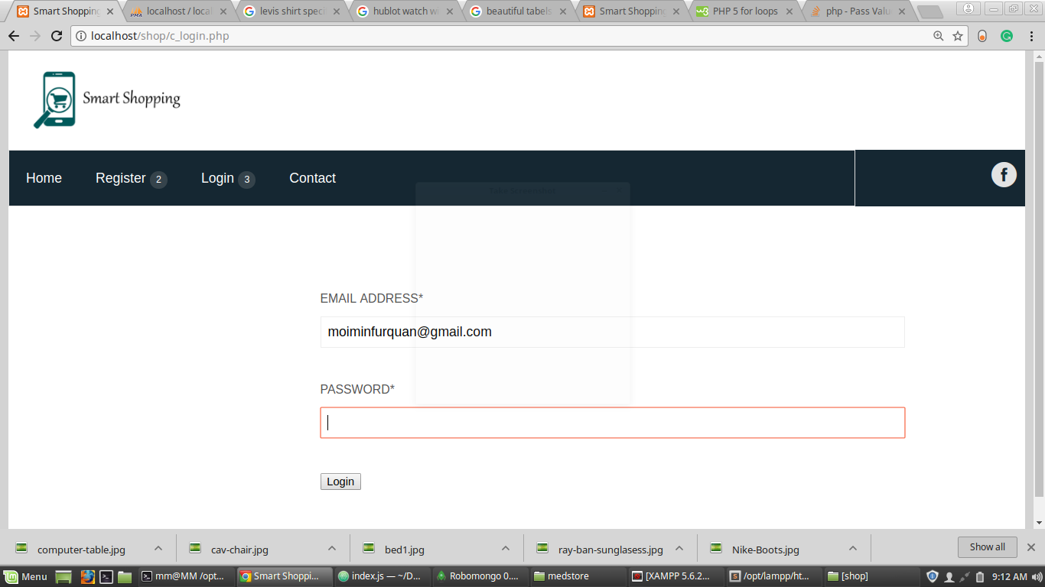
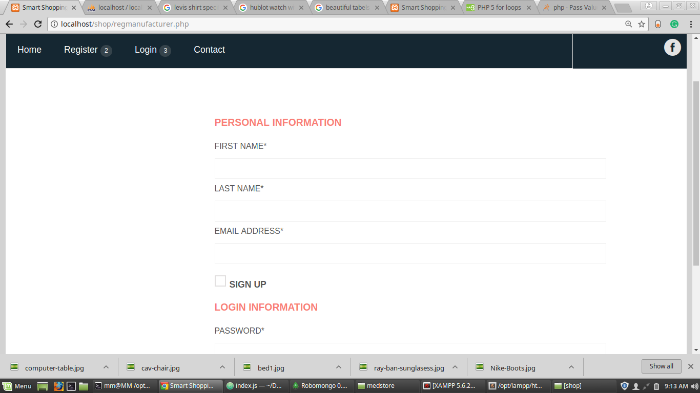
Login
Register

Slide 9
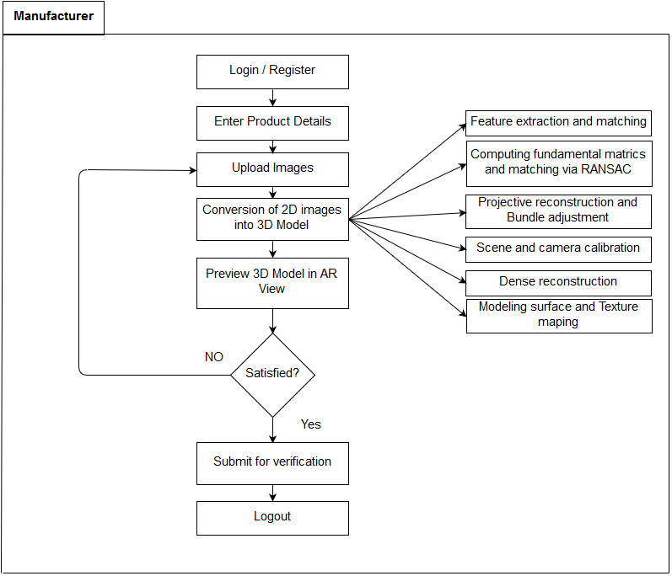

Slide 10
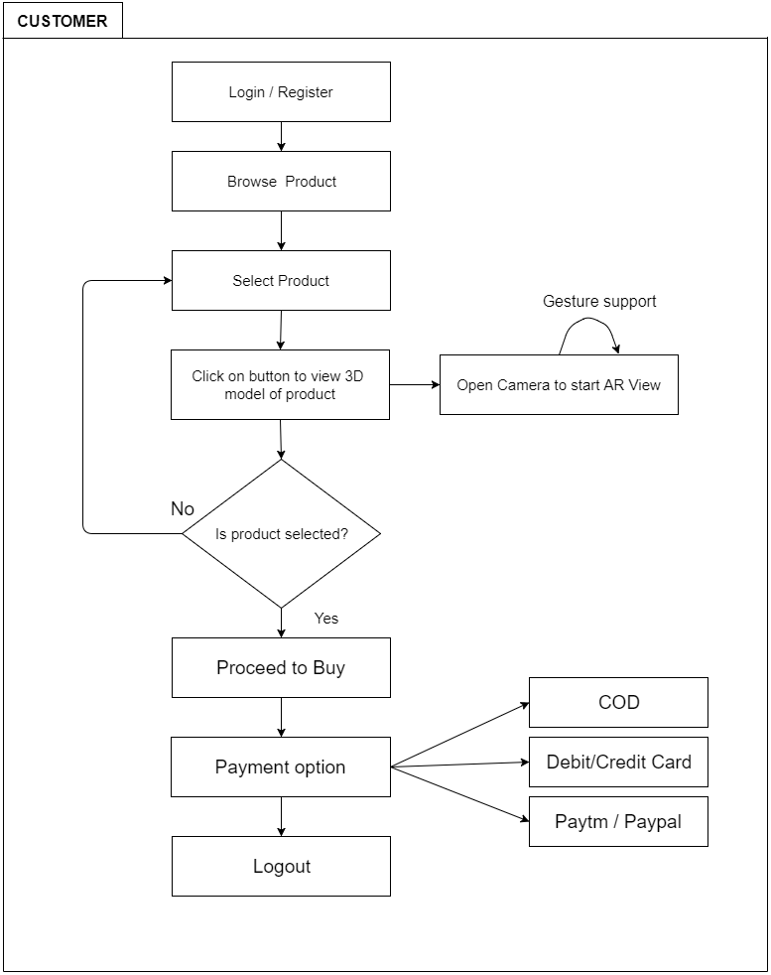

Slide 11
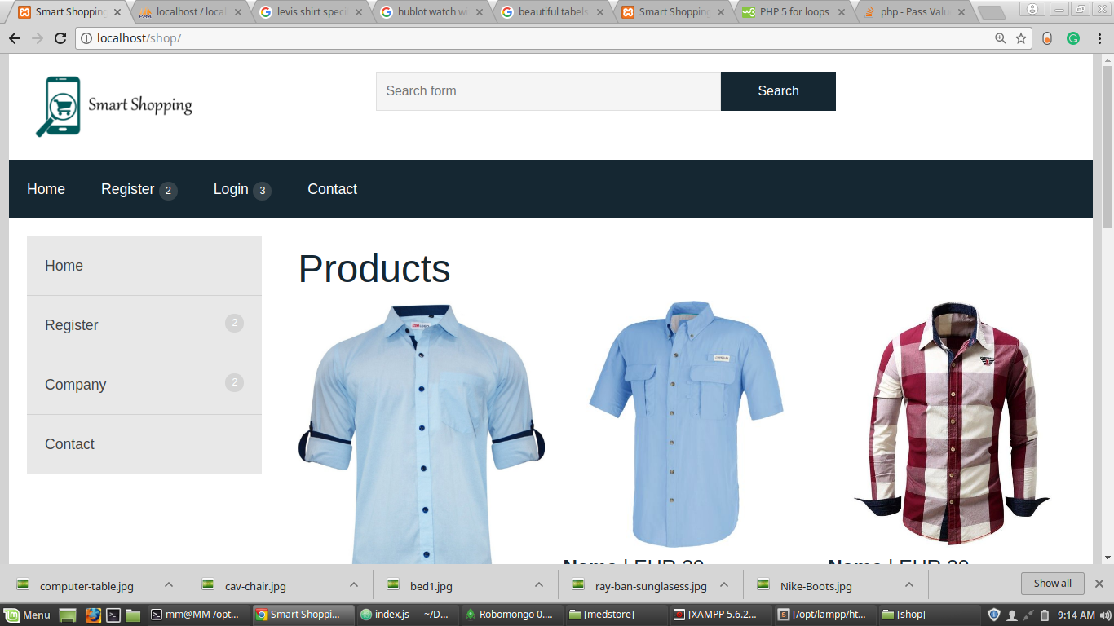

Slide 12
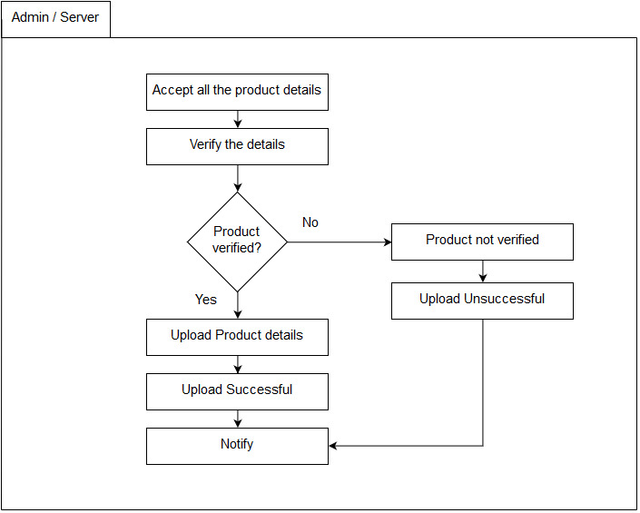

Slide 13
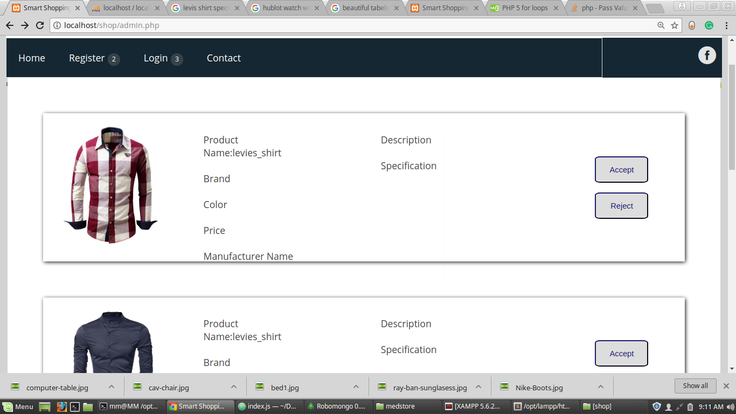

Slide 14
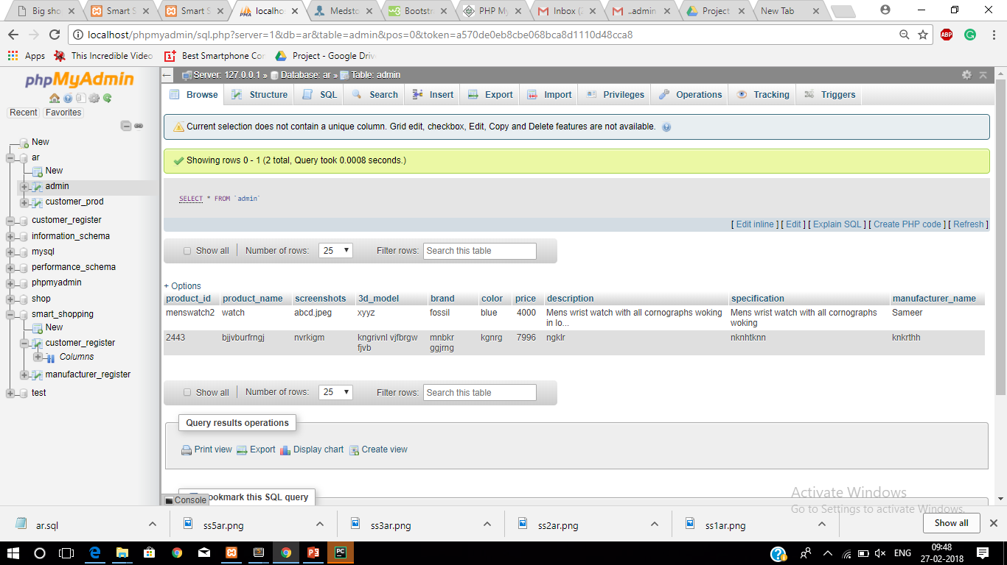

Slide 15
Steps For Generation of 3D Model
Establishing Point correspondence
Feature extraction
Feature matching
Refining correspondence
Computing Fundamental matrices
Robust matching via RANSAC
Dense reconstruction
Epipolar rectification
Dense matching
Knowledge in the scene
Multi-scale matching
Dense triangulation for multiple frames
Texture mapping and rendering
Modeling surface
Highlights and specular reflection
Texture mapping

Slide 16



Feature Extraction
Features will be extracted from the provided 2D images
by using ORB (Oriented Fast and Rotated BRIEF), which
is generally a combination of FAST key point detector
and BRIEF descriptor with many modifications to enhance
the performance. This generally eliminates the background
of the 2D image using ORB technique.
Steps For Extraction
Read Image
Using grabCut Function
Masking
Processing
Print Output
Original
Extracted
16

Slide 17
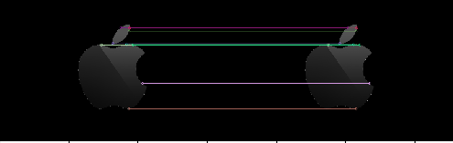
Feature Matching
Feature matching is mixing of features from different images
using the technique called find homograph and calib 3D for
complex images. After the removal of the background of 2D
images, those images are matched based on their features.
Steps For Feature Matching
Read Images
Using ORB Technique
Point to Point Matching
Print Output
17

Slide 18




Where can we Implement?
E-commerce
Medical
Gaming
Machine Modeling
18

Slide 19
Literature Survey
2.1 Paper Title
Augmented Reality E-Commerce: How the Technology Benefits People’s Lives
2.1.1 Weaknesses
This paper presents a new type of e-commerce system, AR e-commerce, which visually brings virtual products into real physical environments for user interaction. 3D model is generated manually and with marker.
2.1.2 How to Overcome
3D model can be generated automatically and without marker.
Contd…

Slide 20
2.2 Paper Title
E-Commerce Direct Marketing using Augmented Reality
2.2.1 Weaknesses
Not 3D model but prototype model is being generated that too manually(i.e. dummy prototype)
In this paper they use a marker-based calibration to calibrate the camera and estimate the pose of the markers in AR video editing system. This system consists of the following five subsystems: i) video input/output, ii) image feature extraction and marker recognition, iii) camera calibrated pose estimation, iv) augmented reality superimposition, and v) messaging.
2.2.2 How to Overcome
Prototype is only first or preliminary version of any product which can be overcome by making a real 3D model of the product automatically. No markers will be needed.
Contd…

Slide 21
2.3 Paper Title
A survey of plasticity in 3D user interfaces
2.3.1 Weaknesses
In this paper they have shown that, the current methods offer adaptation to different constraints such as hardware, user and semantic in order to maximize the usability of applications.
This paper generates only the plastic model of the product. They have presented an overview of current techniques for designing plastic 3D user interfaces.
2.3.2 How to Overcome
We will be generating the 3D model and not plastic 3D model of the product and that too manually.

Slide 22
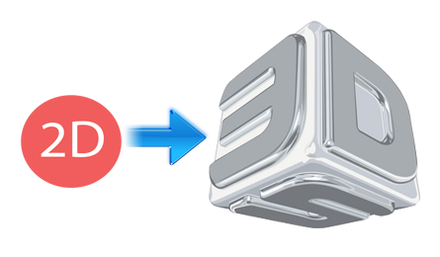
Conclusion
Our app will be able to produce 3D model of the product within a few minutes.
3D model will be generated by fastest processing algorithm.
22

Slide 23
References
D. A. Bowman, E. Kruijff, J. J. LaViola, and I. Poupyrev. 3D User Interfaces: Theory and Practice. Addison Wesley Longman Publishing Co., Inc., 2004
C. Hand. A survey of 3D interaction techniques. In Computer graphics forum, volume 16, pages 269–281. Wiley Online Library, 1997.
old_mkss.pdf book for image 3D:
https://www.opengl.org/discussion_boards/showthread.php/177674-Using-OpenCV-with-OpenGL-for-texture-mapping
23

Slide 24
Thank you

