Slide 1
Stroke Prediction Analysis
Subtitle: Data Analytics Case Study
Presented by: Syed Muhammad Uzair Ahmed
Date: 14/7/2024

Slide 2
Table of Contents
Introduction
Objective
Data Overview
Data Preprocessing
Exploratory Data Analysis
Conclusion
Next Steps

Slide 3
Objective:
To analyze the stroke prediction dataset to identify the risk factors associated with strokes. This analysis aims to provide insights on various trends associated with Stroke.

Slide 4
DATA OVERREVIEW
Dataset Source: Kaggle - Stroke Prediction Dataset
Features:
id: Unique identifier
gender: Gender of the patient
age: Age of the patient
hypertension: Whether the patient has hypertension
heart_disease: Whether the patient has heart disease
ever_married: Marital status of the patient
work_type: Type of work the patient does
Residence_type: Type of residence (Urban/Rural)
avg_glucose_level: Average glucose level in the blood
bmi: Body mass index
smoking_status: Smoking status of the patient
stroke:Whether the patient had a stroke

Slide 5
Data Preprocessing
Steps:
Handling missing values
Standardization
Handling Duplicates
Normalizing the data

Slide 6
Exploratory Data Analysis

Slide 7
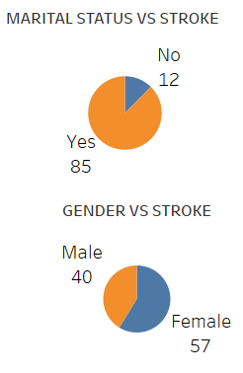
MARRIED PEOPLE HAS GREATER CHANCES OF STROKE AS
COMPARED TO NON MARRIED PEOPLE
FEMALES HAVE SLIGHTLY GREATER CHANCES OF
STROKE THAN MEN

Slide 8
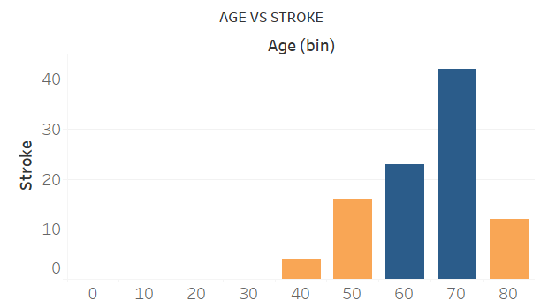
The chances of stroke varies between different ages however the age between 70 to 80 has a Greater chance of stroke comparatively

Slide 9
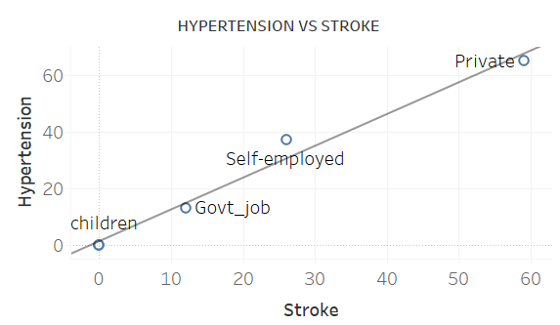
The relationship between stroke and hypertension is directly proportional
Whereas private job workers have a very great chance of stroke

Slide 10
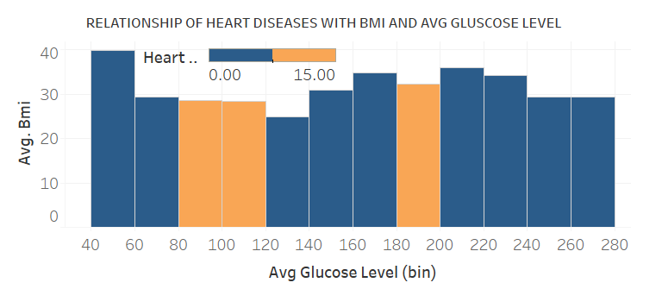
The heart disease has a slightly stronger chance at Avg glucose level between 80 to 120 along with approx 25 bmi.

Slide 11
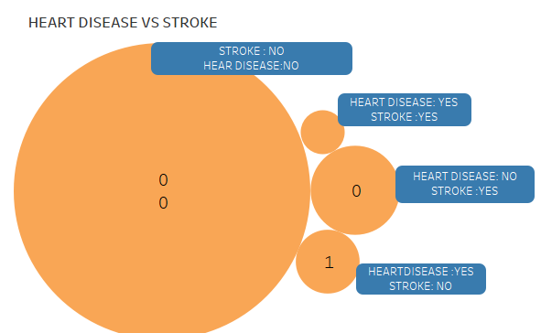
The following illustration shows us that the heart disease is not the major cause of stroke however people having no heart disease are also less likely to have stroke

Slide 12
Conclusion
Insights
Age, hypertension, heart disease, and average glucose level are significant predictors of stroke.
Early detection and management of these risk factors can help in preventing strokes.
Married people mostly females and having private jobs are more likely to have strokes
Stroke can occur in any age group and the elders have slightly greater chances

Slide 13
Action Items
Develop a user-friendly tool for healthcare providers to input patient data and receive stroke risk predictions.
Share insights with public health organizations to develop targeted stroke prevention programs.

Slide 14
THANK YOU

