Slide 1

Artificial Intelligence Lab Project
Wine Quality Predictor
Submitted to: Arfa Hassan

Slide 2

Introduction
We have developed a machine learning model to predict the quality of wines.
goal is to accurately classify the quality of wines based on their chemical properties.
A dataset containing various chemical attributes of wines is utilized, along with their corresponding quality ratings. The problem is to build a model that can predict the quality of a wine based on its chemical composition.

Slide 3

Exploratory Data Analysis
Before building the model, we explored the dataset to gain insights and understand the data better.
Visualizations:
Bar plot of wine quality distribution: We visualized the distribution of wine quality ratings to understand the class balance in the dataset.
Correlation heatmap between features: We analyzed the correlation between different chemical attributes to identify any significant relationships.

Slide 4
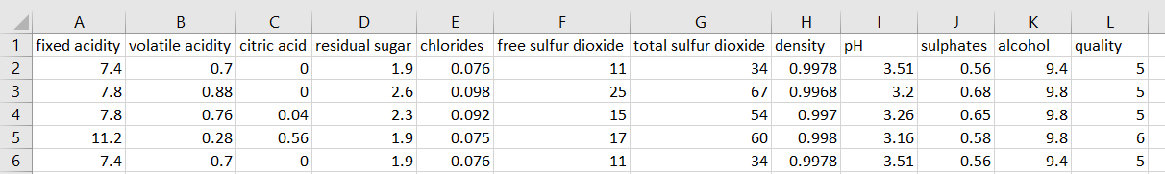
Data Preprocessing and Feature Selection
We performed preprocessing steps to ensure the quality and reliability of the data.
Handling missing values: The dataset used in this project didn't have any missing values, so no additional steps were required.
Feature selection: We selected a subset of relevant features to train our model, considering their impact on wine quality.

Slide 5
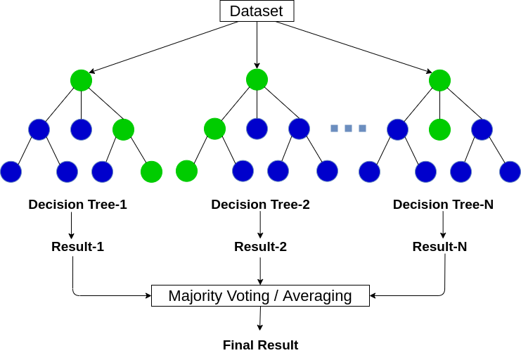
Model Training
We trained a Random Forest Classifier to predict wine quality based on the selected features.
We employed the Random Forest Classifier algorithm due to its robustness and ability to handle complex datasets.

Slide 6
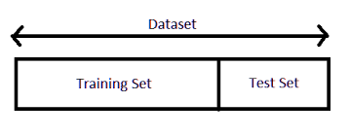
Model Training – Train & Test Split
We split the dataset into training and testing sets and used cross-validation for reliable performance estimation.
then initialized the Random Forest model and fine-tuned its parameters to optimize performance.
We trained the model on the training data to learn the patterns and relationships between the features and wine quality.

Slide 7
Model Evaluation & Performance
We assessed the performance of our model using the test data to measure its accuracy.
The accuracy score is a metric that indicates the proportion of correctly predicted values compared to the total number of predictions.
By comparing the predicted wine quality values with the actual values in the test dataset, we calculated the accuracy score.

Slide 8
Model Prediction & Results
Process of making predictions: We used the trained model to make predictions on new, unseen data.
Showcase sample input: We presented an example input with chemical properties of a wine.
Predicted wine quality: We demonstrated the model's ability to predict the quality of the wine based on the given input.
Model's ability to generalize: We discussed how the model can generalize and make predictions on new, unseen data with satisfactory accuracy.

Slide 9
Front-End Integration
We developed a web application to provide an easy and intuitive interface for wine quality prediction.
The web application allows users to input the chemical properties of a wine and receive a predicted quality rating.
We designed a user-friendly interface with input fields for chemical properties and a button to initiate the prediction.
The frontend of the web application interacts with a Flask server on the backend, which hosts the trained machine learning model. The server handles the prediction requests and returns the results to the frontend for display.

Slide 10

QnA
If you have any questions, feel free to ask

