Slide 1
SoC-Based Out-of-Band Encryption Module
AES-256 Hardware Acceleration with Vitis & ARM NEON
Zynq Zybo Z7-10

Slide 2
Motivation & Problem Statement
Software-only encryption depends on OS security
OS vulnerabilities can expose cryptographic keys
Hardware-based security improves isolation
Goal: Secure, OS-independent encryption using SoC

Slide 3
System Overview
Platform: Zynq Zybo Z7-10 (ARM Cortex-A9 + FPGA)
PS: Control logic, UART, Key Management System
PL: AES-256 encryption/decryption accelerator
Out-of-band communication using UART

Slide 4
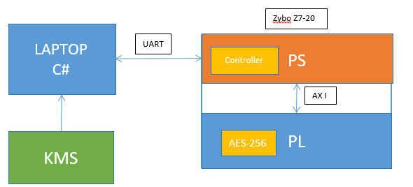
SoC Architecture (PS–PL Co-design)
PS manages control & KMS, PL performs AES-256 acceleration

Slide 5
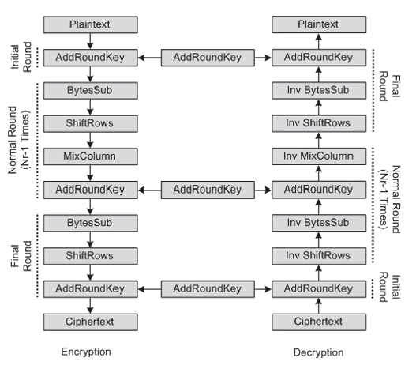
AES-256 Algorithm Overview
Encryption and decryption round structure (14 rounds)

Slide 6
AES-256 Hardware Implementation (PL)
Implemented in Verilog HDL
128-bit data block, 256-bit key
AXI-Lite interface for PS–PL communication
Supports encryption and decryption modes

Slide 7
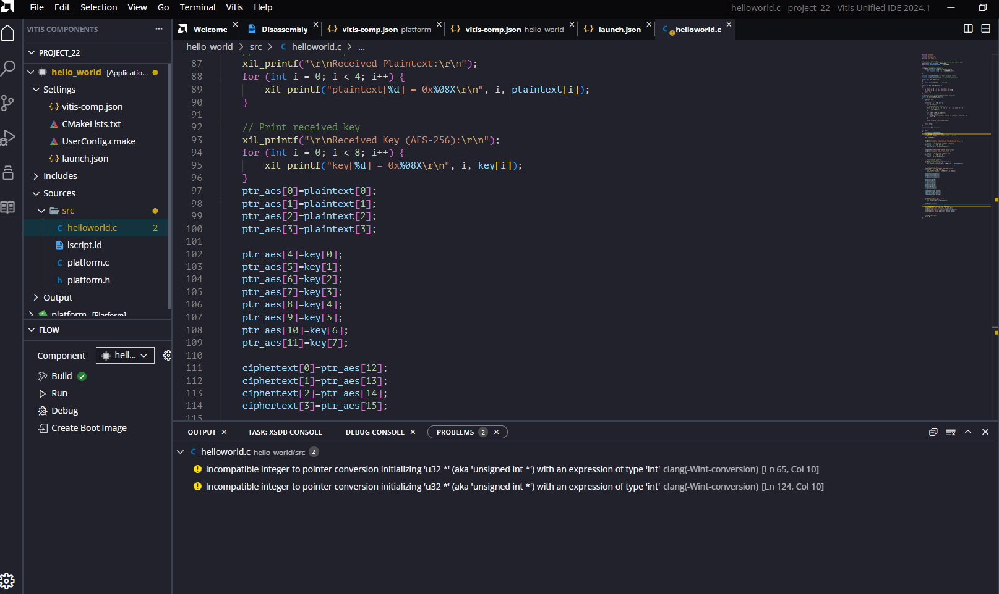
Vitis (PS) Software Implementation
Vitis application handling UART and AXI register access

Slide 8
End-to-End Data Flow
C# Application sends plaintext + key via UART
PS receives data and configures AES core via AXI
PL performs encryption/decryption
Result sent back to PC via UART

Slide 9
ARM NEON Optimization (PS Side)
Task 1: Sum of array (scalar vs NEON)
Task 2: 4×4 matrix multiplication
Task 3: Edge detection on 2D image
Demonstrates SIMD acceleration on Cortex-A9

Slide 10
Conclusion & Future Work
Successful SoC-based secure encryption system
Hardware AES improves security and performance
NEON accelerates data-parallel workloads
Future work: RSA/ECC, secure boot, performance analysis

