Slide 1
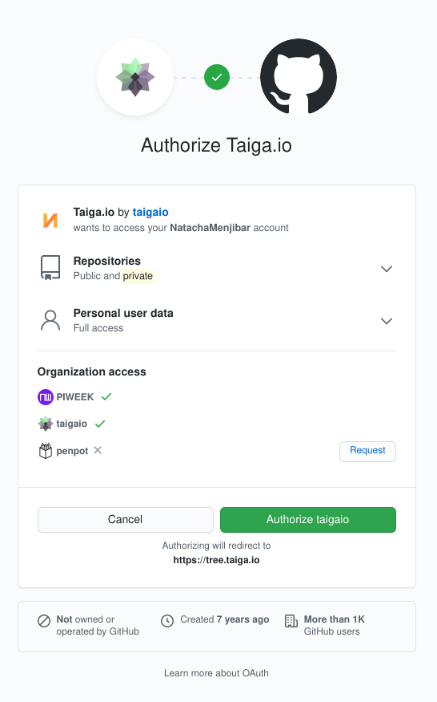
Software Project Management
Project: VoicePilot – Voice-Controlled Browser Automation
Course: Software Project Management
University: Riphah International University
Team Members: Daniyal Wajid, Uzair Hassan
Semester: Fall 2025

Slide 2

Introducing VoicePilot: Hands-Free Browser Automation
VoicePilot is an innovative Chrome extension designed to transform your browsing experience into a seamless, hands-free operation. Leveraging advanced voice recognition, it empowers users to control their web browser naturally and efficiently.
Utilizes the cutting-edge Web Speech API for superior voice recognition accuracy.
Supports a comprehensive suite of commands for tab management, navigation, search, scrolling, and page interaction.
Engineered with a dual focus on enhancing accessibility for all users and boosting overall productivity.

Slide 3
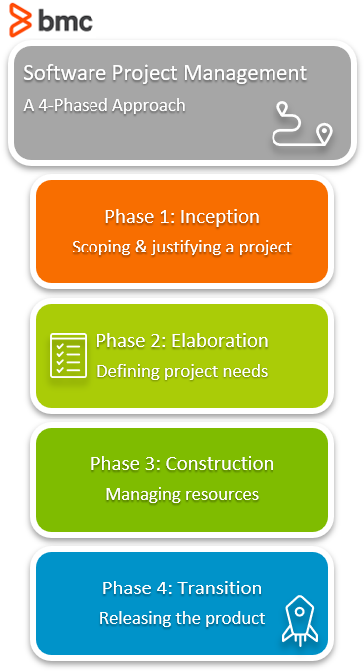
Project VoicePilot: Objectives & Scope Defined
Key Objectives
Develop a fully functional and robust voice-controlled Chrome extension.
Achieve a high voice recognition accuracy.
Project Scope
In-scope Features: Comprehensive voice commands, intuitive tab control, efficient navigation capabilities, and real-time user feedback mechanisms.
Out-of-scope Considerations: Support for mobile browsers, an offline operational mode, and multi-language support are not part of the current project phase.

Slide 4
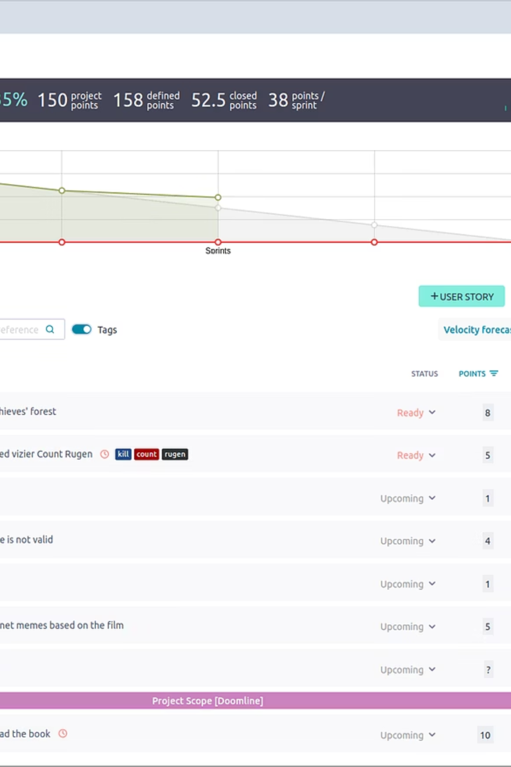



Why Taiga? The Ideal SPM Tool for Our Project
For the VoicePilot project, we strategically selected Taiga as our primary Software Project Management tool. Its robust features and adaptability make it an excellent choice for academic and small team environments.
Agile & Structured Planning
Taiga seamlessly supports both Agile methodologies and structured project planning, allowing for flexibility and organized execution.
Comprehensive Task Tracking
It provides powerful capabilities for task tracking, efficient scheduling, and real-time monitoring of project progress.
Ideal for Teams
Its user-friendly interface and collaborative features are perfectly suited for the dynamics of academic and small-team projects.

Slide 5


Taiga in Action: Project Setup & Structure
Our VoicePilot project was meticulously configured within Taiga to ensure a clear and transparent development process. This foundational setup provides all stakeholders with real-time insights into project status and direction.
A dedicated project was created in Taiga, establishing a defined workflow tailored to our needs.
Project milestones were carefully aligned with key development phases to mark progress and critical delivery points.
User stories were developed directly from functional requirements, ensuring user-centric feature development.
Individual tasks were linked to specific Work Breakdown Structure (WBS) activities for granular tracking.
Outcome: This detailed setup within Taiga resulted in a clear project structure and enhanced visibility for the entire team.

Slide 6

Taiga: Backlog & Task Management for Efficiency
Effective backlog and task management are critical for maintaining momentum and clarity in any software project. Taiga provided the robust framework we needed for VoicePilot.
01
02
Comprehensive Product Backlog
Prioritized Task Categorization
All features and requirements for VoicePilot were meticulously captured and maintained within the product backlog.
Tasks were categorized not only by priority but also by their respective project phases, streamlining workflow.
03
04
Transparent Status Tracking
Quick Identification of Roadblocks
A clear status tracking system—from To-Do to In Progress and ultimately Done—provided immediate visual updates.
The system allowed for easy and rapid identification of potential delays and blockers, facilitating proactive problem-solving.
Benefit: This systematic approach significantly improved our planning accuracy and execution control.

Slide 7
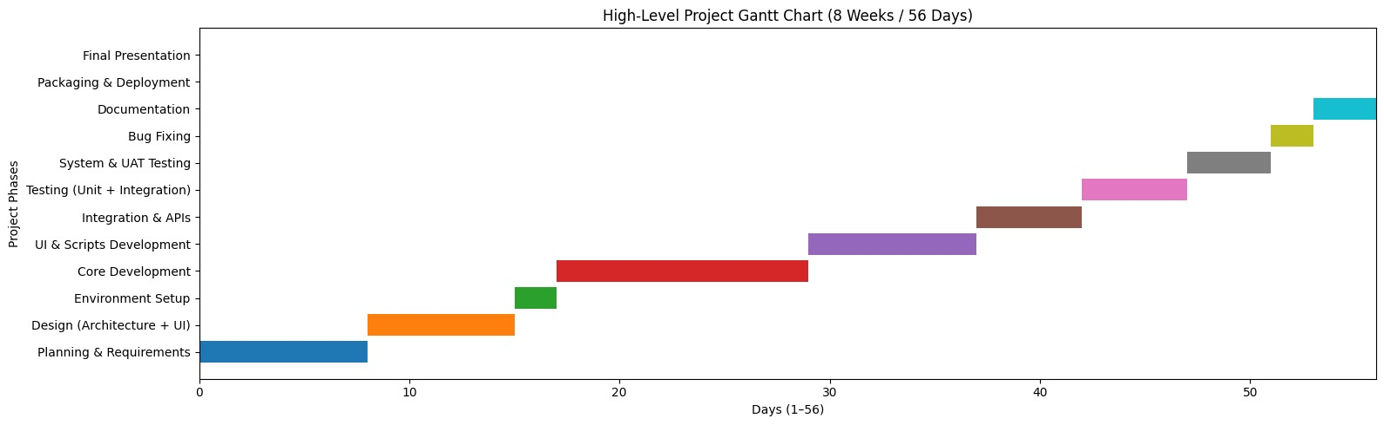
Gantt Chart
Taiga
What & When
How & Code
GitHub

Slide 8
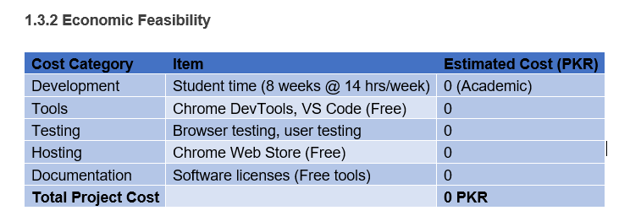
Feasibility Study

Slide 9
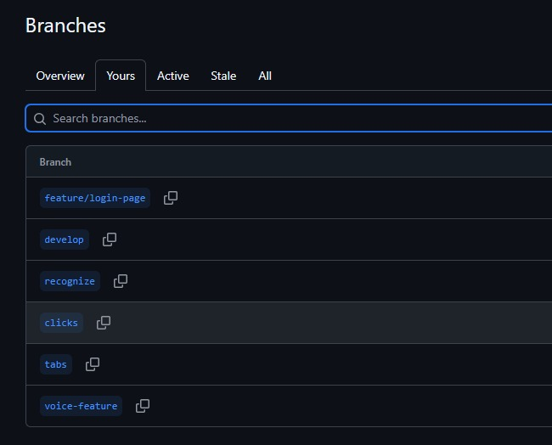

GitHub: The Backbone of Our Code Management
Beyond project planning, robust source code management is paramount. GitHub served as the essential version control tool for the VoicePilot project.
A dedicated GitHub repository was established for the entire VoicePilot project codebase.
All commits, code changes, and version histories were meticulously tracked, providing a complete audit trail.
GitHub's capabilities fostered seamless collaboration among team members, enabling concurrent development and code reviews.
It also served as a reliable backup mechanism, safeguarding our code against data loss.
Repository: github.com/uzairhassan375/SPM-Project

Slide 10
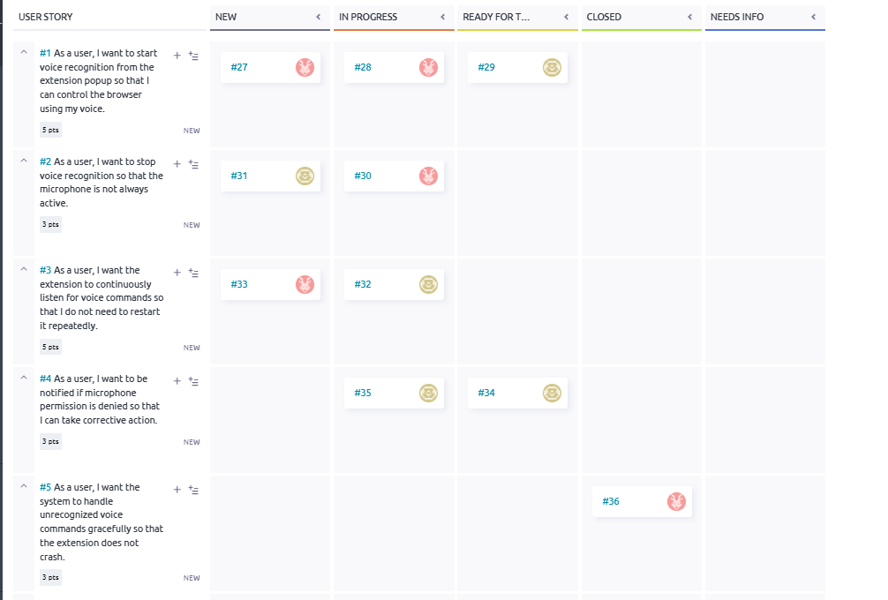
Backlog Management: Taiga
Taiga
What & When
How & Code
GitHub

Slide 11
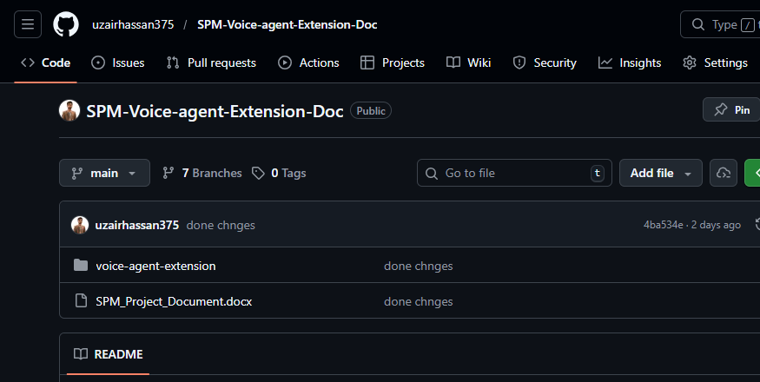
Seamless Integration: GitHub in Harmony
Taiga
What & When
How & Code
GitHub

Slide 12
Conclusion & Key Takeaways from VoicePilot
The VoicePilot project successfully demonstrated the effective application of modern software project management principles and tools.
1
Effective Project Management
Taiga proved to be an invaluable asset for planning, monitoring, and iterative development, fostering efficiency.
2
Secure Code Management
GitHub ensured a secure, collaborative, and version-controlled environment for all source code.
3
Successful Tool Integration
VoicePilot exemplifies strong SPM tool usage, successful execution, and the benefits of integrated platforms.

