Slide 1
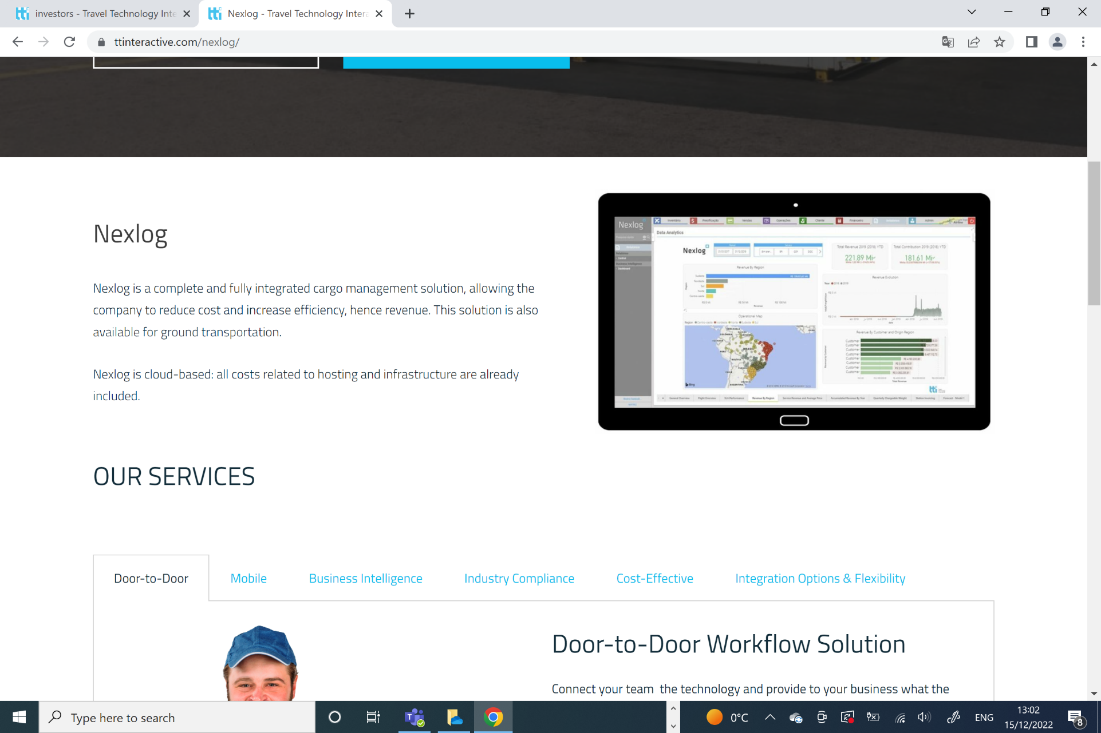
Change first paragraph section to the following:
NEXLOG PAGE
Nexlog is a complete and fully integrated multimodal platform cargo management solution, allowing the company to reduce cost and increase efficiency, hence revenue. This solution is also available for ground transportation.
Nexlog is cloud-based: all costs related to hosting and infrastructure are already included.

Slide 2
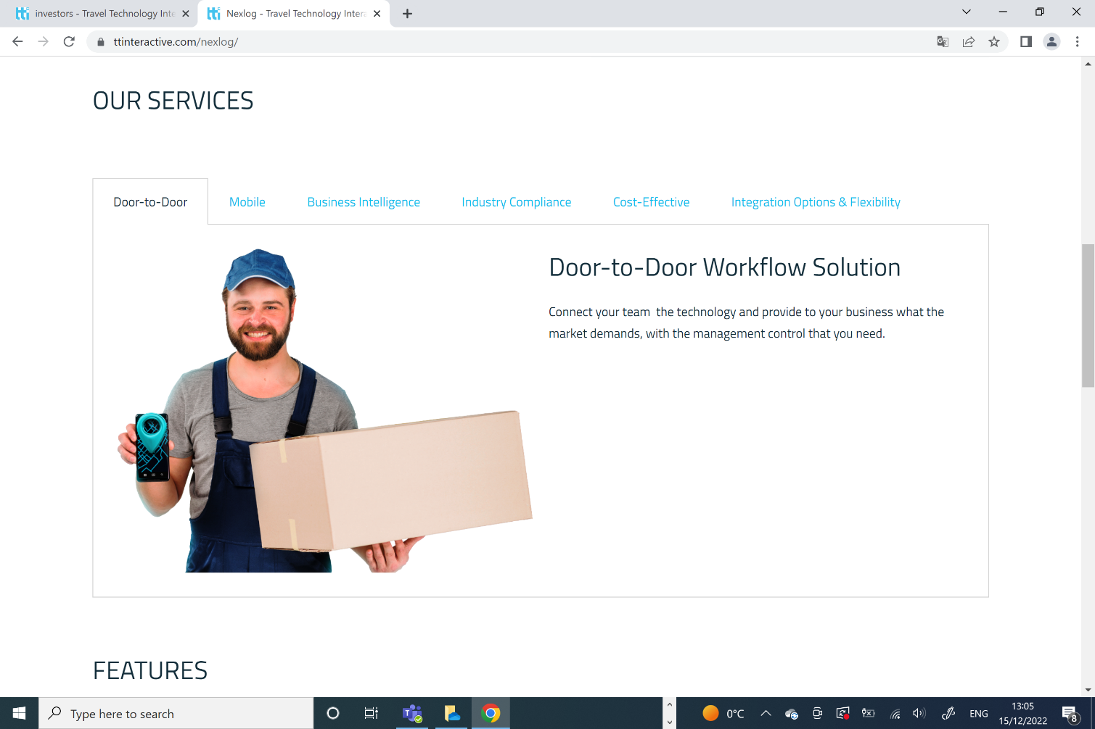
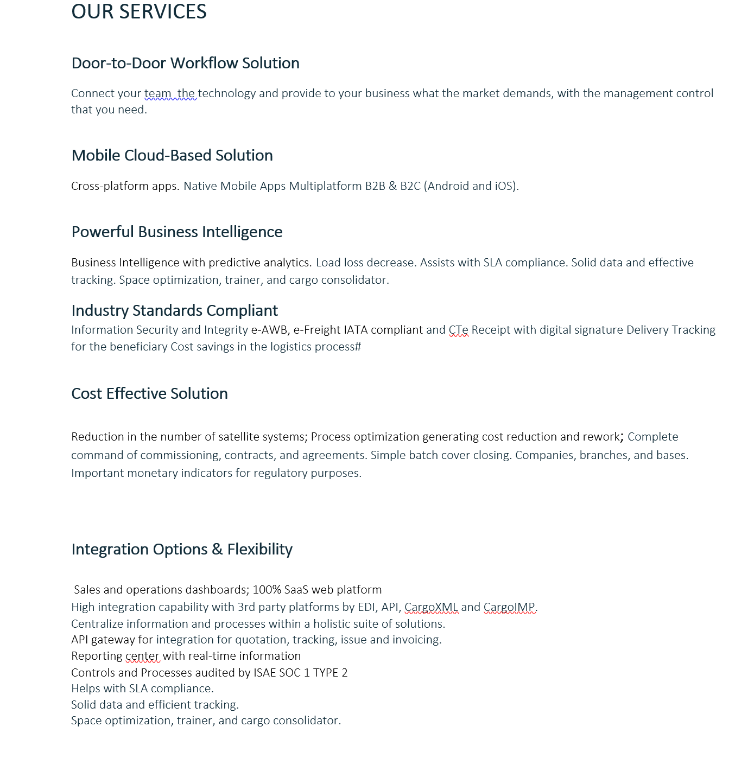
NEXT SECTION TO CHANGE INFORMATION:

Slide 3
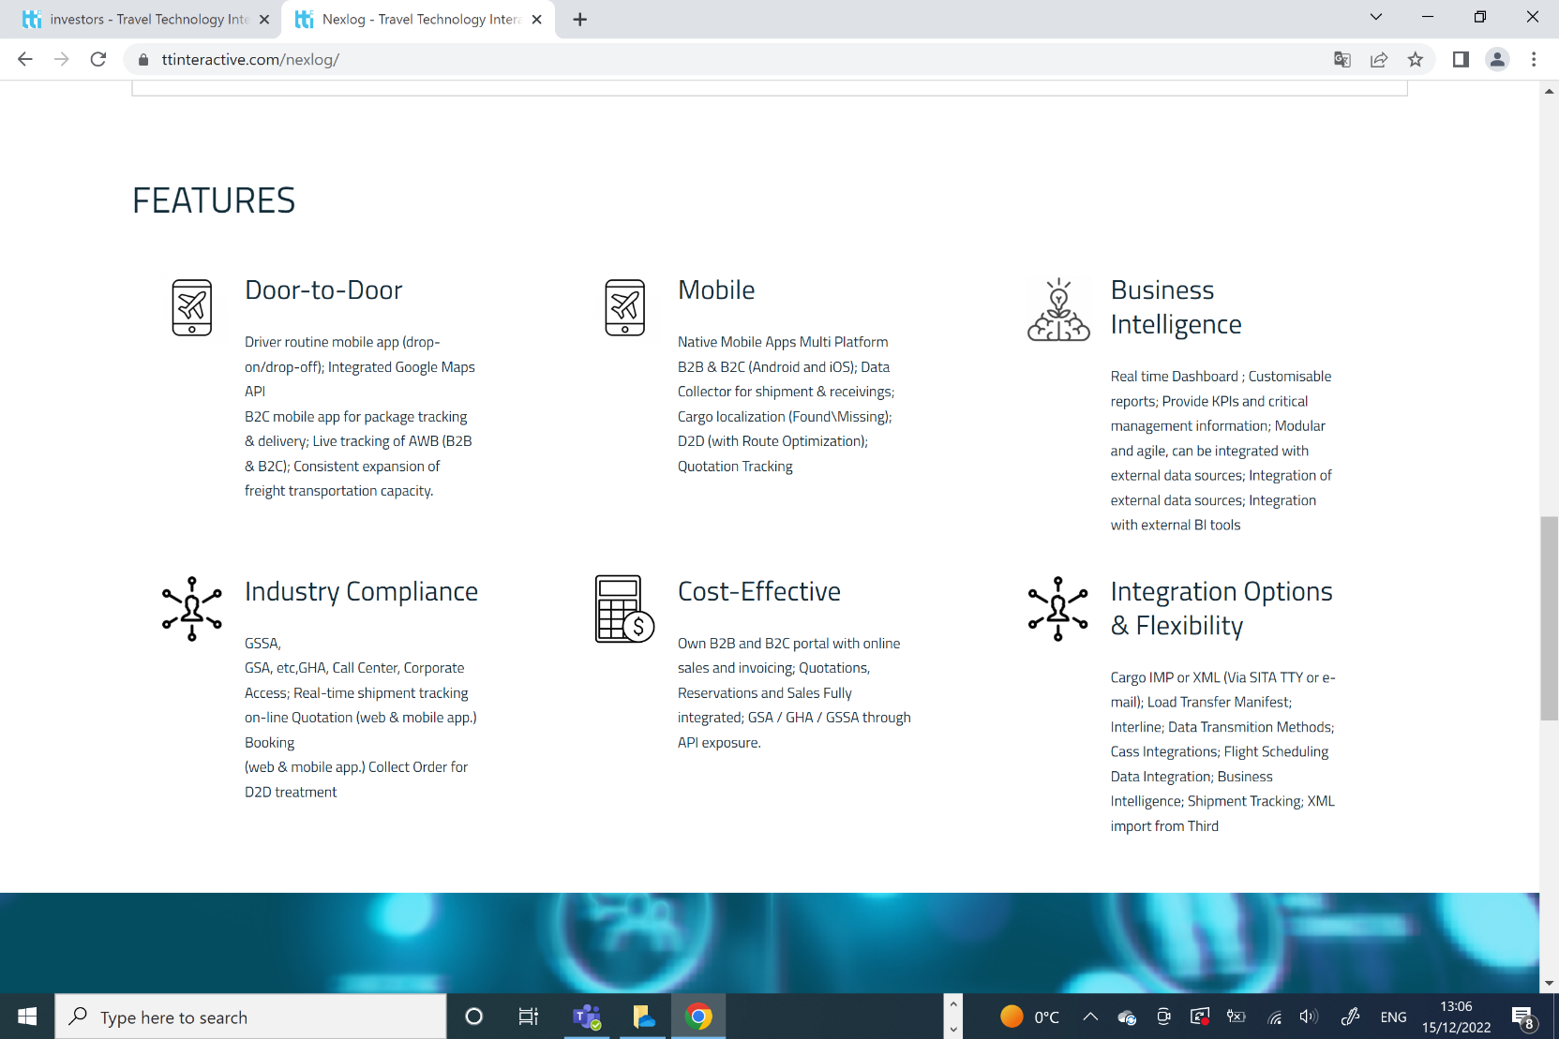
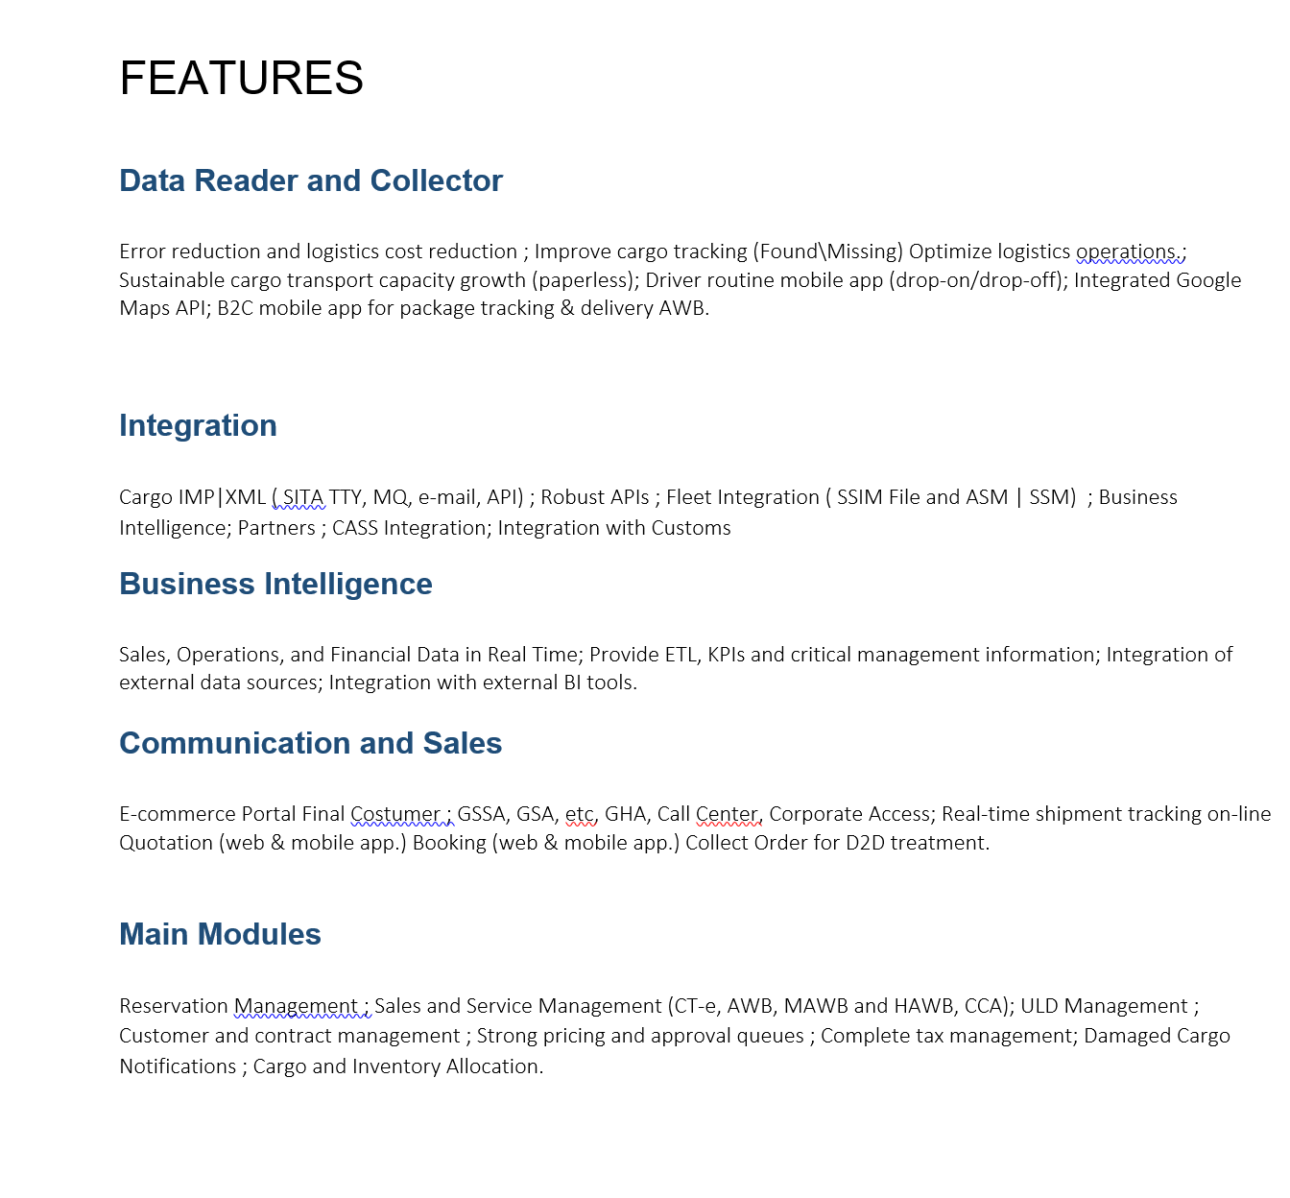
Last Section from Nexlog to change:
(change titles also as you can see)

