Slide 1
RAG BACKEND

Slide 2
SETUP
Parse xml: running locally after parsing “cpg-corpus-cms.xml” file
Generate vectors: using faiss package for vectorising
RAG Implementation: carries out indexes for vector search and using top 5 result for context of query to llm for output result
LLM used: with Groq package : “llama-3.3-70b-versatile”
TBD: Test and optimize vectorization
Django: input prompt API to call model that outputs result
TBD: User model and authorization for customers
Screenshots attached below

Slide 3
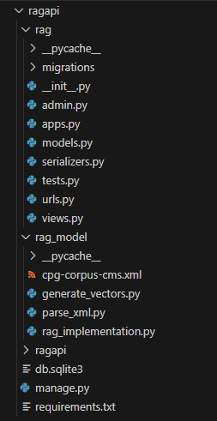
Backend project architecture

Slide 4
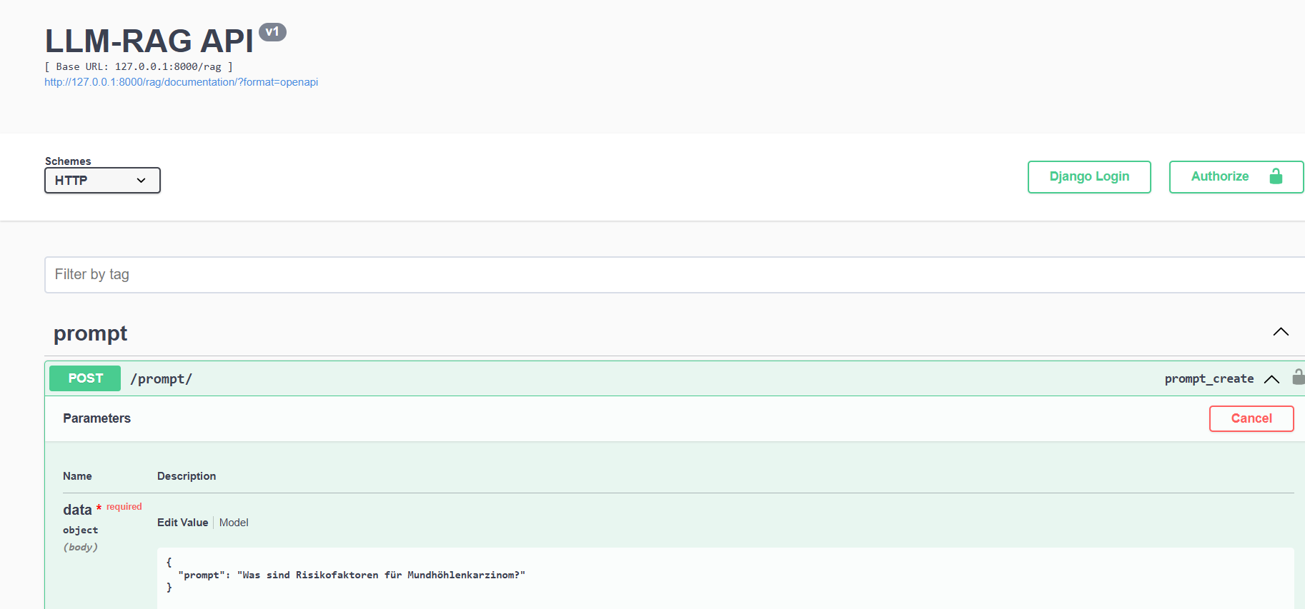
API list input

Slide 5
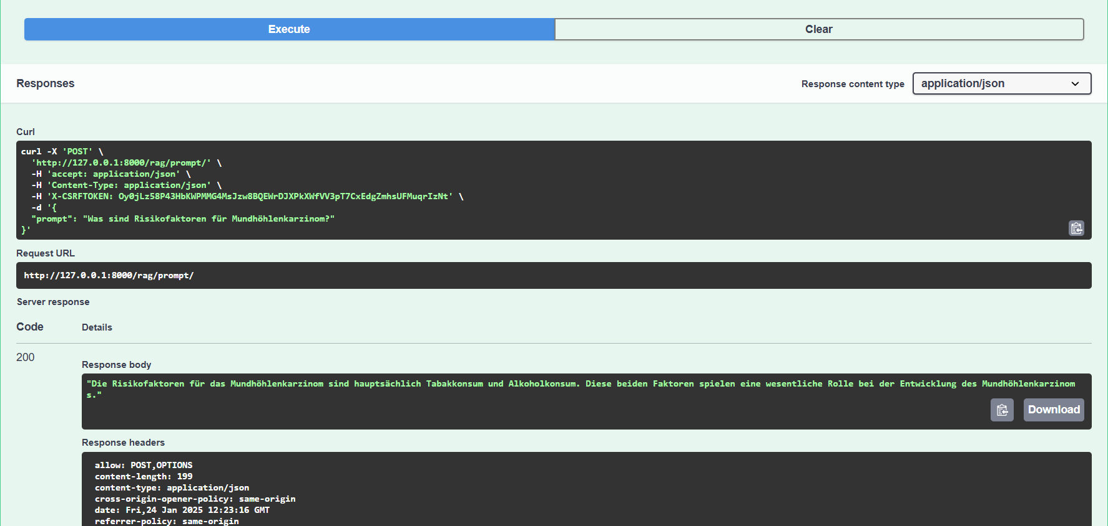
Prompt output

