Slide 1
FINAL PROJECT PRESENTATION
SMART SUPPLY CHAIN AND INVENTORY MANAGEMENT SYSTEM POWERED BY MICROSERVICES
Add names and roll numbers
A web-based platform that helps businesses manage products, inventory, users, and customer orders efficiently with secure role-based access.

Slide 2
Slide 1
Synopsis
The SMART SUPPLY CHAIN AND INVENTORY MANAGEMENT SYSTEM POWERED BY MICROSERVICES is a web-based platform designed for efficient product, stock, and order management.
It combines authentication, inventory control, customer ordering, admin approvals, analytics, and configurable business rules in one centralized system.
The solution is intended for small to medium-scale businesses that need improved inventory visibility, secure access control, and smoother order processing.

Slide 3
Slide 2
Introduction
Small and medium-sized warehouse or retail businesses often depend on spreadsheets, manual records, or disconnected tools for stock and order handling.
This causes inventory mismatch, delayed fulfillment, poor order traceability, and difficulty in making timely operational decisions.
The proposed system addresses these issues through a secure full-stack application with microservice separation, real-time stock validation, and centralized role-based workflows.

Slide 4
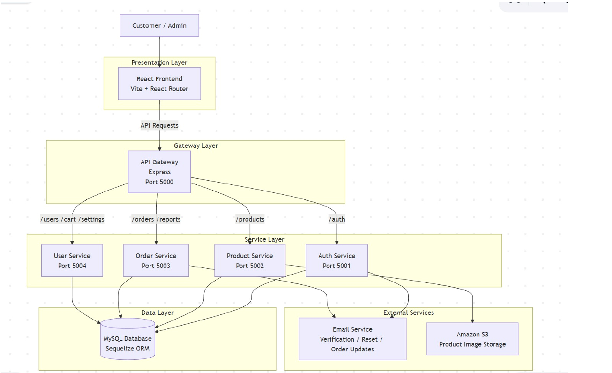
Slide 3
Overall Explanation with Design Diagram
Gateway routes requests to dedicated authentication, product, order, and user services.
Customer workflows cover browsing, cart, checkout, tracking, and returns.
Admin workflows cover product control, approvals, users, settings, reports, and dispatch.
Security layer includes JWT validation, session rotation, role checks, CSRF protection, CORS, and rate limiting.

Slide 5
Slide 4
Dataset Description
Master Data
Transactional Data
System / Control Data
Product: name, category, price, quantity, reserved quantity, weight, image URL/key
User: email, role, admin approval status, validity flag, address details
Cart: user-product mapping with quantity
Order: customer, status, total, shipping info, delivery timestamps
OrderItem: product-wise quantity and price snapshot per order
Wishlist: saved products for customer convenience
UserSession: refresh-token session tracking and revocation
AppSetting: shipping charge, return window, cart limit, low-stock threshold, delivery ETA range
AuditLog: product restock, order actions, and admin activity history
Dataset nature: structured relational operational data stored in MySQL and modeled through Sequelize entities. The system uses live transactional records rather than a static ML dataset.

Slide 6
Slide 5
Implementation Tools / Software
Frontend: React 19, React Router, Vite, Chart.js, HTML, CSS, JavaScript
Backend: Node.js, Express.js, Sequelize ORM, http-proxy-middleware, Multer
Database: MySQL with relational tables for users, products, orders, carts, sessions, settings, and logs
Security: JWT, bcrypt, cookie-based auth, CSRF validation, CORS, express-rate-limit
Utilities: Nodemailer for emails, AWS S3 integration for product images, PM2 and Nodemon for service management
Development approach: modular microservices with gateway routing on ports 5000 to 5004

Slide 7
Slide 6
Output
Secure registration, email verification, login, forgot-password, and approval workflows
Customer-side product browsing with search, filtering, sorting, cart persistence, and checkout
Admin-side product CRUD, low-stock monitoring, restocking, and image management
Order lifecycle handling: place, cancel, dispatch, auto-deliver, and return within configured window
Dashboards and reports: revenue by month, monthly orders, best-selling product, profitable category, CSV exports, and audit logs
Operational flexibility through configurable settings like shipping charge, stock threshold, and delivery timing

Slide 8
Slide 7
Conclusion
The project successfully developed a secure and scalable inventory management and order processing system.
Role-based access, protected sessions, stock reservation logic, and configurable settings improve operational safety and accuracy.
The microservices-based design makes the platform modular, easier to maintain, and ready for further expansion.

Slide 9
Slide 8
Future Enhancement
Integrate payment gateways for real transactions.
Containerization using Docker and orchestration with Kubernetes for scalable deployment.
Connect external shipping/logistics APIs for real delivery tracking.
Introduce AI-based demand forecasting and product recommendation modules.

Slide 10
Slide 9
Outcome
A working capstone application with customer and admin modules, inventory dashboards, reports, approval flow, and secure authentication.
Improved inventory accuracy through reservation tracking, low-stock visibility, order-state management, and return-based stock restoration.
A strong foundation for future smart supply chain capabilities such as forecasting, logistics integration, and cloud-native deployment.

Slide 11
Slide 10
References
Chopra, S. and Meindl, P. Supply Chain Management: Strategy, Planning, and Operation. Pearson.
Chen, J. and Paulraj, A. Towards a theory of supply chain management. Journal of Operations Management.
Date, C. J. An Introduction to Database Systems. Pearson.
React Documentation - https://react.dev/
Express.js Documentation - https://expressjs.com/
Sequelize Documentation - https://sequelize.org/ and JWT Introduction - https://jwt.io/introduction

