Slide 1
External Monitor
POC DELIVERABLE
First PoC | JPMorgan Chase
13
6
7
A Practical proof that external account noise can be turned into a concise, Red Hat-relevant seller view.
reviewed
kept + watch
noise
OBJECTIVES
100
Prove seller value before building automation.
Show the end-state output for one enterprise customer.
Use the PoC as the blueprint for the product build.
highest priority score
Seller-facing Account Pulse sheet
Supporting audit trail and scoring logic
Flow visual and design brief

Slide 2
Problem
The Lack of Filtering, Prioritization, and Seller-Ready Interpretation
WHAT EXISTS
WHY IT FAILS
WHAT A SELLER NEEDS
Official company news
Investor and technology content
Independent reporting
Secondary commentary and duplicates
Duplicate or stale items
Generic market commentary
Weak account relevance
No Red Hat lens
No clear next action
What changed?
Why does it matter?
What is the Red Hat angle?
What should we validate next?
Sellers can access news but it is too noisy to use quickly.
Raw news still leaves the seller doing the work.
Goal: a 30-second account brief, not another news feed.

Slide 3
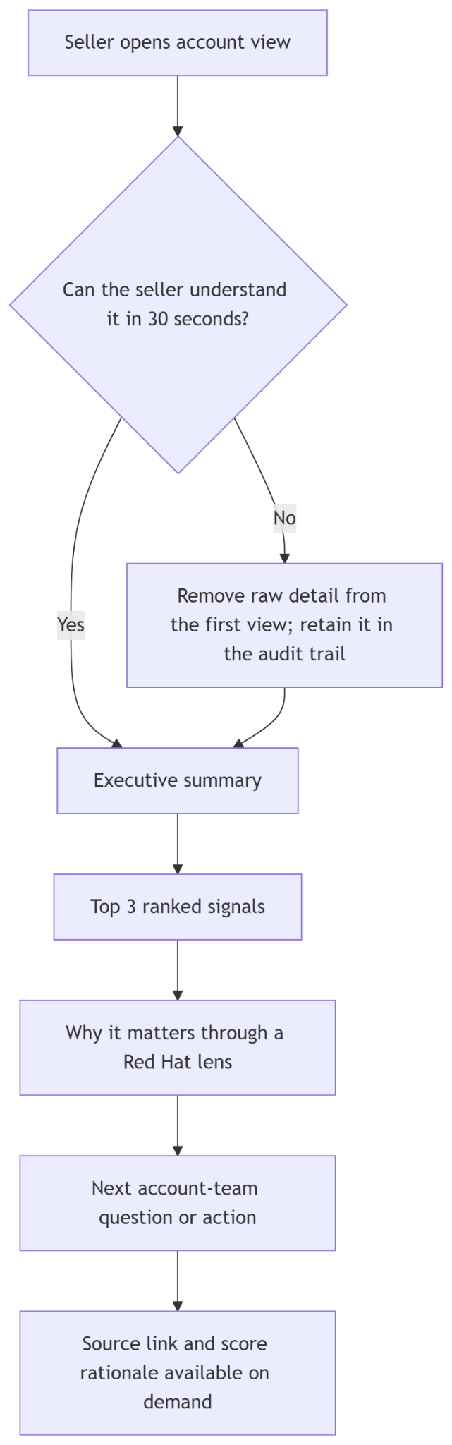
End Outcome
Looking at the Tool From an End-User Perspective
Speed: Prioritizes a strict 30-second comprehension threshold.
Layered Information: Delivers high-level summaries first, with source links and low-level details just one click away.
Strategic Alignment: Filters external signals to explicitly highlight account materiality and immediate sales actionability.

Slide 4
Proposed tool
External Monitor Converts Public Account Activity Into Concise Account Pulse Outputs
1
Monitor
2
Filter
3
Apply RH lens
4
Rank
5
Deliver
Review a bounded set of public sources for a named account.
Remove duplicates, stale items, and generic commentary.
Map surviving signals to bounded Red Hat conversation hypotheses.
Score by materiality, RH relevance, actionability, evidence, and novelty.
Present the result in a seller-facing account view and digest.
KEY IDEA
This is not “find more news.” This is “surface the few signals a Red Hat account team should care about.”

Slide 5
PoC design
Manual V1 to Pave the Way for Automated Versions to Come
MANUAL NOW
CODE LATER
Choose one enterprise account with a rich source universe.
Review bounded public sources.
Create a raw signal register.
Filter, dedupe, and score signals.
Apply a controlled Red Hat motion catalog.
Publish a seller-facing Account Pulse sheet.
Source connectors and scheduled refresh
RAG
API / MCP
Entity matching and normalization
Automated deduplication and classification
Multi-account product UI
Digest delivery and feedback loop
Why JPMorgan Chase? Rich public signal volume, a clear Red Hat lens, and enough noise to make filtering value obvious.

Slide 6
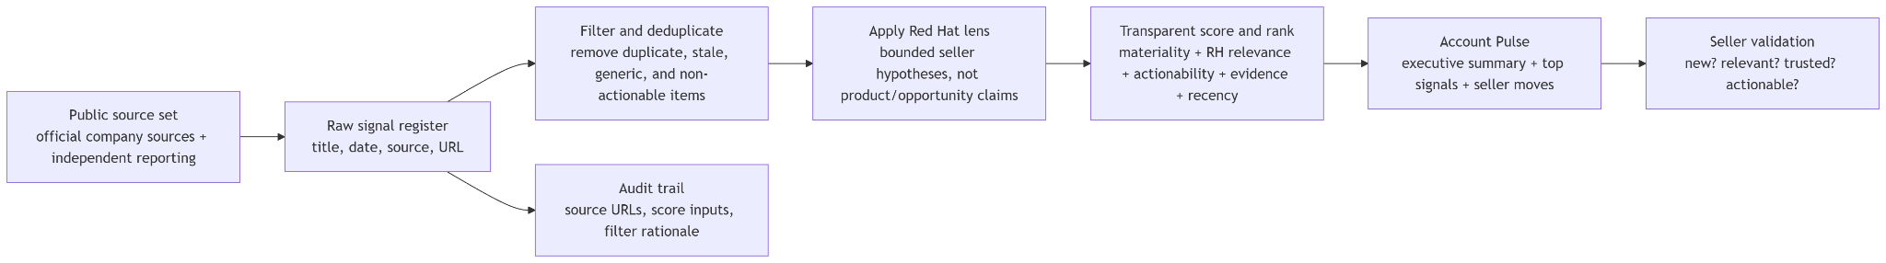
Workflow

Slide 7
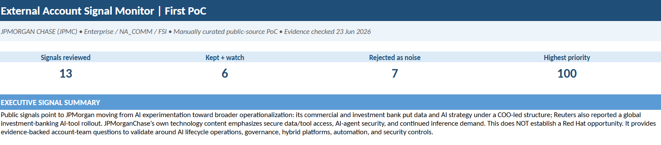
JPMC PoC
30-Sec Glance
13
6
signals reviewed
kept + watch
7
100
rejected noise
top score
Seller view: summary section from the Excel Account Pulse sheet
WHY JPMC
High public signal volume
Strong AI / governance / platform themes
Plenty of irrelevant noise to filter out
Bounded hypotheses only — not an opportunity claim.

Slide 8
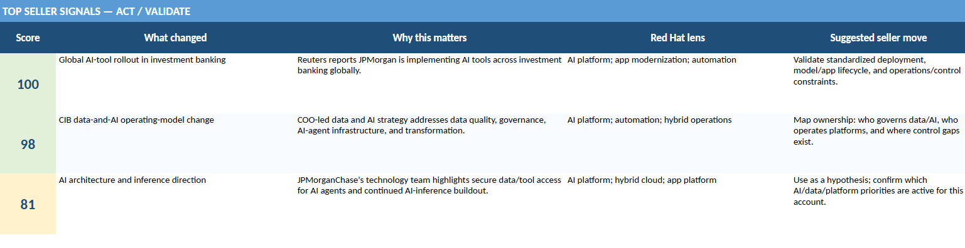
Workbook views
Top 3 Insights (What, Why, and How)
Top signals are concise and paired with the next account-team move.

Slide 9
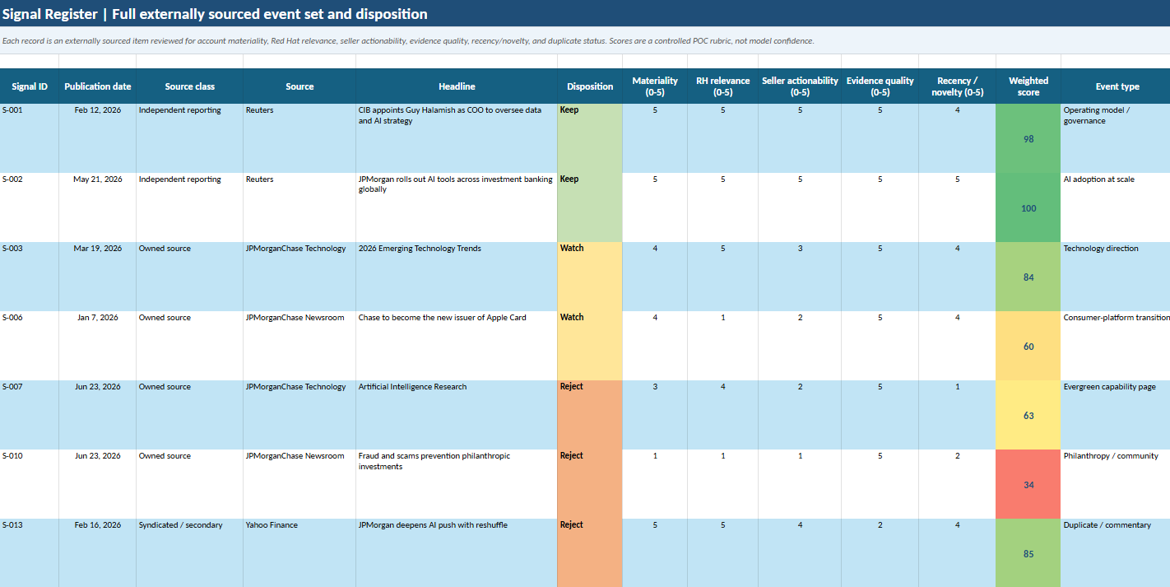
Workbook views
Detailed Line-By-Line View of Pulled Events
The sheet retains disposition, score inputs, and the full audit trail behind the seller view.

Slide 10
What’s next
Using the PoC as a Small, Usable Product Slice.
1. Validate
2. Product shell
3. Signal pipeline
4. Seller workflow
Review the JPMC PoC with the team. Capture: useful, trusted, actionable, missing.
Create a simple multi-account view with sample data and clean navigation.
Automate retrieval, normalization, deduplication, RH motion mapping, and ranking.
Generate a digest / account brief and add a lightweight feedback loop.
Manager ask: approve the direction, then use this PoC as the blueprint for the first product build.

