Slide 1
HEVC

Slide 2
HEVC
H.265
MPEG-H part 2(ISO/IEC 23008-2)
Overview
Reference software

Slide 3
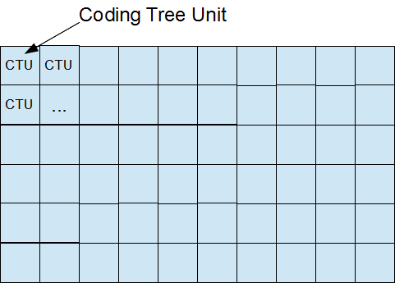
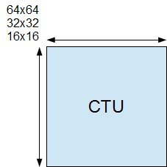
CTU, CU, CTB, CB, PB, and TB
The width and height of CTU are signaled in a sequence parameter set, meaning that all the CTUs in a video sequence have the same size.

Slide 4
Naming conventions
xxxUnit, indicates a coding logical unit which is in turn encoded into an HEVC bit stream.
xxxBlock, it indicates a portion of video frame buffer where a process is target to.

Slide 5
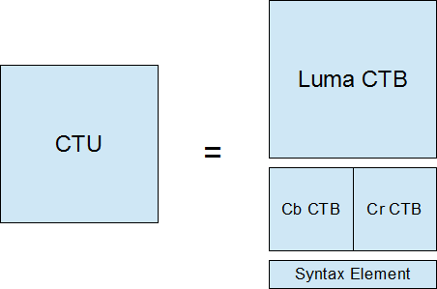
CTU
Is a logical unit. It usually consists of three blocks, namely luma (Y) and two chroma samples (Cb and Cr), and associated syntax elements. Each block is called CTB (Coding Tree Block).

Slide 6
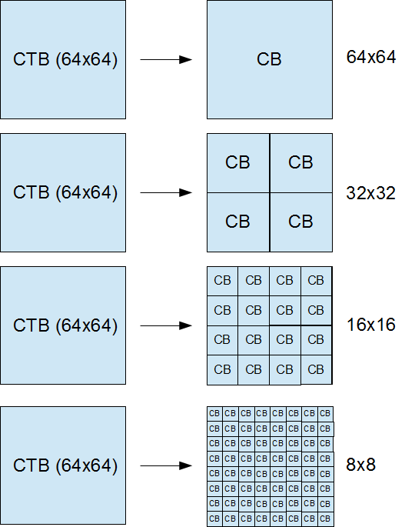
CTB, Coding Tree Block
Each CTB still has the same size as CTU – 64×64, 32×32, or 16×16. Depending on a part of video frame, however, CTB may be too big to decide whether we should perform inter-picture prediction or intra-picture prediction. Thus, each CTB can be differently split into multiple CBs (Coding Blocks) and each CB becomes the decision making point of prediction type. For example, some CTBs are split to 16×16 CBs while others are split to 8×8 CBs. HEVC supports CB size all the way from the same size as CTB to as small as 8×8.

Slide 7
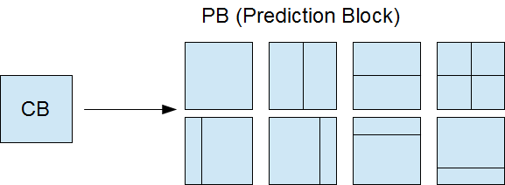
CB, Coding Block ➔ PB, Prediction Block
CB is good enough for prediction type decision, but it could still be too large to store motion vectors (inter prediction) or intra prediction mode. For example, a very small object like snowfall may be moving in the middle of 8×8 CB – we want to use different MVs depending on the portion in CB.
Thus, PB was introduced. Each CB can be split to PBs differently depending on the temporal and/or spatial predictability.

Slide 8
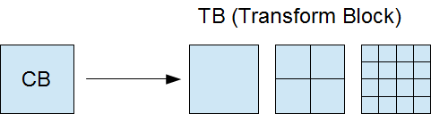
Code residual
Once the prediction is made, we need to code residual (difference between predicted image and actual image) with DCT-like transformation. Again, CB could be too big for this because a CB may contains both a detailed part (high frequency) and a flat part (low frequency). Therefore, each CB can be differently split into TBs (Transform Block). Note that TB doesn’t have to be aligned with PB. It is possible and often makes sense to perform single transform across residuals from multiple PBs, vice versa.

Slide 9
Standard definitions
CTU (coding tree unit): A coding tree block of luma samples, two corresponding coding tree blocks of chroma samples of a picture that has three sample arrays, or a coding tree block of samples of a monochrome picture or a picture that is coded using three separate colour planes and syntax structures used to code the samples. The division of a slice into coding tree units is a partitioning.
CTB (coding tree block): An NxN block of samples for some value of N. The division of one of the arrays that compose a picture that has three sample arrays or of the array that compose a picture in monochrome format or a picture that is coded using three separate colour planes into coding tree blocks is a partitioning.
CB (coding block): An NxN block of samples for some value of N. The division of a coding tree block into coding blocks is a partitioning.

Slide 10
Standard definitions
CU (coding unit): A coding block of luma samples, two corresponding coding blocks of chroma samples of a picture that has three sample arrays, or a coding block of samples of a monochrome picture or a picture that is coded using three separate colour planes and syntax structures used to code the samples. The division of a coding tree unit into coding units is a partitioning.
PB (prediction block): A rectangular MxN block of samples on which the same prediction is applied. The division of a coding block into prediction blocks is a partitioning.
TB (transform block): A rectangular MxN block of samples on which the same transform is applied. The division of a coding block into transform blocks is a partitioning.

Slide 11
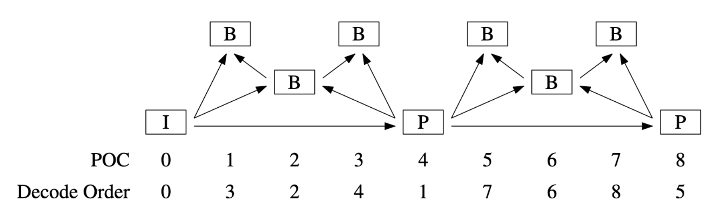
Example: A GOP structure

Slide 12
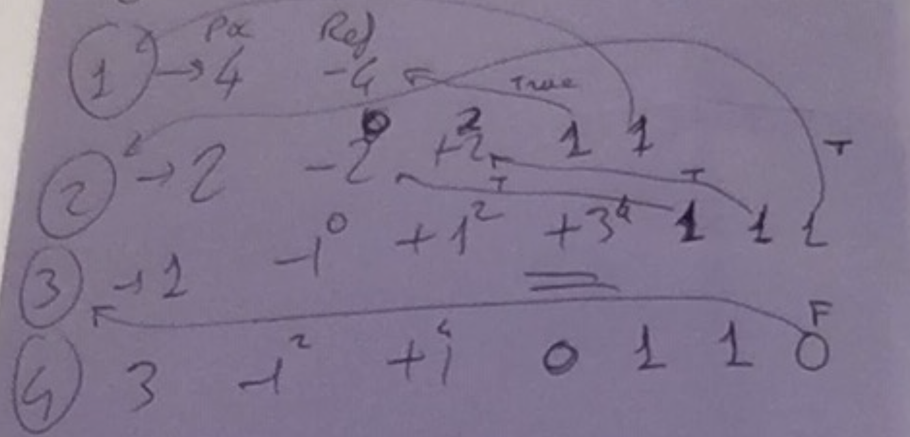
Frame 1 -4 configuration

Slide 13
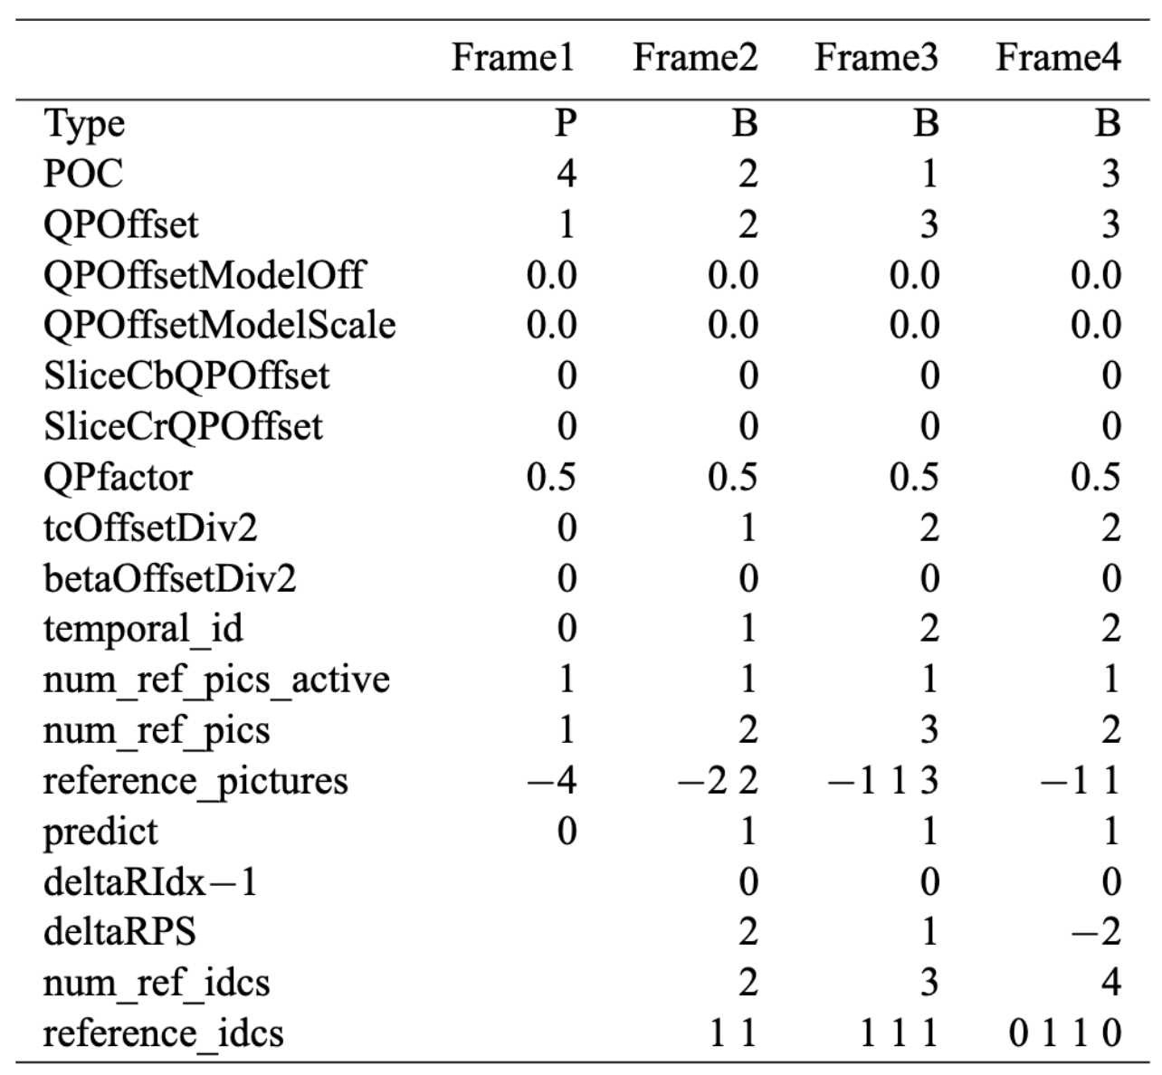
If predict=2, green area auto-computed
QP parameters for rate control
Current PCS frame = 2.
Previous PCS frame = 1
2-1-1 = 0
---
3-2-1=0
---
4-3-1=0
Each frame uses only 1 previous (L0 list) and 1 future (L1 list) frame
https://vcgit.hhi.fraunhofer.de/jct-vc/HM/-/blob/master/doc/software-manual.pdf

Slide 14
HEVC Encoder output (example)
HM software: Encoder Version [16.22] (including RExt)[Linux][GCC 8.4.0][64 bit]
Input File : foreman_qcif.yuv
Bitstream File : str.bin
Reconstruction File : rec.yuv
Real Format : 176x144 25Hz
Internal Format : 176x144 25Hz
Sequence PSNR output : Linear average only
Sequence MSE output : Disabled
Frame MSE output : Disabled
MS-SSIM output : Disabled
xPSNR calculation : Disabled
Cabac-zero-word-padding : Enabled
Frame/Field : Frame based coding
Frame index : 0 - 99 (100 frames)
Profile : main
CU size / depth / total-depth : 64 / 4 / 4

Slide 15
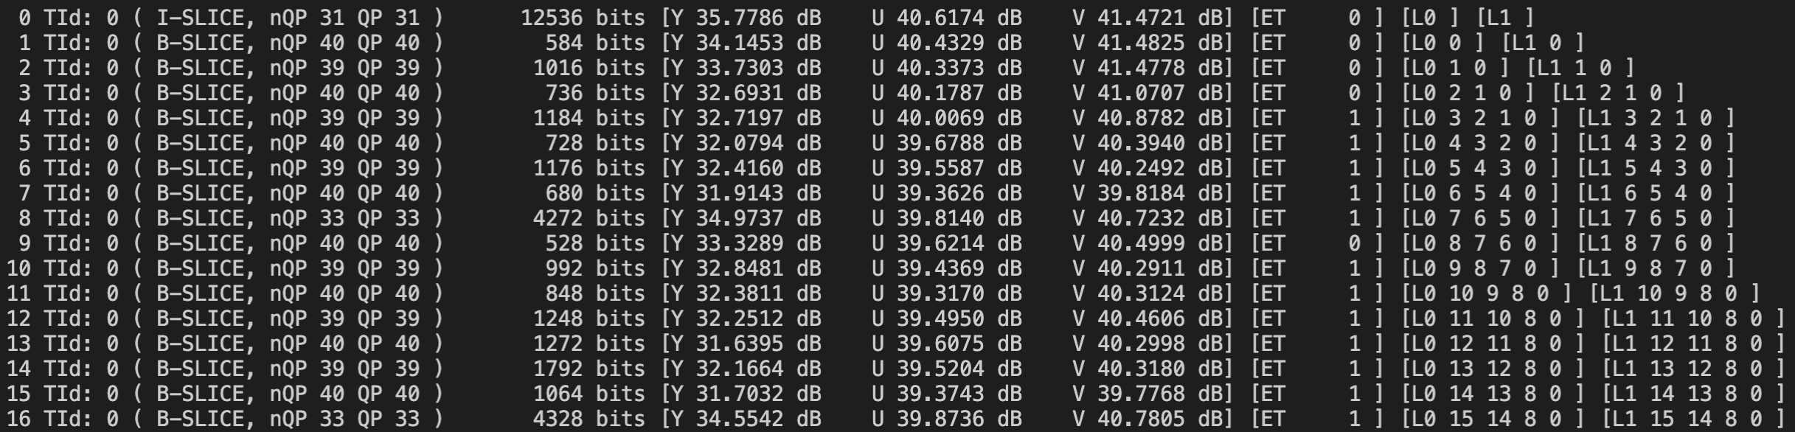
HEVC Encoder output (example)

Slide 16
HEVC Encoder output (example)
SUMMARY --------------------------------------------------------
Total Frames | Bitrate Y-PSNR U-PSNR V-PSNR YUV-PSNR
100 a 33.8880 32.8176 39.5215 40.3270 34.0918
I Slices--------------------------------------------------------
Total Frames | Bitrate Y-PSNR U-PSNR V-PSNR YUV-PSNR
1 i 313.4000 35.7786 40.6174 41.4721 36.9346
P Slices--------------------------------------------------------
Total Frames | Bitrate Y-PSNR U-PSNR V-PSNR YUV-PSNR
0 p -nan -nan -nan -nan -nan
B Slices--------------------------------------------------------
Total Frames | Bitrate Y-PSNR U-PSNR V-PSNR YUV-PSNR
99 b 31.0646 32.7877 39.5105 40.3154 34.0707
RVM: 0.000
Bytes written to file: 16944 (33.888 kbps)
WHY?

