Slide 1
HEVC

Slide 2
HEVC
H.265
MPEG-H part 2(ISO/IEC 23008-2)
Overview
Reference software

Slide 3
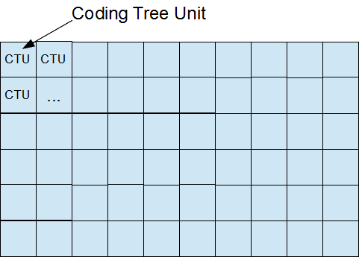
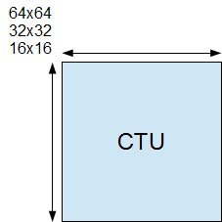
CTU, CU, CTB, CB, PB, and TB
The width and height of CTU are signaled in a sequence parameter set, meaning that all the CTUs in a video sequence have the same size.

Slide 4
Naming conventions
xxxUnit, indicates a coding logical unit which is in turn encoded into an HEVC bit stream.
xxxBlock, it indicates a portion of video frame buffer where a process is target to.

Slide 5
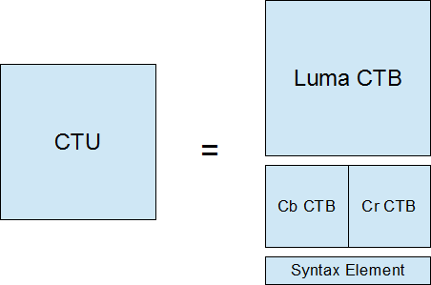
CTU
Is a logical unit. It usually consists of three blocks, namely luma (Y) and two chroma samples (Cb and Cr), and associated syntax elements. Each block is called CTB (Coding Tree Block).

Slide 6
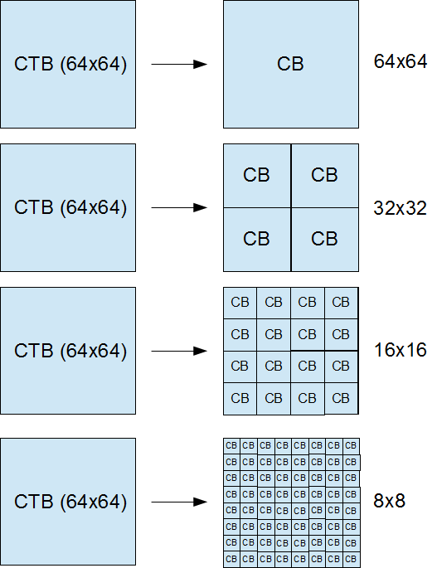
CTB, Coding Tree Block
Each CTB still has the same size as CTU – 64×64, 32×32, or 16×16. Depending on a part of video frame, however, CTB may be too big to decide whether we should perform inter-picture prediction or intra-picture prediction. Thus, each CTB can be differently split into multiple CBs (Coding Blocks) and each CB becomes the decision making point of prediction type. For example, some CTBs are split to 16×16 CBs while others are split to 8×8 CBs. HEVC supports CB size all the way from the same size as CTB to as small as 8×8.

Slide 7
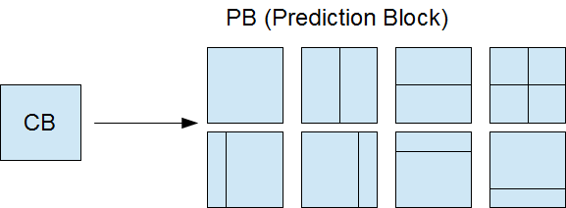
CB, Coding Block ➔ PB, Prediction Block
CB is good enough for prediction type decision, but it could still be too large to store motion vectors (inter prediction) or intra prediction mode. For example, a very small object like snowfall may be moving in the middle of 8×8 CB – we want to use different MVs depending on the portion in CB.
Thus, PB was introduced. Each CB can be split to PBs differently depending on the temporal and/or spatial predictability.

Slide 8
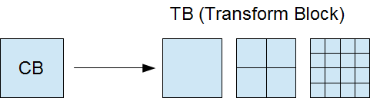
Code residual
Once the prediction is made, we need to code residual (difference between predicted image and actual image) with DCT-like transformation. Again, CB could be too big for this because a CB may contains both a detailed part (high frequency) and a flat part (low frequency). Therefore, each CB can be differently split into TBs (Transform Block). Note that TB doesn’t have to be aligned with PB. It is possible and often makes sense to perform single transform across residuals from multiple PBs, vice versa.

Slide 9
Standard definitions
CTU (coding tree unit): A coding tree block of luma samples, two corresponding coding tree blocks of chroma samples of a picture that has three sample arrays, or a coding tree block of samples of a monochrome picture or a picture that is coded using three separate colour planes and syntax structures used to code the samples. The division of a slice into coding tree units is a partitioning.
CTB (coding tree block): An NxN block of samples for some value of N. The division of one of the arrays that compose a picture that has three sample arrays or of the array that compose a picture in monochrome format or a picture that is coded using three separate colour planes into coding tree blocks is a partitioning.
CB (coding block): An NxN block of samples for some value of N. The division of a coding tree block into coding blocks is a partitioning.

Slide 10
Standard definitions
CU (coding unit): A coding block of luma samples, two corresponding coding blocks of chroma samples of a picture that has three sample arrays, or a coding block of samples of a monochrome picture or a picture that is coded using three separate colour planes and syntax structures used to code the samples. The division of a coding tree unit into coding units is a partitioning.
PB (prediction block): A rectangular MxN block of samples on which the same prediction is applied. The division of a coding block into prediction blocks is a partitioning.
TB (transform block): A rectangular MxN block of samples on which the same transform is applied. The division of a coding block into transform blocks is a partitioning.

Slide 11
Picture partitioning
Instead of macroblocks, HEVC pictures are divided into so-called coding tree blocks, or CTBs for short, which appear in the picture in raster order. Depending on the stream parameters, they are either 64x64, 32x32 or 16x16. Each CTB can be split recursively in a quad-tree structure, all the way down to 8x8. So for example a 32x32 CTB can consist of three 16x16 and four 8x8 regions. These regions are called coding units, or CUs. CUs are the basic unit of prediction in HEVC. If you have been paying attention you have already inferred that CUs can be 64x64, 32x32, 16x16 or 8x8. The CUs in a CTB are traversed and coded in Z-order. Example ordering in a 64x64 CTB:

Slide 12
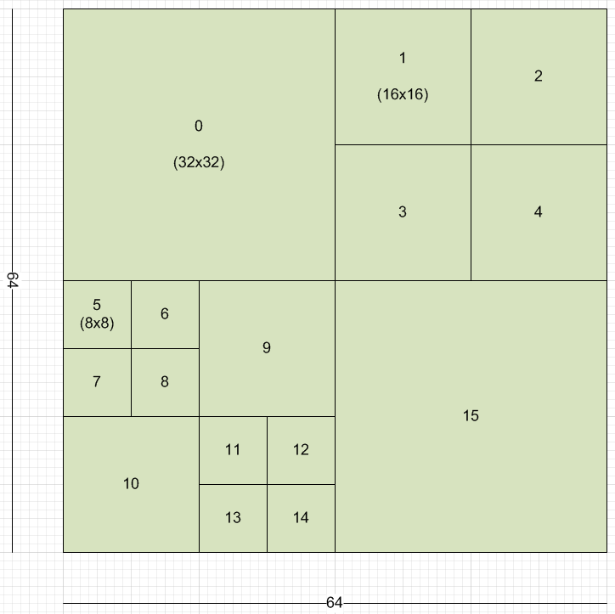
64x64 CTBs (raster order) and CTB (Z-order)
…

Slide 13
Slice, slice segment, NAL (Network Abstraction Layer)
Like in AVC, a sequence of CTBs is called a slice. A picture can be split up into any number of slices, or the whole picture can be just one slice. In turn, each slice is split up into one or more “slice segments”, each in its own NAL unit.
Only the first slice segment of a slice contains the full slice header, and the rest of the segments are referred to as dependent slice segments. A dependent slice segment is not decodable on its own; the decoder must have access to the first slice segment of the slice.
This splitting of slices exists to allow for low-delay transmission of pictures without the coding efficiency loss of using many full slices. For example, a camera could send out a slice segment of the first CTB row so that the playback device on the other side of the network can begin drawing the picture before the camera is done coding the second CTB row. This can help achieve low-latency video conferencing. HEVC does not support any interlaced tools (no more MBAFF hooray!). Interlaced video can still be coded, but it must be coded as a sequence of field pictures. No mixing of field and frame pictures.

Slide 14
Residual coding
For each CU, a residual signal is coded. HEVC supports four transform sizes: 4x4, 8x8, 16x16 and 32x32. Like AVC, the transforms are integer transforms based on the DCT. However the transform used for intra 4x4 is based on the DST (discrete sine transform). There is no Hadamard-transform like in AVC. The basis matrix uses coefficients requiring 7 bit storage, so it is quite a bit more precise than AVC. The higher precision and larger sizes of the transforms are one of the main reasons HEVC performs so much better than AVC. The residual signal of a CU consists of one or more transform units, or TUs. The CU is recursively split with the same quad-tree method as the CTB splitting, with the smallest allowable block being of course 4x4, the smallest TU. For example a 16x16 CU could contain three 8x8 TUs and four 4x4 TUs. For each luma TU there is a corresponding chroma TU of one quarter the size, so a 16x16 luma TU comes with two 8x8 chroma TUs. Since there is no 64x64 transform, a 64x64 CU must be split at least once into four 32x32 TUs. The only exception to this is for skipped CUs, when there is no residual signal at all. Note that there is no 2x2 chroma TU size. Since the smallest possible CU is 8x8, there are always at least four 4x4 luma TUs in an 8x8 region, and that region thus consists of four luma 4x4’s and two chroma 4x4s (as opposed to 8 2x2s). Like the CUs in a CTB, TUs within a CU are also traversed in Z-order.

Slide 15
Residual coding
If a TU has size 4x4, the encoder has the option to signal a so-called “transform skip” flag, where the transform is simply bypassed all together, and the transmitted coefficients are really just spatial residual samples. This can help code crisp small text for example. Inverse quantization is essentially the same as in AVC. The way a TUs coefficients are coded in the bitstream is vastly different from AVC. First, the bitstream signals a last xy position, indicating the position of the last coefficient in scan order. Then the decoder, starting at this last position, scans backwards until it reaches position 0,0, known as the DC coefficient. The coefficients are grouped into 4x4 coefficient groups. The coefficients are scanned diagonally (down and left) with each group, and the groups are scanned diagonally as well. For each group, the bitstream signals if it contains any coefficients. If so, it then signals a bit for each of the 16 coefficients in the group to indicate which are non-zero. Then for each of the non-zero coefficients in a group the remainder of the level is signaled. Finally the signs of all the non-zero coefficients in the group are decoded, and the decoder moves on to the next group. HEVC has an optional tool called sign bit hiding. If enabled and there are enough coefficients in the group, one of the sign bits is not coded, but rather inferred. The missing sign is inferred to be equal to the least significant bit of the sum of all the coefficient’s absolute values. This means that when the encoder was coding the coefficient group in question and the inferred sign was not the correct one, it had to adjust one of the coefficients up or down to fix that. The reason this tool works is that sign bits are coded in bypass mode (not compressed) and thus are expensive to code. By not coding some of the sign bits, the savings more than makes for any distortion caused by adjusting one of the coefficients.

Slide 16
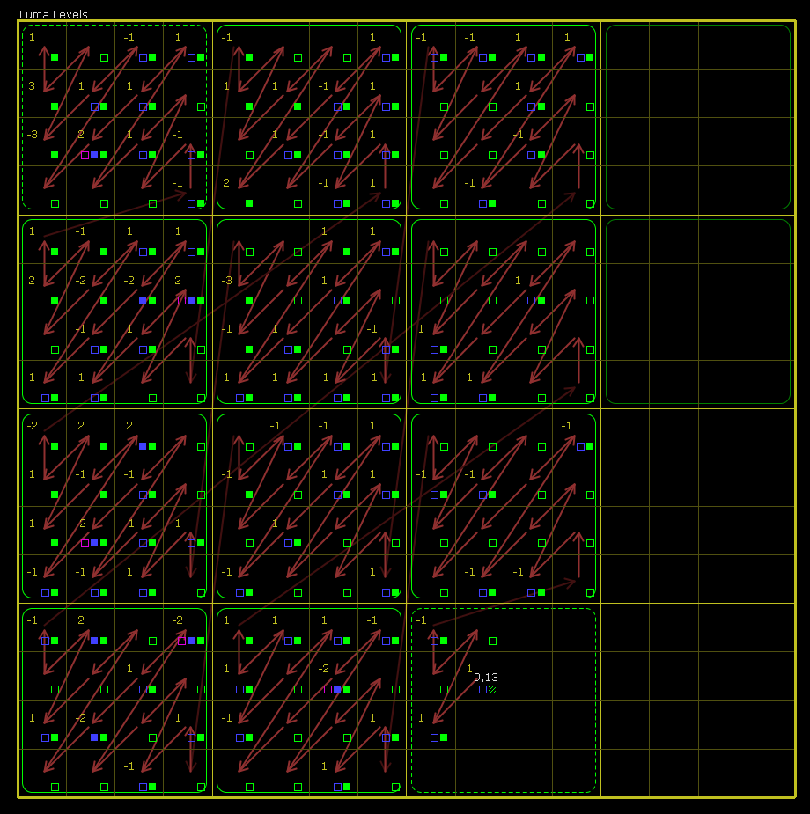
Example of the scan process of a 16x16 TU

Slide 17
Summary
Frame/Fotogramma/Picture
Field (even/odd)
Slice
Slice segment
Coding Tree Units (CTO)➔ 64x64, 32x32 or 16x16
Coding Blocks (CBs)➔ 64x64, 32x32, 16x16 or 8x8
Transform Unit (Tus) ➔ 32x32, 16x16 or 8x8 (note: 64x64 CB ➔ split in 4, 32x32 TU)
Residual: transform of each CB

Slide 18
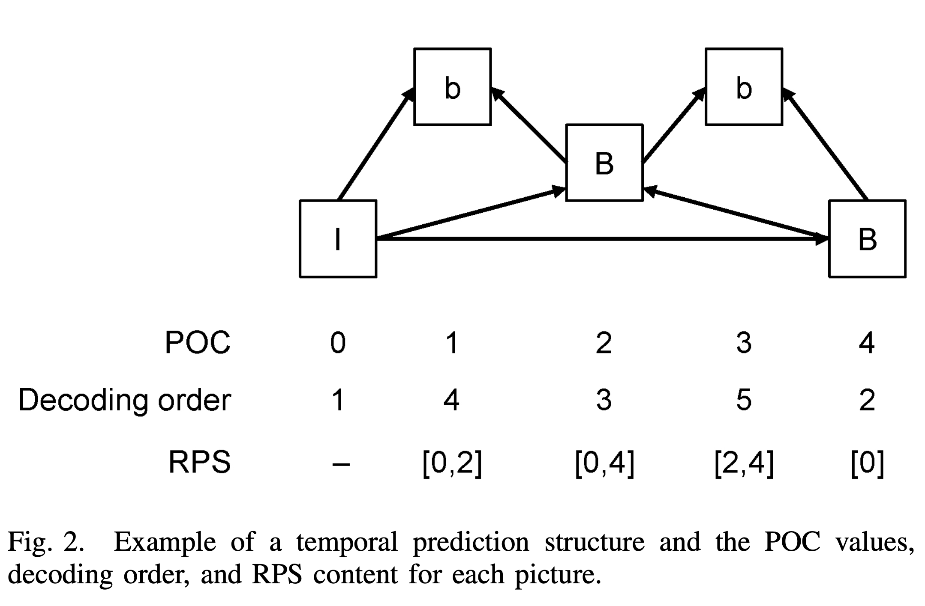
Example of RPS

Slide 19
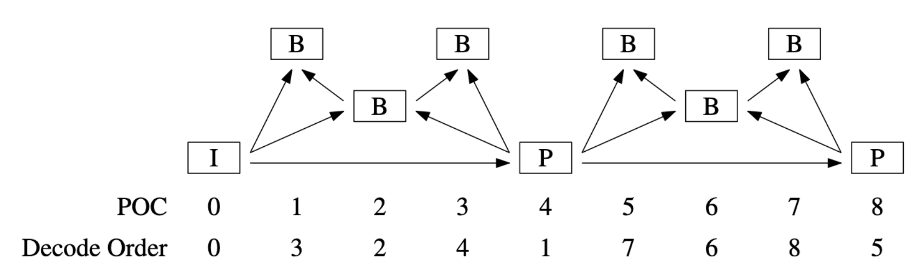
Example: A GOP structure

Slide 20
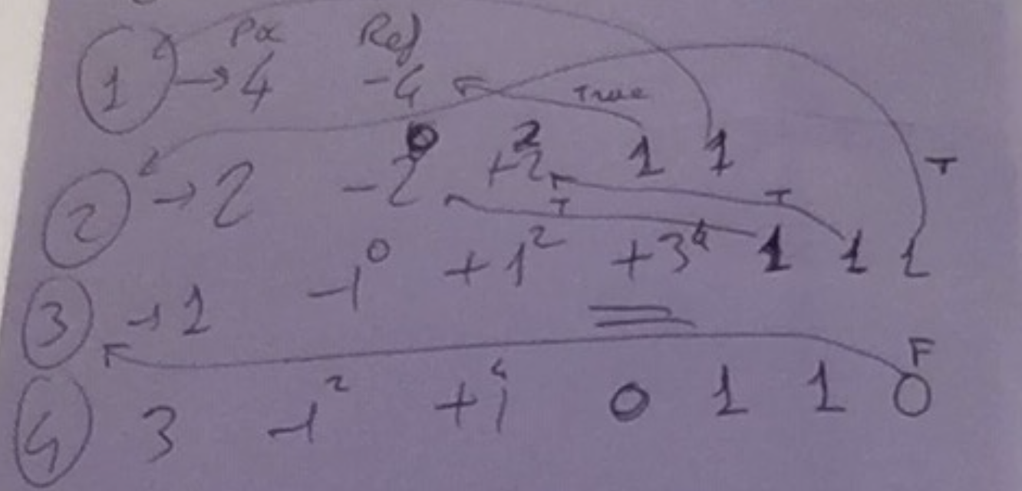
Frame 1 -4 configuration

Slide 21
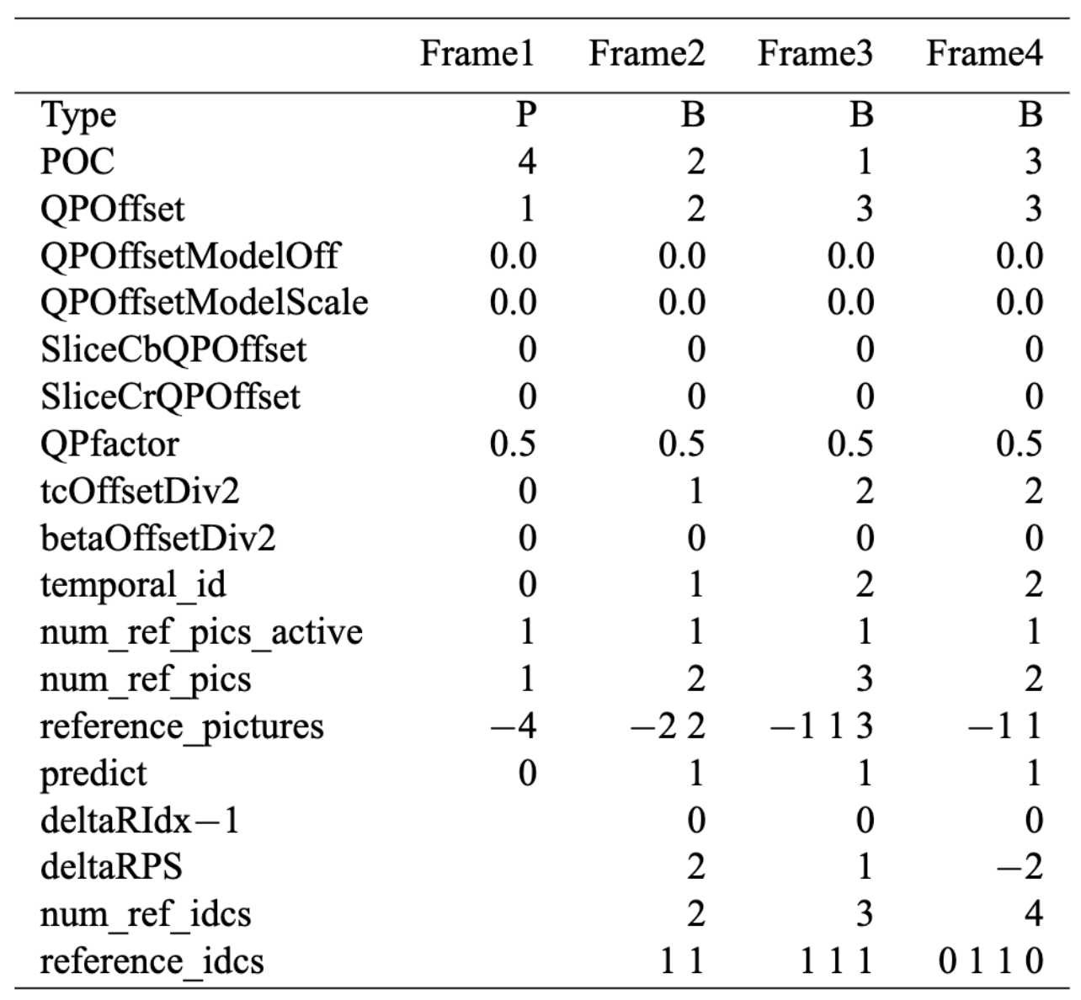
If predict=2, green area auto-computed
QP parameters for rate control
Current PCS frame = 2.
Previous PCS frame = 1
2-1-1 = 0
---
3-2-1=0
---
4-3-1=0
Each frame uses only 1 previous (L0 list) and 1 future (L1 list) frame
https://vcgit.hhi.fraunhofer.de/jct-vc/HM/-/blob/master/doc/software-manual.pdf

Slide 22
HEVC Encoder output (example)
HM software: Encoder Version [16.22] (including RExt)[Linux][GCC 8.4.0][64 bit]
Input File : foreman_qcif.yuv
Bitstream File : str.bin
Reconstruction File : rec.yuv
Real Format : 176x144 25Hz
Internal Format : 176x144 25Hz
Sequence PSNR output : Linear average only
Sequence MSE output : Disabled
Frame MSE output : Disabled
MS-SSIM output : Disabled
xPSNR calculation : Disabled
Cabac-zero-word-padding : Enabled
Frame/Field : Frame based coding
Frame index : 0 - 99 (100 frames)
Profile : main
CU size / depth / total-depth : 64 / 4 / 4

Slide 23
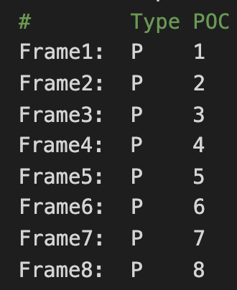
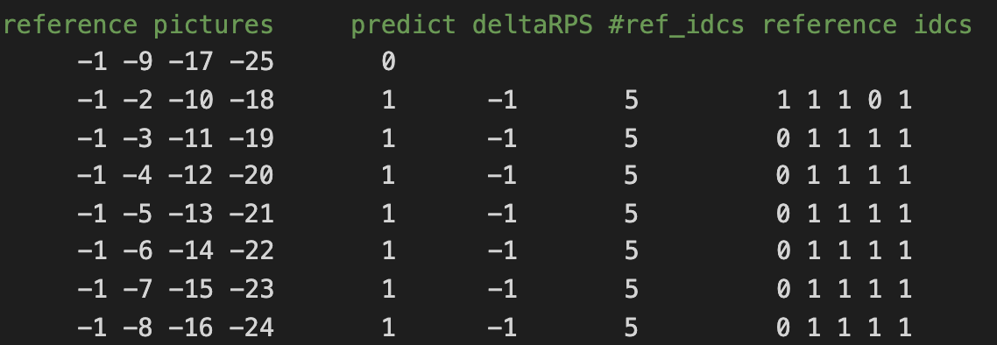
HEVC: input

Slide 24
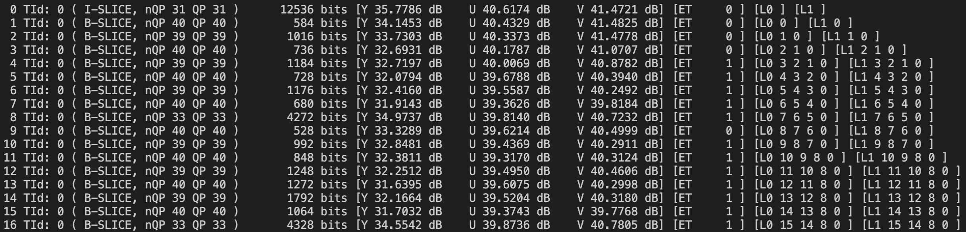
HEVC Encoder output (example)
L0 and L1 reference picture index: la

Slide 25
HEVC Encoder output (example)
SUMMARY --------------------------------------------------------
Total Frames | Bitrate Y-PSNR U-PSNR V-PSNR YUV-PSNR
100 a 33.8880 32.8176 39.5215 40.3270 34.0918
I Slices--------------------------------------------------------
Total Frames | Bitrate Y-PSNR U-PSNR V-PSNR YUV-PSNR
1 i 313.4000 35.7786 40.6174 41.4721 36.9346
P Slices--------------------------------------------------------
Total Frames | Bitrate Y-PSNR U-PSNR V-PSNR YUV-PSNR
0 p -nan -nan -nan -nan -nan
B Slices--------------------------------------------------------
Total Frames | Bitrate Y-PSNR U-PSNR V-PSNR YUV-PSNR
99 b 31.0646 32.7877 39.5105 40.3154 34.0707
RVM: 0.000
Bytes written to file: 16944 (33.888 kbps)
WHY?

Slide 26
References
https://forum.doom9.org/showthread.php?t=167081

