Slide 1
HEVC
Multiview and 3D

Slide 2
Multiple video sequences
Multiple video sequences ==> Layers
Layer 0
Layer 1
Layer 2
Layer …
In MV- and 3D-HEVC, a layer can represent texture, depth, or other auxiliary information of a scene related to a particular camera perspective
All layers belonging to the same camera perspective are denoted as a view

Slide 3
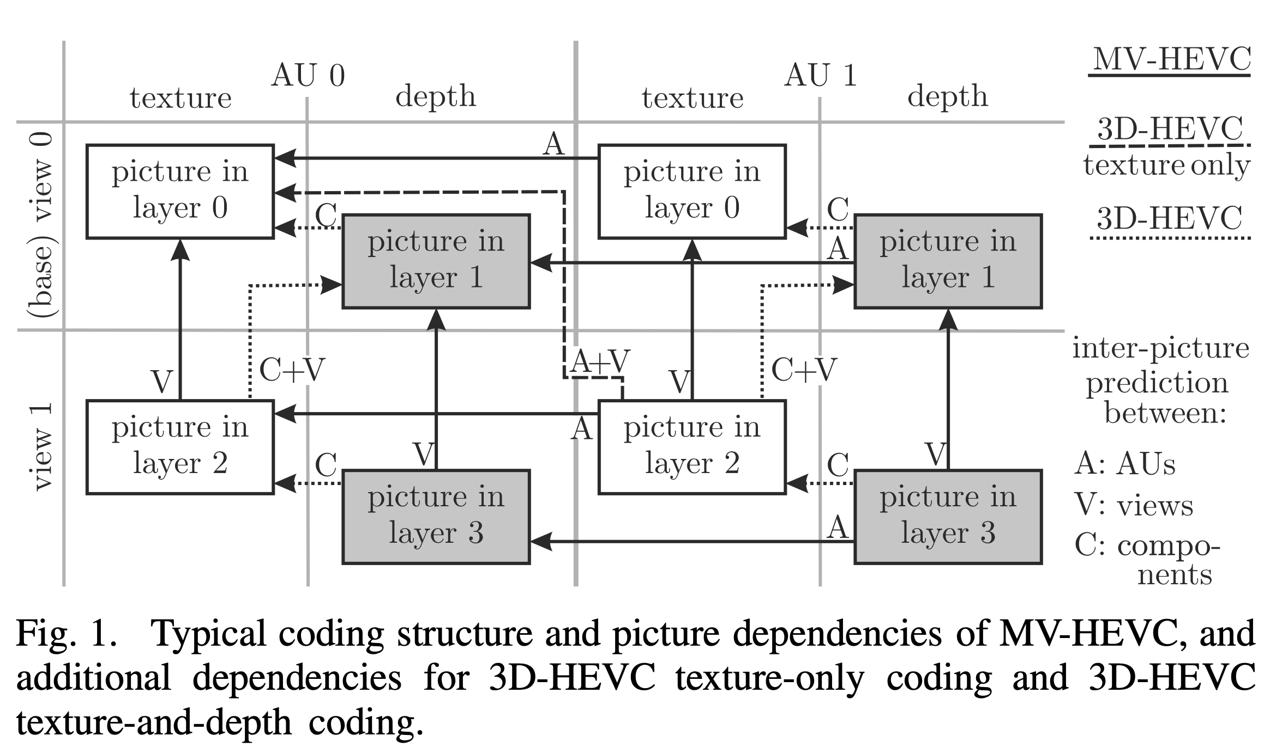

Slide 4
References
DM-HEVC-002-2015-MV_3D-Overview.pdf
DM-HEVC-M36590-FTV-software-user-guidelines.pdf
https://www.fujii.nuee.nagoya-u.ac.jp/multiview-data/
http://ultravideo.cs.tut.fi/#testsequences
https://stackoverflow.com/questions/48684107/how-to-set-input-file-in-command-in-htm-software-for-multiview-video
https://tech.ebu.ch/docs/events/3dtv09/presentations/ebu_3dtv09_ohm.pdf (OLD)

