Slide 1







TECHNOLOGY USAGE AND DEMOGRAPHICS ANALYSIS (A Comprehensive Survey Analysis on Current and Future Trends)
Date: October 2024
Presented By: Uzoma Ewurum

Slide 2



OUTLINE
Executive Summary
Introduction
Methodology
Results
Visualization – Charts
Dashboard
Discussion
Findings & Implications
Conclusion
Appendix

Slide 3

EXECUTIVE SUMMARY
Programming Languages: HTML/CSS ranks as the top programming language both now and in the future.
Databases: MySQL is the leading database in current usage, while MongoDB is emerging as the preferred database for the future.
Web Frameworks and Platforms: JavaScript frameworks such as Angular and React dominate, with strong future interest.
Platforms: Linux and Windows continue to be the most widely used platforms, and developers show no significant shift away from these in the future.

Slide 4

INTRODUCTION
The purpose of this survey analysis is to uncover trends in current and future technology usage, including programming languages, databases, platforms, and web frameworks.
This analysis combines both demographic data and technology preferences from developers to provide a comprehensive view of the tech landscape.

Slide 5

METHODOLOGY
The data used in this analysis was collected from a survey of developers across various industries.
Technologies Dataset: Focused on programming languages, databases, web frameworks, and platforms.
Demographics Dataset: Provided data on the gender, age, and educational background of respondents.
Visualization tools such as Looker Studio were used for generating interactive dashboards.

Slide 6
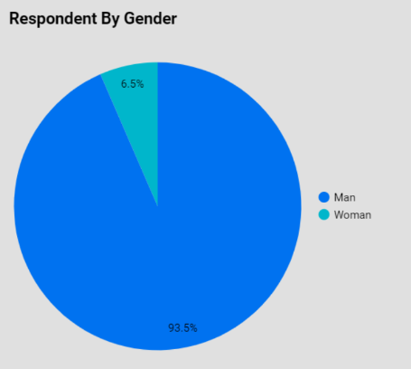
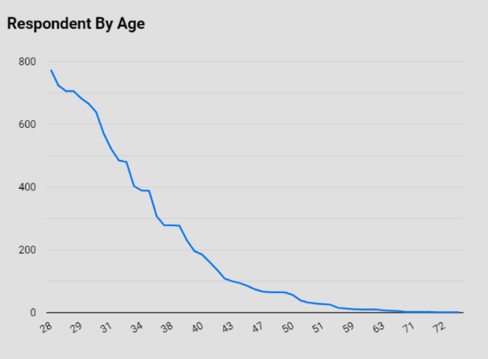
RESULTS
Gender distribution in the survey shows that the majority of respondents are male, with minor representation from females and other gender groups.
The majority of respondents are in the 22-29 age group and hold a Bachelor's degree, primarily in computer science or related fields.

Slide 7
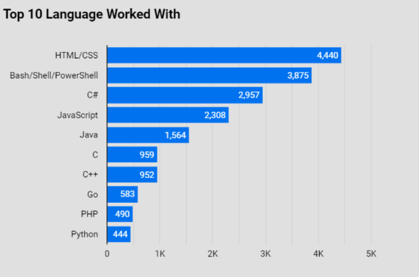
PROGRAMMING LANGUAGE TRENDS (CURRENT)
Current Top 10 Programming Language
Top language: HTML/CSS.
JavaScript and SQL are also widely used.
Python, though still popular, ranks lower compared to HTML/CSS in this dataset.

Slide 8
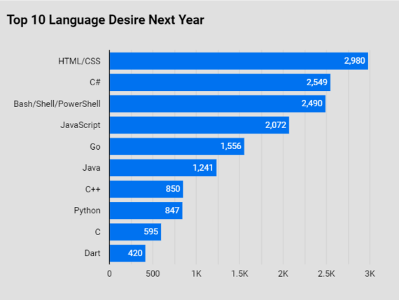
PROGRAMMING LANGUAGE TRENDS (FUTURE)
Future Top 10 Programming Languages
Top language (future): HTML/CSS continues to dominate

Slide 9
PROGRAMMING LANGUAGE TRENDS - FINDINGS & IMPLICATIONS
Findings
HTML/CSS remains the leading choice for front-end development, with sustained interest in the future.
Implications
Front-end and web development skills (HTML/CSS) remain in high demand.

Slide 10
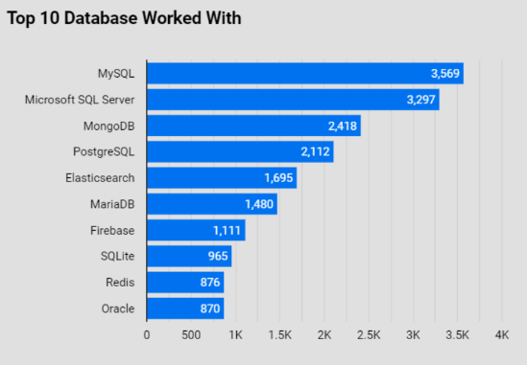
DATABASE TRENDS (CURRENT)
Current Top 10 Databases
Top database: MySQL is the dominant choice for current projects.
Other databases such as PostgreSQL and SQLite also play significant roles.

Slide 11
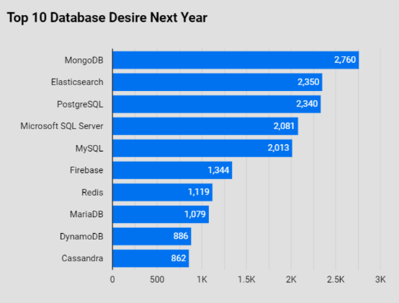
DATABASE TRENDS (FUTURE)
Future Top 10 Databases
Top database (future): MongoDB emerges as the database of choice for future projects, indicating a shift towards NoSQL solutions for more flexible and scalable databases.

Slide 12
DATABASE TRENDS - FINDINGS & IMPLICATIONS
Findings
MySQL is the go-to solution for current relational database needs, widely used in enterprise applications.
MongoDB is gaining significant interest for its scalability and flexibility, marking a shift toward NoSQL databases.
Implications
Companies will continue to rely on MySQL for structured data but may increasingly adopt MongoDB for unstructured or semi-structured data solutions.

Slide 13

DASHBOARD
Dashboard URL: GitHub Link

Slide 14
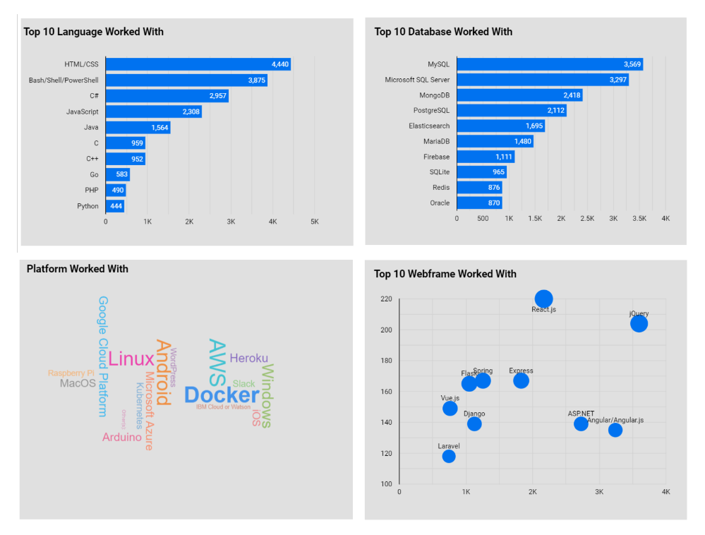
DASHBOARD TAB 1

Slide 15
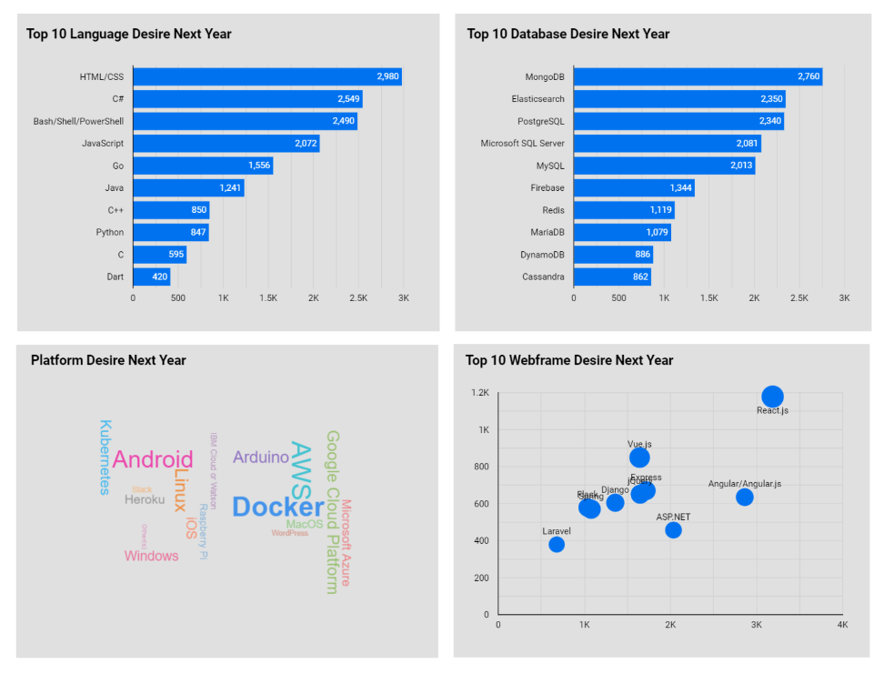
DASHBOARD TAB 2

Slide 16
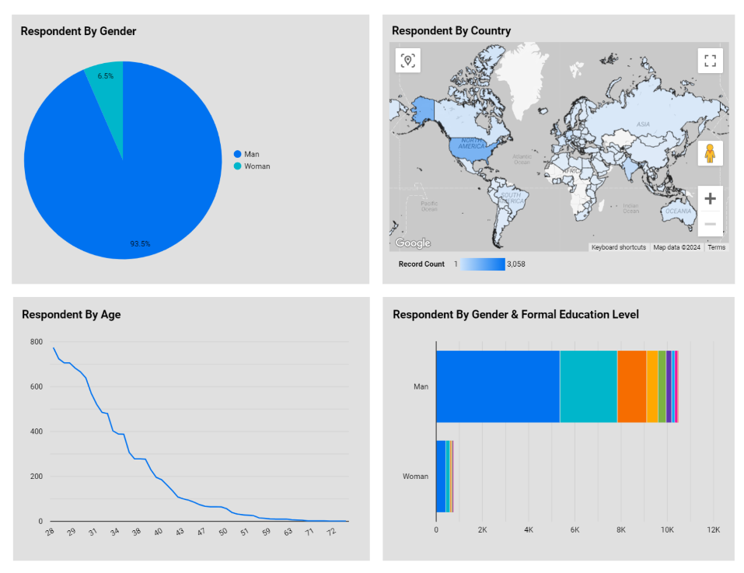
DASHBOARD TAB 3

Slide 17
DISCUSSION

Slide 18
OVERALL FINDINGS & IMPLICATIONS
Findings
Front-End Development: HTML/CSS dominate both now and in the future.
Back-End Development: SQL remains a critical skill, and databases like MongoDB are gaining popularity.
Platforms: Linux and Windows continue to be the top platforms for developers, with no major shift toward alternative platforms in the near future.
Implications
Companies should continue investing in training their developers in web technologies like HTML/CSS, JavaScript, and frameworks like React and Angular.
There is a need for enhanced skills in NoSQL databases such as MongoDB to accommodate future application scalability.

Slide 19

CONCLUSION
HTML/CSS and JavaScript are the dominant technologies for web development.
SQL remains essential for backend development, with future growth expected in MongoDB.
Traditional platforms like Linux and Windows are still favored, though the interest in cloud-native platforms is rising.

Slide 20

APPENDIX
Include any relevant additional charts, or tables that you may have created during the analysis phase.

Slide 21
JOB POSTINGS
In Module 1 you have collected the job posting data using Job API in a file named “job-postings.xlsx”. Present that data using a bar chart here. Order the bar chart in the descending order of the number of job postings.

Slide 22
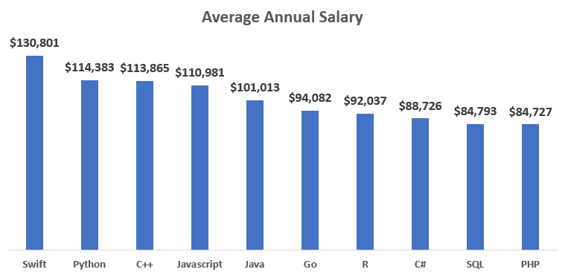
POPULAR LANGUAGES

