Slide 1
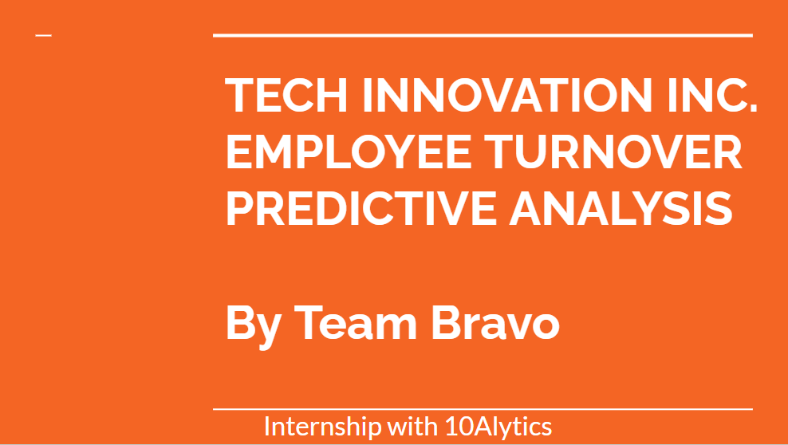

Slide 2
COLLABORATORS
Austin Amadi
Anslem Akadu
Uzoma Ewurum
Grace Adedayo

Slide 3
INTRODUCTION
Tech innovations Inc. is a leading technology company at the forefront of digital transformation and innovation.
The organization is experiencing high turnover rates and struggles to attract and retain top talent in key positions.
The objective of this project is to leverage HR data and advanced analytics to develop predictive models and actionable insights that will enhance employee recruitment and retention strategies.

Slide 4
PROJECT OVERVIEW
SUPERVISED MACHINE LEARNING
DATA COLLECTION AND PREPARATION
EXPLORATORY DATA ANALYSIS (EDA)
DATA
PRE-PROCESSING

Slide 5
DATA SOURCES
DATA COLLECTION AND PREPARATION
HR Data containing 19 Features and 1000 Records
DATA PREPARATION & CLEANING
There were no missing data, however Satisfaction_Score had 13 Outliers which were removed during preprocessing in preparation for machine learning.

Slide 6
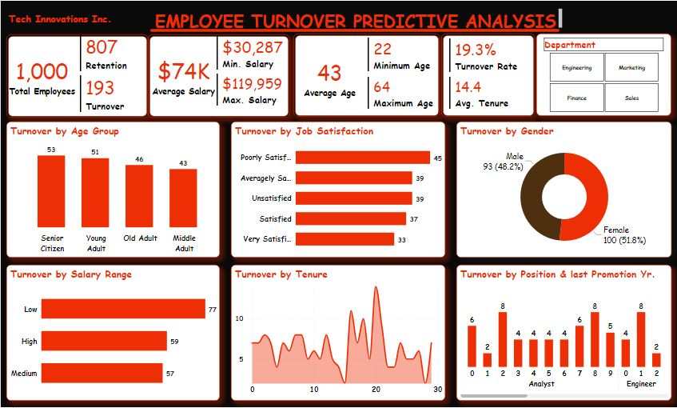
EXPLORATORY DATA ANALYSIS (EDA)

Slide 7
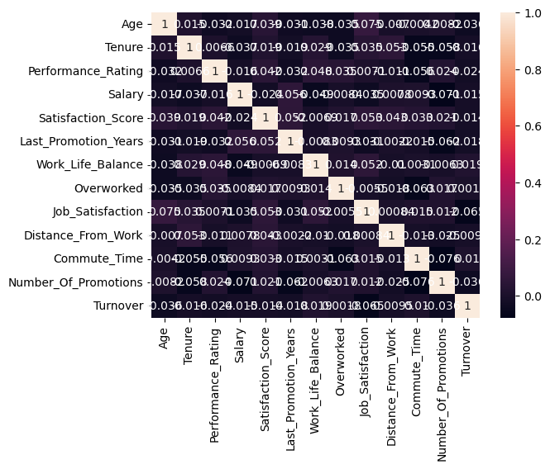
CORRELATION MATRIX
EXPLORATORY DATA ANALYSIS (EDA)

Slide 8
FEATURE ENGINEERING
DATA
PRE-PROCESSING
Engineered 10 New Features, A total of 29 Features.
All four categorical variables were labeled encoded
All 29 variables were then Standardized.
Data was split into train and test data in a ratio of 80:20. However 5 features were rejected as they had anomalies. Thus, 24 Features were used to train and test data.

Slide 9
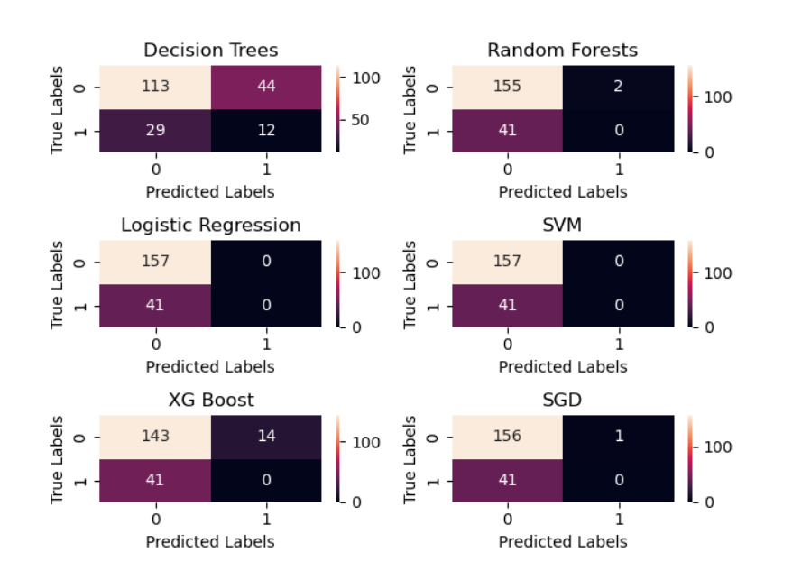
SUPERVISED MACHINE LEARNING

Slide 10
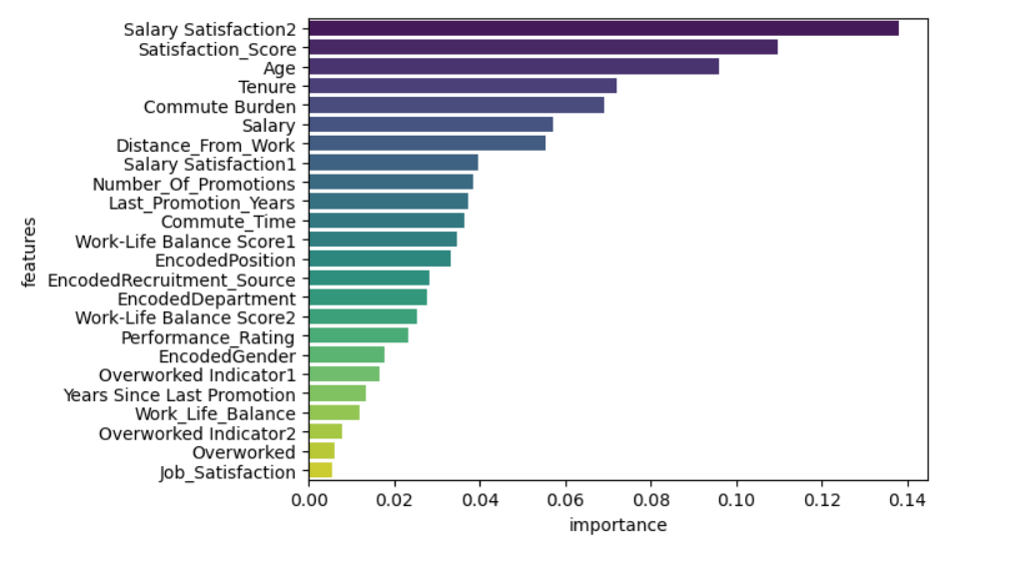
FEATURE IMPORTANCE (DECISION TREE)
SUPERVISED MACHINE LEARNING
Selected the Top (5) Features having Two(2) Engineered Feature
Salary Satisfaction = Salary X Job Satisfaction
Commute Burden = Distance from Work X Commute Time

Slide 11
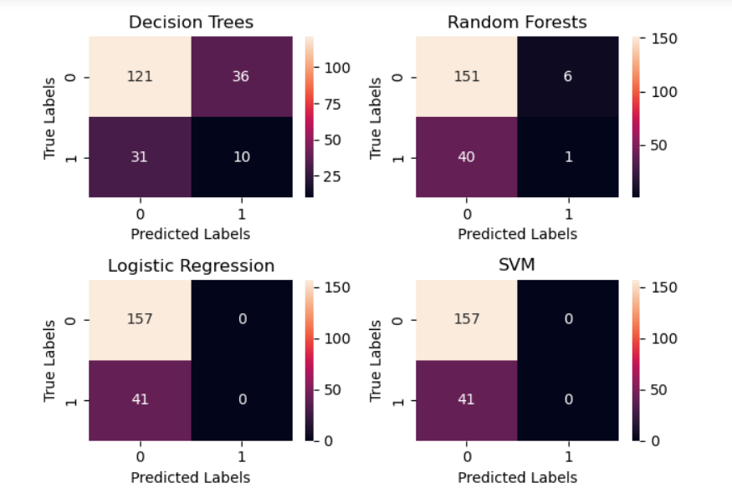
SUPERVISED MACHINE LEARNING

Slide 12
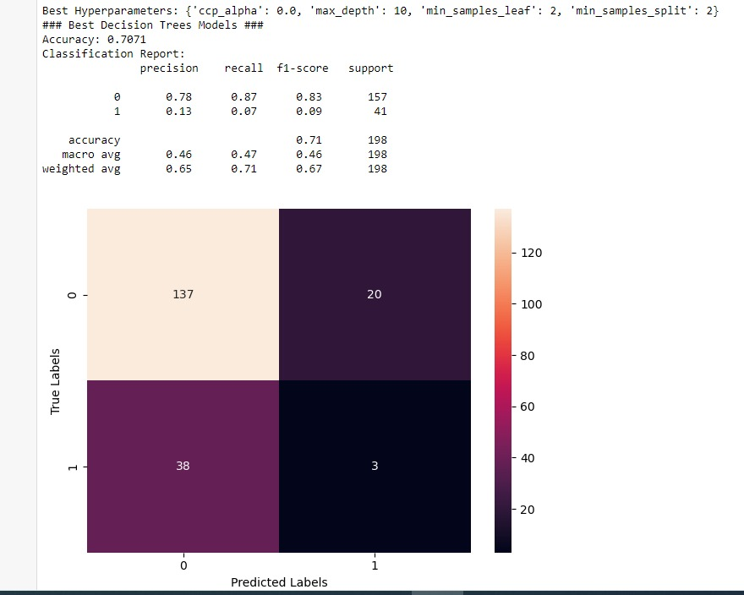
MODEL FINE TUNING (HYPERPARAMETER)
SUPERVISED MACHINE LEARNING

Slide 13
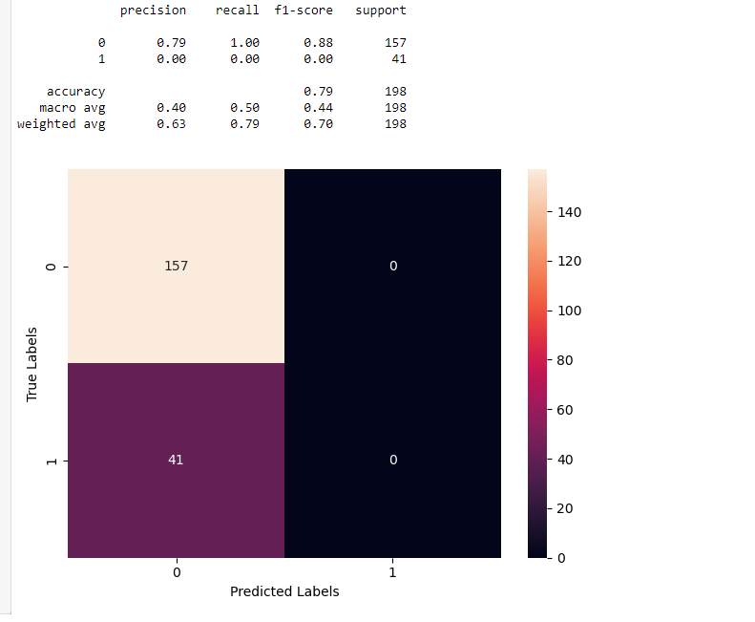
EMSEMBLE METHOD
SUPERVISED MACHINE LEARNING
Combined all four models

Slide 14
CONCLUSION & RECOMMEDATION
The Machine Learning Models did poorly because there was no significant correlation nor pattern between turnover and other features.
For this project, Decision Tree would be the best model with Best Hyperparameters: {'ccp_alpha': 0.0, 'max_depth': 10, 'min_samples_leaf': 2, 'min_samples_split': 2} for Employee Turnover Prediction though with accuracy of 71%.
However, we recommend data recollection with improved data collection methods.

