Slide 1
Red Sea University
Dental Clinic Management System
Modernization, Architecture, Implementation Strategy & Professional Development Plan
React + Laravel + MySQL | Modern replacement of the legacy Dreamweaver/PHP implementation

Slide 2
Executive Summary
What the project is — and what the modernization should achieve
Rebuild the existing educational dental-clinic management concept as a modern web application.
Keep the documented functional scope: patients, doctors, students, reception, appointments, medical records, reporting and administration.
Replace the legacy Dreamweaver/PHP-style presentation with a maintainable React frontend and Laravel REST API.
Use a normalized MySQL database, role-based access control, validation, auditability and backup strategy.
Build an MVP first, then add advanced capabilities such as interactive dental charting and analytics.
Red Sea University Dental Clinic — Modernization & Development Plan | 2

Slide 3
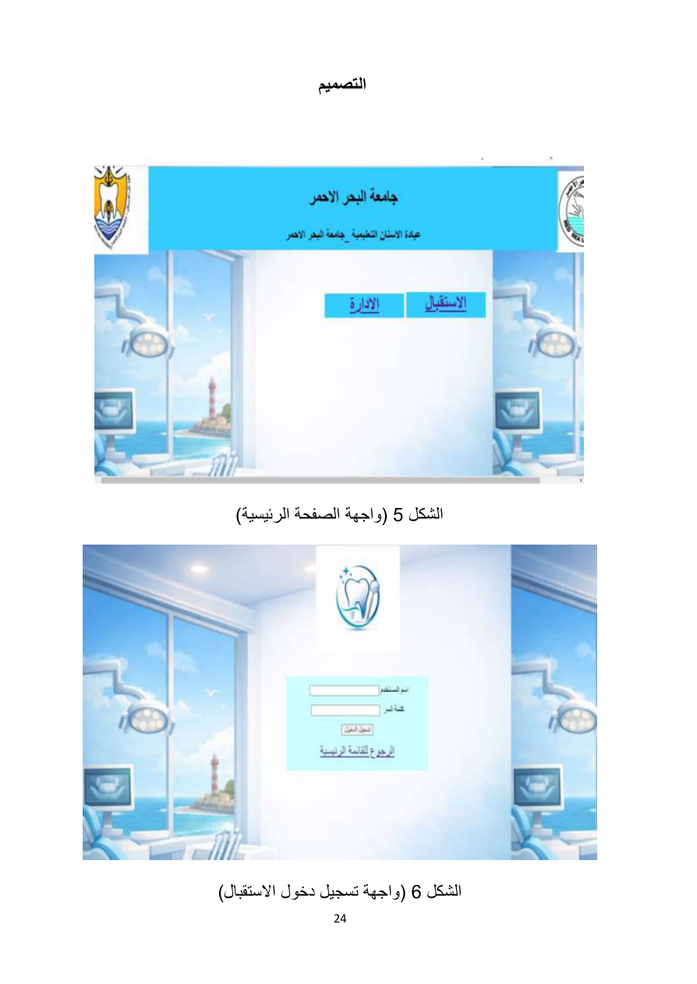
What the Existing Documentation Shows
Source-derived: the PDF describes a dental clinic management system and its original design
The documented system is for an educational dental clinic at Red Sea University.
The original implementation uses a traditional web-development stack and the design section shows simple login, registration and record-display screens.
The documented actors include administration, doctors and reception; the data model also discusses students and interns.
The documentation describes requirements, analysis, design, testing and maintenance phases.
Red Sea University Dental Clinic — Modernization & Development Plan | 3

Slide 4
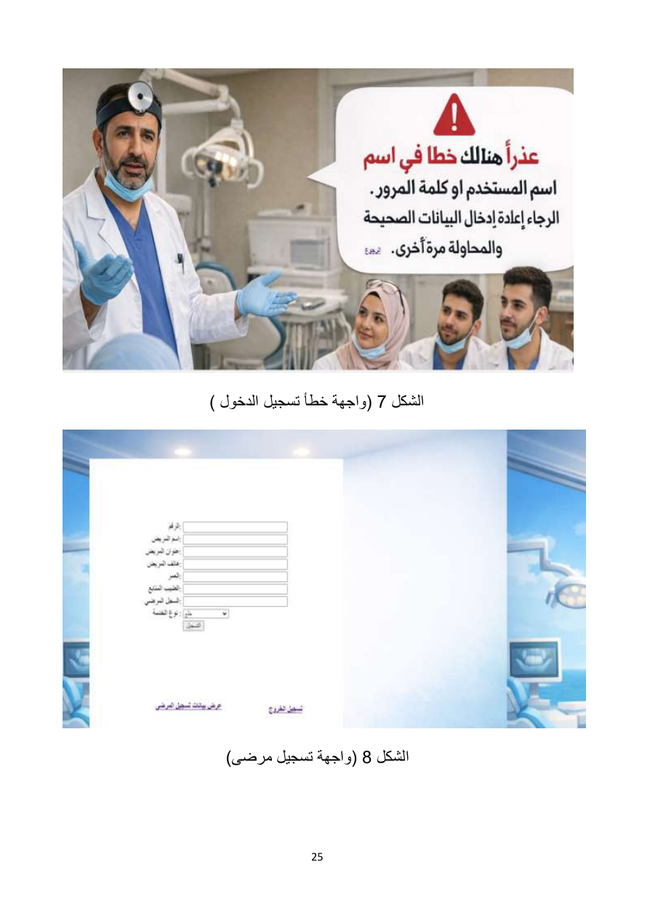
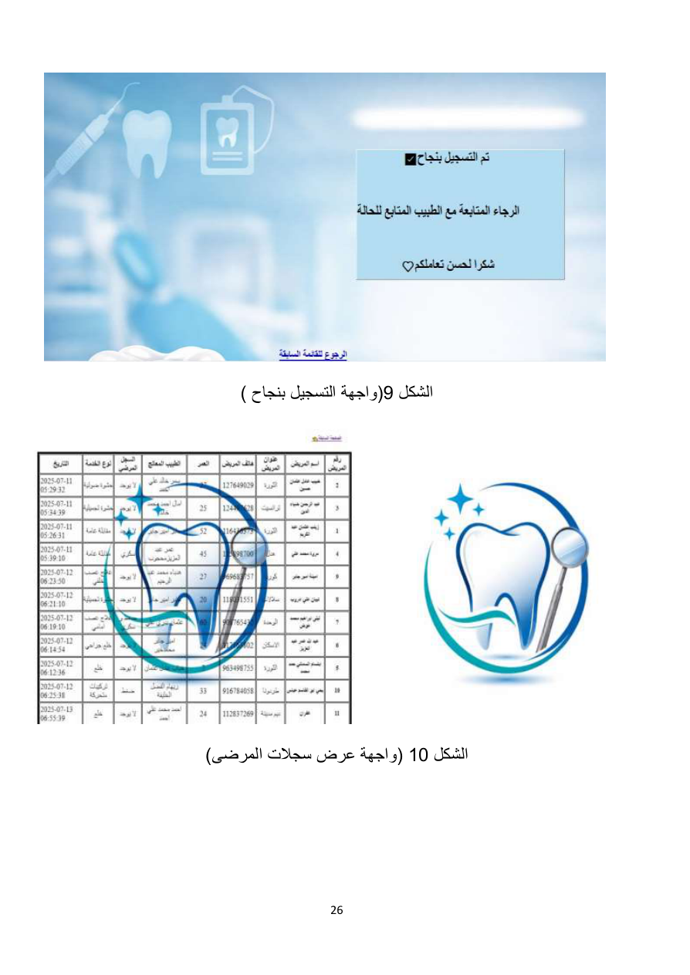
Legacy UI: Why We Should Not Copy It Literally
Source screenshot — use as a functional reference, not as the visual target
Static background imagery and small forms dominate the interface.
Navigation is basic and the data tables are visually dated.
These screens are still valuable because they reveal the intended workflows.
Modernization principle: preserve behavior and requirements; redesign the UX/UI.
Red Sea University Dental Clinic — Modernization & Development Plan | 4

Slide 5
Functional Scope — Core Modules
Authentication
Patients
Doctors
Students / Interns
Login, logout, identity and
role-based access.
Registration, profiles, search
and patient history.
Profiles, qualifications,
specialization and status.
Educational users involved in
clinic operations.
Appointments
Medical Records
Reports
Administration
Booking, scheduling, cancellation
and status tracking.
Visits, diagnosis, treatment and
clinical notes.
Operational and administrative
reporting.
Users, permissions, settings and
system oversight.
Red Sea University Dental Clinic — Modernization & Development Plan | 5

Slide 6
User Roles
Administrator
Doctor
Receptionist
Full system administration, user management,
configuration, reporting and oversight.
Access assigned patients/appointments and
create or update clinical information according
to policy.
Register patients, search patients and manage
appointment workflows.
Dental Student / Intern
Educational workflow access as defined by the university; permissions should be narrower than
administrative users.
Red Sea University Dental Clinic — Modernization & Development Plan | 6

Slide 7
Recommended Role Model
This is a modernization recommendation, not a direct quotation from the source
ADMIN
DOCTOR
DENTAL_STUDENT
INTERN
RECEPTIONIST
Define permissions independently from UI visibility so the backend remains authoritative.
Role → Permission → Policy → API endpoint
Red Sea University Dental Clinic — Modernization & Development Plan | 7

Slide 8
System Architecture
Recommended 2026 architecture
React Frontend
Laravel REST API
MySQL
Responsive UI
Routing
Forms
State/query management
Arabic/English RTL support
Authentication
Authorization
Validation
Business logic
Eloquent ORM
Normalized relational schema
Indexes
Constraints
Backups
React
↓ HTTPS / JSON
Laravel API
↓ Eloquent
MySQL
Red Sea University Dental Clinic — Modernization & Development Plan | 8

Slide 9
Technology Stack
Frontend: React.js
Routing: React Router
HTTP/API client: Axios
Server-state/data fetching: TanStack Query
Forms: React Hook Form + Zod
UI: Tailwind CSS + a consistent component system
Icons: Lucide
Backend: Laravel
Authentication: Laravel Sanctum
Database: MySQL
Version control: Git + GitHub
Optional later: PDF/Excel export, charts, automated testing and deployment tooling
Red Sea University Dental Clinic — Modernization & Development Plan | 9

Slide 10
Why React + Laravel?
Recommended technology choice
React
Laravel
MySQL
Fits a modern interactive dashboard, reusable components, responsive UX and your existing React experience.
Strong routing, validation, authentication, authorization, ORM, migrations, testing and API development.
Well suited to the relational nature of patients, appointments, doctors, students and medical records.
Key principle: the frontend never connects directly to MySQL.
All business rules and security checks must be enforced by the backend.
Red Sea University Dental Clinic — Modernization & Development Plan | 10

Slide 11
Database Design — Core Entities
users
patients
doctors
students
appointments
medical_records
diagnoses
treatments
patient_documents (optional)
audit_logs
Normalize data instead of storing a complete medical history in one text field.
Store date_of_birth rather than a permanent age value.
Use foreign keys for patient/doctor/student/appointment relationships.
Use status fields for workflows such as appointments and active users.
Keep medical and audit data traceable.
Red Sea University Dental Clinic — Modernization & Development Plan | 11

Slide 12
Patients Table — Recommended
patients
──────────────
id
patient_number
first_name
last_name
date_of_birth
gender
phone
address
emergency_contact
created_at
updated_at
Do not store age as a permanent field; calculate it from date_of_birth.
Use a unique patient_number for clinic-facing identification.
Separate identity/contact information from clinical records.
Add indexes for patient_number, phone and searchable name fields.
Red Sea University Dental Clinic — Modernization & Development Plan | 12

Slide 13
Doctors, Students and Users
users
id | name | email | password | role | status
DOCTORS
id | user_id | specialization | qualification | license_number
STUDENTS
id | user_id | student_number | level | supervisor_id | student_type
Use users for authentication identity.
Use doctors/students for role-specific profile data.
Do not duplicate passwords across role tables.
Model intern status/type explicitly if the university needs a separate workflow.
Red Sea University Dental Clinic — Modernization & Development Plan | 13

Slide 14
Appointments — Core Design
appointments
──────────────
id
patient_id
doctor_id
student_id
appointment_date
start_time
end_time
status
reason
notes
created_by
created_at
updated_at
Statuses: Scheduled, Confirmed, Completed, Cancelled, No Show.
Backend must prevent double-booking for the same doctor/time slot.
Support search/filtering by date, doctor, patient and status.
Calendar UI is recommended for the modern frontend.
Red Sea University Dental Clinic — Modernization & Development Plan | 14

Slide 15
Medical Records — Recommended Structure
medical_records
────────────────
id
patient_id
doctor_id
student_id
appointment_id
visit_date
chief_complaint
clinical_notes
diagnosis_summary
treatment_plan
treatment_notes
follow_up_date
Clinical information belongs in medical records, not the patients table.
Link each record to the patient and, where applicable, appointment and responsible clinician/student.
Use separate diagnosis and treatment entities if reporting or structured analytics are required.
Red Sea University Dental Clinic — Modernization & Development Plan | 15

Slide 16
Diagnosis, Treatment and Dental Chart
Diagnoses
Treatments
Dental Chart
Structured diagnosis records linked to a medical visit.
Treatment name, description, notes and optional cost.
Track tooth number, condition, treatment and status for each patient.
The documentation explicitly recommends adding a dental map/chart for patient follow-up.
An interactive chart is a high-value modernization feature: click a tooth → view/update condition → record treatment.
Keep the chart data structured so it can later support reporting.
Red Sea University Dental Clinic — Modernization & Development Plan | 16

Slide 17
Data Relationships
USER
├── DOCTOR ─────┐
├── STUDENT ────┼── APPOINTMENTS
└── RECEPTIONIST │
│
PATIENT ──────────┘
│
└── MEDICAL_RECORDS
├── DIAGNOSES
├── TREATMENTS
└── DENTAL_CHART
Patient has many appointments.
Patient has many medical records.
Doctor can have many appointments and records.
Student/intern can be linked to appointments and educational clinical work.
Medical records can contain multiple structured diagnoses/treatments.
Red Sea University Dental Clinic — Modernization & Development Plan | 17

Slide 18
Frontend Information Architecture
src/
├── api/
├── components/
├── layouts/
├── pages/
│ ├── auth/
│ ├── dashboard/
│ ├── patients/
│ ├── doctors/
│ ├── students/
│ ├── appointments/
│ ├── medical-records/
│ └── reports/
├── hooks/
├── context/
├── routes/
├── utils/
└── types/
Keep page-level concerns separate from reusable components.
Centralize API calls rather than scattering Axios calls across every component.
Use query/mutation hooks for server data.
Use shared layouts for authenticated areas.
Design for RTL and English from the beginning.
Red Sea University Dental Clinic — Modernization & Development Plan | 18

Slide 19
Laravel Backend Structure
app/
├── Http/
│ ├── Controllers/
│ ├── Requests/
│ └── Resources/
├── Models/
├── Services/
├── Policies/
└── Notifications/
Controllers should coordinate requests, not contain 100-line business workflows.
Form Requests handle validation.
Policies enforce authorization.
Services can encapsulate complex business logic.
API Resources keep response formats consistent.
Eloquent models represent database relationships and persistence.
Red Sea University Dental Clinic — Modernization & Development Plan | 19

Slide 20
API Design — Examples
POST /api/login
POST /api/logout
GET /api/patients
POST /api/patients
GET /api/patients/{id}
PUT /api/patients/{id}
DELETE /api/patients/{id}
GET /api/appointments
POST /api/appointments
PUT /api/appointments/{id}
GET /api/patients/{id}/medical-records
POST /api/patients/{id}/medical-records
Use consistent HTTP verbs and resource naming.
Return predictable JSON structures.
Use validation errors with useful field-level messages.
Protect private endpoints with authentication and authorization.
Red Sea University Dental Clinic — Modernization & Development Plan | 20

Slide 21
Authentication & Authorization
Authentication
Authorization
Backend Authority
Who are you? Login, session/token handling and logout.
What are you allowed to do? Roles, permissions and policies.
React can hide buttons, but Laravel must enforce access.
React → Laravel Sanctum → Authenticated User → Policy/Permission → Controller
Red Sea University Dental Clinic — Modernization & Development Plan | 21

Slide 22
Security Requirements
Password hashing — never store plaintext passwords.
Server-side validation for every important input.
Authorization policies for sensitive operations.
Rate limiting for authentication and abuse-prone endpoints.
Parameterized database access through Eloquent/query builder.
Output/input handling to reduce XSS risks.
HTTPS in deployment.
Audit logs for sensitive record changes.
Least-privilege access to medical information.
Regular database backups and restore testing.
Red Sea University Dental Clinic — Modernization & Development Plan | 22

Slide 23
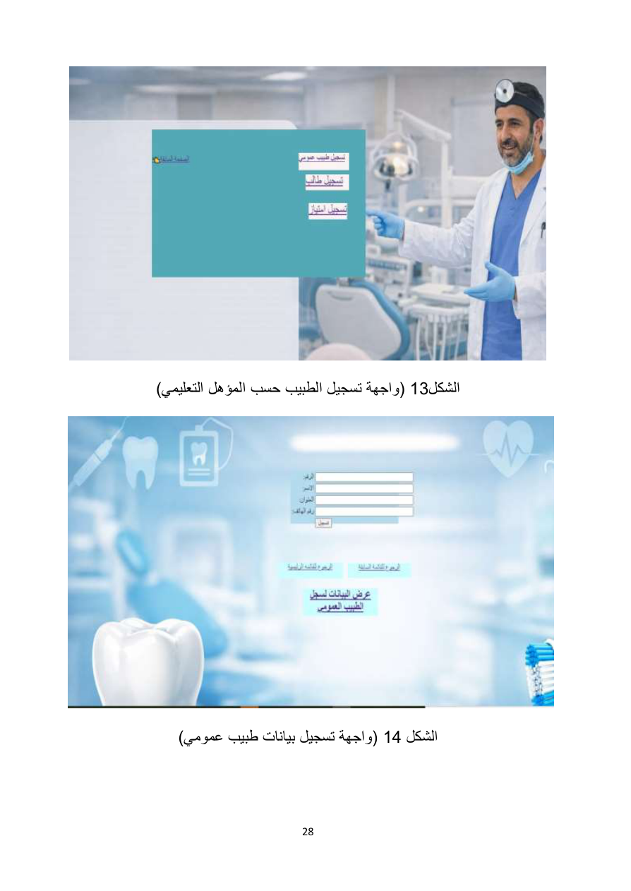
Modern UI/UX Direction
Do not reproduce the old background-heavy screens.
Use a clean dashboard, sidebar navigation and consistent cards/tables/forms.
Use responsive layouts for desktop, tablet and mobile.
Use Arabic + English from day one; support RTL properly.
Use a restrained design system: university brand colors, accessible contrast, consistent typography and spacing.
Use modern tables with search, filters, pagination and clear actions.
Red Sea University Dental Clinic — Modernization & Development Plan | 23

Slide 24
Dashboard — Target Experience
Conceptual layout
┌─────────────────────────────────────────────────────┐
│ Red Sea University Dental Clinic User ▼ │
├──────────────┬──────────────────────────────────────┤
│ Dashboard │ Dashboard │
│ Patients │ [Patients] [Today] [Completed] │
│ Doctors │ │
│ Students │ Upcoming Appointments │
│ Appointments │ Patient | Doctor | Time | Status │
│ Records │ │
│ Reports │ Activity / Charts │
│ Settings │ │
└──────────────┴──────────────────────────────────────┘
Red Sea University Dental Clinic — Modernization & Development Plan | 24

Slide 25
Patient Profile — Target Experience
Header: patient number, name, age, phone and status.
Tabs: Overview | Appointments | Medical History | Dental Chart | Treatments.
Timeline of visits and clinical events.
Clear distinction between read-only history and editable current visit.
Search and filters for long histories.
Optional document/X-ray attachments only if approved by the university.
Patient #RSU-000123
Ahmed Mohamed
Age: 25 Phone: 09xxxxxxxx
Medical History
12 Sep 2026 — Dental Caries — Composite Filling
Doctor: Dr. Ahmed | Student: Mohamed
Red Sea University Dental Clinic — Modernization & Development Plan | 25

Slide 26
Appointment Workflow
Receptionist
↓
Select Patient
↓
Select Doctor / Student
↓
Select Date & Time
↓
Backend checks availability
↓
Create Appointment
↓
Confirmation
↓
Doctor/Student sees schedule
Prevent duplicate bookings on the backend.
Support reschedule/cancel actions with proper permissions.
Provide calendar and list views.
Filter by day, doctor, patient and status.
Red Sea University Dental Clinic — Modernization & Development Plan | 26

Slide 27
Reports & Search
Patient Reports
Appointment Reports
Doctor Reports
Medical Reports
Registration, demographics and patient activity.
Daily schedule, status, doctor and patient filters.
Doctors, specialization and operational activity.
Visits, diagnosis, treatment and follow-up data.
Search should be server-side for scalability.
Use filters, pagination and sorting.
Provide print/export where the university requires it.
Possible later exports: PDF and Excel.
Red Sea University Dental Clinic — Modernization & Development Plan | 27

Slide 28
Testing Strategy
Unit tests: focused business logic and services.
Feature/API tests: authentication, CRUD, validation, authorization and workflow rules.
Integration tests: React ↔ Laravel API behavior.
UI tests for critical workflows such as login, patient registration and appointment booking.
Security tests: unauthorized access, role boundaries, invalid input and rate limits.
Regression testing before every release.
Example appointment tests
✓ Can create appointment
✓ Can cancel appointment
✓ Cannot double-book doctor
✓ Unauthorized user cannot create
✓ Invalid date/time is rejected
Red Sea University Dental Clinic — Modernization & Development Plan | 28

Slide 29
Git & Professional Workflow
main
develop
feature/auth
feature/patients
feature/appointments
feature/medical-records
feature/reports
Commit small, meaningful changes.
Use pull requests when working with a team.
Keep main stable.
Tag release versions.
Example commits: feat: add patient management; fix: prevent duplicate appointments.
Red Sea University Dental Clinic — Modernization & Development Plan | 29

Slide 30
Development Strategy — Vertical Slices
Do not build the entire backend first and the entire frontend later.
Build one complete feature from database → API → UI → test.
Finish the slice before moving to the next module.
Recommended first slice: authentication.
Second slice: patients.
Then appointments, medical records, dental chart, reports and dashboard.
Feature
↓
Migration → Model → Request → API → React page → Test
↓
DONE
Red Sea University Dental Clinic — Modernization & Development Plan | 30

Slide 31
MVP Roadmap
1
Authentication
Login, logout, users, roles, permissions
2
Patients
CRUD, search, profile
3
Doctors & Students
Profiles, status, assignments
4
Appointments
Booking, calendar, status, conflict prevention
5
Medical Records
Visits, diagnosis, treatment, history
6
Dental Chart
Interactive tooth tracking
7
Reports & Dashboard
Filters, statistics, exports
8
Hardening
Testing, security, backup, deployment
Red Sea University Dental Clinic — Modernization & Development Plan | 31

Slide 32
Implementation Timeline — Example
Week 1 — Requirements, ERD, use cases, UI wireframes, project setup
Week 2 — Authentication, users, roles and permissions
Week 3 — Patients, doctors and students
Week 4 — Appointments, calendar and booking rules
Week 5 — Medical records, diagnosis and treatment
Week 6 — Dental chart
Week 7 — Reports, dashboard, search and filters
Week 8 — Testing, security, responsive polish and bug fixing
Week 9 — Deployment, backup, documentation and user training
Red Sea University Dental Clinic — Modernization & Development Plan | 32

Slide 33
Deployment Architecture
UNIVERSITY SERVER
┌──────────────────────────────┐
│ React static/build assets │
│ Laravel API │
│ MySQL │
│ Backup storage │
└──────────────────────────────┘
↓
University LAN
↓
Reception | Doctors | Students | Admin
The original scope emphasizes an internal/local university environment.
Use HTTPS even on an internal network where practical.
Schedule automatic database backups.
Test restore procedures, not only backup creation.
Cloud deployment can be a future phase if the university approves it.
Red Sea University Dental Clinic — Modernization & Development Plan | 33

Slide 34
Backup & Operational Reliability
Daily
Weekly
Restore Test
Automated database backup.
Secondary/longer-retention backup.
Regularly verify that backups can actually be restored.
Medical data makes recoverability a core requirement.
Document backup location, retention, restore procedure and responsibility.
Do not treat backup as an afterthought.
Red Sea University Dental Clinic — Modernization & Development Plan | 34

Slide 35
What NOT to Use as the New Architecture
Do not rebuild the application as Dreamweaver-managed PHP pages.
Do not mix SQL queries into presentation pages.
Do not store all clinical history as one unstructured text field.
Do not let every role access every record.
Do not rely on frontend-only validation.
Do not store plaintext passwords.
Do not make the UI a collection of static background images and tiny forms.
Red Sea University Dental Clinic — Modernization & Development Plan | 35

Slide 36
Professional Definition of Done
A feature is not finished when the screen appears to work.
It is finished when database constraints, backend validation, authorization, API behavior, frontend UX and tests all agree.
Critical workflows are tested with both valid and invalid inputs.
Errors are handled clearly.
Sensitive operations are auditable.
Documentation and deployment instructions exist.
Definition of Done
Database ✓
API ✓
Security ✓
UI/UX ✓
Tests ✓
Documentation ✓
Red Sea University Dental Clinic — Modernization & Development Plan | 36

Slide 37
Source Design Screens — Login & Registration
Use these screens to confirm original workflow intent.
Redesign the visual layer completely in the new React application.
Red Sea University Dental Clinic — Modernization & Development Plan | 37

Slide 38
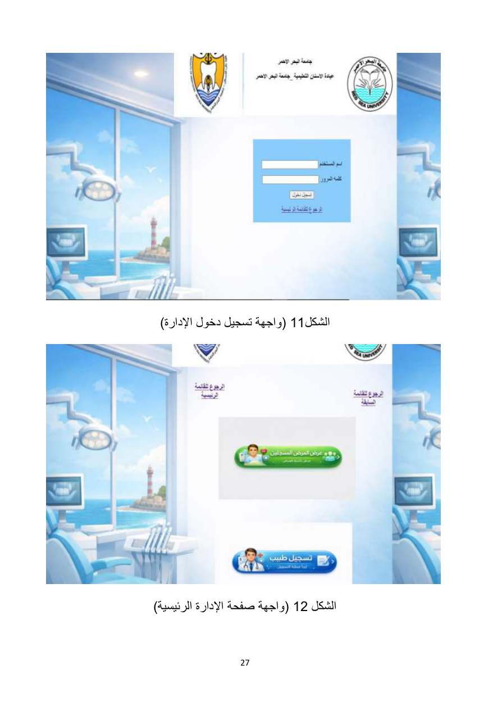
Source Design Screens — Patient & Records
Original patient registration and record-display workflows shown in the source documentation.
Red Sea University Dental Clinic — Modernization & Development Plan | 38

Slide 39
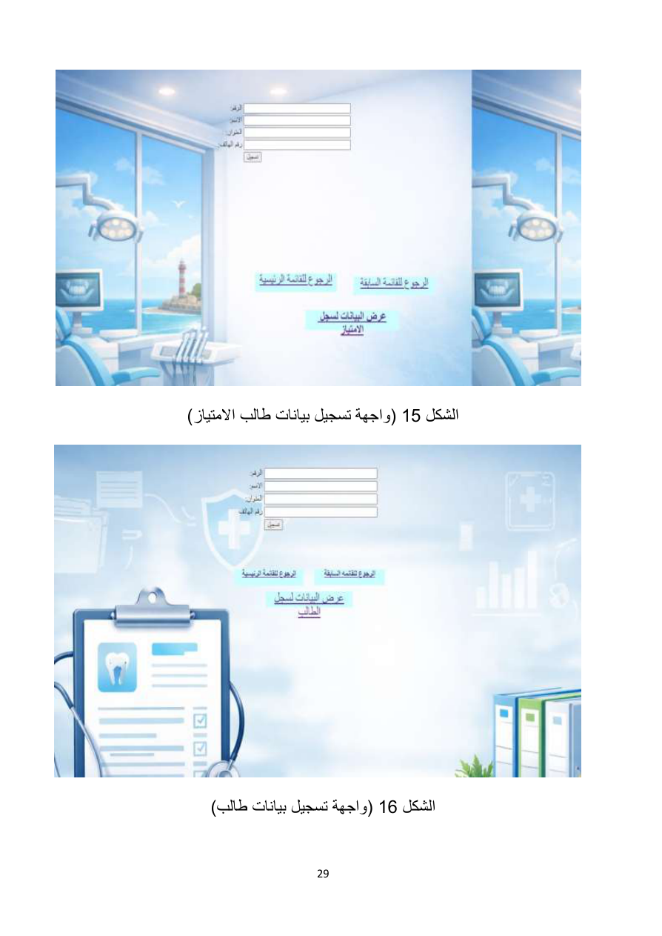
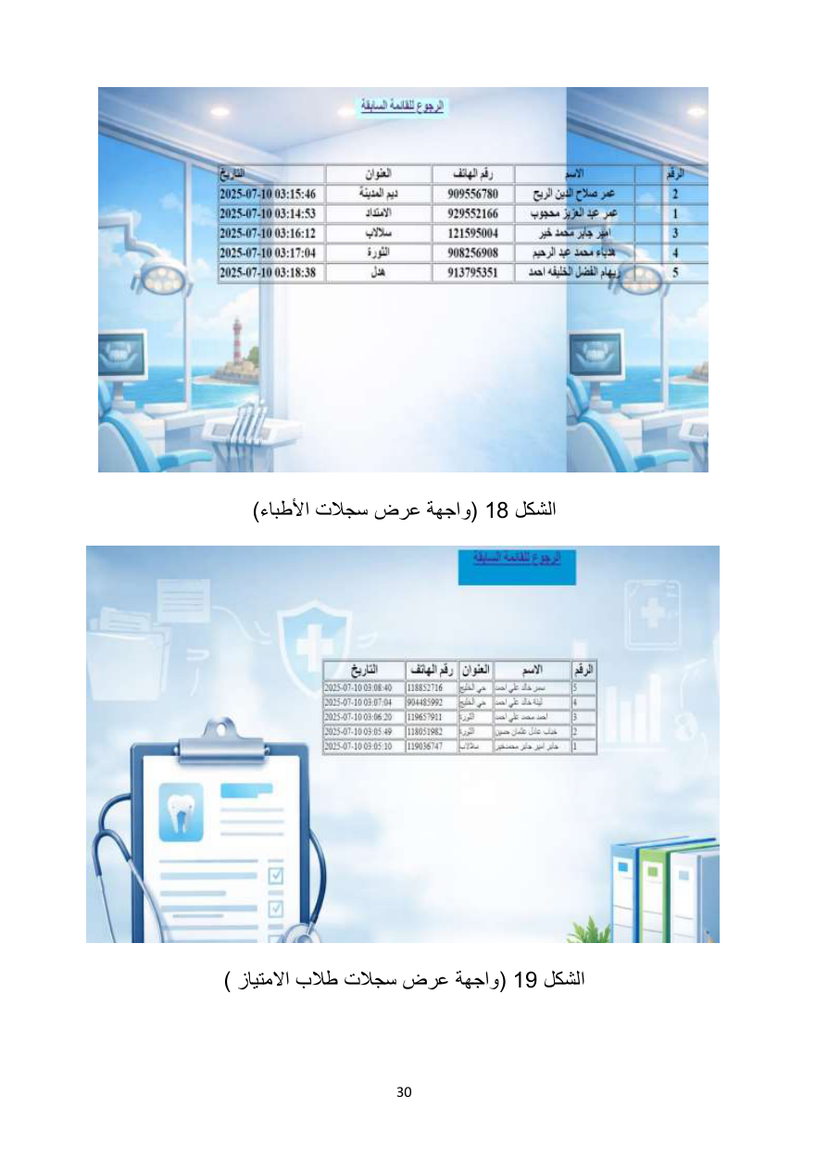
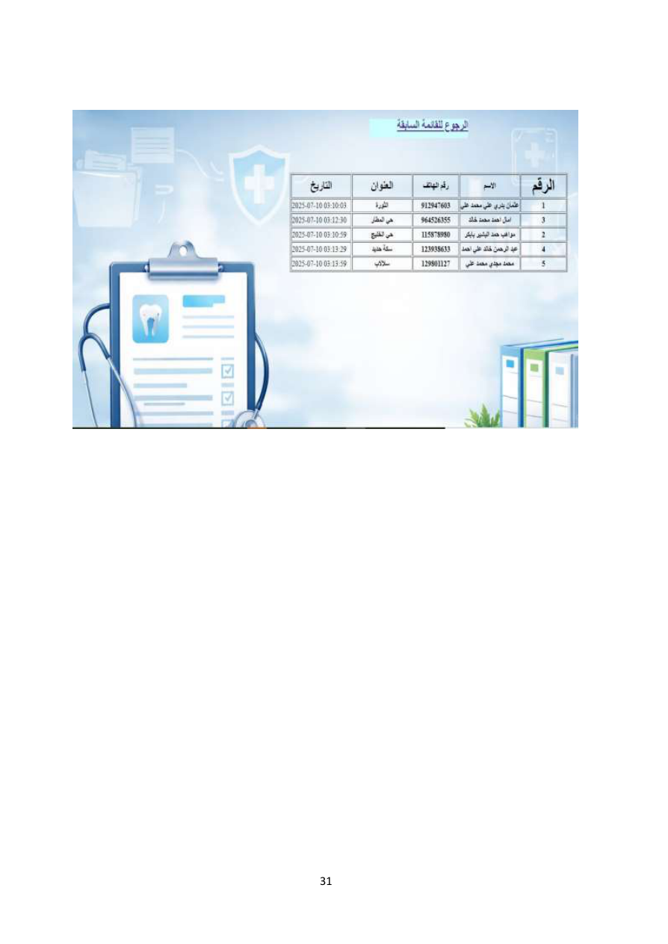
Source Design Screens — Administration, Doctors & Students
These screens show administrative login/home, doctor registration and student/intern-related records in the original design.
Red Sea University Dental Clinic — Modernization & Development Plan | 39

Slide 40
Phase 0 — Before Writing Code
Confirm exactly what the university wants preserved from the existing system.
Confirm all user roles and their permissions.
Confirm whether students/interns create records directly or only assist doctors.
Confirm appointment rules, working hours and conflict policy.
Confirm what clinical fields are required for a visit.
Confirm whether dental charting, attachments, exports and notifications are required for MVP.
Confirm data migration needs: will existing legacy data be imported?
Confirm hosting: local university server vs internet/cloud.
Red Sea University Dental Clinic — Modernization & Development Plan | 40

Slide 41
Project Kickoff Checklist
☐ Requirements approved
☐ Roles and permissions approved
☐ ERD approved
☐ UI wireframes approved
☐ Repository created
☐ Development environments configured
☐ Laravel project created
☐ React project created
☐ MySQL database configured
☐ Authentication strategy agreed
☐ First vertical slice defined
Red Sea University Dental Clinic — Modernization & Development Plan | 41

Slide 42
Recommended First Build
Start with Authentication + Role-Based Access.
Create the users table and role model.
Implement Laravel Sanctum authentication.
Create React login page.
Create protected routes.
Create role-aware dashboard shell.
Add logout and session/token handling.
Write API/feature tests before moving to Patients.
Milestone #1
React Login
↓
Laravel API
↓
Sanctum
↓
User + Role
↓
Protected Dashboard
Red Sea University Dental Clinic — Modernization & Development Plan | 42

Slide 43
Then Build Patients End-to-End
Laravel migration → patients table
Patient model + relationships
Form Request validation
Patient API controller/resource
Search + pagination endpoint
React patient list
React create/edit form
Patient profile page
Authorization rules
Tests
Only after this is stable: move to Appointments.
Red Sea University Dental Clinic — Modernization & Development Plan | 43

Slide 44
Final Target
Modern Dental Clinic Platform
React UI
+
Laravel REST API
+
MySQL
+
Authentication / RBAC
+
Appointments
+
Medical Records
+
Dental Chart
+
Reports
+
Audit Logs
+
Backup / Deployment
Goal: preserve the documented business purpose while replacing the legacy implementation with a maintainable, secure and modern system.
Red Sea University Dental Clinic — Modernization & Development Plan | 44

Slide 45
Source vs. Recommendation
Important distinction
Documented / Source-derived
Recommended modernization
Clinic purpose, core actors, patient/doctor/student concepts, appointments
, records, reporting, original design screens and documented scope.
React + Laravel + MySQL architecture, normalized schema, Sanctum, policies,
audit logs, dental-chart UI, calendar UI, automated backups, testing strategy
and professional Git workflow.
The recommended items are engineering decisions for the rebuild; they should be validated with the university before becoming contractual requirements.
Red Sea University Dental Clinic — Modernization & Development Plan | 45

