Slide 1
Final project – Home Automation
Unai Zurbano Martin - 873795621

Slide 2
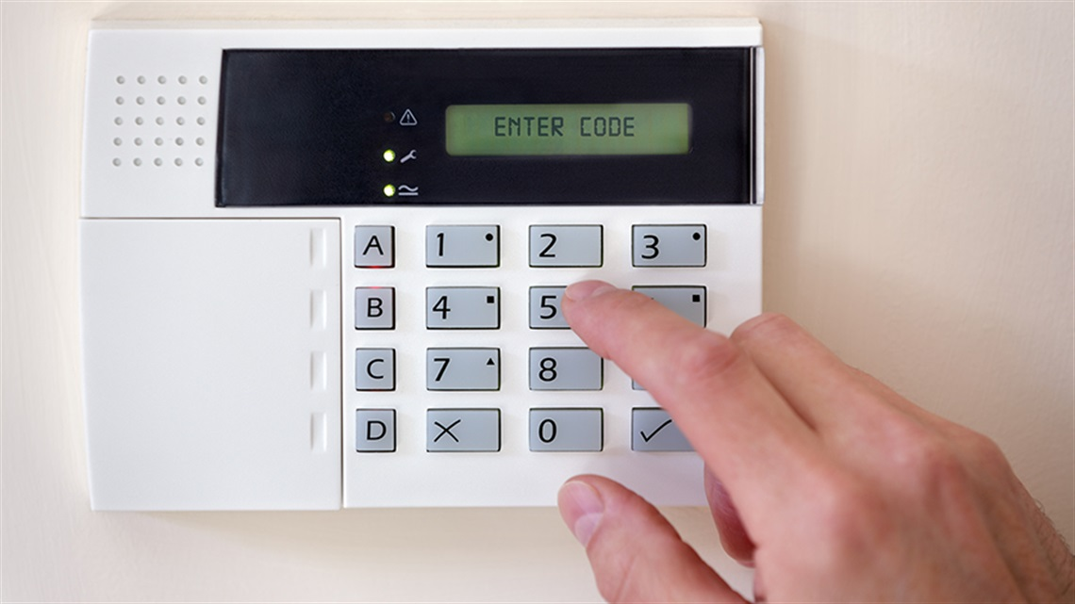
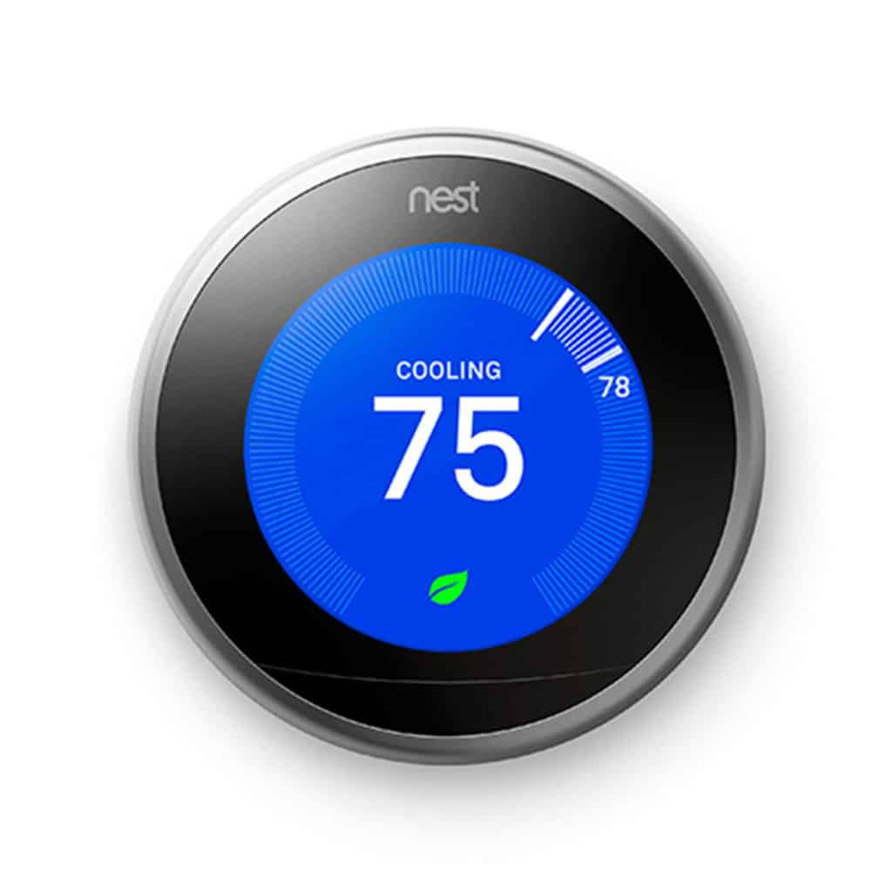
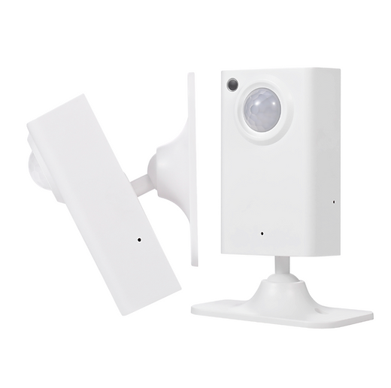
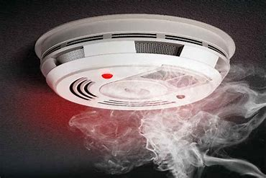
Concept

Slide 3
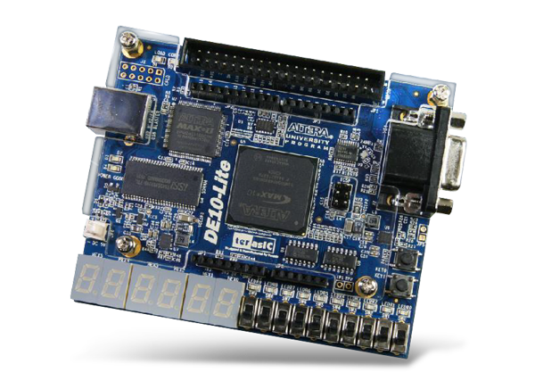
Concept

Slide 4
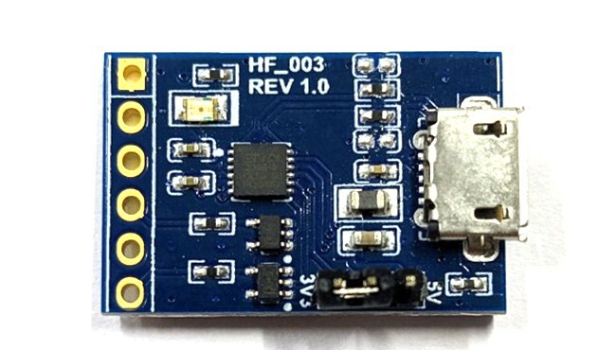
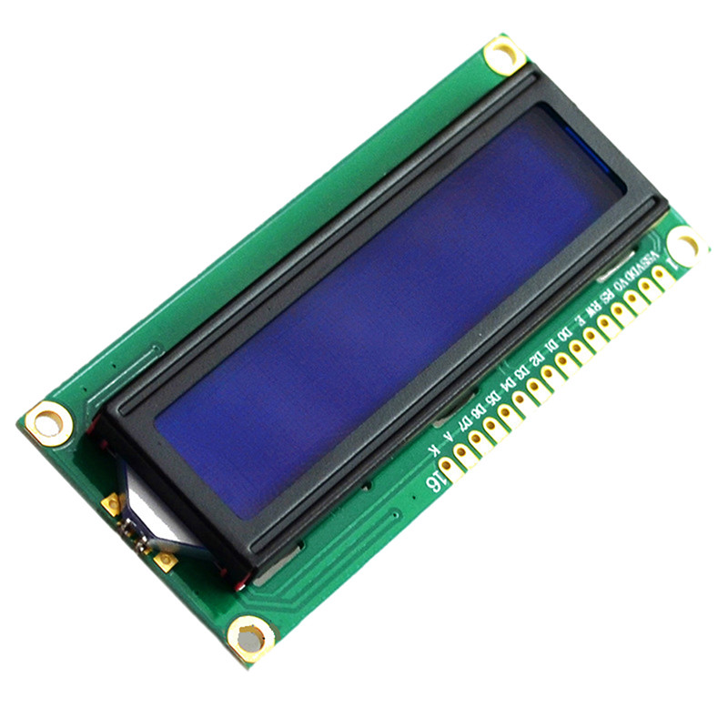
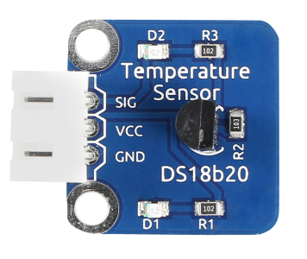
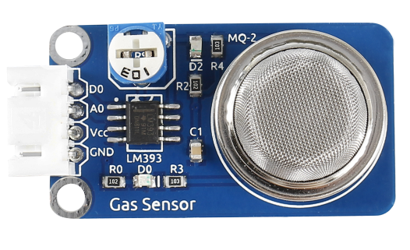
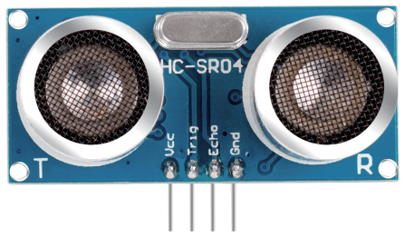
Components

Slide 5
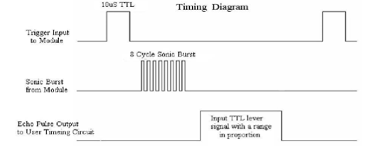
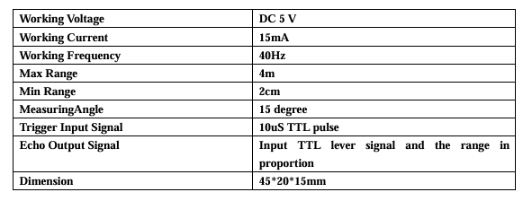
HC-SR04
VCC: 5V
Trigger: Input trigger
Echo: Output measurement (Voltage divider)
GND: Gnd
60ms
uS / 58 = centimeters
(datasheet)

Slide 6
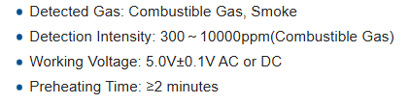
MQ-2
Potentiometer to adjust trigger digital output signal
D0: Digital output (Detection when 0) (Voltage divider)
A0: Analog output Interface (ADC module required)
VCC: 5V
GND: Gnd
(datasheet)

Slide 7
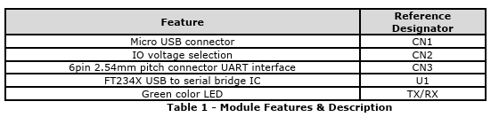
LC234X (UART interface)
Tx: Transmit Asynchronous Data Output
Rx: Receiving Asynchronous Data Input
GND: Gnd
(datasheet)

Slide 8
Components

Slide 9
Data ready
Counter 3s
Counter 5s
UART Rx
Count start
RxD Data
Count done
Count start
UART Device
GPIO[35]
USB
Count done
UART Rx
Data ready
GPIO[33]
Ultrasonic
FSM
Security control
Clk
Rst
Ultrasonic
Display Controller
HEX0
Light control
States
HEX1
HEX2
HEX3
HEX4
HEX5
Smoke sensor
LEDR
Fire Alarm

Slide 10
Button = 1
5s count done
Idle
Locking
Locked
2s count done
Incorrect
Char = 1
Ultrasonic = 1
Smoke = 1
Intruder
else Char
FIRE Alarm
Smoke = 0
S_123
S_12
S_1
Char = 1
Char = 4
Char = 3
Char = 2
Smoke = 1

Slide 11
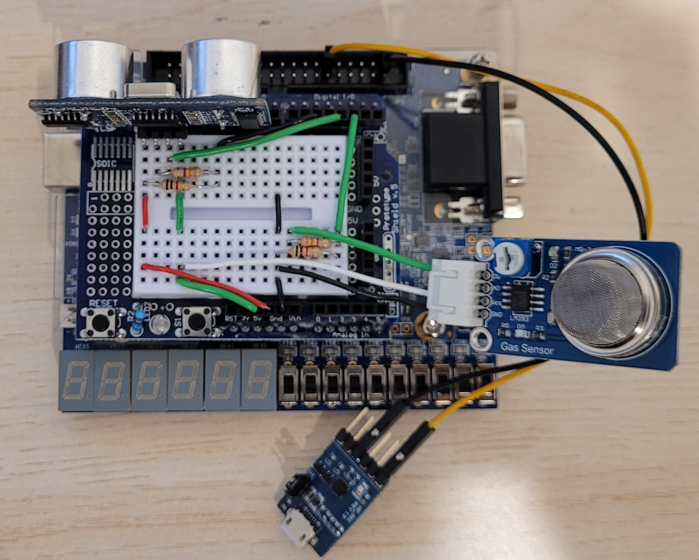
Let’s see it working!

Slide 12


Conclusion and future improvements
Integration of multiple sensors.
FSM to manage security and real-time conditions
LCD Display and Temperature sensor

Slide 13

Conclusion and future improvements
Integration of multiple sensors.
FSM to manage security and real-time conditions
LCD Display and Temperature sensor
Integration of remaining sensors
Add ADC for analog sensors
Possible integration with Bluetooth or Wi-Fi
3D printed housing to reduce undesired conditions

