Slide 1
Statistical Modeling
UZMA SIDDIQUI
Roll no:15

Slide 2
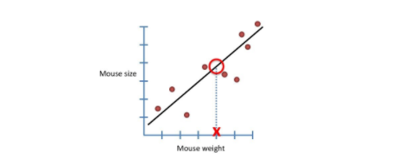
Statistical Modeling
A statistical model is a mathematical representation of observed data.
A statistical model is usually specified as a mathematical relationship between one or more random variables and other non-random variables. As such, a statistical model is "a formal representation of a theory".

Slide 3
HOW IT IS USED:
When data analysts apply various statistical models to the data they are investigating, they are able to understand and interpret the information more strategically.
This practice allows them to identify relationships between variables, make predictions about future sets of data, and visualize that data so that non-analysts and stakeholders can consume and leverage it.
While data scientists are most often tasked with building models and writing algorithms, analysts also interact with statistical models in their work on occasion.
“As machine learning and artificial intelligence become more commonplace, more and more companies and organizations are leveraging statistical modeling in order to make predictions about the future based off data,”
data analytics need to understand how the underlying models work…No matter what kind of analysis you are doing or what kind of data you are working with, you are going to need to use statistical modeling in some way.”

Slide 4
3 Reasons to Learn Statistical Modeling
Choose the Right Model
Prepare Your Data
Better Communicator
There are many different types of statistical models
data analyst should be able to identify not only which model will help best,but also which model is most appropriate for the data they’re working with.
To ensure your analysis is accurate and viable, the data must first be cleaned up.
This cleanup often includes organizing the gathered information and removing “bad or incomplete data” from the sample.
Before any statistical model can be completed, you need to explore, understand the data. “If there is no quality, then you can’t really derive any insights from it.”
Having a thorough understanding of statistical modeling can help you better communicate.
you will be better equipped to reach conclusions and therefore generate better data visualizations
allow you to generate and explain those more granular details when necessary.

Slide 5
Important Statistical Techniques in Data Analysis
Before any statistical model can be created, an analyst needs to collect or fetch the data housed on a database, clouds, social media, or within a plain excel file. To do this, analysts must also have a solid grasp of data structure and management, including how and where data is stored, fetched, and maintained.
Once it comes time to analyze the data, there are an array of statistical models analysts may choose to utilize, most common techniques will fall into the following two groups:
Supervised Learning
Unsupervised Learning
Regression Models
Classification Models
Clustering Algorithms and Association rules.

Slide 6
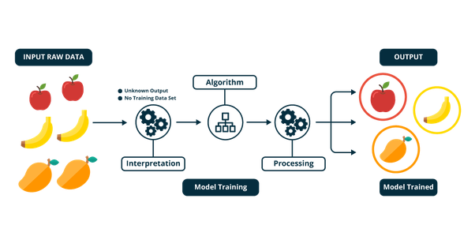
Supervised Learning
Supervised learning as the name indicates the presence of a supervisor as a teacher.
Basically supervised learning is a learning in which we teach or train the machine using data which is well labeled
After that, supervised learning algorithm analyses the data and produces a correct outcome from labeled data.

Slide 7
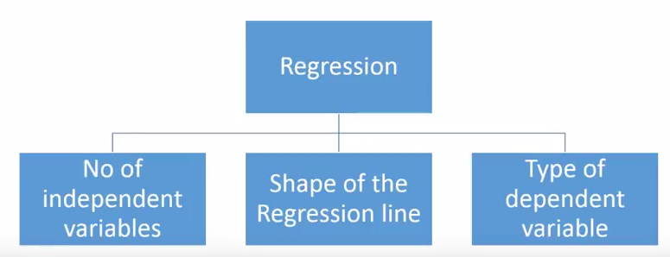
Regression Model
Regression is a technique used to model and analyze the relationships between variables
There are various kinds of regression techniques available to make predictions. These techniques are mostly driven by three metrics (number of independent variables, type of dependent variables and shape of regression line).
The Independent variable is the cause . Its value are independent of other variable.
The Dependent variable is the effect. Its value are depends on the change of independent variables.

Slide 8
Types of Regression techniques
The most traditional regression models that have been used for a long time are
linear regression, logistic regression and polynomial regression
Other examples of regression models can include
stepwise regression, ridge regression, lasso regression, and elastic net regression.

Slide 9
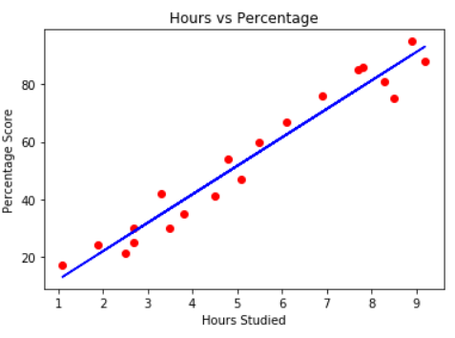
Linear Regression Model
A linear regression equation : Y = a + bX
A linear regression refers to a regression model that is completely made up of linear variables.
Single Variable Linear Regression is a technique used to model the relationship between a single input independent variable and an output dependent variable using a linear model i.e a line.
Multi-Variable Linear Regression where a model is created for the relationship between multiple independent input variables and an output dependent variable.
It is represented by an equation Y=a+b*X + e, where a is intercept, b is slope of the line and e is error term. This equation can be used to predict the value of target variable based on given predictor variable(s).

Slide 10
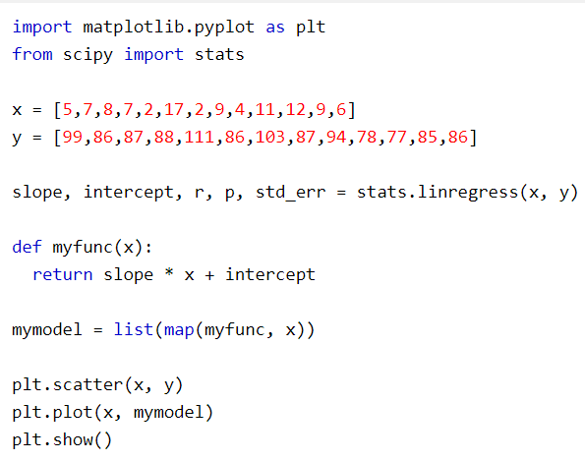
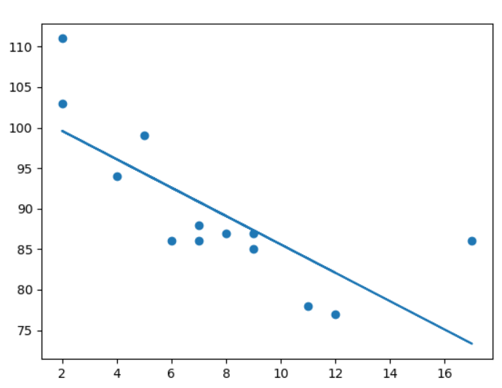
Example of Linear Regression Model
Output:

Slide 11

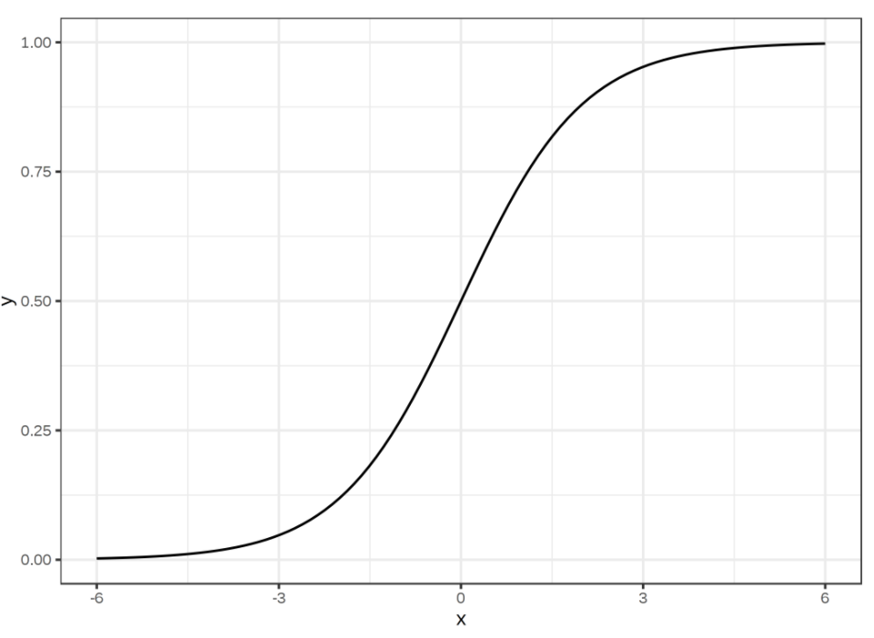
Logistic regression
The linear regression model can work well for regression, but fails for classification.
A linear model does not output probabilities.
A solution for classification is logistic regression.
Logistic regression models the probabilities for classification problems with two possible outcomes. It's an extension of the linear regression model for classification problems.
the logistic regression model uses the logistic function to squeeze the output of a linear equation between 0 and 1.
Used:
Fraud Detection
Disease diagnosis
Emergency Detection
Spam ,No Spam
The logistic function is defined as:

Slide 12
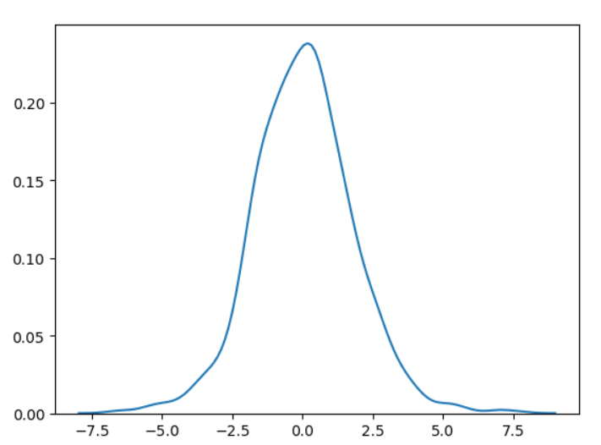
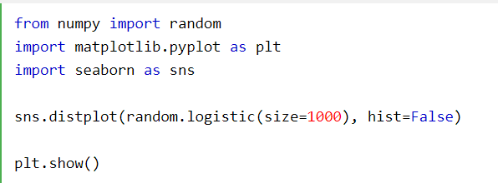
Example of Logistic Regression
It has three parameters:
loc - mean, where the peak is. Default 0.
scale - standard deviation, the flatness of distribution. Default 1.
size - The shape of the returned array.

Slide 13
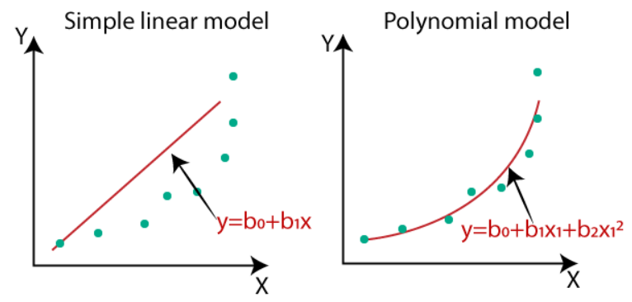
Polynomial Regression model
If we apply a linear model on a linear dataset, then it provides us a good result as we have seen in Simple Linear Regression, but if we apply the same model without any modification on a non-linear dataset, then it will produce a drastic output. Due to which loss function will increase, the error rate will be high, and accuracy will be decreased.
So for such cases, where data points are arranged in a non-linear fashion, we need the Polynomial Regression model. We can understand it in a better way using the below comparison diagram of the linear dataset and non-linear dataset.
In the image, we have taken a dataset which is arranged non-linearly. So if we try to cover it with a linear model, then we can clearly see that it hardly covers any data point. On the other hand, a curve is suitable to cover most of the data points, which is of the Polynomial model.
Hence, if the datasets are arranged in a non-linear fashion, then we should use the Polynomial Regression model instead of Simple Linear Regression.
Equation of the Polynomial Regression Model:
Simple Linear Regression equation:
y = b₀+b₁x
Multiple Linear Regression equation:
y= b₀+b₁x+ b₂x₂+ b₃x₃+....+ b_{n}x_{n}

Slide 14
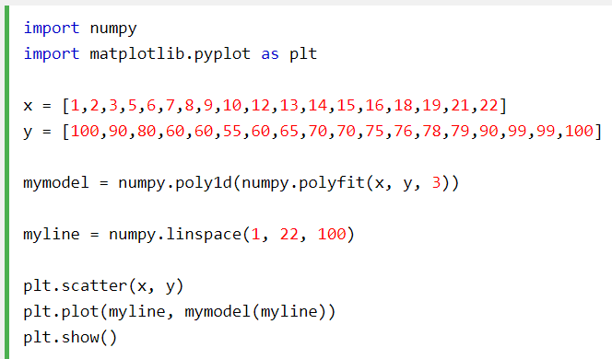
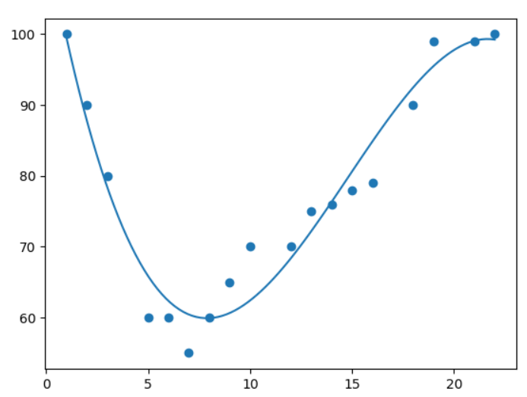
Example of Polynomial Regression Model
Output:

Slide 15
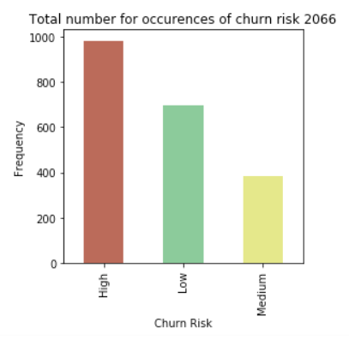
Classification Model
Classification is when the feature to be predicted contains categories of values. Each of these categories is considered as a class into which the predicted value falls and hence has its name, classification.
Classification algorithms include:
Naive Bayes
Logistic regression
K-nearest neighbors
(Kernel) SVM
Decision tree
Ensemble learning

Slide 16
Unsupervised Learning
Unsupervised Learning is a machine learning technique in which the users do not need to supervise the model. Instead, it allows the model to work on its own to discover patterns and information that was previously undetected. It mainly deals with the unlabelled data.
Unsupervised Learning Algorithms allow users to perform more complex processing tasks compared to supervised learning.
Unsupervised learning algorithms include clustering, anomaly detection, neural networks, etc.
Unsupervised learning problems further grouped into clustering and association problems.

Slide 17
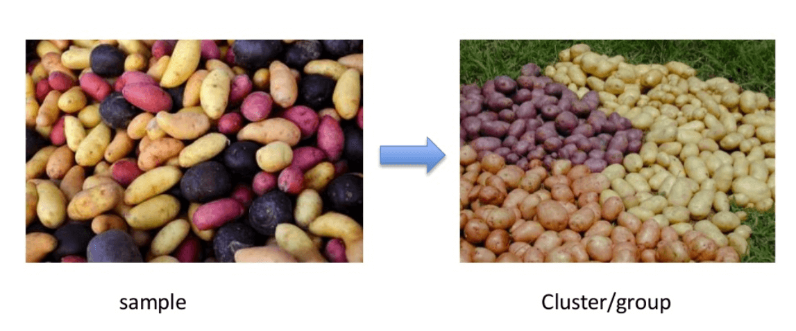
Clustering:
It mainly deals with finding a structure or pattern in a collection of uncategorized data. Clustering algorithms will process your data and find natural clusters(groups) if they exist in the data. You can also modify how many clusters your algorithms should identify.

Slide 18
Clustering Types
Hierarchical clustering
K-means clustering
K-NN (k nearest neighbors)
Principal Component Analysis

Slide 19
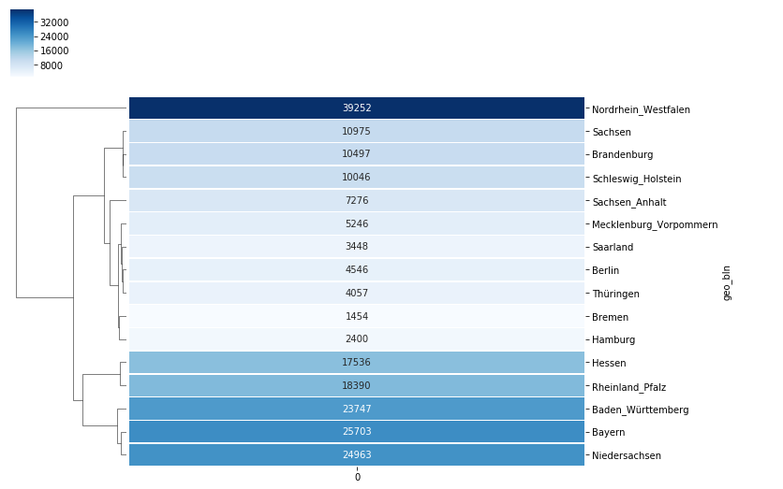
Hierarchical Clustering:
Hierarchical clustering is an algorithm which builds a hierarchy of clusters. It begins with all the data which is assigned to a cluster of their own. Here, two close cluster are going to be in the same cluster. This algorithm ends when there is only one cluster left.

Slide 20
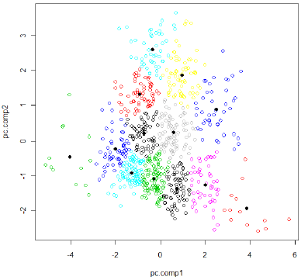
K-means clustering
K means it is an iterative clustering algorithm which helps you to find the highest value for every iteration. Initially, the desired number of clusters are selected. In this clustering method, you need to cluster the data points into k groups. A larger k means smaller groups with more granularity in the same way. A lower k means larger groups with less granularity.
In k-means clustering, each group is defined by creating a centroid for each group. The centroids are like the heart of the cluster, which captures the points closest to them and adds them to the cluster.

Slide 21
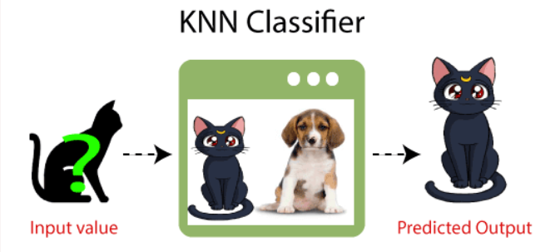
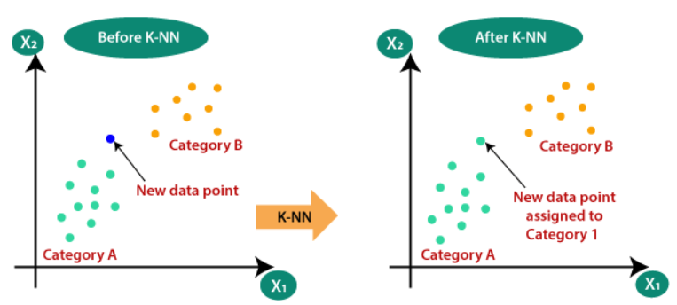
K- Nearest neighbours
K-NN algorithm assumes the similarity between the new case/data and available cases and put the new case into the category that is most similar to the available categories.
KNN algorithm at the training phase just stores the dataset and when it gets new data, then it classifies that data into a category that is much similar to the new data.

Slide 22
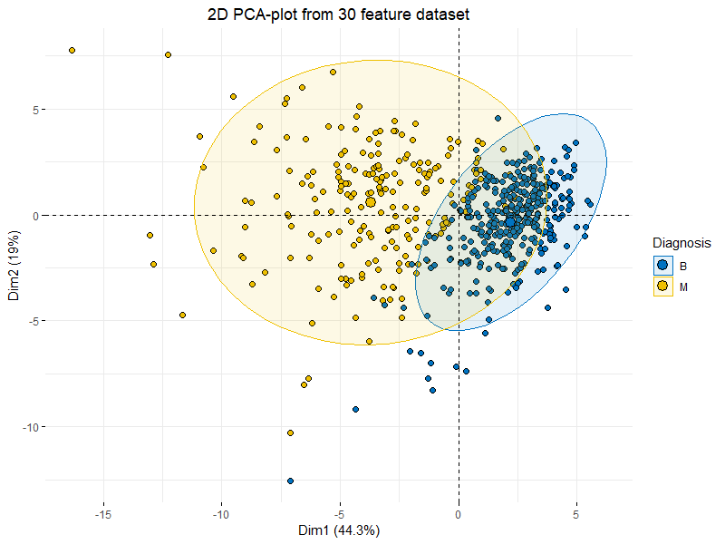
Principal Component Analysis
Principal component analysis aims at reducing a large set of variables to a small set that still contains most of the information in the large set. The technique of principal component analysis enables us to create and use a reduced set of variables, which are called principal factors.

Slide 23
Association
Association rules allow you to establish associations amongst data objects inside large databases. This unsupervised technique is about discovering interesting relationships between variables in large databases. For example, people that buy a new home most likely to buy new furniture.
Other Examples:
A subgroup of cancer patients grouped by their gene expression measurements
Groups of shopper based on their browsing and purchasing histories
Movie group by the rating given by movies viewers

Slide 24
Thankyou
max growth

