Slide 1

Impact of Covid-19 on Learning Modalities
Year 2021 – 2022
Data 602 – Final Project
By:
Mubashira Qari

Slide 2
Data Sources & Links
The datasets are acquired from the following sources,
HealthData.gov
NYTimes Covid-19 data – GitHub
US Zip code to County State to FIPS Look Up – data.world
States Names and Abbreviations – GitHub
The links are provided below:
https://healthdata.gov/National/School-Learning-Modalities/aitj-yx37
https://github.com/nytimes/covid-19-data
https://github.com/jasonong/List-of-US-States/blob/master/states.csv

Slide 3
Research Questions
The research questions for this project are the following:
1- Which state has the most covid cases for the year 2021 and 2022?
2- Which state has the most deaths caused by covid for the year 2021 and 2022?
3- Which state has the highest average student count for hybrid, remote and in-person learning
modality for the year 2021 and 2022?

Slide 4
Project Implementation
The project implementation is performed using the following libraries, tools and applications:
Python Pandas, NumPy
Python Matplotlib
Plotly Express
Census library for API
Scikit-learn library for Machine learning
Quick DBD for Relational Schema Diagram
PostgreSQL Database
Tableau for visualization
Plotly-Dash for visualization

Slide 5
Tasks Performed on Data
Exploratory Data Analysis (EDA) – Summary of school learning modalities, Covid-19 cases, states names and abbreviation data, and Census API Call data are thoroughly explored by importing the datasets into Pandas dataframe.
Extract Load Transform (ETL) – Merging dataframe, Cleaning columns and values, Dropping duplicates, NULL, special characters, Extracting year from time, Renaming column names, Replacing NULL values with zero, Applying Group By and Aggregate functions.

Slide 6
Supervised Machine Learning
For machine learning analysis, following are the main steps performed:
Fulfill the requirement for numeric data and no missing data.
Converting categorical data using Scikit-learn LabelEncoder() function.
Normalize or Standardize the data using StandardScaler() function.
KNeighborsClassifier, LogesticRegression, and DecisionTreeClassifier models are applied and evaluated.

Slide 7
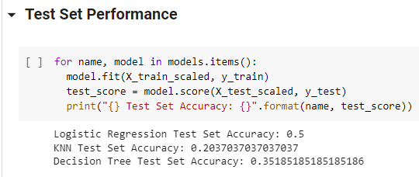
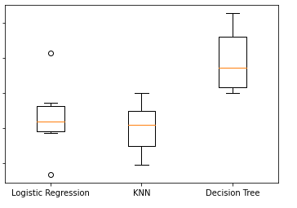
Supervised Machine Learning
Conclusion:
Decision Tree model has the highest accuracy but still very low.
One of the reason might be that there are not enough features in the dataset.
Also, there is not enough data to predict correct accuracy.
Since the dataset is thoroughly cleaned, so noise might not be the cause of low accuracy.

Slide 8
PostgreSQL Database

Slide 9
Plotly Dash Visualization

Slide 10
Tableau Data Visualizations

