Slide 1

Impact of Covid-19 on Learning Modalities
Year 2021 – 2022
Data 602 – Final Project
By:
Mubashira Qari
Notes:
The topic of my final project is, “Impact of Covid of Learning Modalities -Year 2021-2022”. The reason I choose to investigate this topic is because there is a major shift in students’ learning modalities due to the impact of Covid-19 since the beginning of the year 2020.

Slide 2
Data Sources & Links
The US state level datasets are acquired from the following sources,
HealthData.gov
NYTimes Covid-19 data – GitHub
US Zip code to County State to FIPS Look Up – data.world
States Names and Abbreviations – GitHub
The links are provided below:
https://healthdata.gov/National/School-Learning-Modalities/aitj-yx37
https://github.com/nytimes/covid-19-data
https://github.com/jasonong/List-of-US-States/blob/master/states.csv
Notes:
The School Learning Modalities dataset is about weekly estimates of school learning modality (including in-person, remote, or hybrid learning) for U.S. K-12 public and independent charter school districts for the 2021-2022 school year.
NYTimes Covid-19 data on GitHub provides the state level covid-19 cases and deaths count for the year 2021 and 2022.
Since the modalities dataset has only the state abbreviations and the aim is to design a relational database with one-to-many relationship, the states and names dataset is also fetched from GitHub.

Slide 3
Research Questions
The research questions for the project are the following:
1- Which state has the most covid cases for the year 2021 and 2022?
2- Which state has the most deaths caused by covid for the year 2021 and 2022?
3- Which state has the highest average student count for hybrid, remote and in-person learning
modality for the year 2021 and 2022?

Slide 4
Project Implementation
The project implementation is performed using the following libraries, tools and applications:
Python Pandas, NumPy
Python Matplotlib
Plotly Express
Census library for API Call
Scikit-learn libraries for Machine learning
Quick DBD Tool for Relational Schema Diagram
PostgreSQL Database
Tableau Application for visualization
SQLAlchemy – The Database Toolkit for Python
Plotly-Dash for visualization
Google Colab, Jupyter Notebook, Visual Code Studio

Slide 5
Tasks Performed on Data
Exploratory Data Analysis (EDA) – Summary of school learning modalities, Covid-19 cases, states names and abbreviation data, and Census API Call data are thoroughly explored by importing the datasets into Pandas dataframe.
Extract Load Transform (ETL) – Merging dataframe, Cleaning columns and values, Dropping duplicates, NULL, special characters, Extracting year from time, Renaming column names, Replacing NULL values with zero, Applying Group By and Aggregate functions.
Data Normalization – After fetching US states population, student count, covid cases and deaths count were divided by population for calculating per capita and multiplied by 10k for normalization.
Data Exported – Modality_df, Covid_df and States_df dataframe are exported for visualization analysis.
Notes:
After thorough cleaning and data wrangling, the three dataframes are exported as
posgres_modality_df.csv
posgres_covid_df.csv
posgres_states_df.csv
Next, the posgres_modality_df.csv and posgres_covid_df.csv files have been imported to census_api notebook for performing API call to fetch states populations.
The population dataset is merged with modality and covid datasets.
The objective is to normalize the data by converting the student count in hybrid, remote and in-person and the covid count to correct proportion by dividing it to the population of each state. And then normalizing the values by multiplying them to 10K.
Finally, three file ready for PostgreSQL database, Supervised ML, Plotly Dash and Tableau visualization analysis are:
tableau_modality_df.csv
tableau _covid_df.csv
posgres_states_df.csv

Slide 6
Supervised Machine Learning
Following are the main steps performed for supervised machine learning prediction :
Fulfill the requirement for numeric data and no missing data.
Converting categorical data using Scikit-learn LabelEncoder() function.
Normalize or Standardize the data using StandardScaler() function.
KNeighborsClassifier, LogesticRegression, and DecisionTreeClassifier models are applied and evaluated.
Notes:
Here, a thorough supervised machine learning requirement steps have been performed. KNN algorithm, Logistic Regression and Decision Tree model have been applied and accuracy have been calculated.

Slide 7
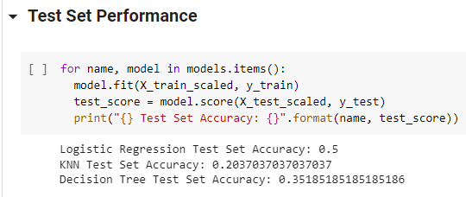
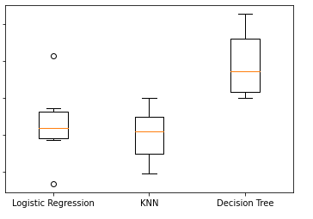
Supervised Machine Learning
Conclusion:
Decision Tree model has the highest accuracy but still very low.
One of the reason might be that there are not enough features in the dataset.
Also, there is not enough data to predict correct accuracy.
Since the dataset is thoroughly cleaned, so noise might not be the cause of low accuracy.
Notes:
As you can see that Decision Tree model has the highest accuracy but still very low.
And the reason might be not enough features in the dataset, not enough rows in the dataset.
Noise might not be the cause of low accuracy, since dataset is thoroughly cleaned.

Slide 8
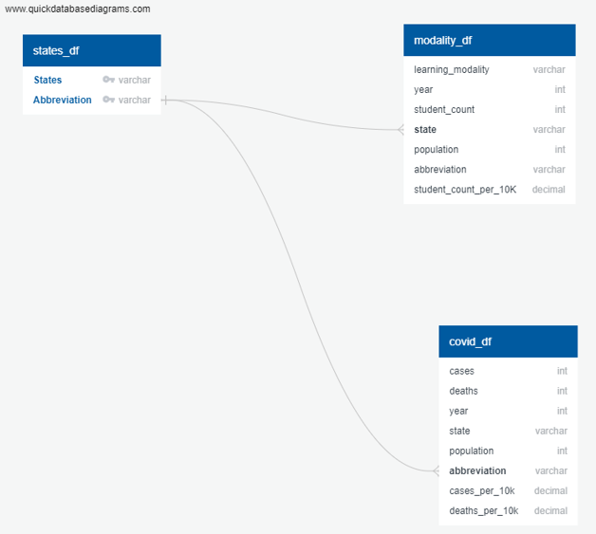
PostgreSQL Database
A relational database is created in
PostgreSQL database – covid_modality_db
A relational schema diagram is designed
using the tool Quick DBD.
Three tables created are – states_df,
modality_df, and covid_df
SQL queries are performed and imported into
the python file using SQLAlchemy Toolkit.
Notes:
A relational database schema diagram has been made using the tool Quick DBD and PostgreSQL queries have been generated.
Finally, PostgreSQL database has been created with the name: covid_modality_db and three tables’
a- states_df
b- modality_df
c- covid_df

Slide 9
Tableau App Analysis
Nevada has the highest learning count for hybrid in 2021. Whereas Maryland has the highest student count for hybrid in 2022.
Nevada has the highest student count per 10k between 2021 - 2022.
North Dakota has the highest covid cases per 10k in 2021. Rhode Island has the highest covid cases per 10k in 2022.
Mississippi has the highest death count per 10k between 2021 – 2022.
Notes:
Three datasets are imported in Tableau and a relational model is created to visualize the data.
These are the results of my visualization analysis.

Slide 10
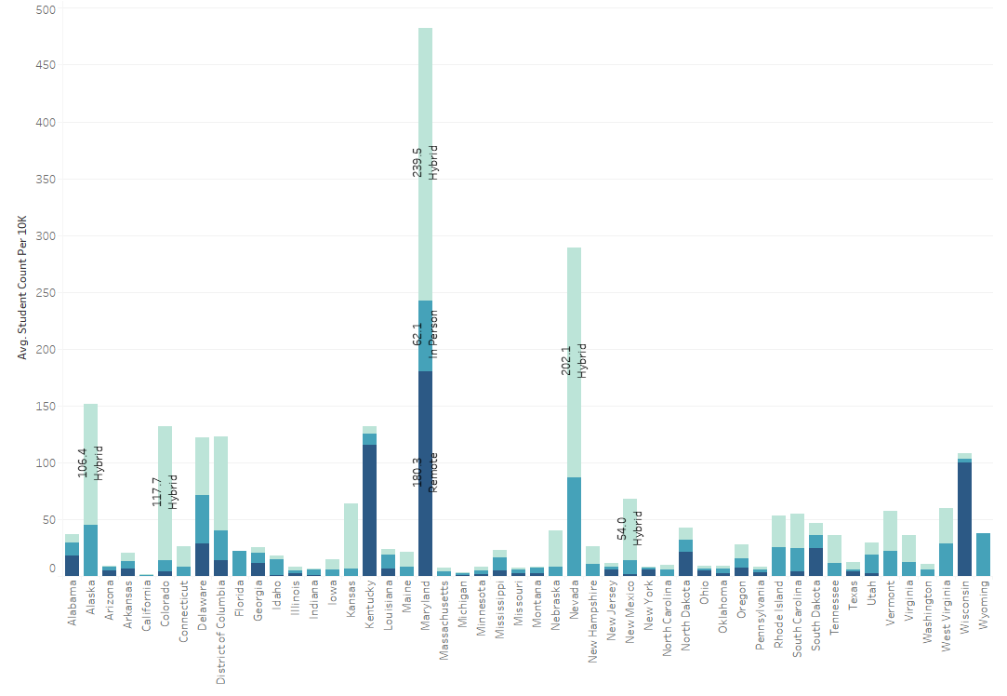
Tableau Visualizations
Tableau Story: Impact of Covid on Learning Modalities - 2021-2022

Slide 11
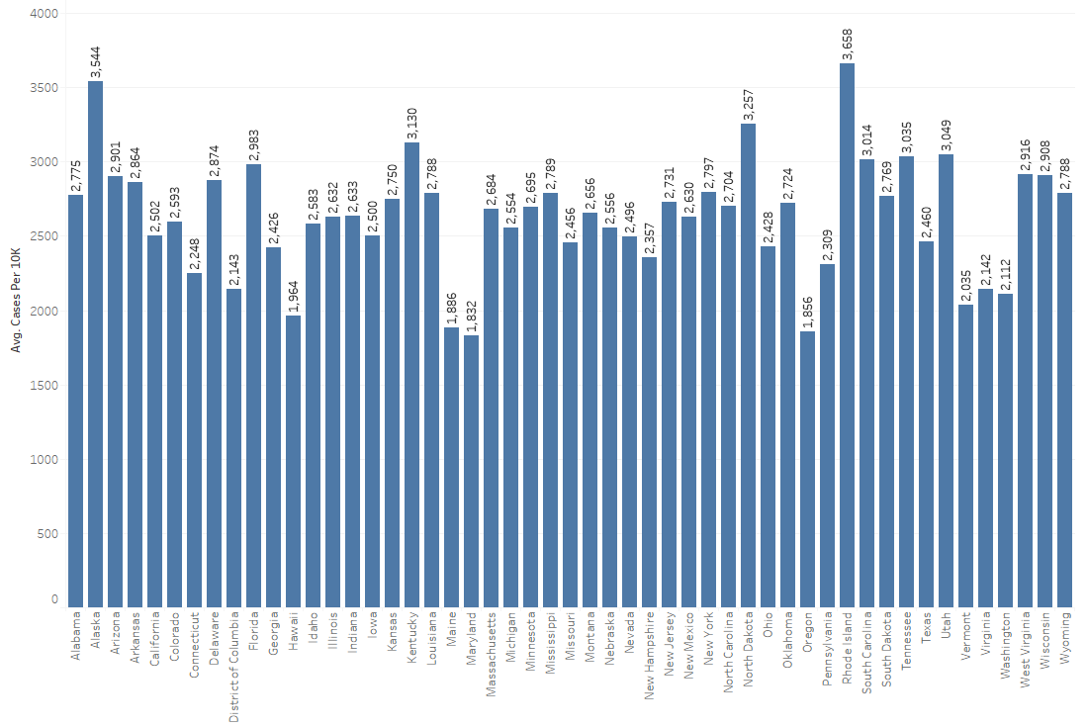
Tableau Visualizations
Tableau Story: Impact of Covid on Learning Modalities - 2021-2022

Slide 12
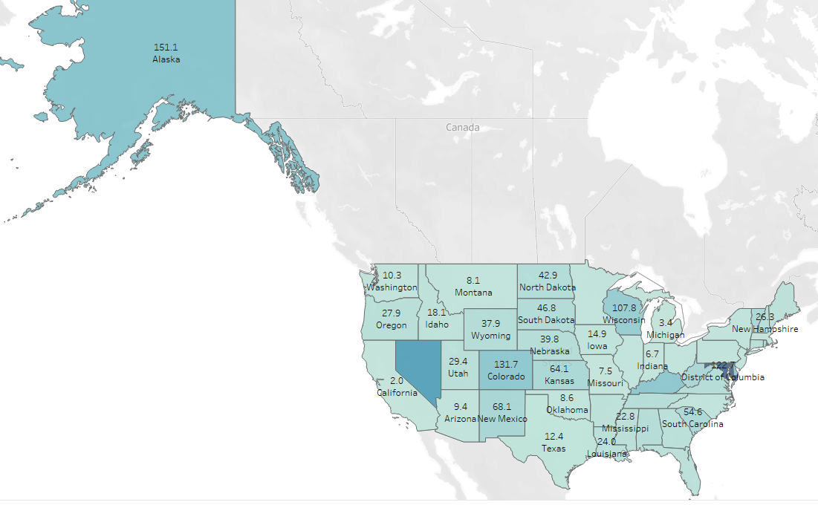
Tableau Visualizations
Tableau Story: Impact of Covid on Learning Modalities - 2021-2022

Slide 13
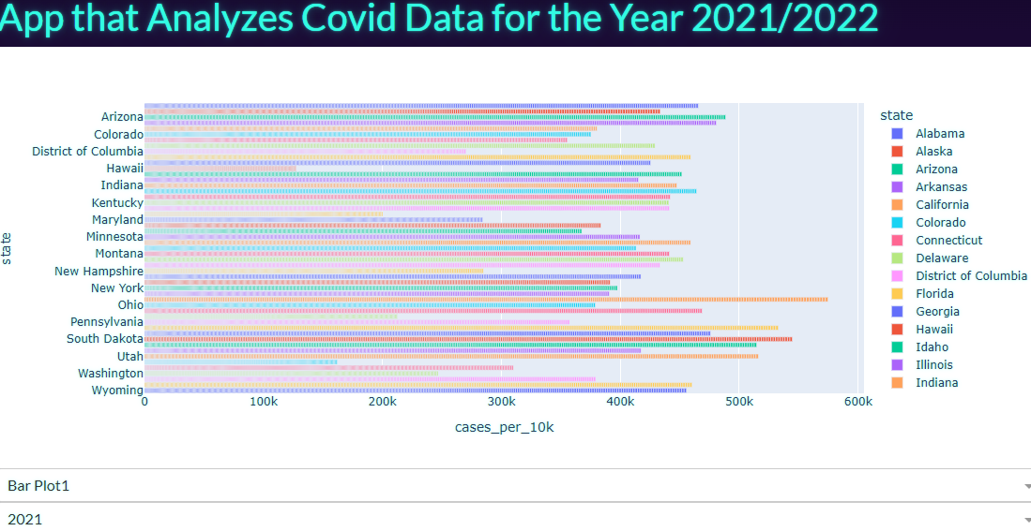
Plotly Dash App Analysis
Plotly Dash App Link
Notes:
Now here queries from PostgreSQL database are imported into the python file using SQLAlchemy – The Database Toolkit for Python which facilitate creating connection to the database performing SQL queries in Python.
I have used the file “app.py” in Visual Code Studio for this purpose.

Slide 14
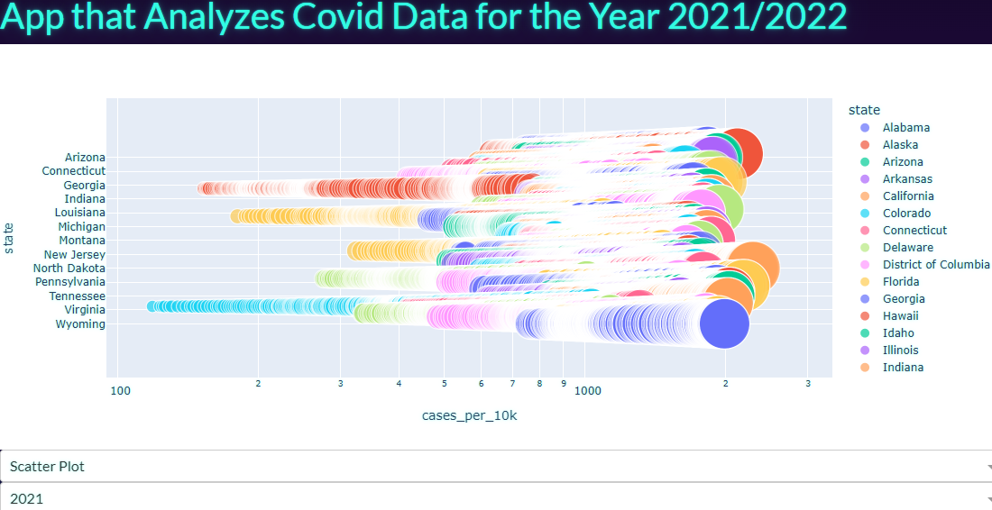
Plotly Dash App Analysis
Plotly Dash App Link

Slide 15
Challenges Encountered
One of the challenges in the dataset is that the rows for the US Hawaii state has incorrect student count. Same numbers are repeating for the hybrid, remote and in-person student count.
I discovered this fact in the Tableau visualizations.
After pinpointing the data for each state, I found out the issue with Hawaii state.
Next, I went to the original data source website and checked that the data has the same issue there.
So, for this reason, I have filtered out the Hawaii state from the dataset.
Notes:
After visualizing the data into charts, I have noticed that the student count for the Hawaii state is same for all three categories.
After checking original source, it got confirmed that the issue is in the original data, so I filtered out Hawaii state.

