Slide 1

Impact of Covid-19 on Learning Modalities
Year 2021 – 2022
Data 602 – Final Project
By:
Mubashira Qari

Slide 2
Data Sources & Links
The US state level datasets are acquired from the following sources,
HealthData.gov
NYTimes Covid-19 data – GitHub
US Zip code to County State to FIPS Look Up – data.world
States Names and Abbreviations – GitHub
The links are provided below:
https://healthdata.gov/National/School-Learning-Modalities/aitj-yx37
https://github.com/nytimes/covid-19-data
https://github.com/jasonong/List-of-US-States/blob/master/states.csv

Slide 3
Research Questions
The research questions for the project are the following:
1- Which state has the most covid cases for the year 2021 and 2022?
2- Which state has the most deaths caused by covid for the year 2021 and 2022?
3- Which state has the highest average student count for hybrid, remote and in-person learning
modality for the year 2021 and 2022?

Slide 4
Project Implementation
The project implementation is performed using the following libraries, tools and applications:
Python Pandas, NumPy
Python Matplotlib
Plotly Express
Census library for API Call
Scikit-learn libraries for Machine learning
Quick DBD Tool for Relational Schema Diagram
PostgreSQL Database
Tableau Application for visualization
SQLAlchemy – The Database Toolkit for Python
Plotly-Dash for visualization

Slide 5
Tasks Performed on Data
Exploratory Data Analysis (EDA) – Summary of school learning modalities, Covid-19 cases, states names and abbreviation data, and Census API Call data are thoroughly explored by importing the datasets into Pandas dataframe.
Extract Load Transform (ETL) – Merging dataframe, Cleaning columns and values, Dropping duplicates, NULL, special characters, Extracting year from time, Renaming column names, Replacing NULL values with zero, Applying Group By and Aggregate functions.
Data Normalization – After fetching US states population, student count, covid cases and deaths count were divided by population for calculating per capita and multiplied by 10k for normalization.
Data Exported – Modality_df, Covid_df and States_df dataframe are exported for visualization analysis.

Slide 6
Supervised Machine Learning
Following are the main steps performed for supervised machine learning prediction :
Fulfill the requirement for numeric data and no missing data.
Converting categorical data using Scikit-learn LabelEncoder() function.
Normalize or Standardize the data using StandardScaler() function.
KNeighborsClassifier, LogesticRegression, and DecisionTreeClassifier models are applied and evaluated.

Slide 7
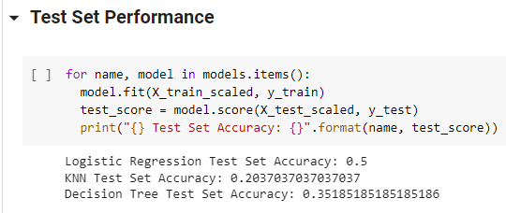
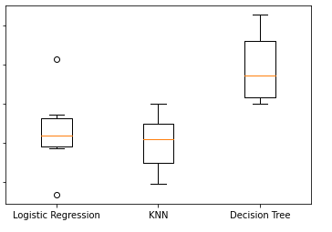
Supervised Machine Learning
Conclusion:
Decision Tree model has the highest accuracy but still very low.
One of the reason might be that there are not enough features in the dataset.
Also, there is not enough data to predict correct accuracy.
Since the dataset is thoroughly cleaned, so noise might not be the cause of low accuracy.

Slide 8
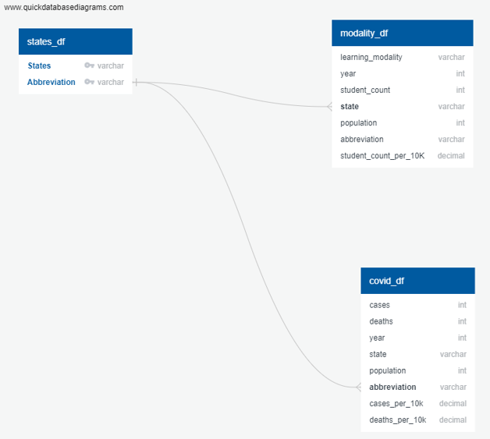
PostgreSQL Database
A relational database is created in
PostgreSQL database – covid_modality_db
A relational schema diagram is designed
using the tool Quick DBD.
Three tables created are – states_df,
modality_df, and covid_df
SQL queries are performed and imported into
the python file using SQLAlchemy Toolkit.

Slide 9
Tableau App Analysis
Nevada has the highest learning count for hybrid in 2021. Whereas Maryland has the highest student count for hybrid in 2022.
Nevada has the highest student count per 10k between 2021 - 2022.
North Dakota has the highest covid cases per 10k in 2021. Rhode Island has the highest covid cases per 10k in 2022.
Mississippi has the highest death count per 10k between 2021 – 2022.

Slide 10
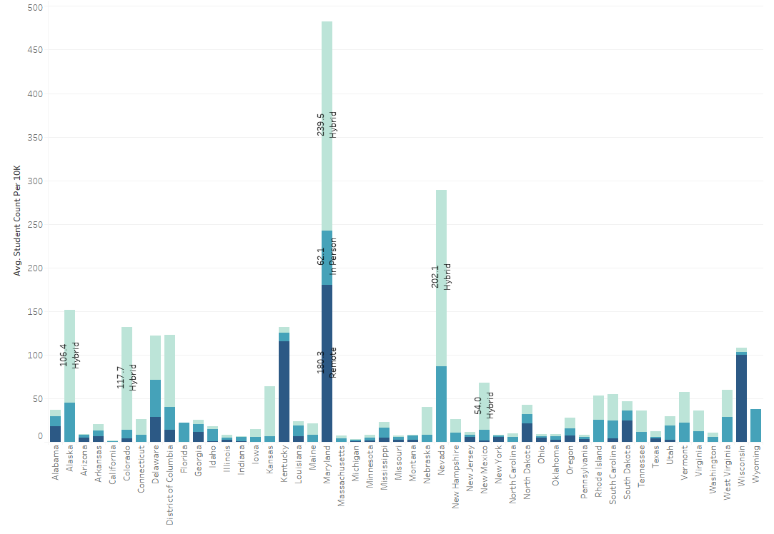
Tableau Visualizations
Tableau Story: Impact of Covid on Learning Modalities - 2021-2022

Slide 11
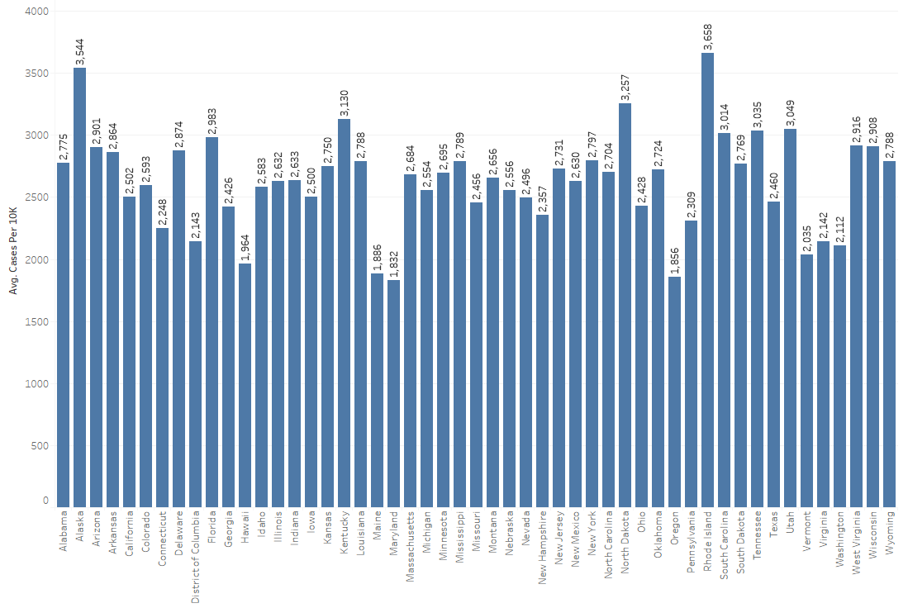
Tableau Visualizations
Tableau Story: Impact of Covid on Learning Modalities - 2021-2022

Slide 12
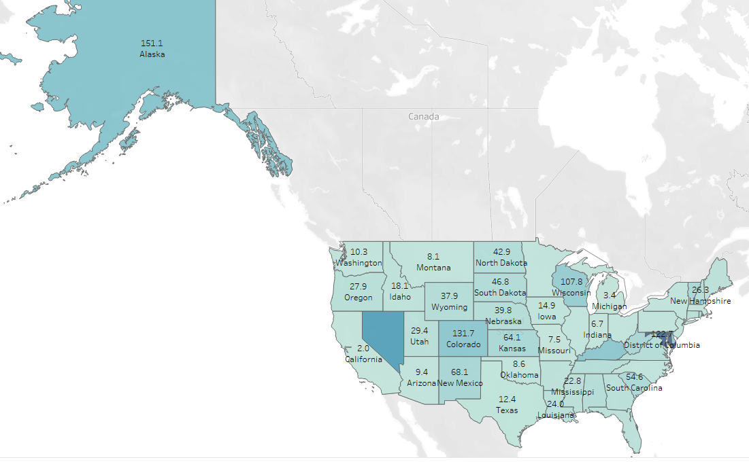
Tableau Visualizations
Tableau Story: Impact of Covid on Learning Modalities - 2021-2022

Slide 13
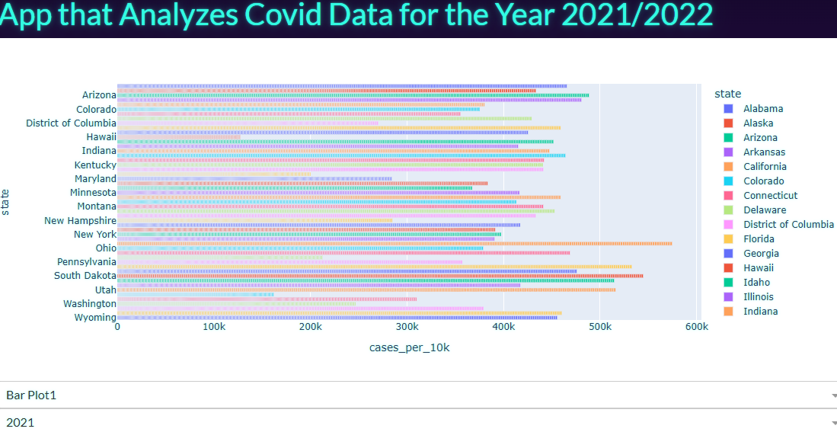
Plotly Dash App Analysis
Plotly Dash App Link

Slide 14
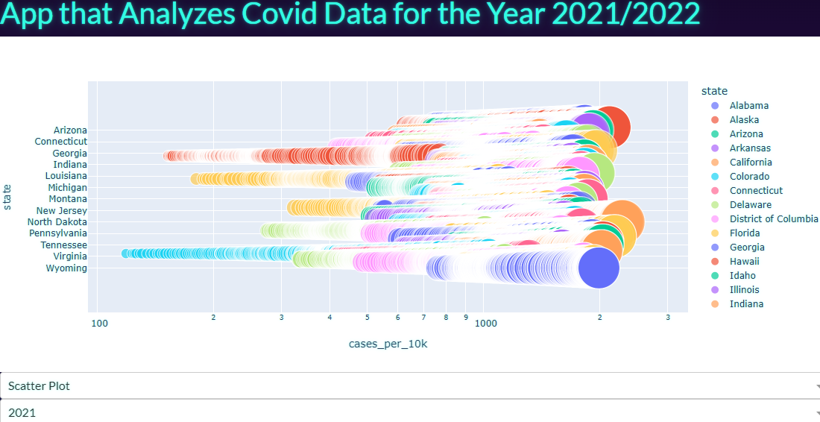
Plotly Dash App Analysis
Plotly Dash App Link

Slide 15
Challenges Encountered
One of the challenges in the dataset is that the rows for the US Hawaii state has incorrect student count. Same numbers are repeating for the hybrid, remote and in-person student count.
I discovered this fact in the Tableau visualizations.
After pinpointing the data for each state, I found out the issue with Hawaii state.
Next, I went to the original data source website and checked that the data has the same issue there.
So, for this reason, I have filtered out the Hawaii state from the dataset.

