Slide 1
Supervised Machine Learning Model Integration Using Flask
Project # 4
By: Mubashira Qari

Slide 2
Data Source:
The datasets from the NYPD Stop, Question, and Frisk database are used in this project and are available for download from the links provided below. Data is made available in CSV format.
Publications, Reports - NYPD

Slide 3
Problem Worth Solving, Analyzing, and Visualizing:
‘Stop, Question, and Frisk’ database is used in this machine learning project.
The aim is to predict, whether the suspect will be arrested or not.
And to predict, whether the summons will be issued or not for the suspect.

Slide 4
Implementation:
The project implementation is done using Scikit-learn library in machine learning, along with the following.
Python Pandas
Flask Web Framework
Python Matplotlib
HTML/CSS/Bootstrap
JavaScript D3.js
PostgreSQL Database
Tableau
Host application using Heroku

Slide 5
The 2017, 2018 and 2019 ‘Stop, Question and Frisk’ datasets are merged together to perform the preprocessing steps and prepare for the training dataset.
The 2020 ‘Stop, Question and Frisk’ dataset is retrieved to perform the preprocessing steps and prepare for the testing dataset.
Exploratory Data Analysis (EDA)

Slide 6
Data Preprocessing (ETL):
Merging 2017,18, &19 for training data and keeping 2020 for testing.
Removing unwanted text from columns.
Finding null values and checking for missing values.
Convert time into seconds to have integer values for machine learning.
Replacing the text strings with zeros in the integer columns.
Fixing two different names for single category.
Removing special characters from the data values.

Slide 7
Data Preprocessing (ETL):
Rename the columns.
Dropping columns which are not impacting the outcome.
Converting columns to correct data type.
Binning the categorical values in almost 10 out of 27 columns .
Converting values to numeric using Label Encoder for two category values columns.
Converting values to numeric using ‘get_dummies’ function for hierarchical category columns.
Normalizing the data using StandardScaler() function.

Slide 8
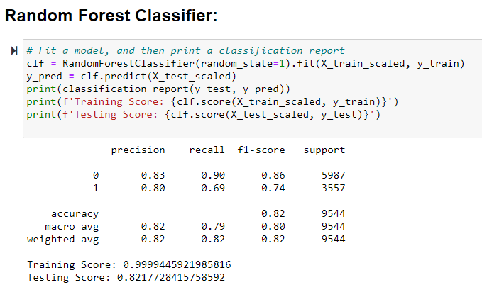
Random Forest Classifier for Arrest Prediction:
Actual Predicted
Positives(1’s) 10884 - 1189(FN) - 2368(TP)
Negatives (0’s) 25212 - 472(FP) - 5515(TN)
Total - 36,096
Accuracy: Overall how often is the classifier correct.
Precision: How often model correctly predict positives or negatives
Recall(Sensitivity): How well the model is able to predict the class.
F1 Score: of a class is the harmonic mean of precision and recall.

Slide 9
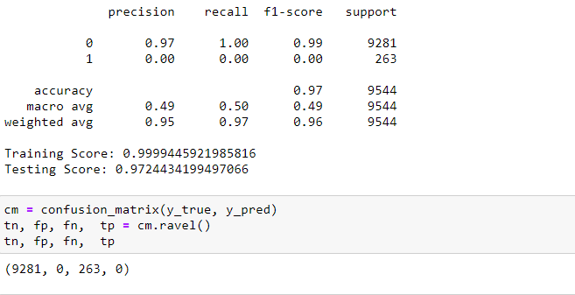
Random Forest Classifier for Summons Prediction:
Actual Predicted
Positives(1’s) 1040 ------ 263 (FN) ----- 0(TP)
Negatives (0’s) 35056 ---- 0 (FP) - 9281(TN)
Total - 36,096

Slide 10
Techniques & Challenges for Handling Imbalance Data:
Undersampling : Sampling from the majority class in order to keep only a part of these points.
Oversampling: Replicating some points from the minority class in order to increase its cardinality.
SMOTE: generating synthetic data or creating new synthetic points from the minority class to increase cardinality.
When using the resampling techniques, we are training the model on wrong proportions of two classes.Thus classifier learned this way will have lower accuracy on the future real test data than the classifier trained on unchanged data. So the true proportion of classes is important to know for classifying a new point, which gets lost due to resampling.
So, when applying these methods, one needs to be careful and clear in mind about the goal to be achieved.

Slide 11
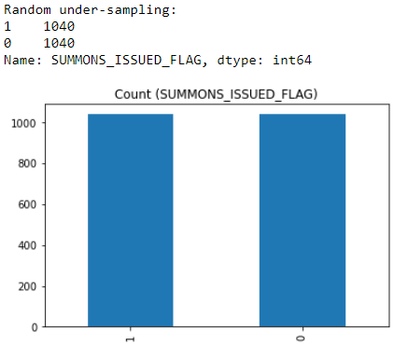
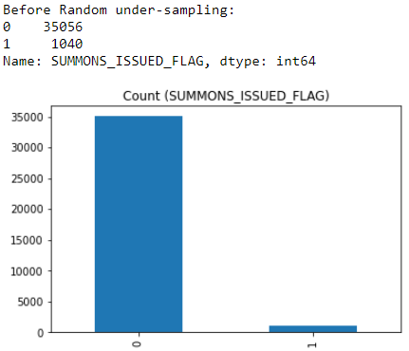
Analyzing the Outcome Data:

Slide 12
Finding the Important Features
Feature Importances

Slide 13
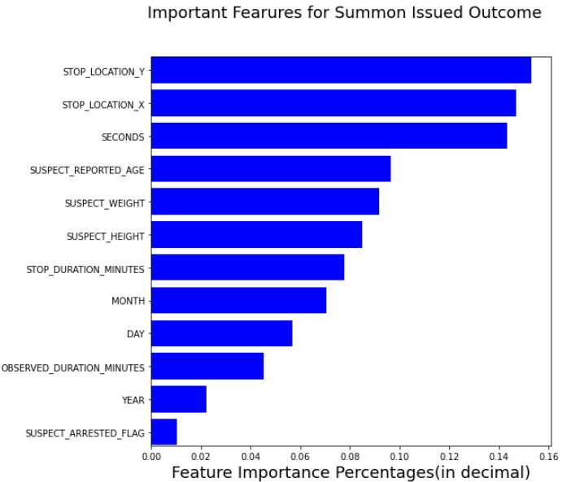
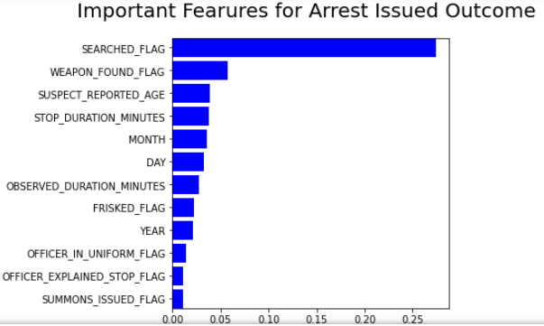
Twelve most important features are selected for prediction purposes and models are saved using joblib tools.

Slide 14
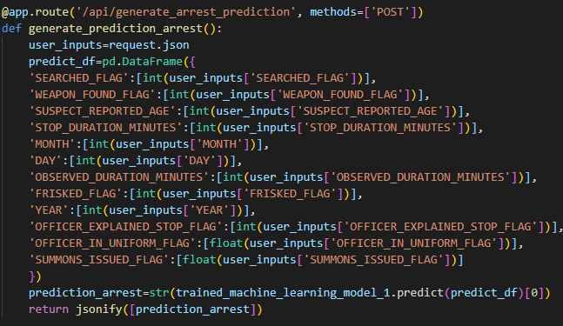
Flask Application:
Model is fetched and prediction is made in file main.py

Slide 15
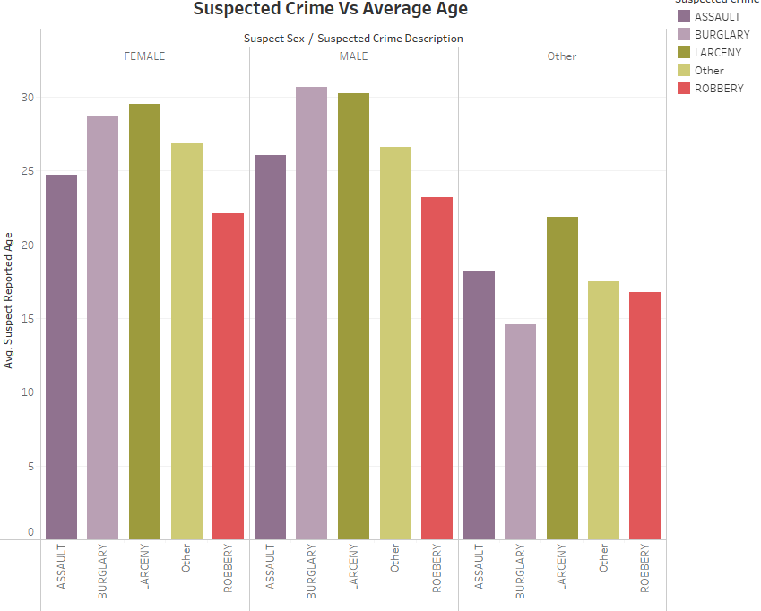
Tableau Visual Analytics
Heroku Deployment: Heroku Deployment

