Slide 1
Supervised Machine Learning Model Integration Using Flask
Project # 4
By: Mubashira Qari

Slide 2
Data Source:
Data records from the NYPD Stop, Question, and Frisk database are available for download from the links provided below. Data is made available in CSV format.
Publications, Reports - NYPD

Slide 3
Problem Worth Solving, Analyzing, and Visualizing:
‘Stop, Question, and Frisk’ database has multiple features which are important in affecting the outcome. The aim of this machine learning project is to predict, whether the summons is issued or not for the suspect.
Also to find out which features, mostly contribute to the arrest of the suspect.

Slide 4
Implementation:
The project implementation is done using Scikit-learn library in machine learning, along with the following.
Python Pandas
Flask Web Framework
Python Matplotlib
HTML/CSS/Bootstrap
JavaScript D3.js
SQL Database
Tableau
Host application using Heroku or amazon cloud for deployment

Slide 5
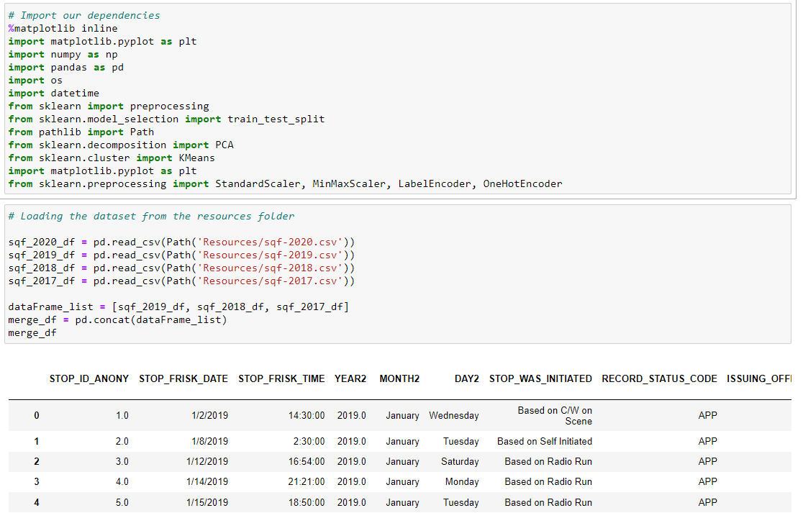
The 2017, 2018 and 2019 ‘Stop, Question and Frisk’ datasets are merged together to perform the preprocessing steps and prepare for the training dataset.
The 2020 ‘Stop, Question and Frisk’ dataset is retrieved to perform the preprocessing steps and prepare for the testing dataset.
Exploratory Data Analysis (EDA)

Slide 6
Data Preprocessing (ETL):
Import our dependencies
Loading the dataset from the resources folder
Merging 2017,18, &19 for training data and keeping 2020 for testing
Removing unwanted text from columns
Find null values
Function checking for missing values
Generate our categorical variable lists
Check the number of unique values in each column

Slide 7
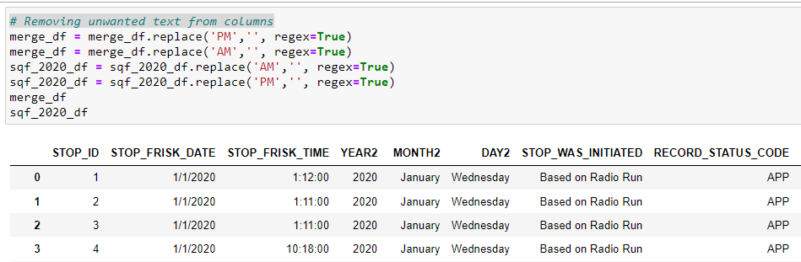
Data Preprocessing (ETL):

Slide 8
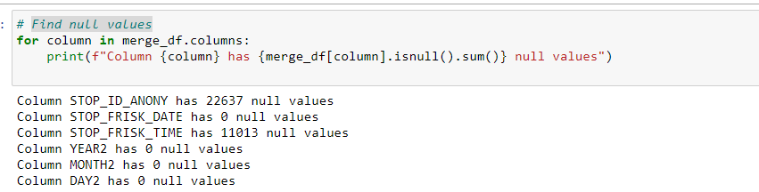
Data Preprocessing (ETL):

Slide 9
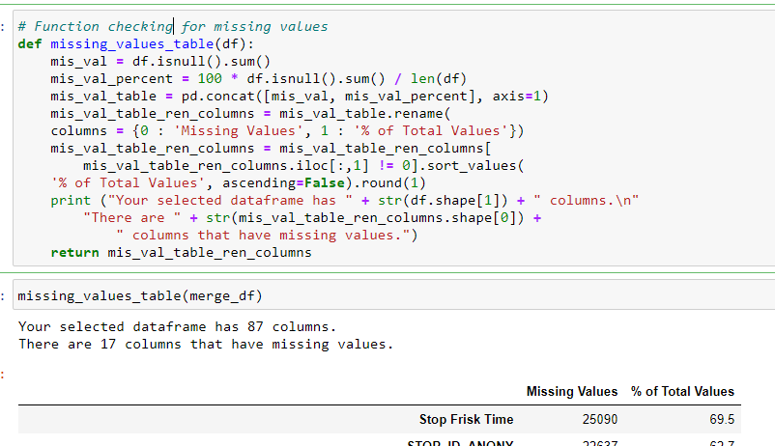
Data Preprocessing (ETL):

Slide 10
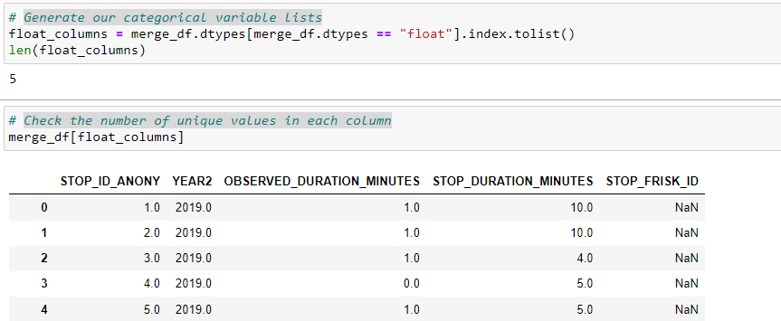
Data Preprocessing (ETL):

Slide 11
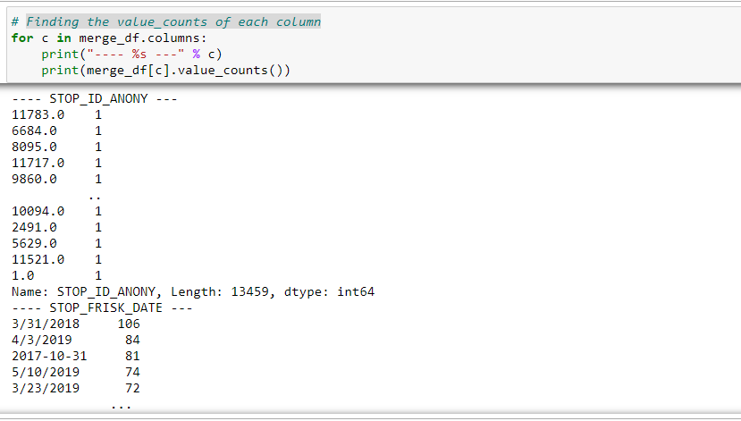
Data Preprocessing (ETL):

Slide 12
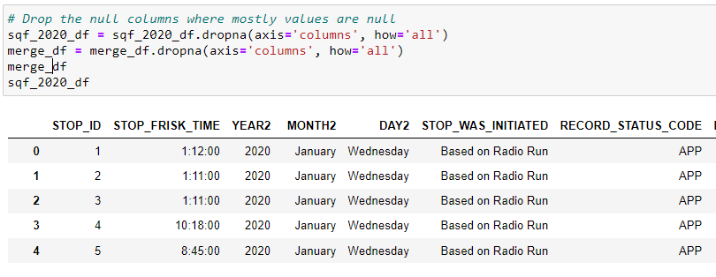
Data Preprocessing (ETL):

Slide 13
Data Preprocessing (ETL):
Convert time into seconds to have integer values for machine learning
Replacing the text strings with zeros in the integer columns
Replacing two different category names with one category
Removing special characters from the values
Rename the columns
Dropping columns which are not playing any role in the feature importances of the datasets
Converting to correct data type
Transform 'Summons Issued' outcome column into binary
Binning of categories in columns is performed
Files are saved as a csv files for further applications of data

Slide 14
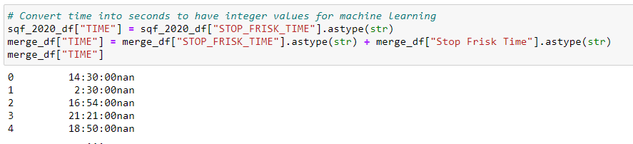
Data Preprocessing (ETL):

Slide 15
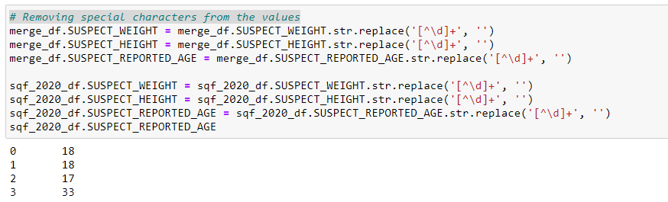
Data Preprocessing (ETL):

Slide 16
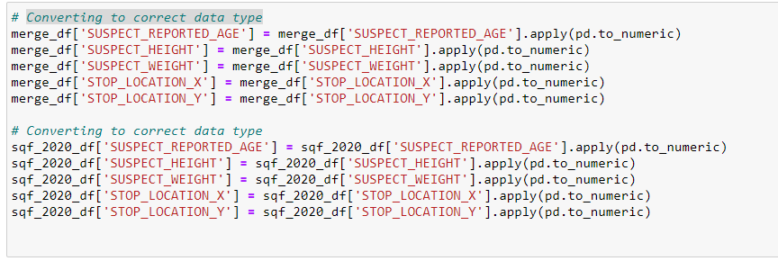
Data Preprocessing (ETL):

Slide 17
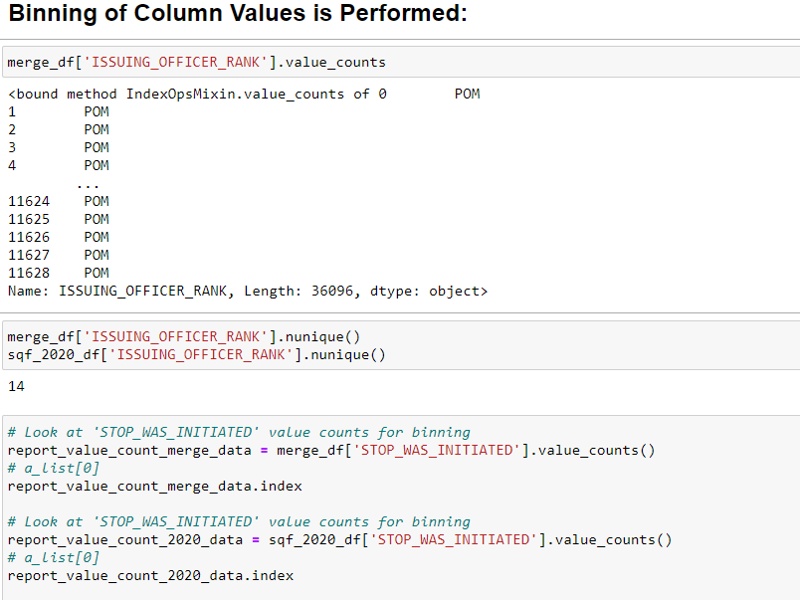
Data Preprocessing (ETL):

Slide 18
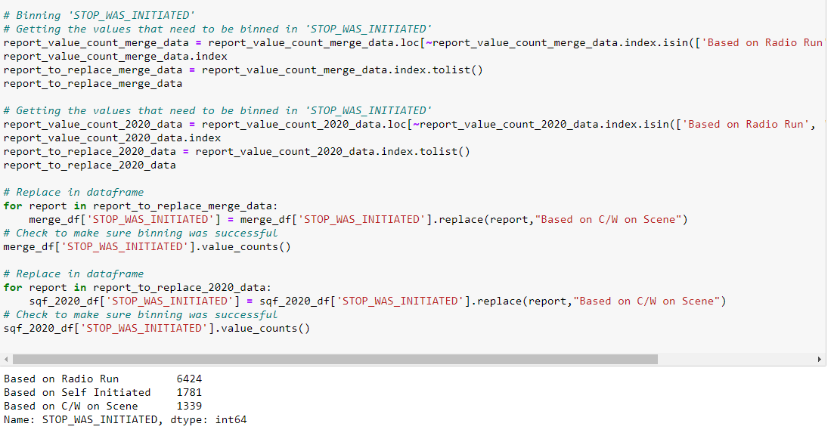
Data Preprocessing (ETL):

Slide 19
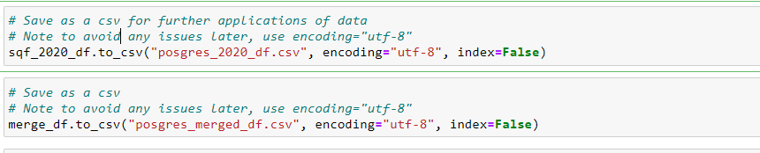
Data Preprocessing (ETL):

Slide 20
Data Preprocessing (ETL):
Converting categorical data to numeric using Label Encoder for unhirarchial data value columns
Convert categorical data to numeric and separate target feature for training data using get_dummies encoding method for the entire dataframe
Scaling the data by using the StandardScaler() function
Assigning first the outcome as: SUMMONS_ISSUED_FLAG
Logistic Model fitting
Random Forest Classifier fitting
Fitting Different Models on Imbalance Data for Optimization
Import an Extremely Random Trees classifier
Import an Adaptive Boosting classifier
Applying K-nearest neighbors

Slide 21
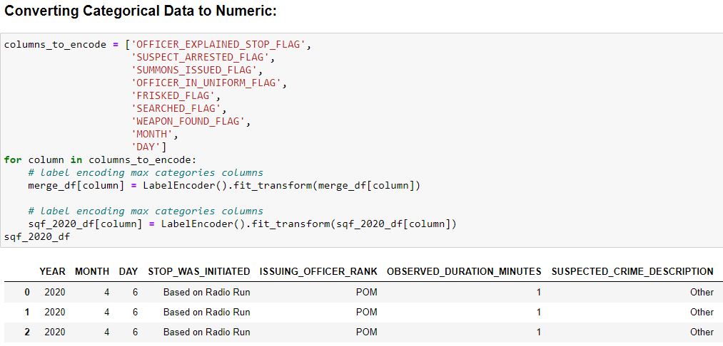
Data Preprocessing (ETL):

Slide 22
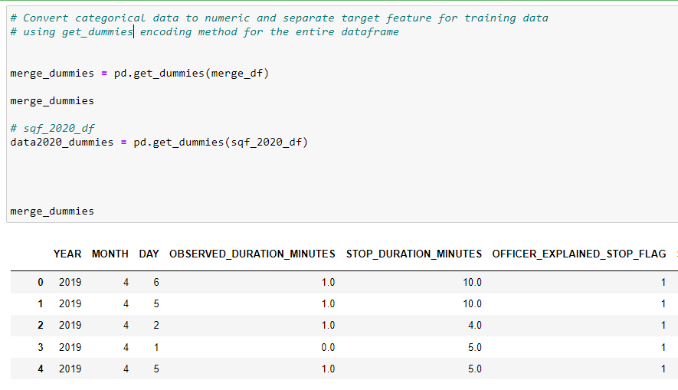
Data Preprocessing (ETL):

Slide 23
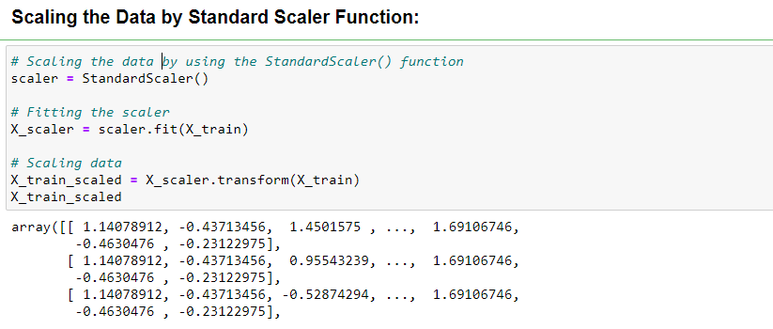
Data Preprocessing (ETL):

Slide 24
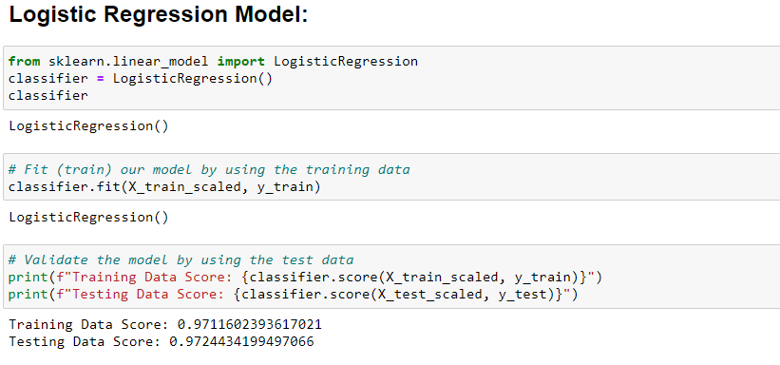
Logistic Regression Model:
Fit (train) our model by using the training data.
Validate the model by using the test data

Slide 25
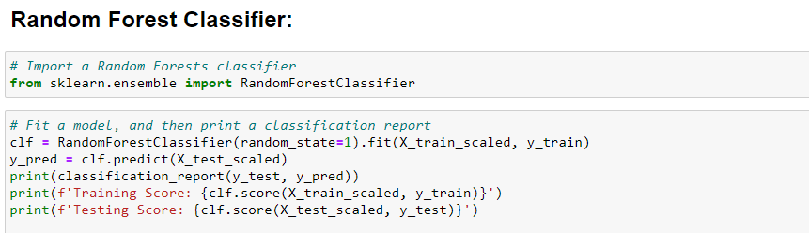
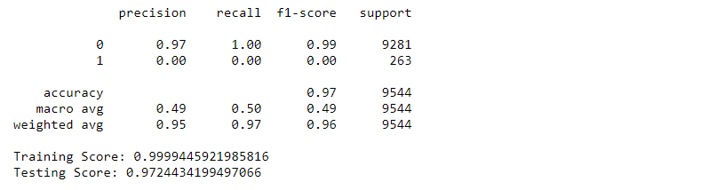
Random Forest Classifier:

Slide 26
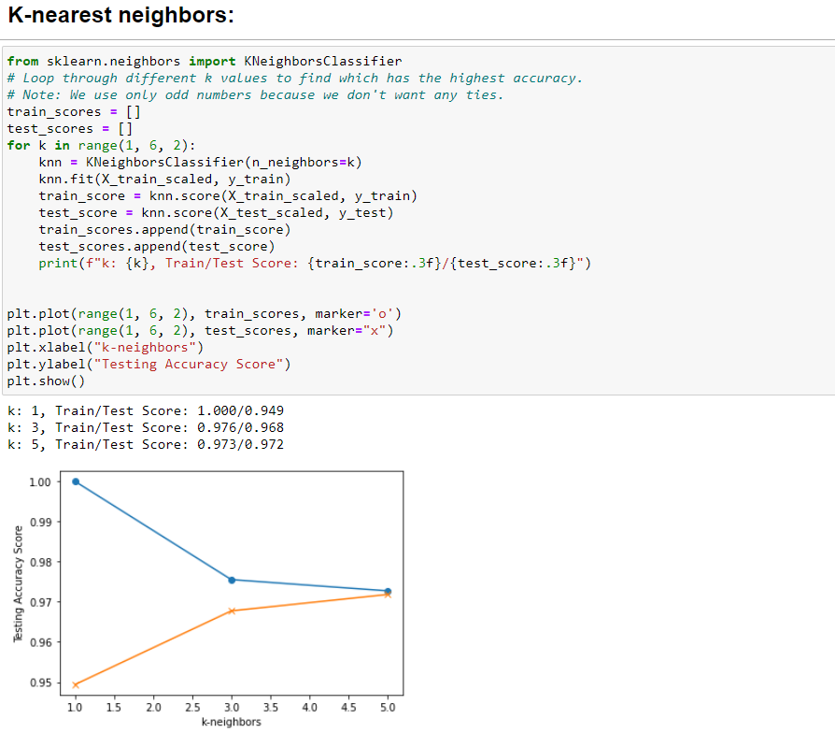
K-nearest neighbors:

Slide 27
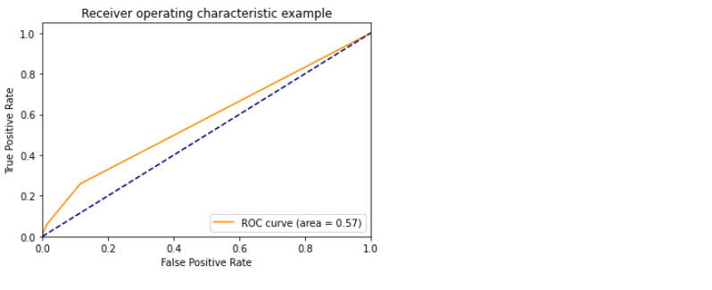
Receiver Operating Characteristic Curve (ROC):
The receiver operating characteristic (ROC) curve helps us visualize this tradeoff. The false positive rate and the true positive rate are calculated for several thresholds, and we plot them against each other.

Slide 28
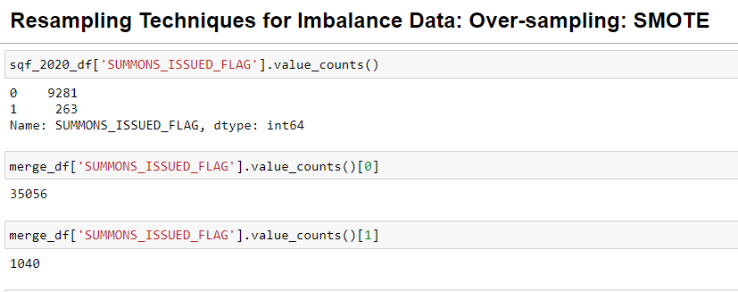
Resampling Techniques:

Slide 29
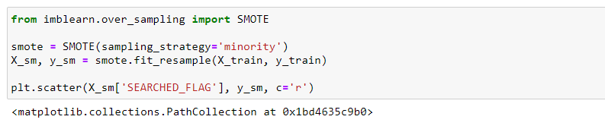
Resampling Techniques:

Slide 30
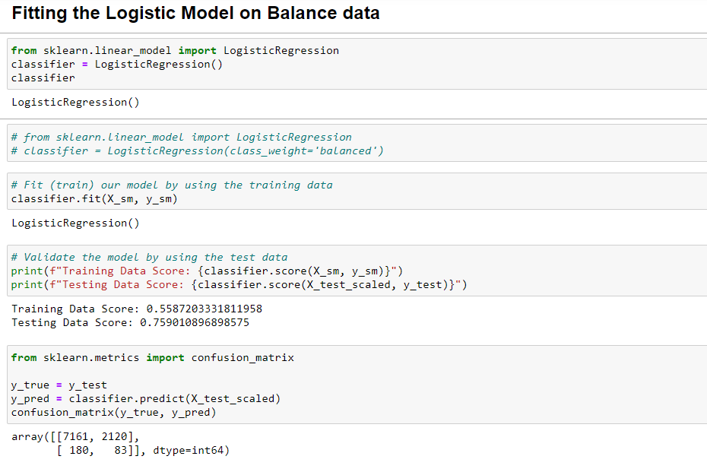
Refitting the Model:

Slide 31
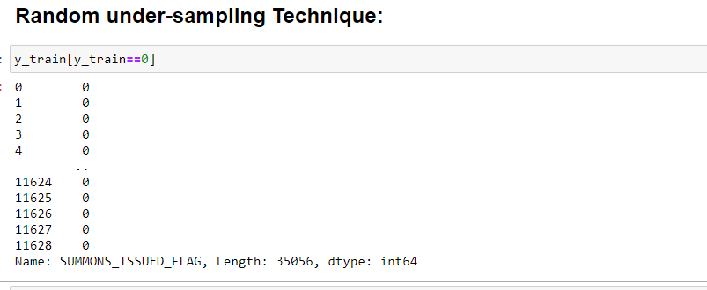
Resampling Techniques:

Slide 32
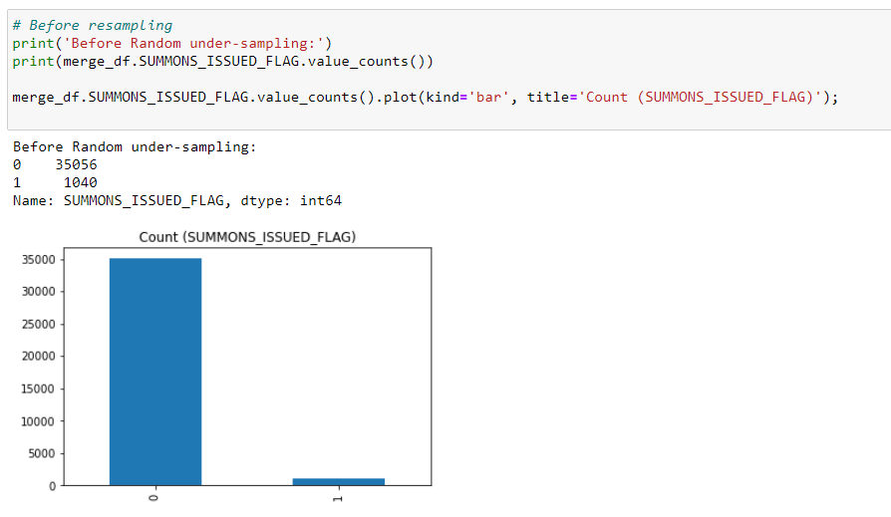
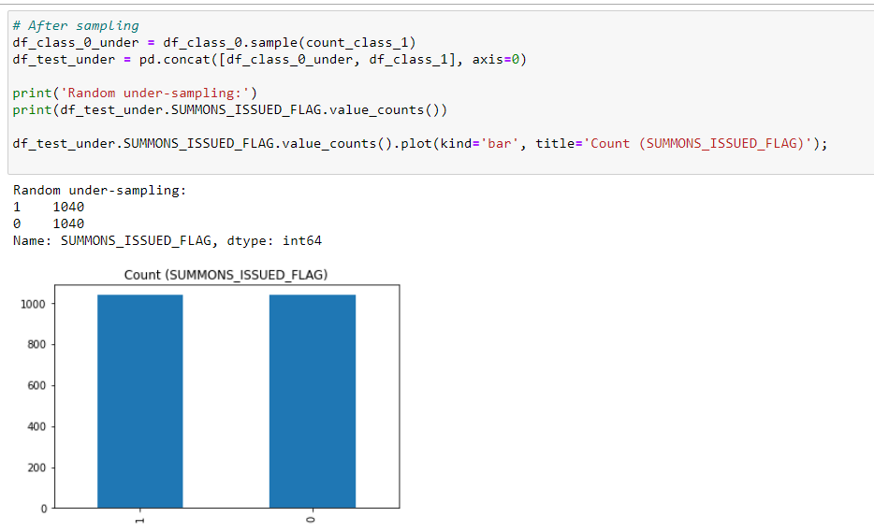
Resampling Techniques:

Slide 33
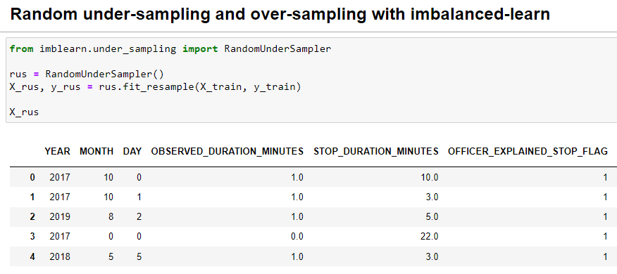
Resampling Techniques:

Slide 34
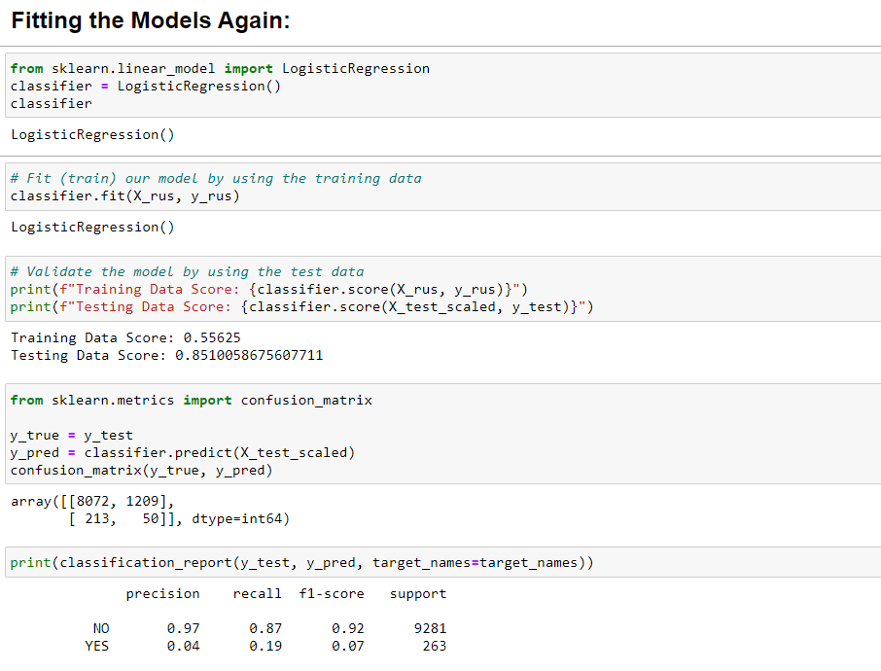
Refitting the Model:
Assigning Another outcome : 'SUSPECT_ARRESTED_FLAG' and repeat the all the steps

Slide 35
Finding the Important Features
Feature Importances

Slide 36
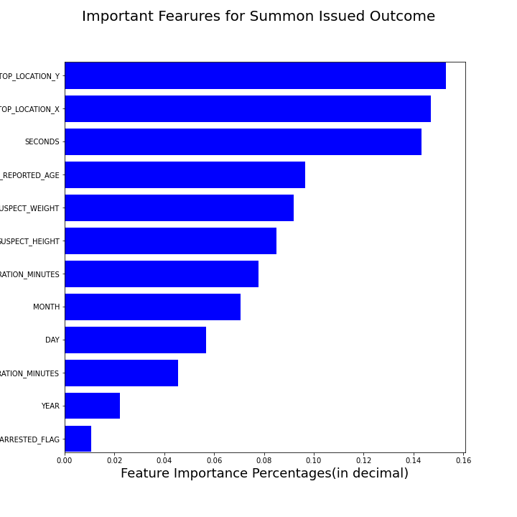
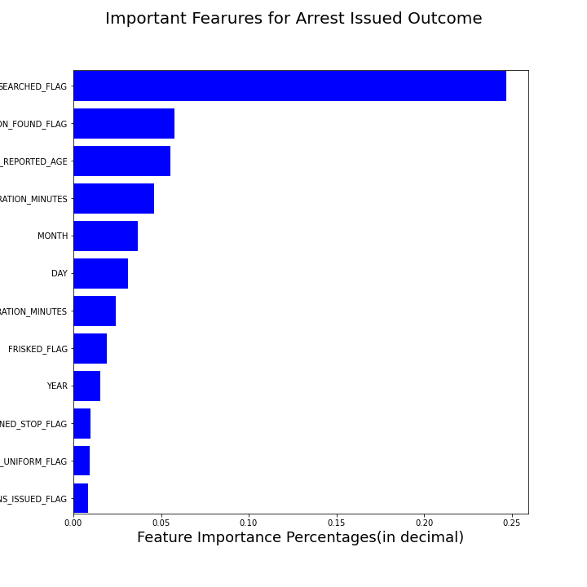

Slide 37
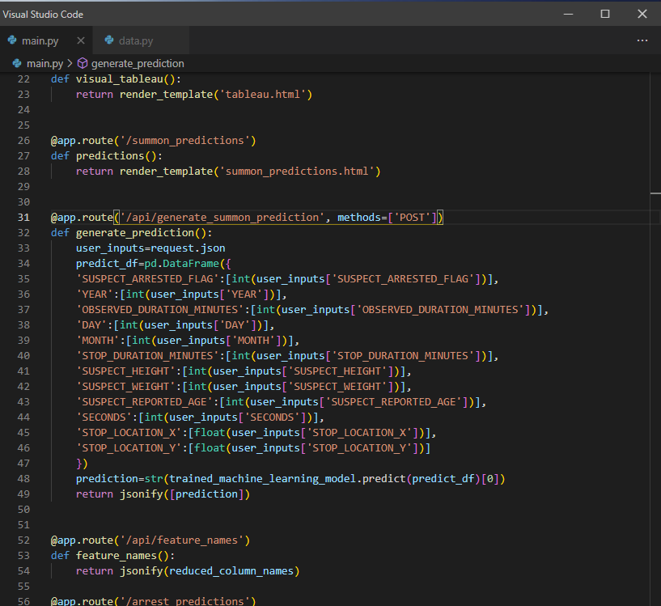
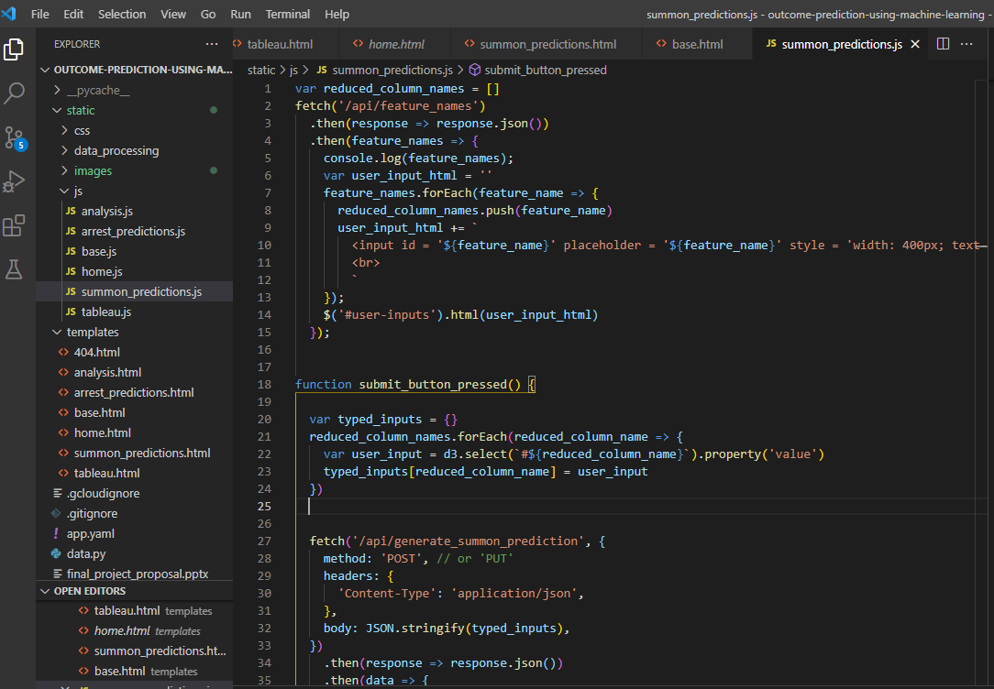
Flask Application:

Slide 38
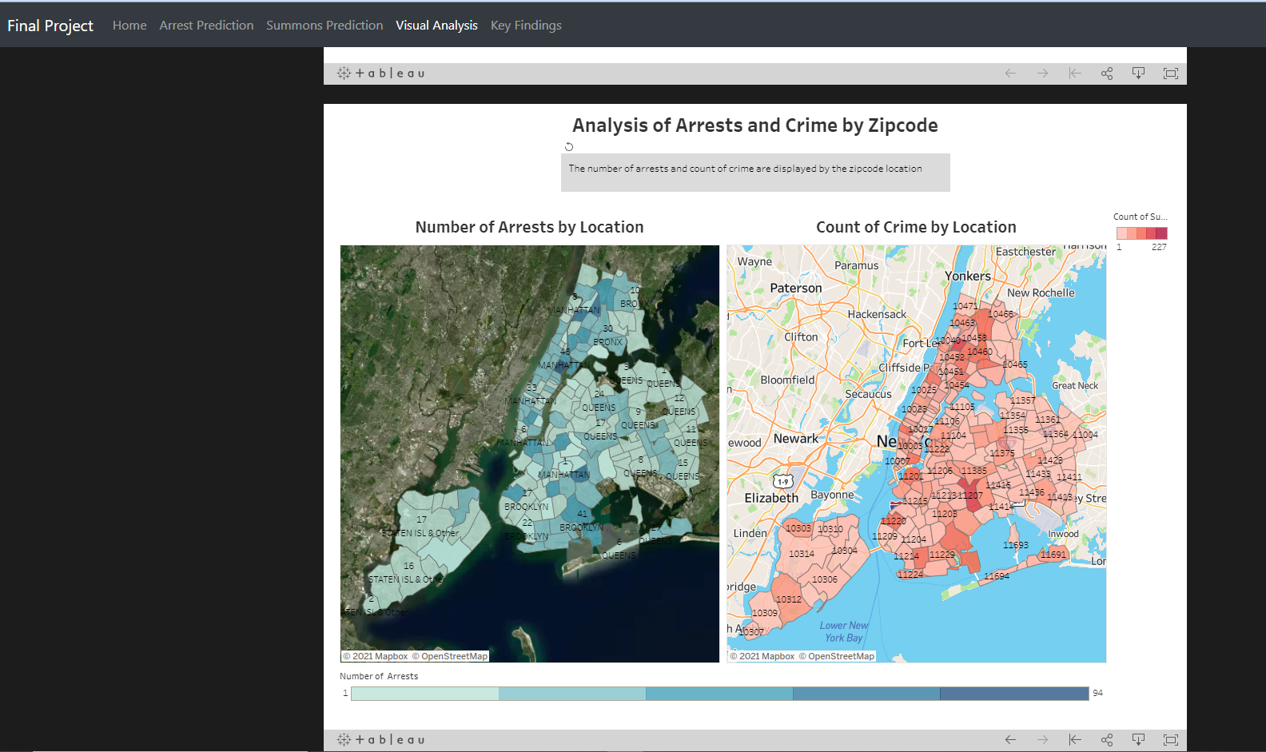
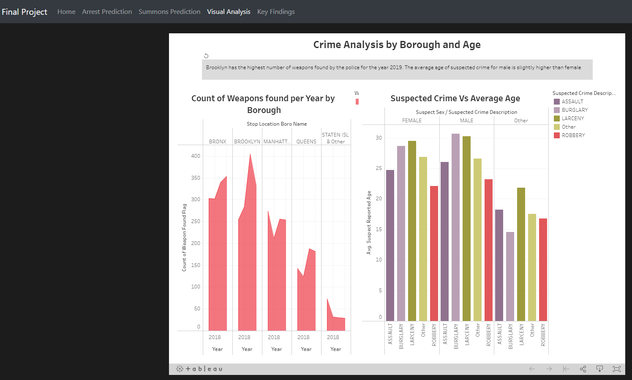
Tableau Visual Analytics

Slide 39
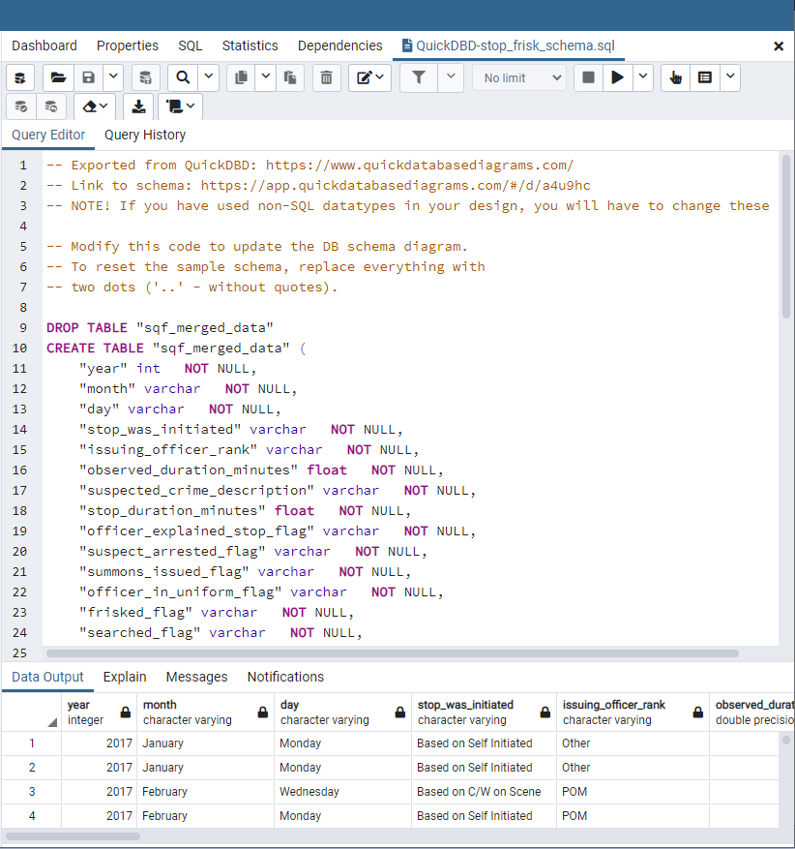
PostgreSQL Database

