Slide 1
Data Visualization using Flask Application
By: Mubashira Qari

Slide 2
Objectives:
Use Flask - micro web framework application.
Use Python, Javascript, html, CSS.
Extract, transform and Load data - (use Quick DBD, SQLAlchemy).
Use PostgreSQL.
Use Python d3 library.
Make an interactive dashboard by telling a story through some visuals like charts, graph using plotly, leaflet map, and dropdowns to filter data.
Use one Javascript library, not used so far - Chart.js.

Slide 3
Datasets:
US county level 5 years census dataset through an API call.
US county level education dataset from ‘Economic Research Services’ (LINK)
Best counties to live(LINK)

Slide 4
Expected story for the Output:
Relationship between the high school graduation and income level.
Relationship between poverty and education.
Overtime change in the number of students performance on state level.
And others to be determined later.

Slide 5
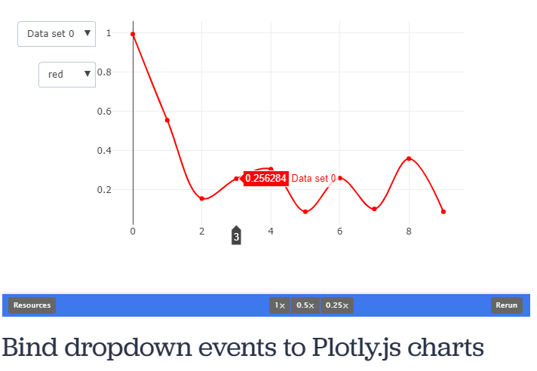
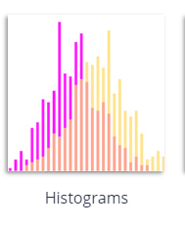
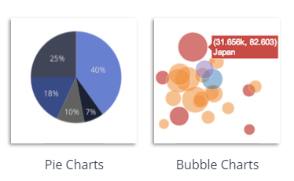
Visual Sketches:

