Slide 1
Practical training presentation
on
Machine learning
Submitted by:
Uzma Khanam
RTU Roll no: 16EEMCS115
Training by:
Adhoc Networks (P).LTD Jaipur
Duration of training: 45Days

Slide 2


Place of internship
Adhoc Networks, a phenomenal place of interactive learning, strives for providing an outstanding platform for acquiring skills in the field of the latest and trending open source technologies in today’s digital advancing world.
The leaders in Data Science Domain Technologies training, provide the best blend of delivery aspects, superb training content and best-of-breed services to professionals and interns for a bright career.
Adhoc networks is a group of experienced IT professionals providing world class Hands-On Projects Oriented Corporate & Technical trainings through Classroom / Virtual Trainings & Online Classes for Organizations (Govt. & Public Listed) Clients & Individuals in the domains of Data Science, Machine Learning, Big Data, AWS Cloud, Open Source Technologies & Red Hat Courses.

Slide 3
Machine learning
Machine learning is the field of study that gives computers the capability to learn without being explicitly programmed. Ml is one of the most exciting technologies that one would have ever come across. As it is evident from the name, it gives the computer that which makes it more similar to humans:
The ability to learn. Machine learning is actively being used today, perhaps in many more places than one would expect.

Slide 4
Introduction
“Emotated Music” is an intelligent system that saves the time and effort of the user to play music according to the mood.
Having the internet connection on, the system browses to the Wynk music website on the Chrome browser and plays a playlist that suits to the current mood of the user.

Slide 5
Requirements
Hardware Requirements:
Minimum RAM : 4GB
Web Camera (inbuilt/external)
Operating System: Windows 7 or later / Ubuntu 16.04 or later
Anaconda Distribution[3]
Python 3.7

Slide 6
Libraries
keras
tensorflow
OpenCV
imutils
numpy
pygame
selenium

Slide 7
Features
The emotion of the detected face is labeled according to the following 7 classes of emotions.
Anger
Disgust
Fear
Happiness
Sadness
Surprise
Neutral
The emotion that has the highest probability is labeled and on its basis, the desired type of songs are played.

Slide 8
Working
The project has been carried in three steps:
Graphical Interface
Face Detection
Facial Expression Prediction
Automated Music

Slide 9

Graphical Interface
Module used:
pygame

Slide 10
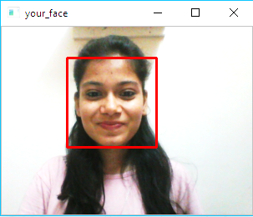
Face Detection
To capture image: OpenCV
To detect face: harcascade classifier for frontal face.[2]

Slide 11
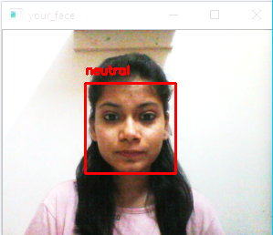
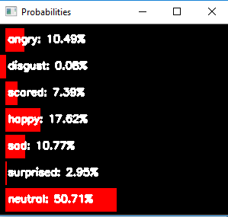
Facial Expression Prediction
Emotion classification: pre trained model – XCEPTION – trained on FER dataset.[1]
Detected face is labeled with the emotion having the maximum probability amongst all 7
Accuracy – 70%

Slide 12
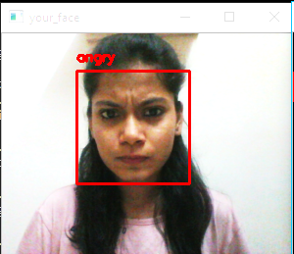
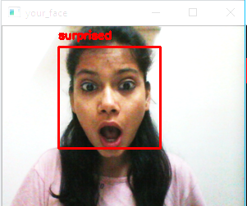
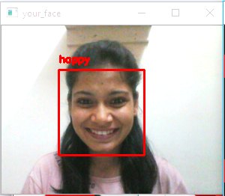
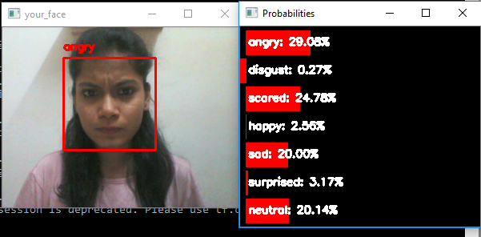
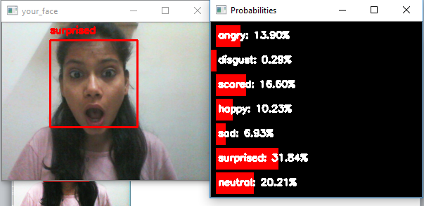
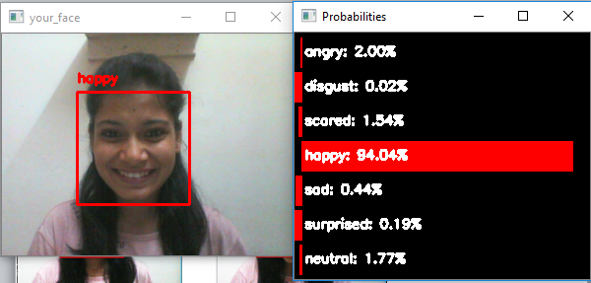
Some more emotions…

Slide 13
Automated Music
Model used: Selenium
Browser and Driver: Google Chrome
Music Player: Wynk Music website
The desired HTML elements like playlists and buttons are selected to play the required music as per the returned label of the emotion.

Slide 14
Use case
This project can be purely used for the entertainment purpose as it saves time in searching songs or finding a correct playlist to be played in the then mood of the user. It does all the work with a single click.

Slide 15
References
[1] Ubaid Usmani. (2019, July) GitHub, Inc. [Online]. https://github.com/Geek-ubaid/Stress-Detection/blob/master/_mini_XCEPTION.102-0.66.hdf5
[2] Vadim Pisarevsky. (2019, June) GitHub, Inc. [Online]. https://github.com/opencv/opencv/blob/master/data/haarcascades/haarcascade_frontalface_alt.xml
[3] Frank Ceballos. (2019, June) Towards Data Science. [Online]. https://towardsdatascience.com/installing-keras-tensorflow-using-anaconda-for-machine-learning-44ab28ff39cb

Slide 16
Thank You

