Slide 1



KPMG
View in Power BI
Last data refresh:
5/13/2023 9:02:38 AM UTC
Downloaded at:
5/13/2023 9:04:54 AM UTC

Slide 2
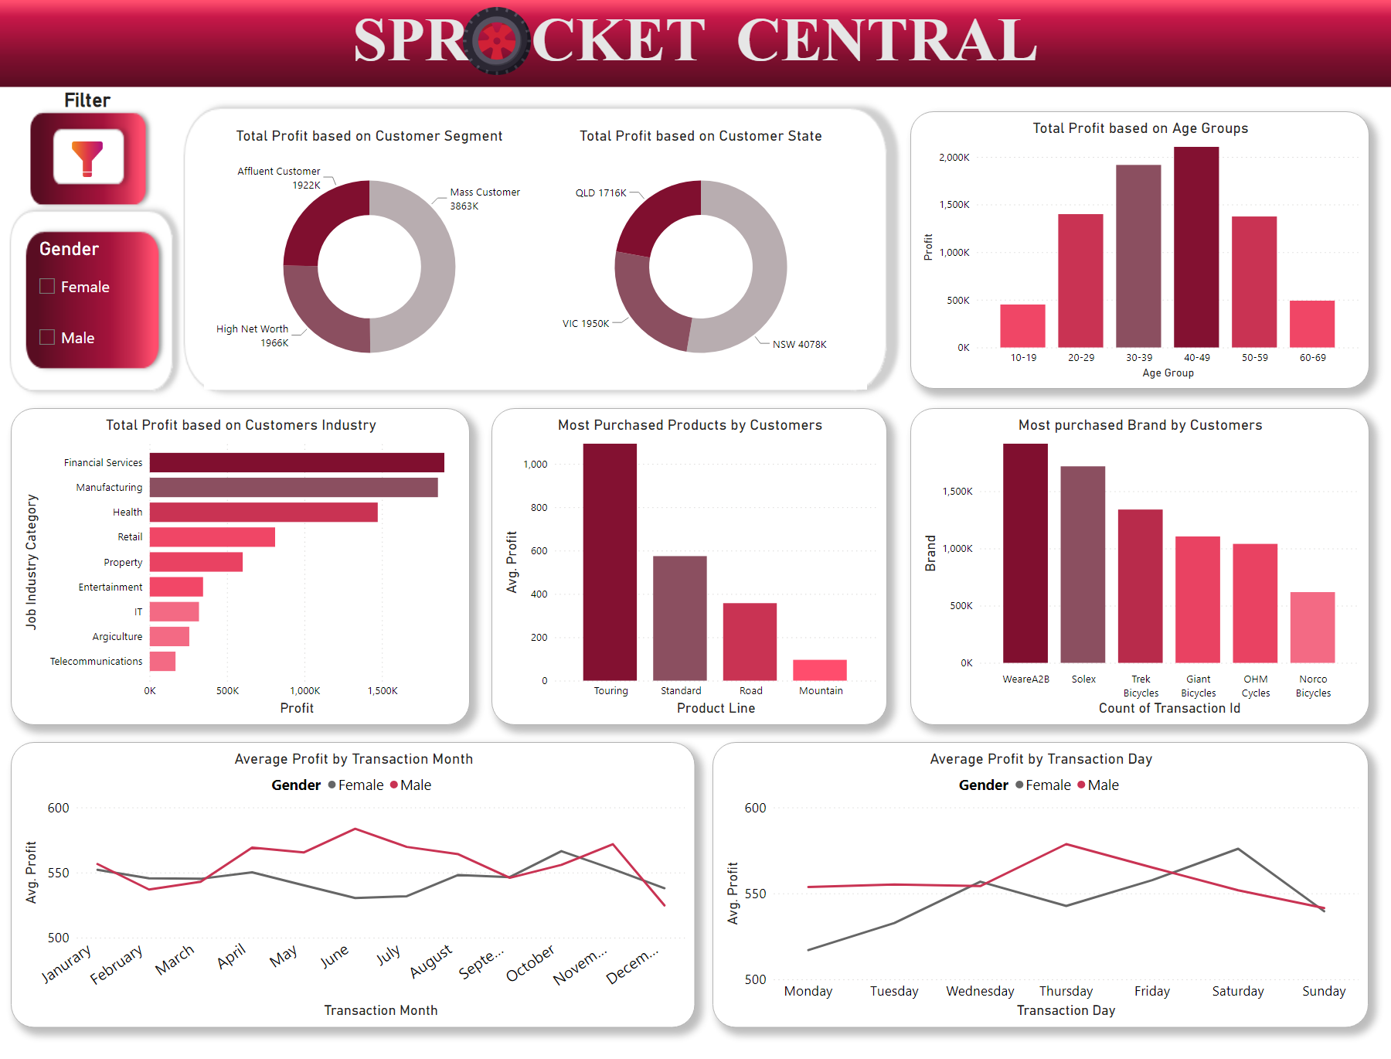
Page 1
Notes:
Total Profit based on Customer Segment
No alt text provided
Total Profit based on Customer State
No alt text provided
Total Profit based on Age Groups
No alt text provided
Total Profit based on Customers Industry
No alt text provided
Most Purchased Products by Customers
No alt text provided
Most purchased Brand by Customers
No alt text provided
Average Profit by Transaction Month
No alt text provided
Average Profit by Transaction Day
No alt text provided
image
No alt text provided
Filter
No alt text provided
slicer
No alt text provided
textbox
No alt text provided
image
No alt text provided

