Slide 1
Terraform
Presenter Name
Notes:
ID=d924773e-9a16-4d6d-9803-8cb819e99682 Recipe=text_billboard Type=TextOnly Variant=0 FamilyID=AccentBoxWalbaum_Zero

Slide 3
Terraform 101
Terraform is HashiCorp's infrastructure as code tool. It lets you define resources and infrastructure in human-readable, declarative configuration files, and manages your infrastructure's lifecycle

Slide 4
tf format

Slide 5
Hand-on

Slide 6
(1) Hello world with nginx docker
Source code: terraform_docker

Slide 7
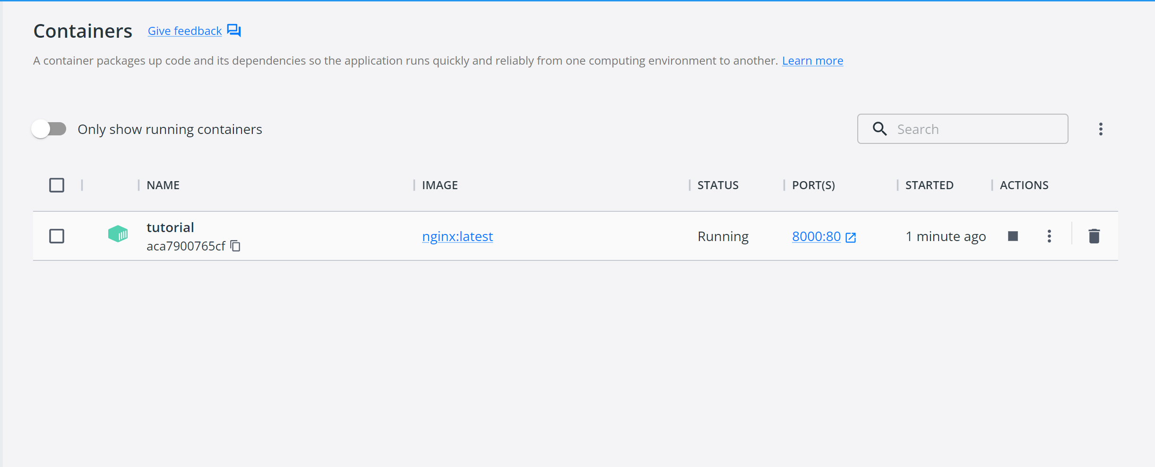
(2) Check result

Slide 8
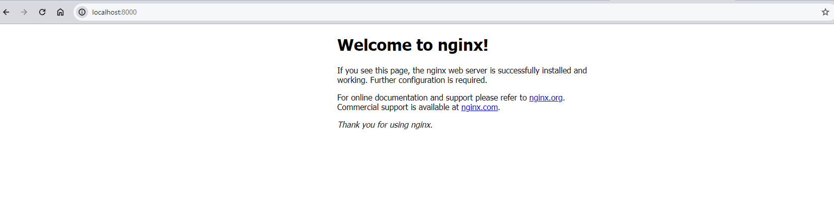
(2) Check result

Slide 9
(3) Hello world with EC2 instance
Souce code

Slide 10
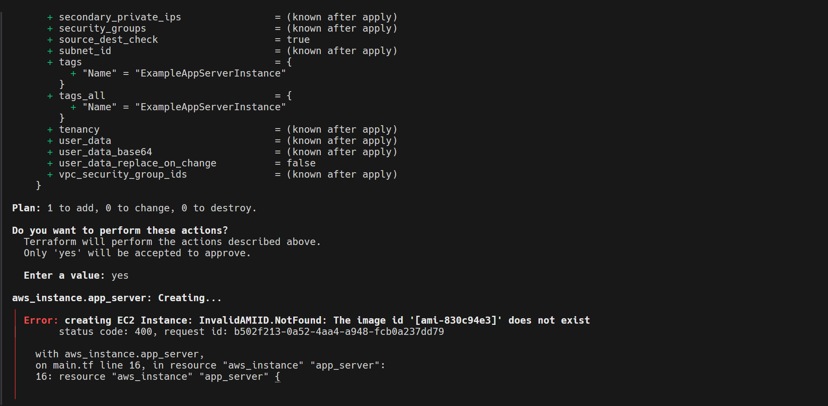
(4) Error: AMI does not exist
Souce code

Slide 11
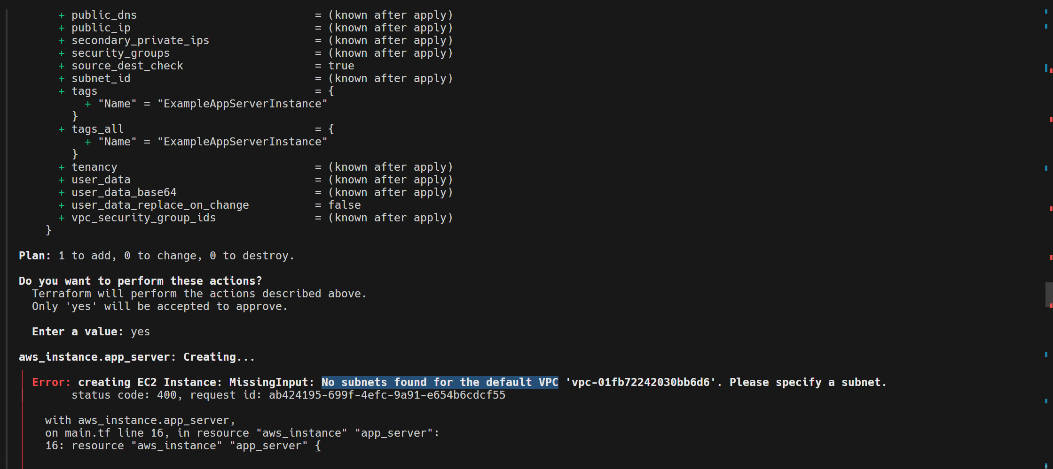
(4) Error: No subnets found for the default VPC
Souce code

Slide 12
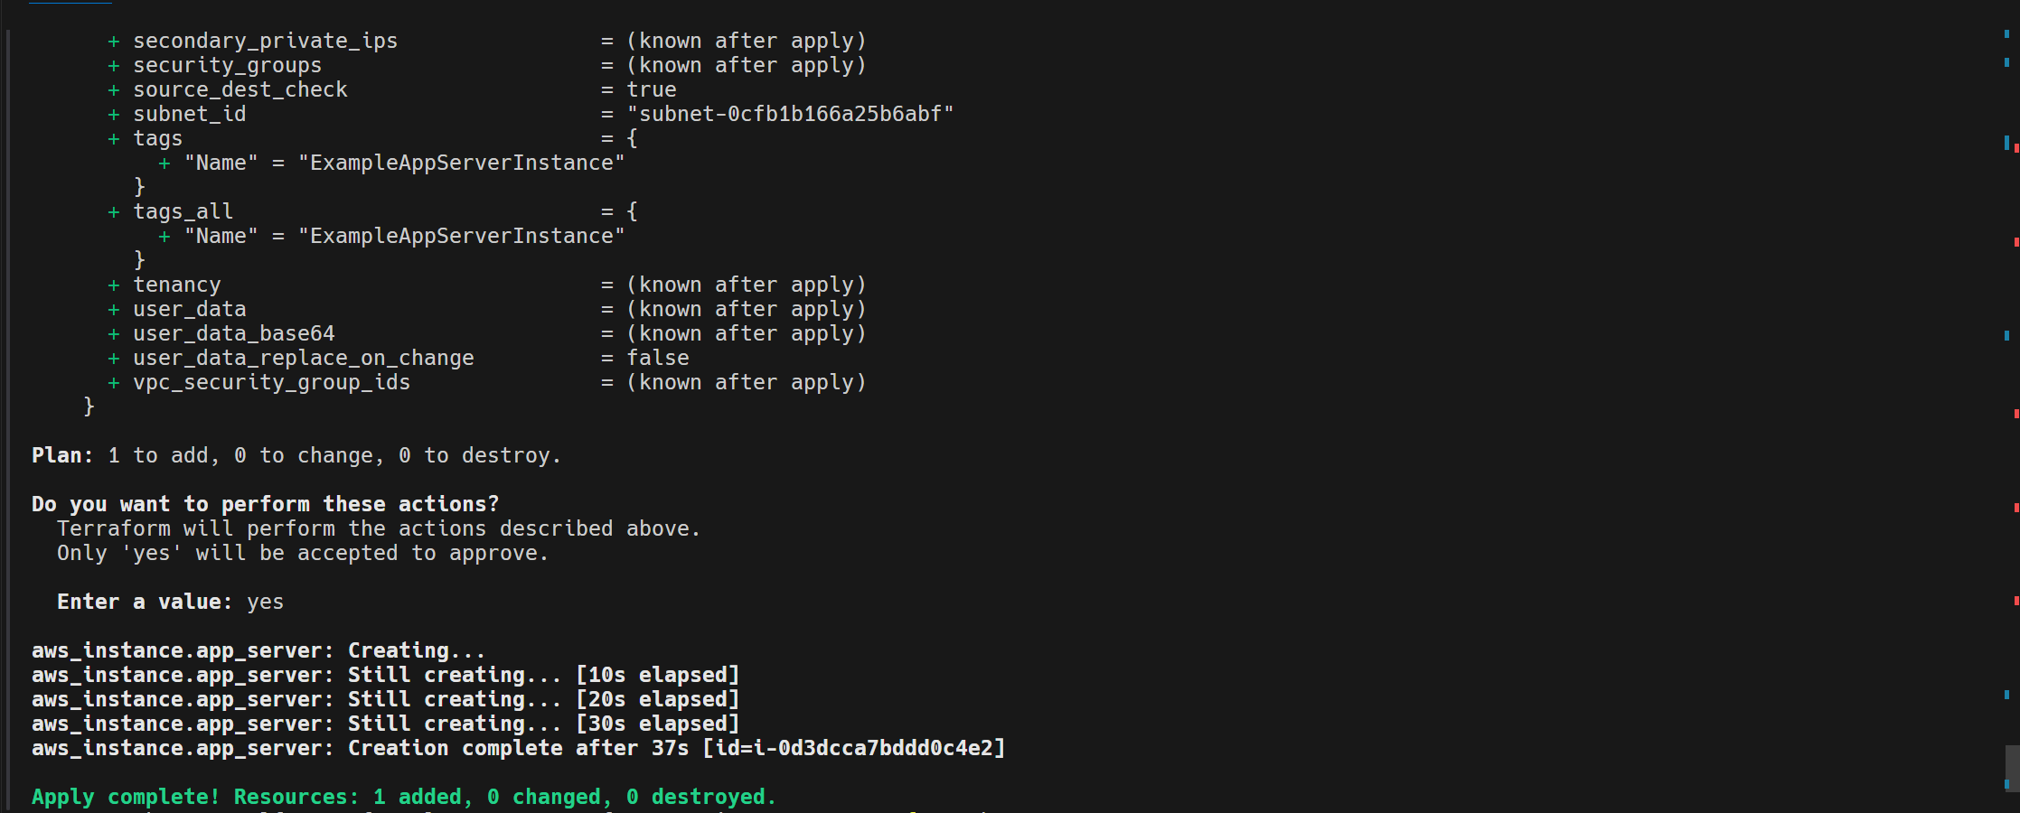
(4) Success:
Souce code

Slide 13
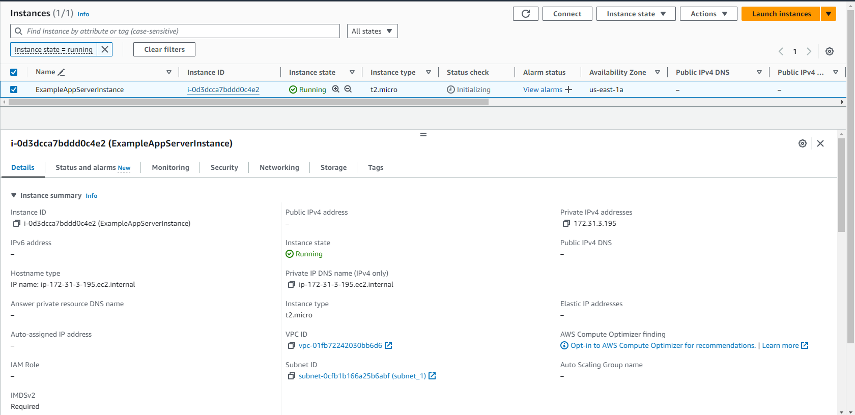
(6) Check result

Slide 14
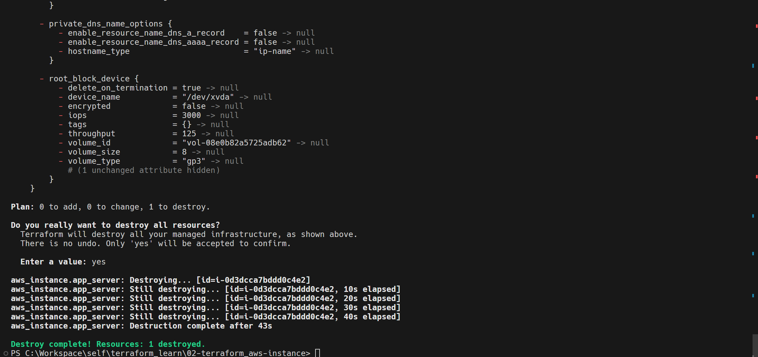
(7) Destroy

