Slide 1
AccentBox
Presenter Name
Notes:
ID=d924773e-9a16-4d6d-9803-8cb819e99682 Recipe=text_billboard Type=TextOnly Variant=0 FamilyID=AccentBoxWalbaum_Zero

Slide 3
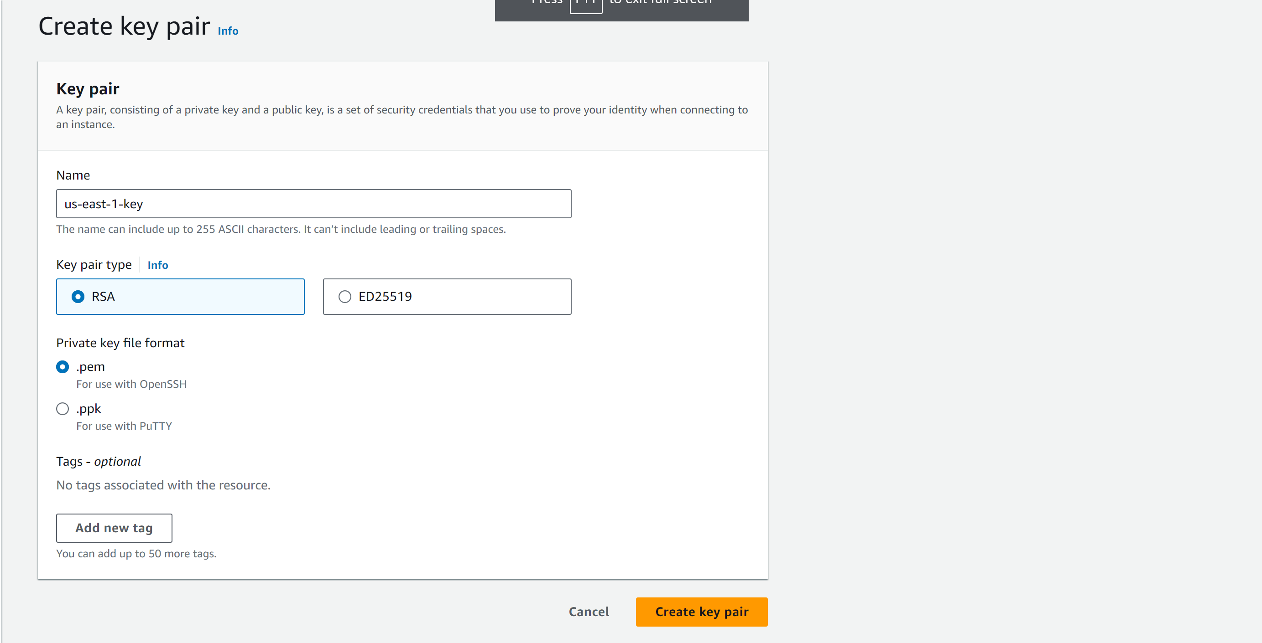
Create & download key pair

Slide 4
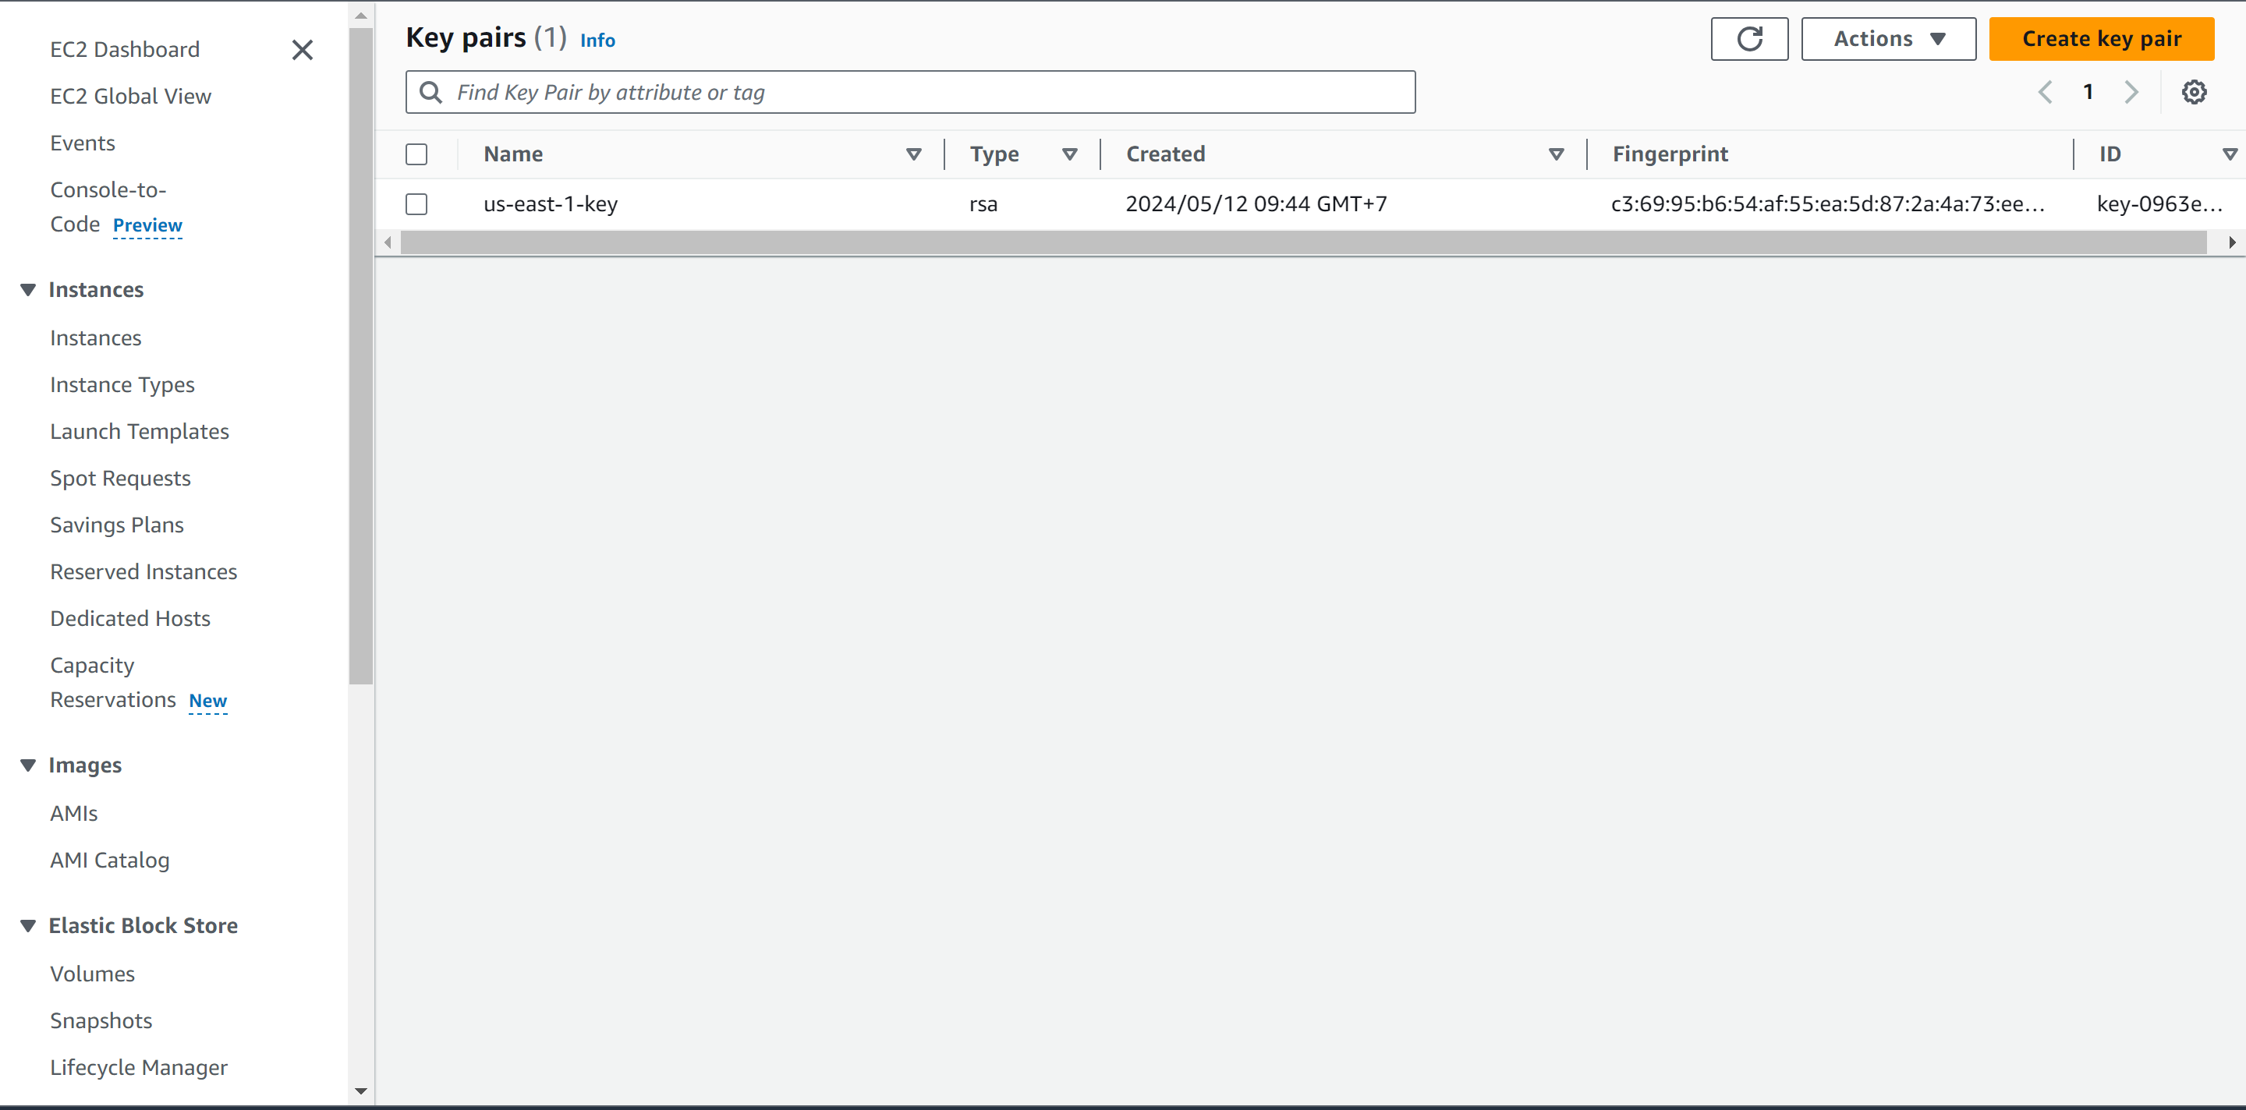
Create & download key pair

Slide 5
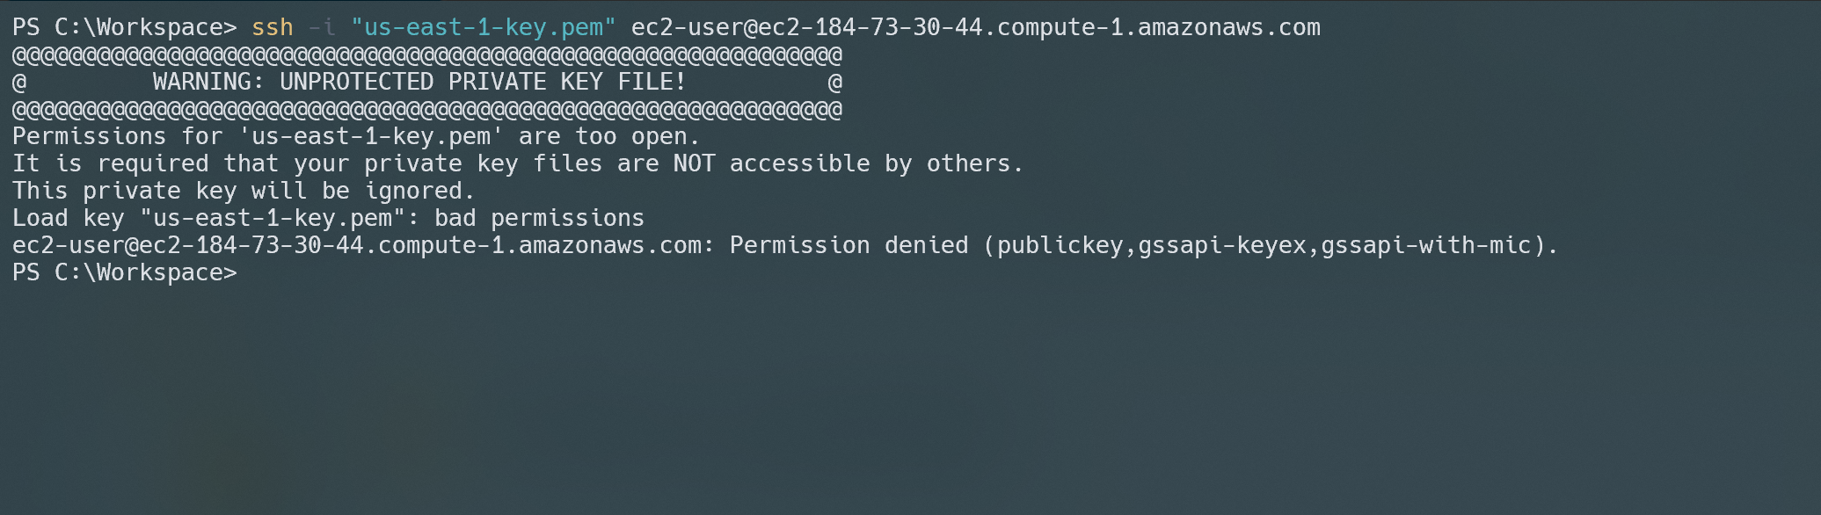

Slide 6
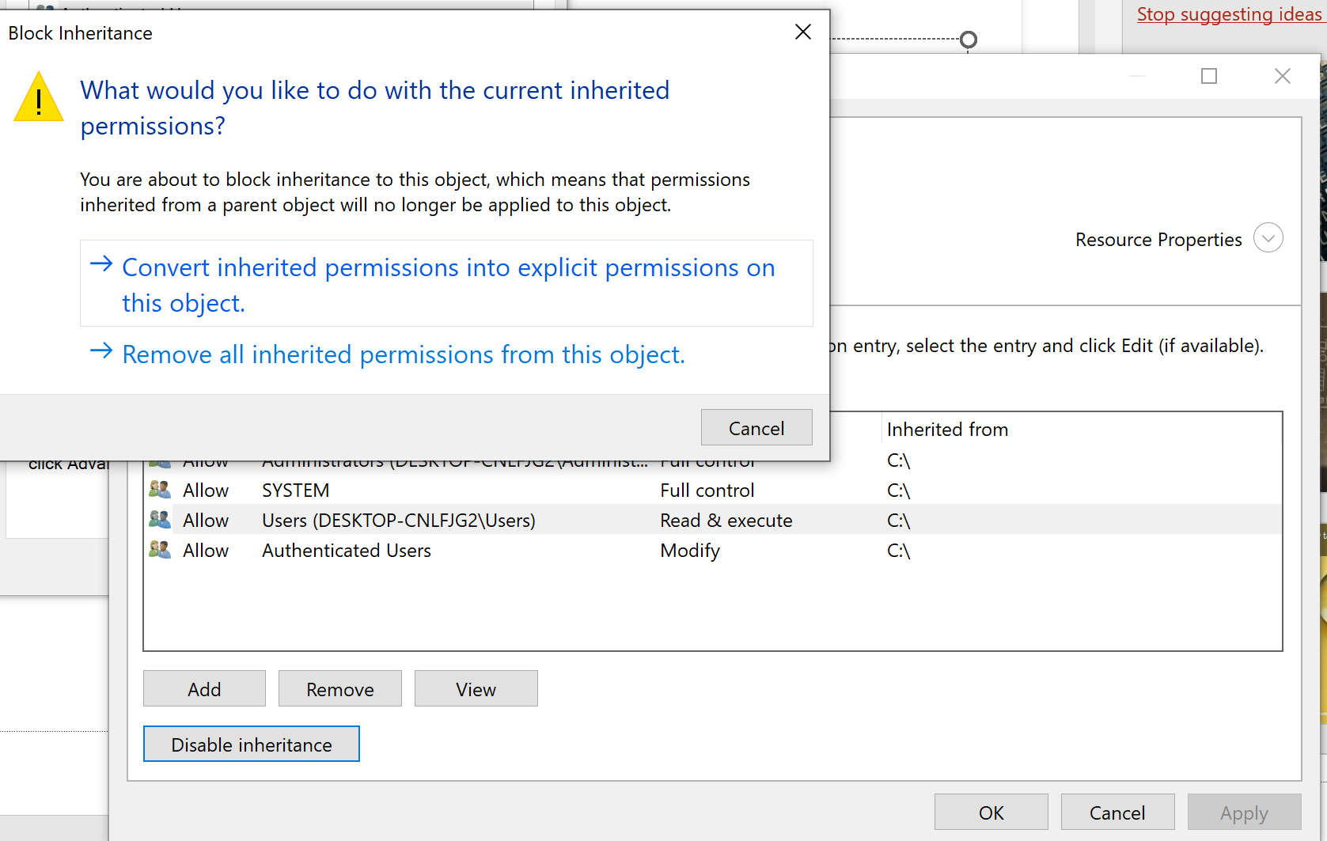
Menu context -> Properties-> security tab -> advanced -> Disable inheritance

Slide 7
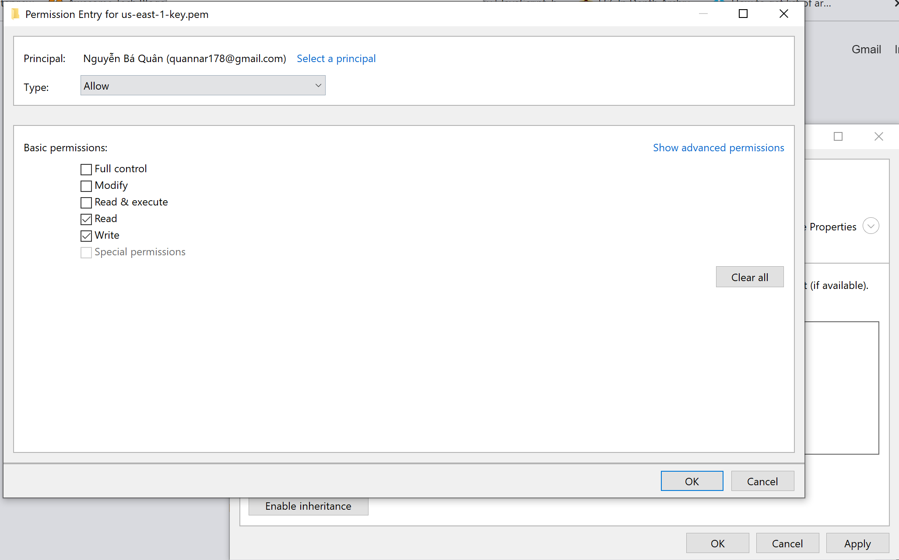
Add permission -> Ok -> apply -> OK

Slide 8
It's good to run as little as possible as a priviliged user, as you want to restrict the potential damage in case someone exploits your program. You don't want to run your Node code as root unless you absolutely have to.
Therefore, it's better to run your Node program on an unprivileged port (say, port 8000), and instead have a lightweight web server such as Nginx listen on port 80 and simply forward traffic to your Node program.

Slide 9
Command: install nginx
sudo yum install nginx –y
nginx –v
service nginx status
sudo nano /etc/nginx/conf.d/nextjs-app.conf
sudo nginx –t
sudo systemctl restart nginx

Slide 10
Nginx: sudo nano /etc/nginx/conf.d/nextjs-app.conf
server {
listen 80;
server_name ec2-184-73-30-44.compute-1.amazonaws.com;
location / {
proxy_pass http://localhost:3000;
proxy_http_version 1.1;
proxy_set_header Upgrade $http_upgrade;
proxy_set_header Connection 'upgrade';
proxy_set_header Host $host;
proxy_cache_bypass $http_upgrade;
}
}

Slide 11
Command: pm2
sudo yum install -y nodejs
node –v
npm –v
npx create-next-app@latest
npm run build
sudo npm install pm2 –g
pm2 start npm --name nextjs-app -- start
ss –tnlp
pm2 save
pm2 startup
Notes:
https://suvankar.medium.com/deploying-a-next-js-application-on-an-ec2-instance-with-pm2-and-nginx-922975ecd611

Slide 12
HTTPs
sudo yum install -y certbot python3-certbot-nginx
sudo certbot --nginx -d example.com -d www.example.com
Notes:
https://www.digitalocean.com/community/tutorials/how-to-secure-nginx-with-let-s-encrypt-on-ubuntu-20-04

