Slide 1

Multi-factor Image based User Authentication Technique

Slide 2

What is User Authentication?
Authentication is the process of validating a user based on his credentials.
Authentication provides a filter so that only the correct user has access to certain sensitive data.

Slide 3

Problem Today…
There are various algorithms available to restrict access to unauthorized personnel.
But, a lot of them are vulnerable to a certain kinds of attack. This puts the data in jeopardy.

Slide 4
EXISTING ALGORITHMS...
Techniques | Disadvantages
Pixel Based Drawing | Increases margin for error
Pass Neighbor | Vulnerable to intelligent hacker who can easily crack the pattern by observing few times.
Dhamija- Perrig | Vulnerable to Shoulder Surfing
Convex Hull click | Longer authentication time
Story | Story may not make sense if there are limited number of pictures.

Slide 5
What can be done?
We are trying to create an algorithm from the study of previously applied algorithms and implementing them in such a way that their strengths can be combined and their vulnerabilities can be hidden.
In our algorithm, we use a multi-digit password of which half is created using the Graphical Image grid mapped to a Number grid and the remaining half from a conditionally delivered OTP.
This algorithm tries to be resistant to regular hacking attacks.

Slide 6
PROBLEM DEFINITION
User Authentication is a technique to grant access to data on the provision of correct credentials. But, most of the algorithms fall prey to different types of hacking techniques, thus rendering them useless.
Creating an algorithm with minimal vulnerabilities and which will guarantee maximum protection to the data is required.

Slide 7
OUR SOLUTION

Slide 8
Multi-factor Image based User Authentication Technique

Slide 9
Step 1 – Registration
The user will create his/her account with a desired username and his Phone Number.
He will be asked to choose 4 images out of a randomly system generated grid of images.
(These images will be his password for future logins.)

Slide 10
Step 2 – Login Attempt
When the user wants to login, he will be presented with a Login page, which will ask for his username.
After successfully entering his Username, a Preset timer will start in background and the User will be proceeded to the next screen having two grids..

Slide 11

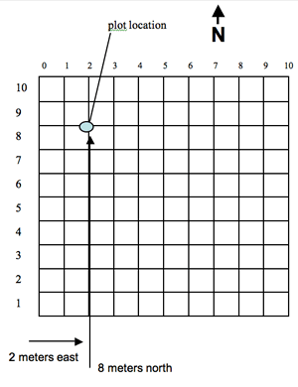
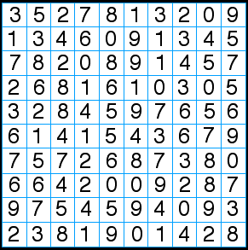
4 7

Slide 12
Password
7
Image Based
OTP

Slide 13
A similar process of number selection will be repeated 3 more times to generate a 4 digit password.
As the images will have random numbers as well as the grid will randomize everytime, the password generated everytime will be completly dynamic and random.
When the First 4 digits are entered correctly before the preset timer runs out, only then the OTP will be sent to the registered mobile number.
In any other case, the login will result in a failure situation.

Slide 14
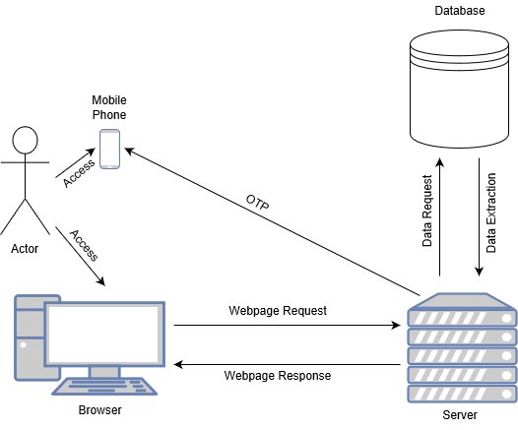
ARCHITECTURE DIAGRAM

Slide 15
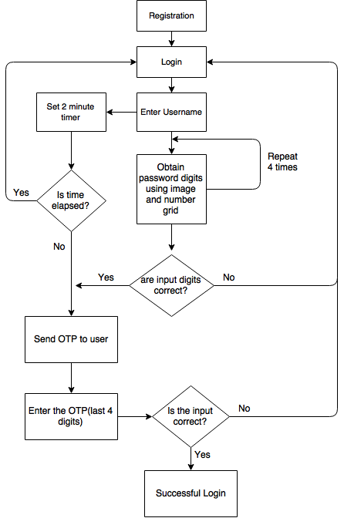
DATA FLOW
DIAGRAM

Slide 16
REQUIREMENTS
A Relational database like MySQL for storing the User Data.
While storing the images in a file system and referencing the image metadata in a relational database works better and will be more efficient.
A server upon which the images will be saved so as to get access on-the-go.

Slide 17
ADVANTAGES
Over other algorithms, this one will have an advantage as :
  Shoulder Surfing attacks.
  b) Brute-force (as long as login attempts are limited to a certain number)
  c) Dictionary Attack.

Slide 18
APPLICATIONS
This authentication technique can be used to secure any basic system or a high valued system.
It can have a specific use in ATM machine system, which when required to be operated by professionals during malfunction, use a dummy password.

Slide 19
CONCLUSION
In this algorithm, we have tried to evade the basic Shoulder Surfing attack as well as Brute Force attack, by taking considerate measures.
There might be a future scope in this project by expanding the scope of this project and proper research.

Slide 20
THANK YOU
By-
APURVA KULKARNI
DEVANG KATEKAR
TANMAY MHASKE
TANMAYEE KULKARNI

