Slide 1

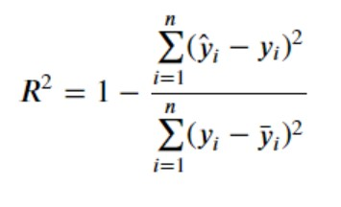
R-squared
R-squared is a statistical measure that indicates how much of the variation of a dependent variable is explained by an independent variable in a regression model.
An R-squared of 100% means that all movements of a security (or other dependent variable) are completely explained by movements in the index (or whatever independent variable you are interested in).

Slide 2

Numpy polynomial
The degree of the polynomial is the largest sum of the exponents of ALL variables in a term

Slide 3

Estimate the two parameters in linear regression
y = β0 + β1 x + ε
β0 = mean(y)-(β1*mean(x))
β1 = (y-mean(y))*(x-mean(x))/(x-mean(x))^2

