Slide 1
Integration
Rabail Tahir

Slide 2
What is integration?
Quite simply , it is the opposite of Differentiation. If differentiation calculates the slope or the rate of change at any given point, then integration calculates the area under a curve or a line.

Slide 3
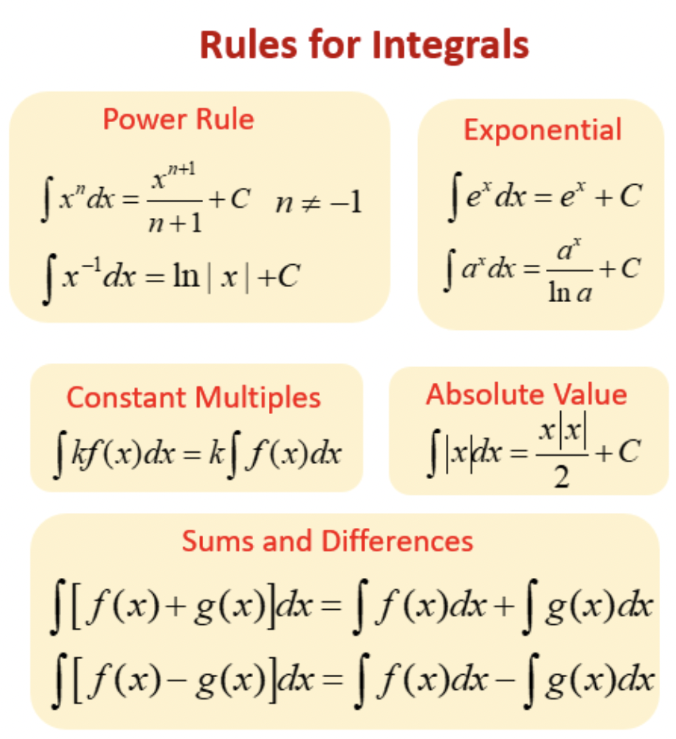

Slide 4
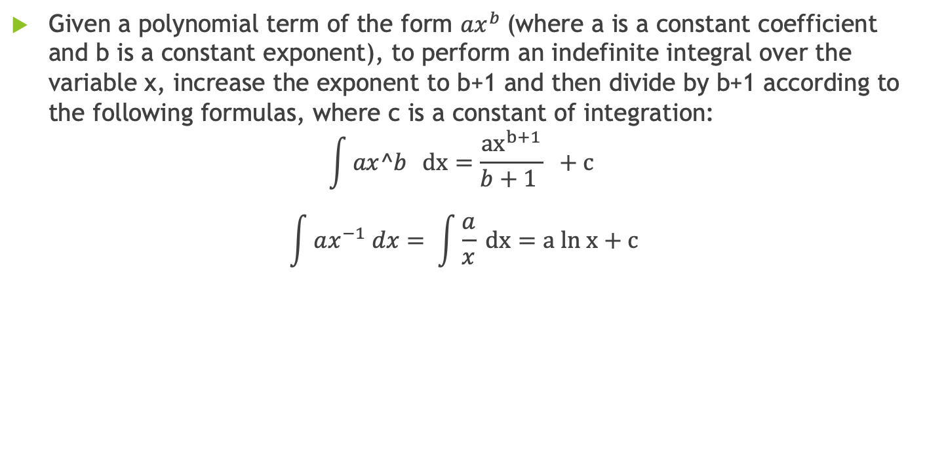
Integrals of Polynomials
Given a polynomial term of the form $ax^{b}$(where a is a constant coefficient and b is a constant exponent), to perform an indefinite integral over the variable x, increase the exponent to b+1 and then divide by b+1 according to the following formulas, where c is a constant of integration:
$$\int{ax^b} dx=\frac{{ax}^{b+1}}{b+1 } +c$$
$$\int{ax^{−1} dx= \int{\frac{a}{x}}} dx=a ln x+c$$

Slide 5
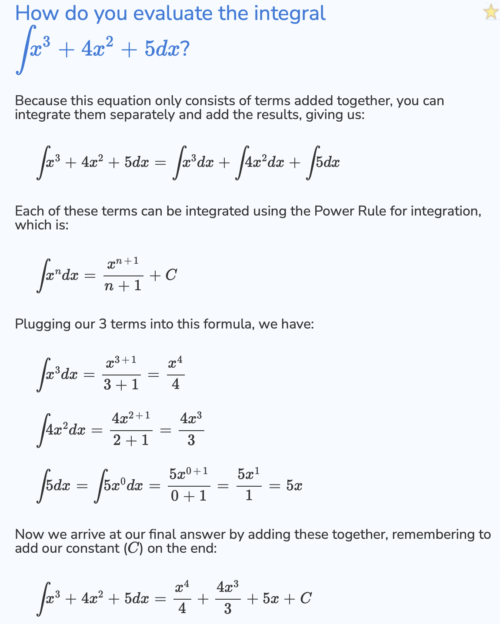
Example

Slide 6
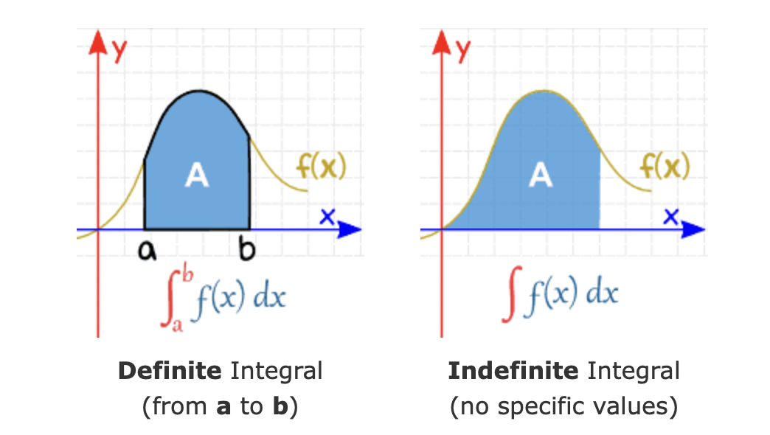
Definite Integrals
Definite Integral includes limits, specifying an interval (a,b).

Slide 7
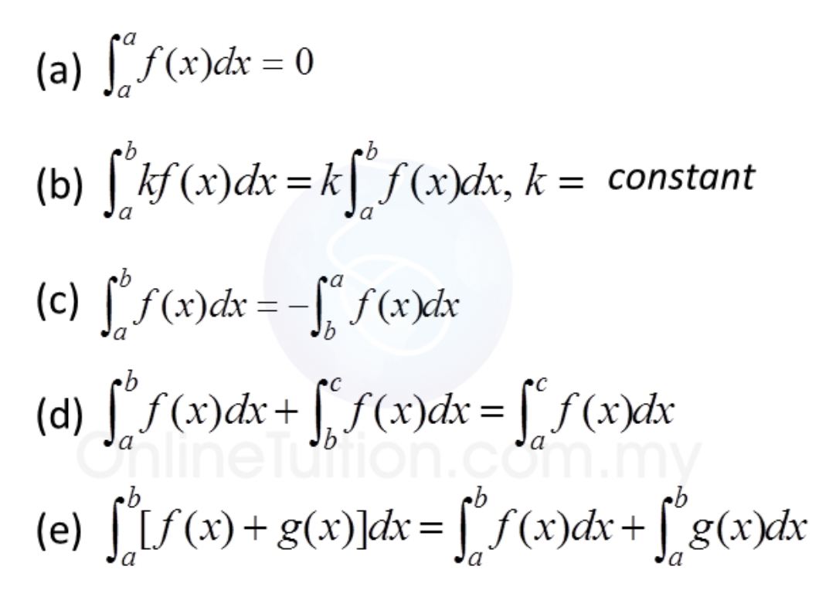
Rules for definite Integrals

Slide 8
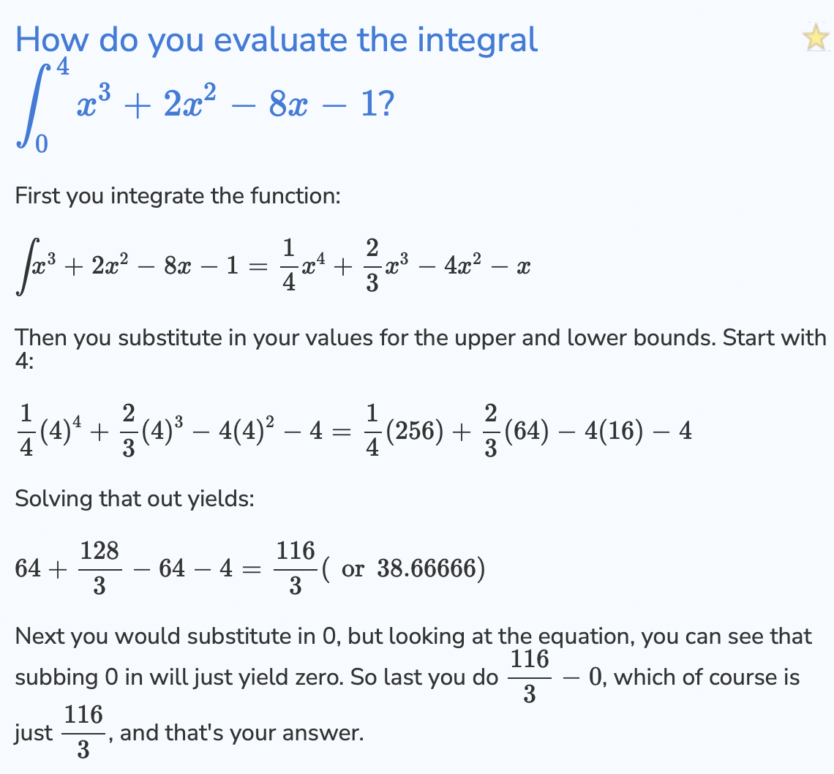

Slide 9
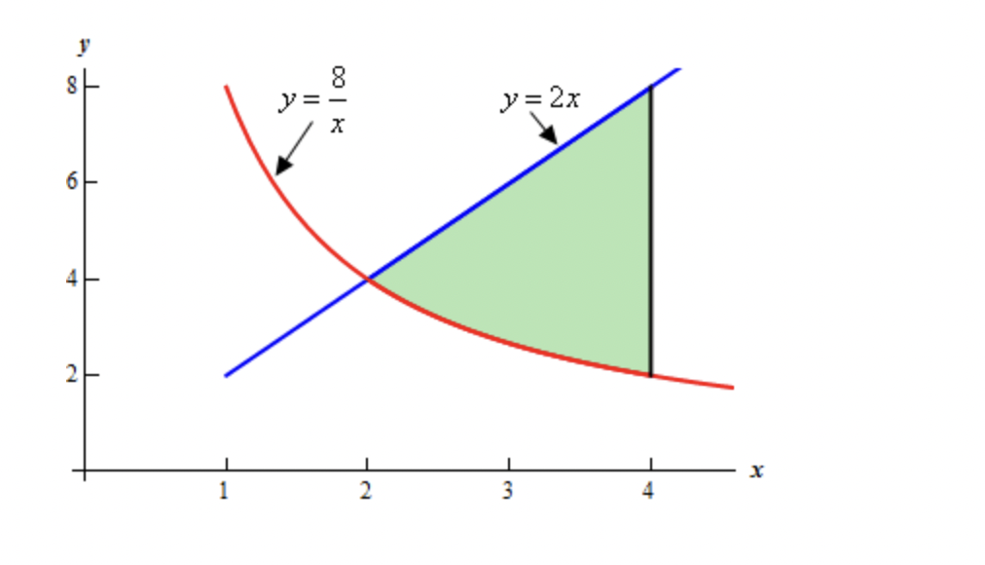

Area bounded by a line and curve
Determine the area of the region bounded by $y= \frac{8}{x}$, y=2x and x=4

Slide 10
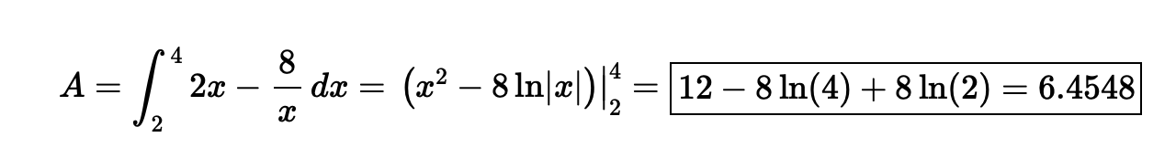
The area is given by

