Slide 1
Welcome
to My Presentation
Uzzal Dhali
Department of English
Serial No.: 22

Slide 2

University Grade Sheets
From internal marks to final marks, and grade calculation.

Slide 3

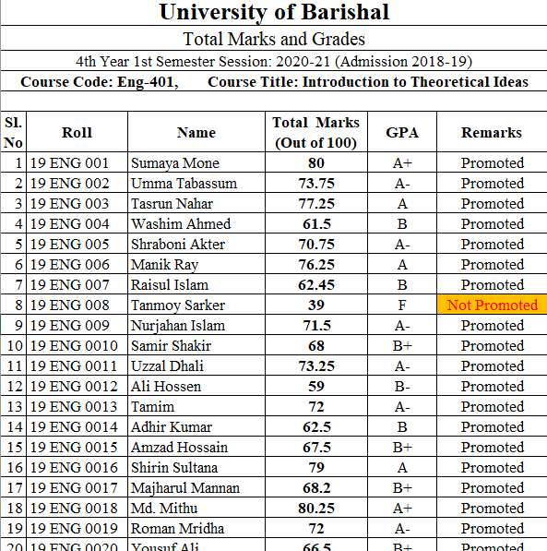
Microsoft Excel
Click image to open file
Internal Marks, Final Exam Marks and Grade Calculation

Slide 4
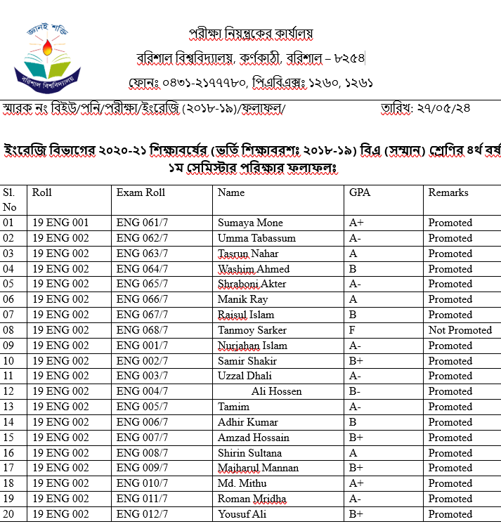
Microsoft Word
Click image to open file
Here the Result Sheets are shown via table

Slide 5

Thank You
FUNKY TUNES
Launch
Launch
BOFFIN

