Slide 1

Speech Emotion Recognition
Name of the Guide:
Prof Dr. Aruna Tiwari
Name of the presenter: Uzzal Saha
Roll of the presenter: 2302101017
November, 2023

Slide 2
Introduction
Human machine interaction is widely used nowadays in many applications. One of the mediums of interaction is speech. The main challenges in human machine interaction is detection of emotion from speech.
Emotion can play an important role in decision making. Emotion can be detected from different physiological signals also. if emotion can be recognized properly from speech then a system can act accordingly. Identification of emotion can be done by extracting the features or different characteristics from the speech and training needed for a large number of speech databases to make the system accurate.

Slide 3
Motivation
As sentient beings, speech is amongst the most natural ways to express ourselves. We depend so much on it that we recognize its importance when resorting to other communication forms like emails and text messages where we often use emojis to express the emotions associated with the messages. As emotions play a vital role in communication, the detection and analysis of the same is of vital importance in today's digital world of remote communication.
Emotion detection is a challenging task, because emotions are subjective. There is no common consensus on how to measure them. We define a Speech Emotions Recognition system as a collection of methodologies that process and classify speech signals to detect emotions embedded in them.

Slide 4


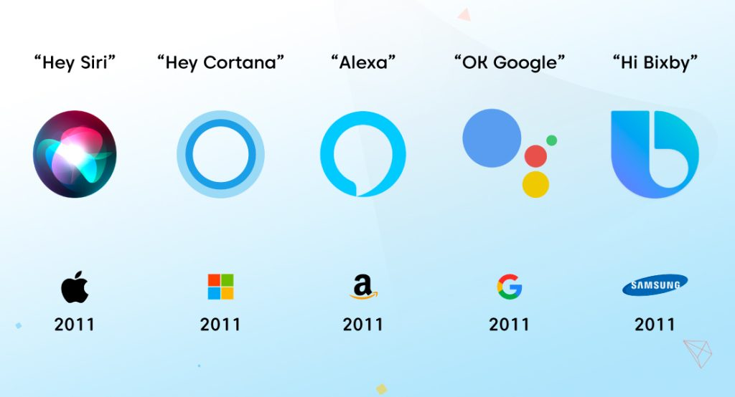



Applications
Security
Mental Health

Slide 5
Dataset
Ryerson Audio-Visual Database of Emotional Speech and Song (RAVDESS) dataset.
• RAVDESS dataset has recordings of 24 actors vocalizing 8 emotions, 21 male actors and 21 female actors, the actors are numbered from 01 to 24 in North American accent.
• All emotional expressions are uttered at two levels of intensity: normal and strong, except for the 'neutral' emotion, it is produced only in normal intensity. Thus, the portion of the RAVDESS that we use contains 60 trials for each of the 24 actors, thus making it 1440 files in total.
• Balanced gender representation. 3 sec clip, samplead at 48 kHz.

Slide 6
Methodology
We harnessed a hybrid approach, combining both CNN and Transformer architectures for effective emotion recognition. In this approach, CNN is utilized for spatial feature representation, whereas the Transformer architecture is deployed for temporal feature representation. This synergistic strategy is designed to capitalize on the unique strengths of each architecture, thereby enhancing the performance and overall adaptability of our emotion recognition model.
The training process involves using a stochastic gradient descent optimizer and a cross-entropy loss function, with the best model checkpointed for further reference. Evaluation is conducted through test set accuracy and confusion matrix analysis, with a train/test split of 80/20. This methodology seeks to create a robust and accurate emotion recognition system by leveraging both spatial and temporal information.

Slide 7
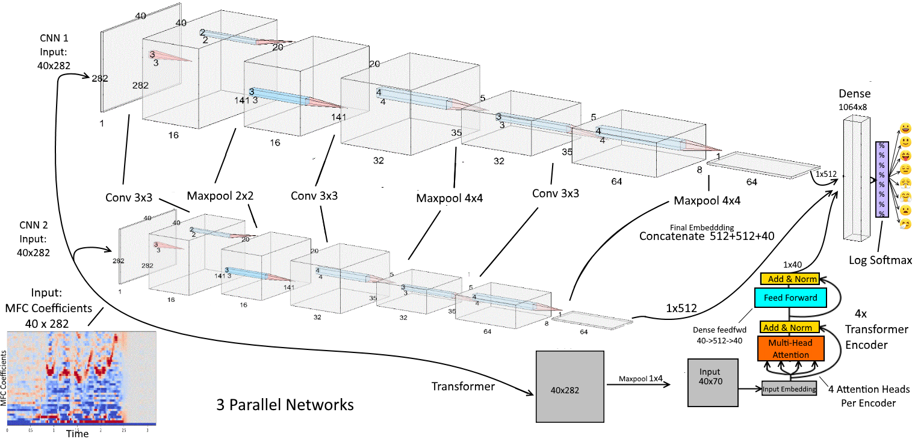
Architecture

Slide 8
Feature Extraction
Extracted MFCC (Mel Frequency Cepstral Coefficients) features
Capture transitions in pitch/frequency over time
Take Fourier Transform of audio snippet
MFCCs are amplitude of resulting spectrum
Used 40 MFC coefficients over 282 time steps
Can visualise as 2D plot, analog to image
Mel Spectrogram
A Fast Fourier Transform is computed on overlapping windowed segments of the signal, and we get what is called the spectrogram. This is just a spectrogram that depicts amplitude.which is mapped on a Mel scale.

Slide 9
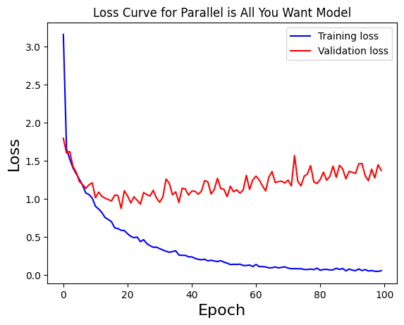
Loss Curve Behavior
This graph shows that the training loss decreases over time, indicating that the model is learning. The validation loss also decreases, but not as much as the training loss. This is a common phenomenon in machine learning, and it is known as overfitting. Overfitting occurs when the model learns the training data too well, and is not able to generalize to new data.
It also shows that the training loss and the validation loss start to converge around epoch 100. This means that the model is starting to learn the training data and the validation data in a similar way. Overall,we can see that the model is able to learn the training data and generalize to new data. The model's performance could be improved by reducing overfitting.

Slide 10
To Overcome Overfitting
Use regularization techniques. These techniques add a penalty to the model's loss function that prevents it from overfitting to the training data.
Use early stopping. This technique stops training the model before it has had a chance to overfit to the training data.
Use a larger training set. A larger training set will give the model more data to learn from, and it will be less likely to overfit to the training data.

Slide 11
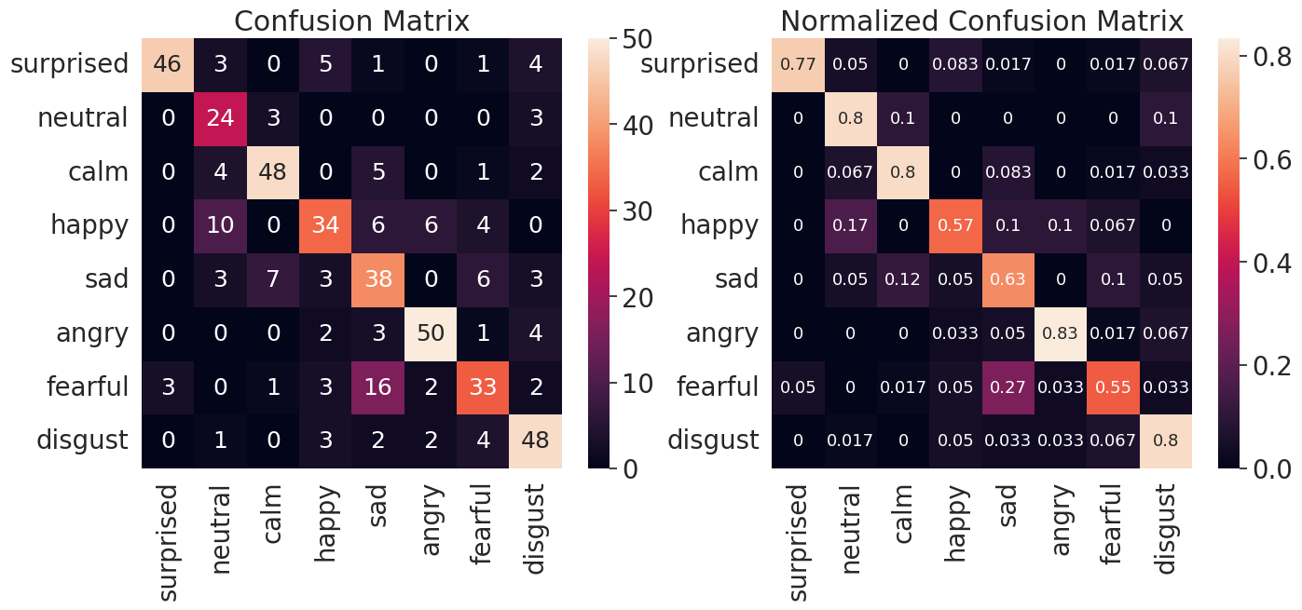
Performance on test set

Slide 12
Conclusion
Achieved 71.33% accuracy in classifying sequential data
Combines CNNs and Transformers for spatial and sequential feature representation respectively
The model has trouble differentiating between 'neutral' and 'angry' emotions.
CNNs and Transformers are cross-applicable and work better together
Demonstrates power of crossing CNNs and Transformers thoughtfully
Balances model accuracy and overfitting
Further optimization of features,such as exploring different architectures, incorporating sentiment analysis, or using larger datasets could improve performance

Slide 13
References
Ba et al, 2016. Layer Normalization. https://arxiv.org/abs/1607.06450
Bahdanau et al, 2015. https://arxiv.org/pdf/1409.0473.pdf
Cheng et al, 2016. Long Short-Term Memory-Networks for Machine Reading. https://arxiv.org/pdf/1601.06733.pdf
He et al, 2015. Deep Residual Learning for Image Recognition. https://arxiv.org/abs/1512.03385
Ioffe, Szegedy, 2015. Batch Normalization: Accelerating Deep Network Training by Reducing Internal Covariate Shift. https://arxiv.org/abs/1502.03167
Krizhevsky et al, 2017. ImageNet Classification with Deep Convolutional Neural Networks. https://papers.nips.cc/paper/4824-imagenet-classification-with-deep-convolutional-neural-networks.pdf
Simonyan and Zisserman, 2015. Very Deep Convolutional Networks for Large-Scale Image Recognition. https://arxiv.org/pdf/1409.1556.pdf

Slide 14
References
Vaswani et al, 2017. Attention Is All You Need. https://arxiv.org/abs/1706.03762
Li et al, 2018. Visualizing the Loss Landscape of Neural Nets. https://papers.nips.cc/paper/7875-visualizing-the-loss-landscape-of-neural-nets.pdf
Masters and Luschi, 2018. Revisiting Small Batch Training for Deep Neural Networks. https://arxiv.org/abs/1804.07612
Srivastava et al, 2014. Dropout: A Simple Way to Prevent Neural Networks from Overfitting. https://www.cs.toronto.edu/~hinton/absps/JMLRdropout.pdf
Peng et al, 2017. Large Kernel Matters —— Improve Semantic Segmentation by Global Convolutional Network. https://arxiv.org/pdf/1703.02719.pdf
Santurkar et al, 2019. How Does Batch Normalization Help Optimization? https://arxiv.org/pdf/1805.11604.pdf

Slide 15
Thank You !

